Slide 1

iSOSY
GOAL SETTING
with OSY
www.osymigrant.org
Notes:
One of the most important things we learn when working with our migrant students is that each moment is extremely valuable because we can be certain those moments will be too few. Too few moments to push or pull them to a finish line. Too few moments to accomplish all the good and meaningful things we dream about.
I also know that some days feel like a victory and other days feel like a defeat. The students we serve are balancing on the edge between challenge and success perhaps more than any other student population. It is not easy to find OSY, connect with OSY, communicate with OSY, and serve OSY. Even if you’ve just been on the job a few weeks, that is something you already know well.
But because of the uncertain and difficult part of this job, the victories are that much sweeter. When we see stories of OSY who have returned to school and earned diplomas, or those who have worked late into the night to achieve what it takes to earn a high school equivalency degree, or those who have dedicated hours of effort at the end of an exhausting day to learn enough English to function well in their communities…we are understandably as proud

Slide 2
Goal Setting
Designing and Following
Educational and Life Pathways
What we are going to do today:
Learn ways to work with OSY to develop educational/life pathways
Understand how to use the goal setting activities/materials with OSY
www.osymigrant.org
Notes:
We’ll begin this training by thinking about OUR goal for the training. What do we hope to have as an outcome of participating in this training?

Slide 3

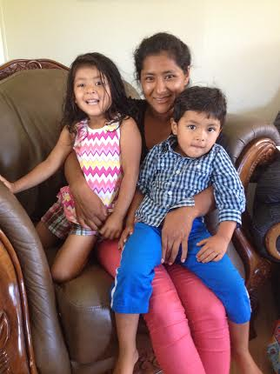
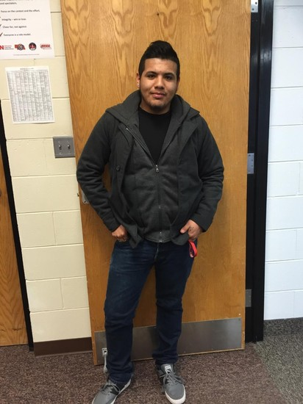
Goal Setting
WHY IT MATTERS
“My future plans include community college and a bachelors degree.”
“I am so grateful for our friendship and for the experience of mutual learning we share.”
“I'm 100% sure I made the right decision. I saw my diploma today.”
www.osymigrant.org
Notes:
We ask the question:
What can we do for the most marginalized group of students in America? We can find them, help them articulate their goals, and give them the tools they need to achieve them.

Slide 4
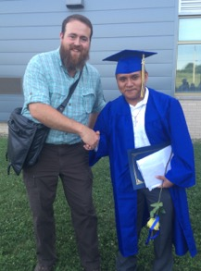

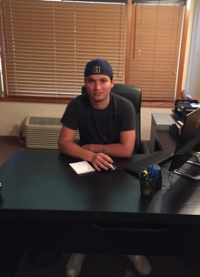
Goal Setting
WHY IT MATTERS
“He came from a 4th grade education background at age 16 and was able to graduate high school at 21 years old. He was the first in his family to graduate.”
“She graduated and received her high school diploma... I was at her graduation ceremony and I remembered when she was just a name on a long list of students.“
“He said, ‘I heard about the OSY program which has changed my life and the way I think. It’s amazing how I could see my dreams becoming a reality.’”
Notes:
We ask the question:
What can we do for the most marginalized group of students in America? We can find them, help them articulate their goals, and give them the tools they need to achieve them.

Slide 5
Goal Setting
WHY FOCUS ON GOAL SETTING?
Many OSY have never been asked about their values, desires, thoughts, or dreams.
Giving voice to aspirations is a new experience for OSY.
OSY may not have an idea that their dreams are even attainable.
www.osymigrant.org

Slide 6
Goal Setting
BENEFITS TO OSY OF GOAL SETTING?
OSY will establish a goal and projected pathway/plan.
OSY will develop/strengthen their sense of self-efficacy.
OSY will develop an understanding of the resources to help them along the way and recognize barriers that may hinder their progress as well as ways to manage them.
OSY will document what they do and be able to see progress towards their goals.
www.osymigrant.org

Slide 7
Goal Setting
BENEFITS TO OSY OF GOAL SETTING?
While it may be easy to ignore or postpone the process of goal setting with our students, it is important to remember that this set of activities, which may take only a couple of hours, can “set the stage” for their future learning.
They will move on to other settings where they may or may not have learning support. Without a strong sense of themselves and their goals, students can lose their motivation to continue.
A student who comes to English (GED, Job Skills) class with goals in mind will have a much greater chance of success.
This framework is for life, not just for the time they are with us.
www.osymigrant.org

Slide 8
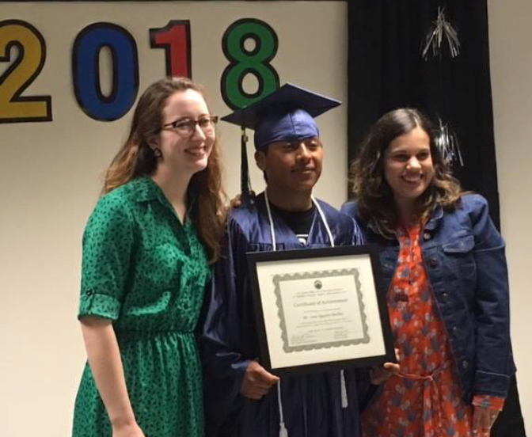
Goal Setting
What are the assets that the OSY in your state bring to your program?
www.osymigrant.org
Notes:
Our students face many challenges- both academic and life- so lets start with talking about the challenges WE might face when talking about goals and plans with these students-

Slide 9

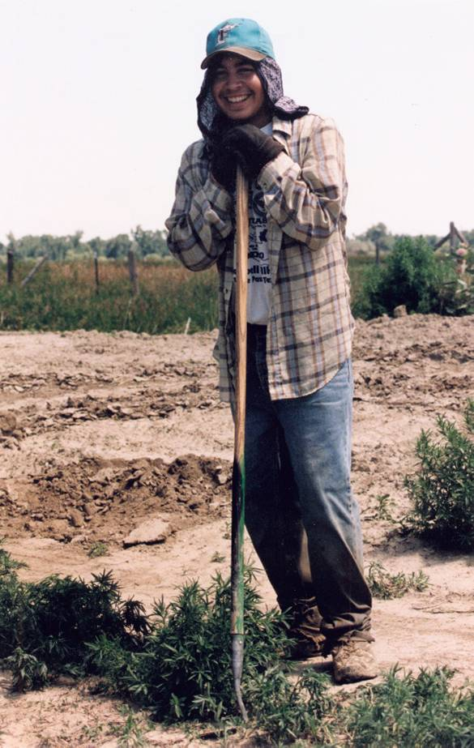
Goal Setting
What are some of the potential challenges you might face in talking about goals and plans with OSY?
www.osymigrant.org
Notes:
Our students face many challenges- both academic and life- so lets start with talking about the challenges WE might face when talking about goals and plans with these students-

Slide 10
Goal Setting
CHALLENGES AND ASSETS OF OSY
Challenges
Many responsibilities that most teenagers don’t face; limited time to study
Medical, psychological, or dental issues that have not been addressed
Limited instructional time with MEP
Assets
Intrinsically motivated
Flexible curricular material choices
The little things get to matter and mean so much
Network of services from state to state
www.osymigrant.org
Notes:
A major difference between OSY and other MEP students is that OSY choose to enroll and participate in Migrant Education activities. In that way, a 17-year-old OSY student is much more of an adult learner than a 17-year-old high school MEP student. The 17-year-old OSY student normally has a job, may have numerous family responsibilities, and may not see an immediate reason for participating in educational activities. Also, OSY students may have immediate support needs, such as medical and dental issues, which can distract them from their academic pursuits. Another challenge for OSY students, especially those with limited time available for study, is that accomplishing learning goals does not often happen as rapidly as students would like. Darkenwald (1986) noted that the adult learner may need up to 100 hours of instruction to move up one grade level in reading. One hundred hours at 4 hours per week (often the maximum amount of time an OSY student has) means 25 weeks of study. Given that many MEP programs have students in one place for only 6 to 16 weeks (the North Carolina average, for example, is 12 weeks), there is urgency to identify and recruit students, explore and clarify their academic goals, design ways to support them in meeting their goals, and help provide the tools to connect them to opportunities when they move. In addition, we must work with students to build “persistence,” which is that combination of time and intensity needed to achieve any goal.

Slide 11
Goal Setting
UNDERLYING CONCEPTS IN GOAL SETTING MATERIAL
Maslow’s Hierarchy of Needs
Growth Mindset
Grit
Persistence
www.osymigrant.org
Notes:
This next section can be used in the training or not- and can be modified to cover one, two or all of the concepts-
When the group were writing activities these were the concepts/ideas that were used to guide the development

Slide 12
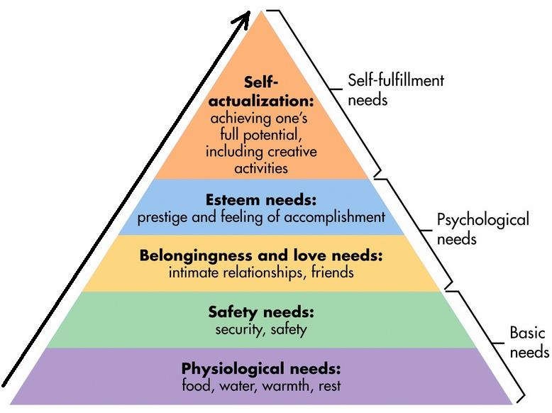
Goal Setting
MASLOW’S HIERARCY OF NEEDS
Notes:
Growth Mindset is something that is good for folks working with OSY to understand- but not something that has to be directly shared with the students- consider it a format that we are approaching goal settings.
We use it because it helps students think about what is in their control, there is growth in temporary failure, but it helps to have a ‘positive’ approach to goal setting.
This is integrated into all of the introduction/ice breakers (outside of the first activity) and we will be doing more on this for PD going forward.
When the group were writing activities these were the concepts/ideas that were used to guide the development

Slide 13
Goal Setting
GROWTH MINDSET
Growth Mindset is a concept based on the research of Dr. Carol Dweck.
A mindset is the group of attitudes we each have and how those attitudes impact how we approach the challenges in our lives. It breaks away the common view of our students that life is predetermined and therefore there is little to nothing that can be done to change it.
It can empower us to try something new, even if there is a risk of not being successful - because we always learn from failure and great things can come out of failure!
Notes:
This next section can be used in the training or not- and can be modified to cover one, two or all of the concepts-
When the group were writing activities these were the concepts/ideas that were used to guide the development

Slide 14
Goal Setting
GROWTH VS. FIXED
Growth Mindset: Assumes intelligence and other qualities, abilities, and talents can be developed with effort, learning, and dedication over time.
Fixed Mindset: Assumes intelligence and other qualities, abilities, and talents are fixed traits that cannot be significantly developed or changed.
www.osymigrant.org
Notes:
2 mindsets we can cultivate. One that embraces problems as opportunities to learn and one that avoids them. Often out of fear of failure

Slide 15
Goal Setting
GROWTH MINDSET QUIZ
Dr. Dweck developed a simple quiz to see whether you have more of a fixed or growth mindset.
Let’s take the quiz:
  Mark the answer you most agree with for each question.
  On the back, circle the number that corresponds with the answer you marked.
  Total each column.
www.osymigrant.org
Notes:
It should be clear that this is a personal quiz
This is something to do with folks but having them do it on their own- not turning it in and not forced to share-
It also should be noted that anyone can adjust their mindset- this quiz just starts people thinking about their personal approach to things

Slide 16

Goal Setting
YOUR OWN MINDSET?
Group discussion:
What did you notice about your own mindset?
Was there anything that surprised you?
Anything you had a reaction to?
www.osymigrant.org

Slide 17
Goal Setting
GRIT
Grit, a concept based on the research of Angela Duckworth, is a crossroads of passion and perseverance.
Addresses how effort is often ignored or overshadowed by ‘talent’ but effort is the underlying successor when you really dig in.
To excel and be successful you have to understand the difference: talent is something you have naturally, and skill is only developed by hours and hours and hours of practice and effort. Effort and continued practice can develop talent.
Learn how to talk about how to integrate ways to help someone become ‘gritty’.
www.osymigrant.org

Slide 18
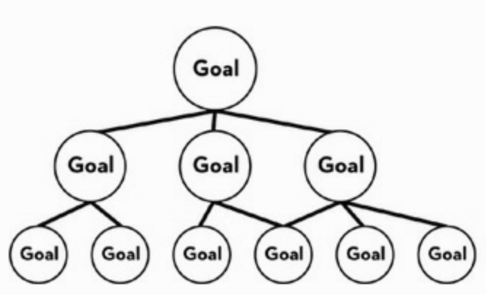
Goal Setting
GRIT
Top-level goal is the compass that gives direction and meaning to all the other goals below it.
The higher the goals go the more abstract, but important, they become as they are partially end goals and not just getting us there.
Bottom-level goals are the most concrete and specific - they are a means to the end, and they get us to what we really want.
www.osymigrant.org
Notes:
Grit is holding the same top-level goal for a long time, and becomes really what organizes what you do in your day-to-day activities.
For very gritty people the mid and low-level goals are in one way or another related to the ultimate goal in a coherent and detailed way
A lack of grit can come from having less coherent and detailed goal structures/plans

Slide 19
Goal Setting
PERSISTENCE
What does this mean to you?
Can you give an example of persistence in your own life?
Can you give an example when you had to help someone else persist?
www.osymigrant.org

Slide 20
Goal Setting
SUPPORTS FOR PERSISTENCE
The student needs to establish a goal or projected pathway.
The student needs to have a sense of self-efficacy.
Students need to develop an understanding of the positive and negative forces that help or hinder their progress and ways to manage those forces.
Students need to see progress towards their objectives.
www.osymigrant.org
Notes:
The National Center for the Study of Adult Learning and Literacy (NCSALL 2000) identified four supports for persistence of adult students in learning programs:
Literacy Volunteers of America (LVA), which merged with Laubach Literacy International in 2002 to form ProLiteracy, also practices reinforcing supports such as those outlined by NCALL. Volunteers in the program were taught to capitalize on the experiences and interests of their adult learners and to build instruction around those experiences. This process can help set students’ anxiety about learning at ease, increase student self-efficacy, increase the relevance of what is being taught to the student, and increase the student’s interest level and participation.

Slide 21
Goal Setting
HOW DOES THIS IMPACT GOAL SETTING AND STUDENT SUCCESS?
Goal setting challenges students - and that is good!
Challenges only help students learn and achieve over time.
”Engagement is a precondition for learning. No learning happens until students become engaged with the material.”
”Holding students to high expectations, done properly, is a way to convey that they have potential.”
www.osymigrant.org
Notes:
Engagement quote is from Harvard Associate Professor Jal Mehta
Holding student to high expectations is quoted from ”Academic Tenancy” by Carol Dweck, Gregory Walton and Geoffrey Cohen

Slide 22
Goal Setting
The Instructors Guide includes an introduction to help understand goal setting with OSY.
  Why Goal Setting?
  The Importance of the Big Picture
  What is a Vision?
  What is a Goal?
  Creating Goals and Visions with OSY

Slide 23
Activity Formats and Flow
1. Discovering Our Vision
2. Documenting Our Vision
3. Setting Short, Medium and Long-Term Goals
4. Mapping Out The Way
5. Planning Step-by-Step
6. Putting It All Together
There are six (6) activities, designed to be sequential, which can be condensed to five (5), or otherwise adapted to suit your needs.
Activities take ~45 minutes but can be modified to fit either a 30- or 60- minute session.
Activities are written for different class structures:
  One-on-One
  Group
  Virtual (video-based distance learning)
Each has an ice breaker/introduction, main content, and wrap-up activity.
All student handouts are in the Student Workbook (no having to make extra copies!).
www.osymigrant.org

Slide 24
Making it Work for You
1. Discovering Our Vision
2. Documenting Our Vision
3. Setting Short, Medium and Long-Term Goals
4. Mapping Out The Way
5. Planning Step-by-Step
6. Putting It All Together
This full sequence of activities is not appropriate for all OSY. It requires significant time and effort.
Migratory students move. If you can get them started thinking about goals and how to reach them, they can continue their work with another provider in a new location.
The materials have clickable tables of contents so that you can quickly find the activities you want to use. You can use these warmups and activities to supplement your existing program.
www.osymigrant.org

Slide 25
Goal Setting
ACTIVITY 1: DISCOVERING OUR VISION
Objective: Through this activity, strong(er) relationships between facilitator and OSY, as well as OSY to OSY (in group setting), will begin to form and everyone will start to think about the bigger picture/vision of one’s life and develop a long-term goal.
Ice Breaker/Dinamica
Main Activity
Wrap Up
Ice Breaker questions that all participants answer
Provides different dynamic ways to facilitate the activity
Questions are general, fun, and written to get everyone comfortable and learning more about each other
Can be written/drawn in Student Book
Dream Big questions:
  What do you believe you are capable of doing in your life?
  The greatest things you could accomplish given the right circumstances, resources and motivation
  This is where I see myself/my life when I am 40 years old
Reflection on the main activity
Sharing out the student’s vision/long-term goal

Slide 26
Goal Setting
ACTIVITY 2: DOCUMENTING OUR VISION
Objective: Through this activity, OSY will learn different ways that a vision/long-term goal can be put on paper - and that this is an important part of goal setting for accountability and motivation.
Ice Breaker/Dinamica
Main Activity
Wrap Up
Memory game that can be played individually or in a group
Demonstrates that you can remember more when you write/draw something and refer to it often
Provides five different ways that the OSY can record their vision/long-term goal
The five different options provide a range of options to appeal to different kinds of folks (art, words, technology, etc.)
Sharing out the student’s project
Placing project in the individual student books
Provides opportunity to practice appropriate feedback

Slide 27
Goal Setting
ACTIVITY 3: SHORT- MEDIUM- AND LONG-TERM GOALS
Objective: Through this activity, OSY will develop the skill to break down a long-term goal into short- and medium-term goals.
Ice Breaker/Dinamica
Main Activity
Wrap Up
Quiz that examines the different habits of goal oriented and non-goal- oriented people
Can be played as a movement game to energize and get folks moving
Examining different long-term goals and some of the activities that help one reach the goal
Discussing what is a short-, medium-, and long-term goal via a sorting activity
Brainstorming some short- and medium-term goal activities to accomplish the student’s vision/long-term goal
Sharing out

Slide 28
Goal Setting
ACTIVITY 4: MAPPING OUT THE WAY
Objective: Through this activity, OSY will understand that there are events along the way to reaching a vision/long-term goal that can help, setback, and/or potentially change the plan - and it is okay.
Ice Breaker/Dinamica
Main Activity
Wrap Up
Discusses how it can feel to make mistakes
Students learn that there is a tremendous amount learned from mistakes
The brain develops and strengthens through mistakes
Playing a game similar to ‘chutes and ladders’ but in the context of goal setting
End of the game is the vision/long-term goal
OSY will place ‘helpers’ and ‘setbacks’ on the board and decide whether they are big, medium or small helpers/setbacks
Brainstorming potential helpers and setbacks to individual vision/long-term goal
Discussion of what is in our control and what is outside of our control (optional)

Slide 29
Goal Setting
ACTIVITY 5: PLANNING STEP-BY-STEP
Objective: Through this activity, OSY will be able to sequentially plan how to realize their vision/long-term plan through short- and middle-term activities and some of the supports they can use to achieve them.
Ice Breaker/Dinamica
Main Activity
Wrap Up
Reading and Reflection activity
Choice of a short statement or two paragraph reading
Open ended/discussion questions are included
Individually completing the Making a Plan in their student books
Transition to Activity 6
Activities 5 + 6 can be combined and done as one activity

Slide 30
Goal Setting
ACTIVITY 6: PUTTING IT ALL TOGETHER
Objective: Through this activity, strong(er) relationships between facilitator and OSY, as well as OSY to OSY (in group setting), will begin to form and everyone will start to think about the bigger picture/vision of one’s life and develop a long-term goal.
Ice Breaker/Dinamica
Main Activity
Wrap Up
Origami
Demonstrates that it is important to have a plan/instructions/guidance when doing a project
The more details/information the better!
Explores different ways to document a plan
Determine which plan works best for the person and the vision/long-term plan
Take the work from Activity 5 and put it into a format of the student’s choice
Celebrate the goal plan
Start working on making it happen!

Slide 31
Goal Setting
Assessment Rubric

Slide 32
Goal Setting
A SKILL FOR LIFE
While it may be easy to ignore or postpone the process of goal setting with our students, it is important to remember that this set of activities, which may take only a couple of hours, can “set the stage” for their future learning.
They will move on to other settings where they may or may not have learning support. Without a strong sense of themselves and their goals, students can lose their motivation to continue.
A student who comes to English (GED, Job Skills) class with goals in mind will have a much greater chance of success.
This framework is for life, not just for the time they are with us.
www.osymigrant.org
Notes:
Many times, we hear people say, “My students are with me for such a short time, I don’t have time for this. I want to get right into teaching my English classes.” While there may be situations in which this is the case, it’s important to always keep in mind that our students, especially those who are with us for a very short time, need to learn to provide context for all their future learning. If they can develop the skills of goal-setting and self-monitoring, they will keep themselves moving toward their goals, no matter the obstacles they encounter.

Slide 33
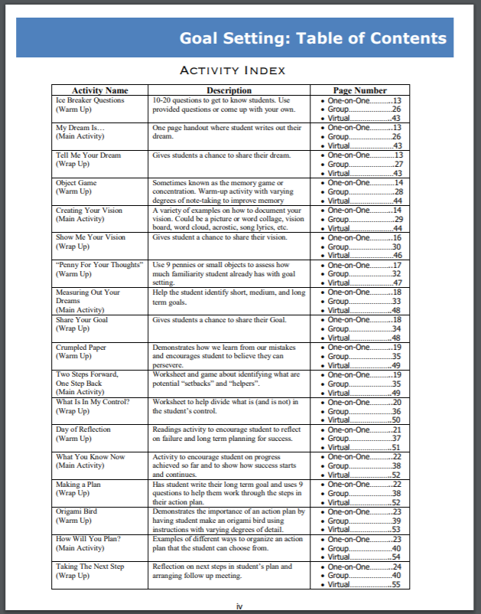
Goal Setting
Material Overview
https://www.osymigrant.org/Newsite/educat/GoalSetting.html

Slide 34
Learning Plans

Slide 35
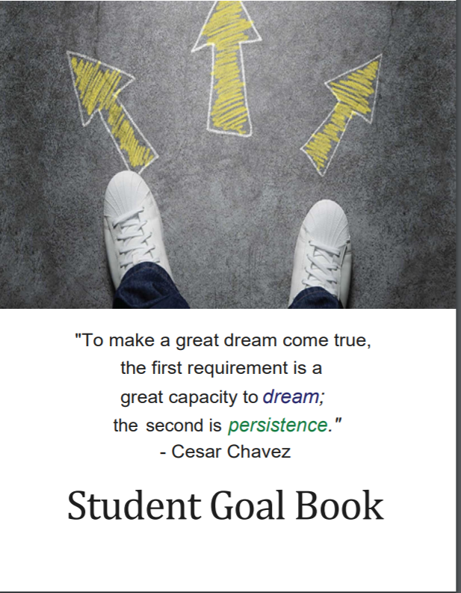
Goal Setting

Slide 36
Goal Setting
Our elegant solution to the portability issue →

Slide 37

Goal Setting
Virtual Instruction
Reminder-this is not a “how to do virtual education”
but there is a webinar for that!
www.osymigrant.org
Notes:
https://drive.google.com/file/d/1TubHjdEj54XEn6C7kymoZpCChYkywgAJ/view

Slide 38
Goal Setting
Know and Share the Basics
Know your expectations (including backup plan)
Know your materials
Delivery? Share file? Share screen?
Know your student
Know yourself
Share your voice
Share text
Share images
Share video
Share your expectations and backup plans
www.osymigrant.org

Slide 39
Goal Setting
Class Norms Lesson
Clearly convey and confirm instructor expectations:
-Reply to message confirming availability
-Join the meeting on time, or cancel in advance
-Prepare a quiet space for class with a notebook, pen, and writing surface
-Use headphones if there are other people present
-Sit up, wear clothes
-Ask questions and report problems
Challenge: elicit student expectations

Slide 40
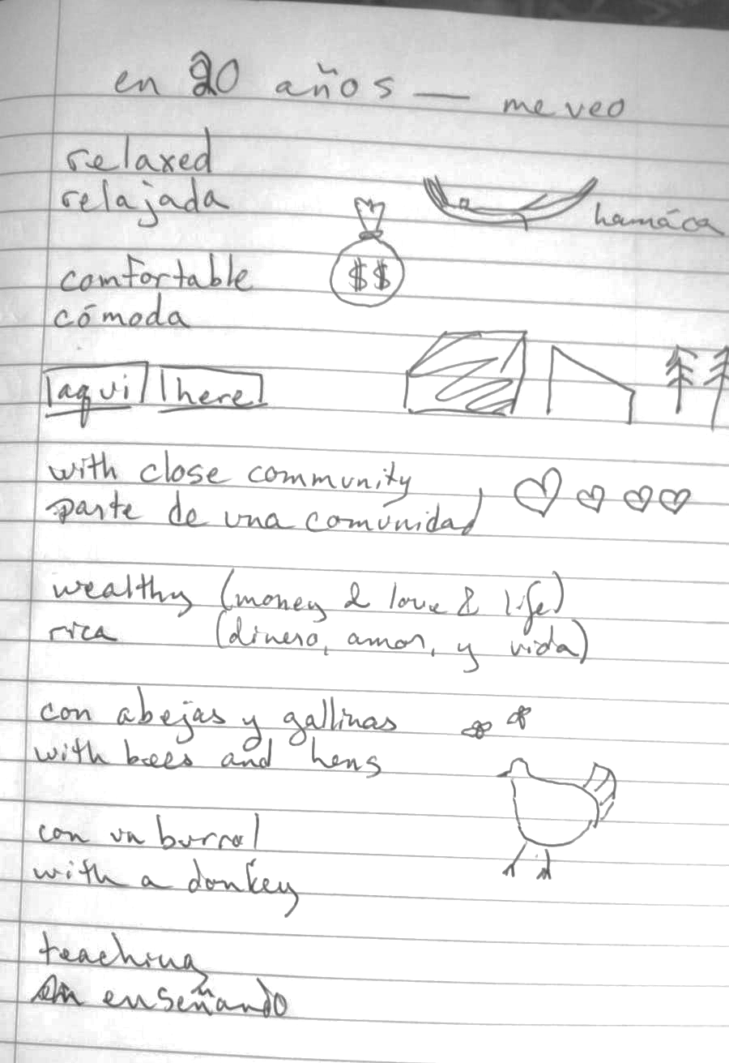

Goal Setting Virtually
Activity 2: Documenting Your Vision

Slide 41
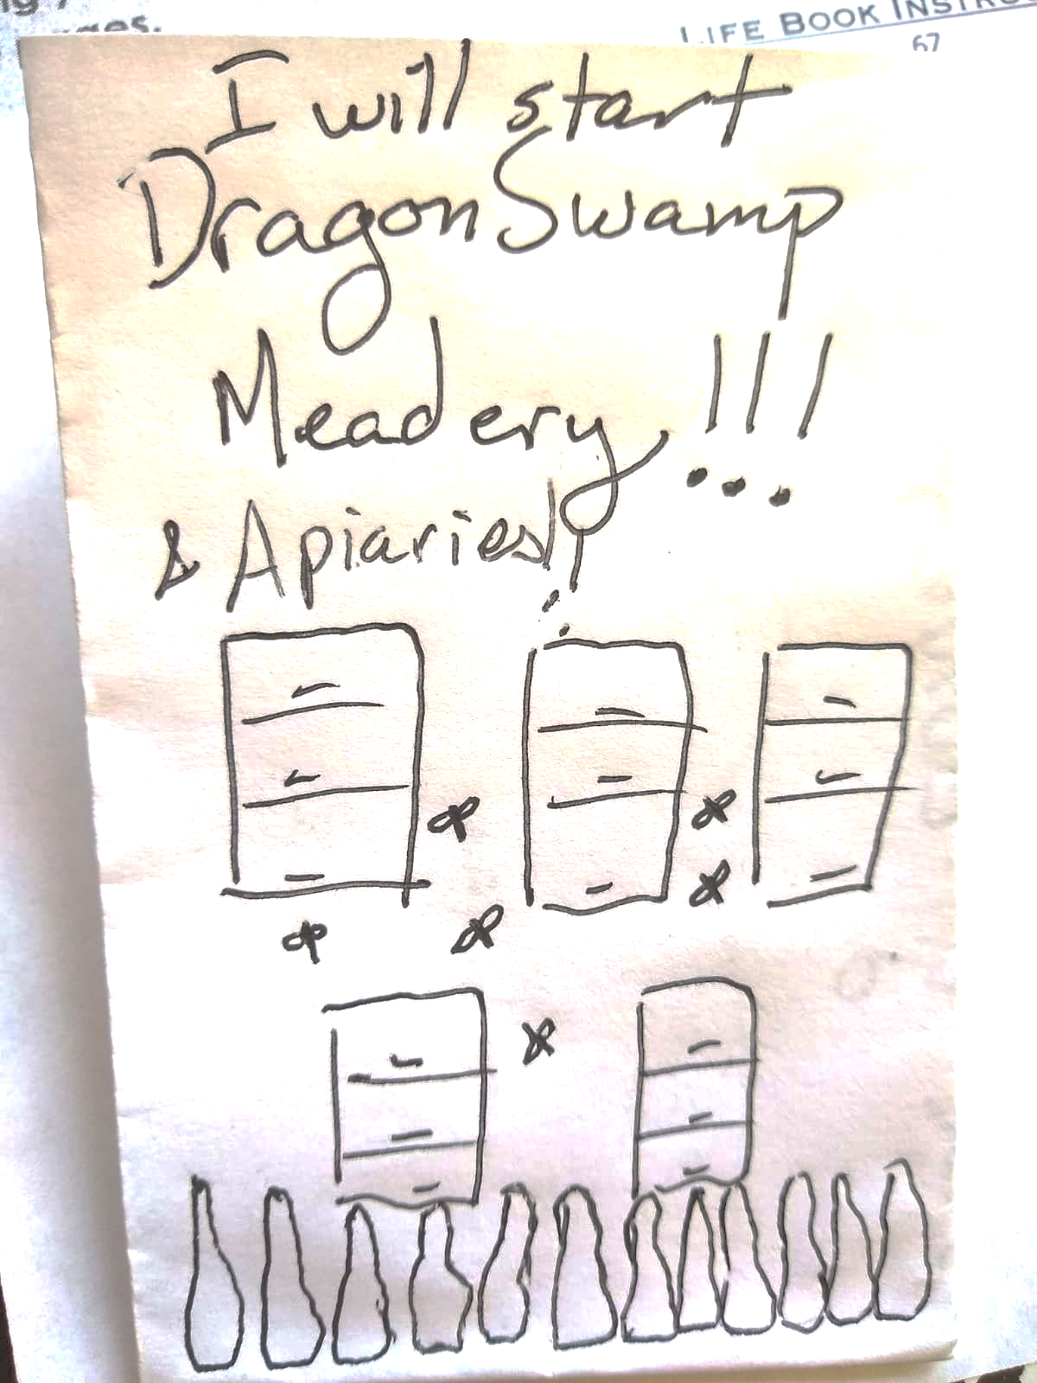
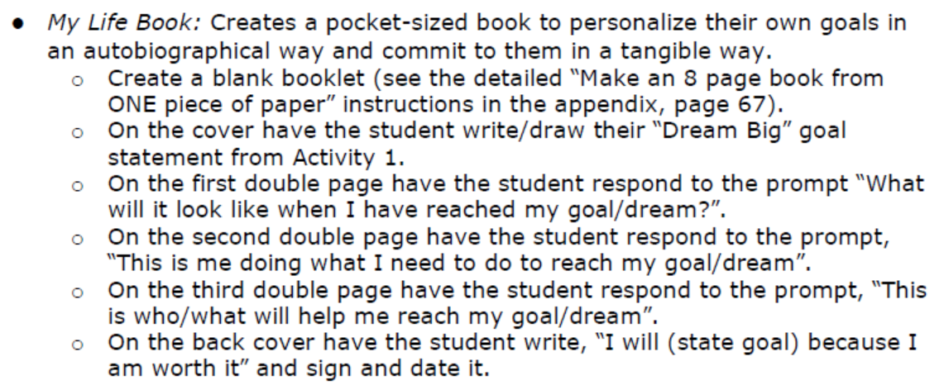
Goal Setting Virtually

Slide 42
Goal Setting
FOR EXAMPLE
Disclaimer: This is not meant to be an exact plan that you must follow, but rather an example of how to think creatively with real situations.
www.osymigrant.org

Slide 43
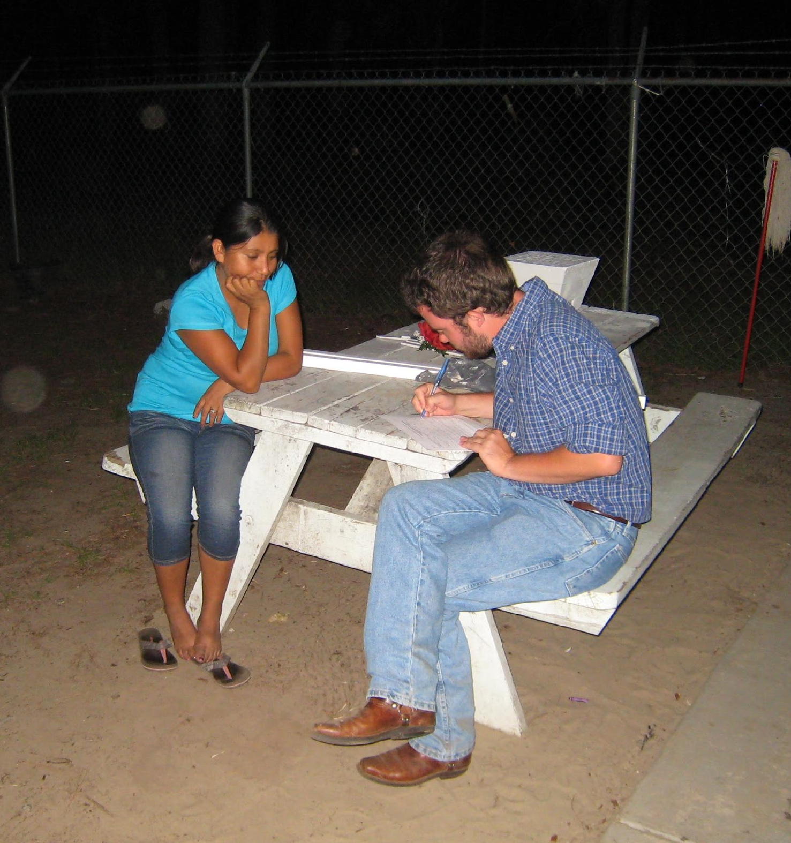
Goal Setting
Abagail
Abagail lives about an hour and a half away from you. For the past few years, she tells you she wants to graduate high school, but keeps dropping out in the fall semesters to help make money for the family. In the spring she normally moves to Florida. She has thought about trying to get her GED instead. She has some support from the head start’s family services office where her little brother attends. They will help out by allowing you to use their office space and computers in the evenings. There are GED classes nearby but are less flexible. It is October now and they usually leave in January. Since she lives far away, you can only make it out there once every two weeks at best.
www.osymigrant.org

Slide 44
Goal Setting
Long term goal: Graduate high school OR complete a GED.
Medium term goal: Begin one of those two paths.
Short term goal: Weigh the pros and cons of completing a high school diploma v. GED.
Plan:
Class 1 -> Activity 1: to get the mindset going and maybe create a pro/con list of what would be the best steps for her.
[Don’t forget to write in your contact information in the back of the book!]
Class 2 -> Activity 3&4: Once it is established if she will get a GED or high school diploma, work through these lessons (two may be combined for time crunch). For this student it is very important that you do Activity 4 to help her work through identifying Setbacks and Helpers as well as What is/is not in my control.
Class 3 -> [Abagail moves back to FL. The Florida program picks up where you left off.]: Activity 5
Class 4 -> go back to Activity 2.
www.osymigrant.org

Slide 45
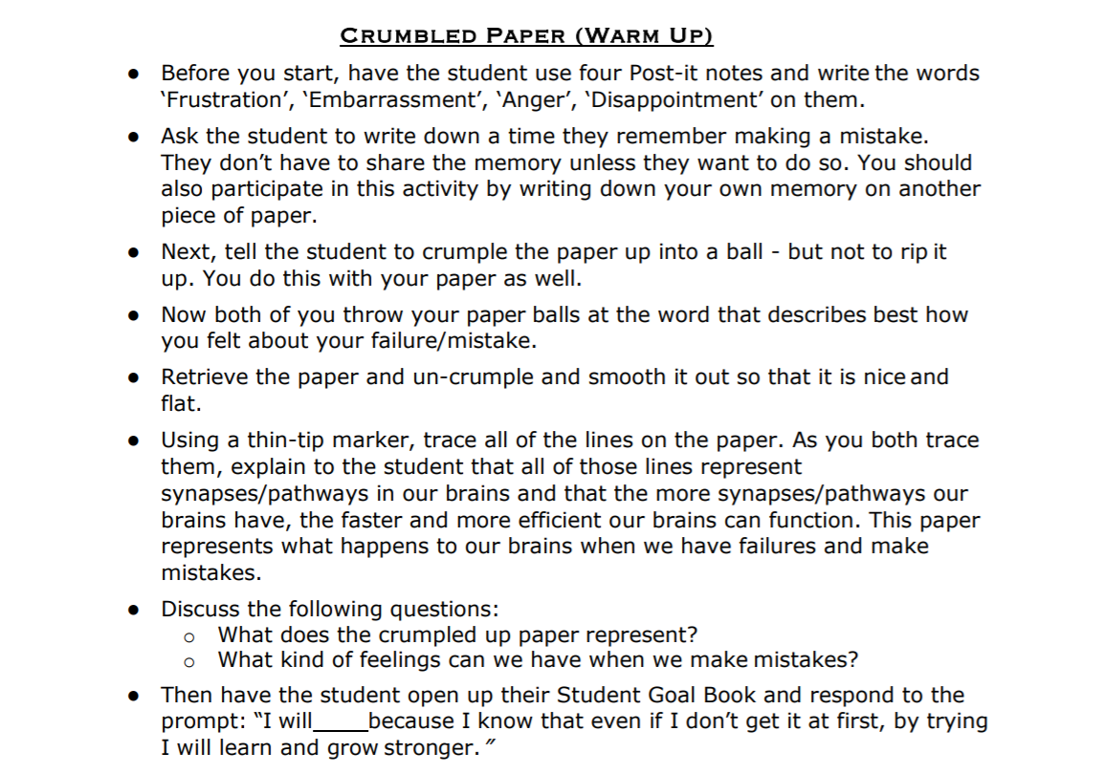
Goal Setting

Slide 46
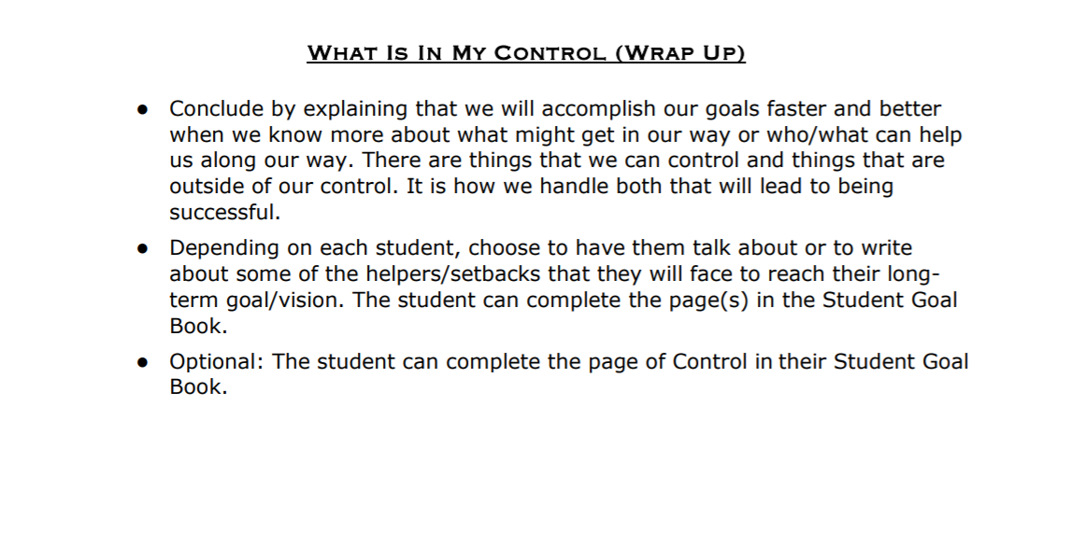
Goal Setting
www.osymigrant.org

Slide 47
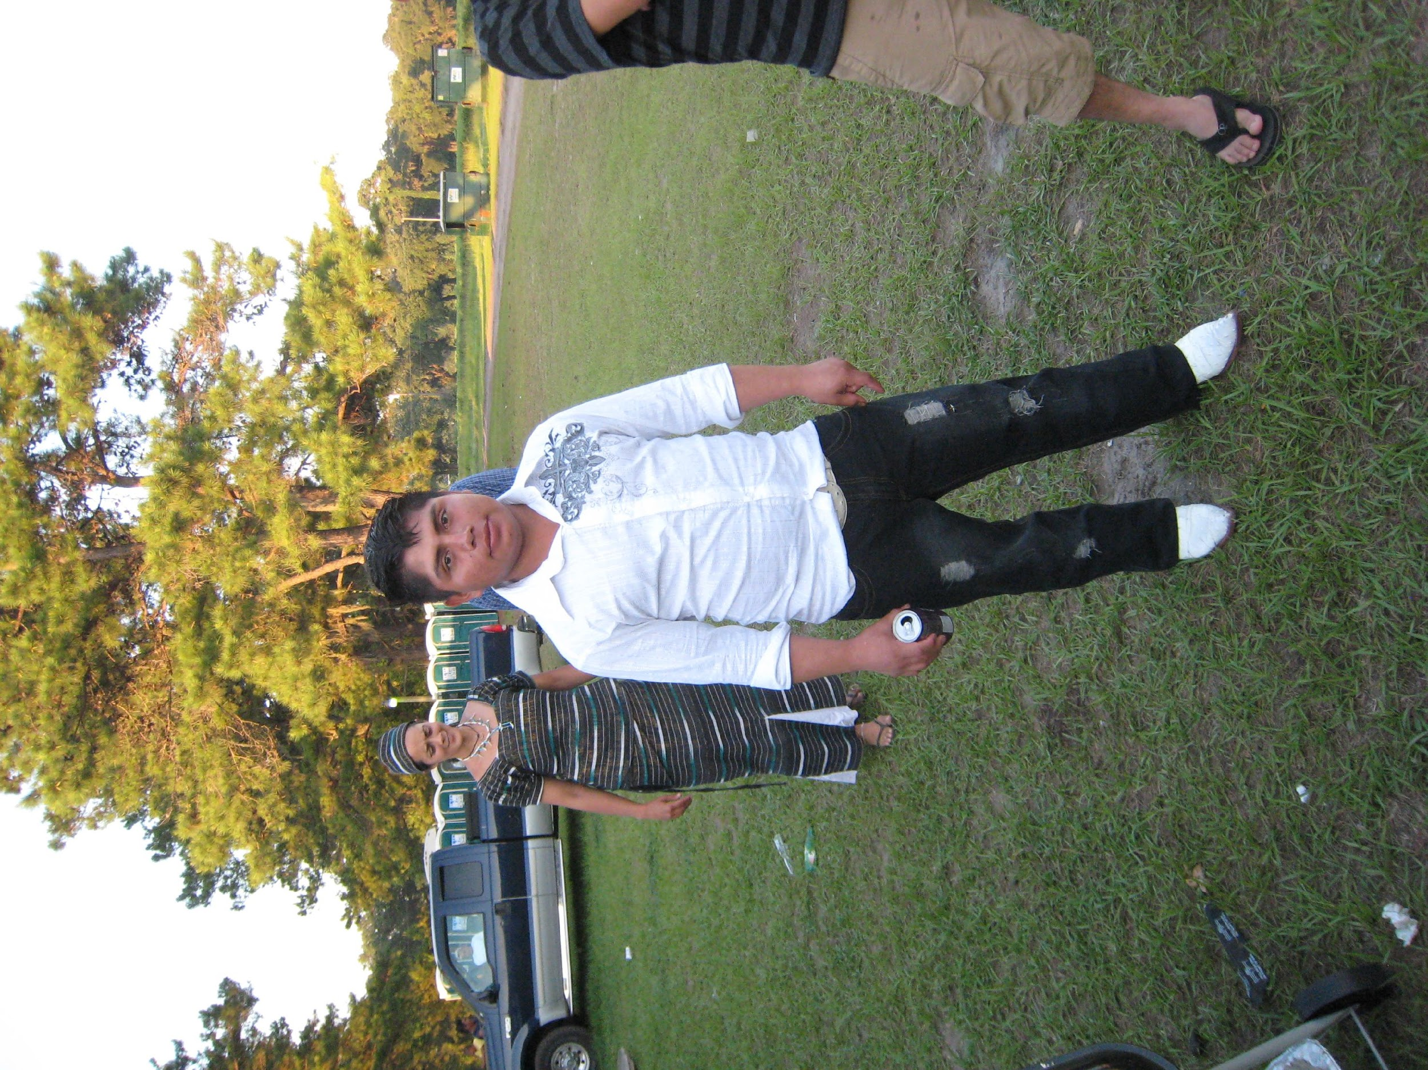
Goal Setting
Kebin
After meeting with a parent, you are going around the camp to see if anyone is new and you meet Kebin. He is a 20-year-old OSY and was born in Georgia but was raised most of his life in Guatemala. Kebin says he wants to get his driver's license and will be here until the end of June (it is currently February). He lives at a camp that might be hard to use as his permanent address. The camp he lives at receives summer English classes, this spring you have some time to pop by for a few classes. He seems skeptical about school, so you don’t want to start off with a 7-week class plan.
www.osymigrant.org

Slide 48
Goal Setting
Long term: Get driver’s license
Medium term: Pass permit test
Short term: Figure out what paperwork he will need to apply
Plan:
Class 1 -> Combine Activities 2-3: Since you know what the goal is, help student to understand goal planning and the importance of writing it down. Write your contact information in the back of his book.
Class 2 ->Combine Activities 5&6: In Activity 5, maybe choose the shorter reading, since the student is not enthusiastic about school.
Class 3 -> You go out to his camp but can’t find Kebin or reach him by phone. Others at camp don’t seem to know here he went. Since you put your name and contact information in his book, KY MEP calls you and you are able to let them know what you have done.
Class 3 -> activity 4 since it is almost inevitable that there will be a setback or unexpected challenge/to establish some more accountability check ins.
Class 4 -> activity 1 if student has been enjoying this and seems inspired to go back to school and/or pursue other goals to show how they can start the goal planning process all over again.
Class 4 -> go back to Activity 2.
www.osymigrant.org

Slide 49
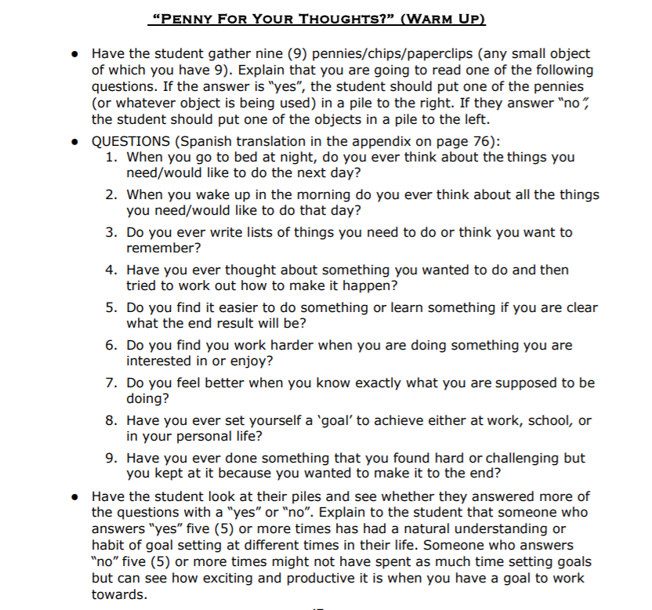
Goal Setting

Slide 50
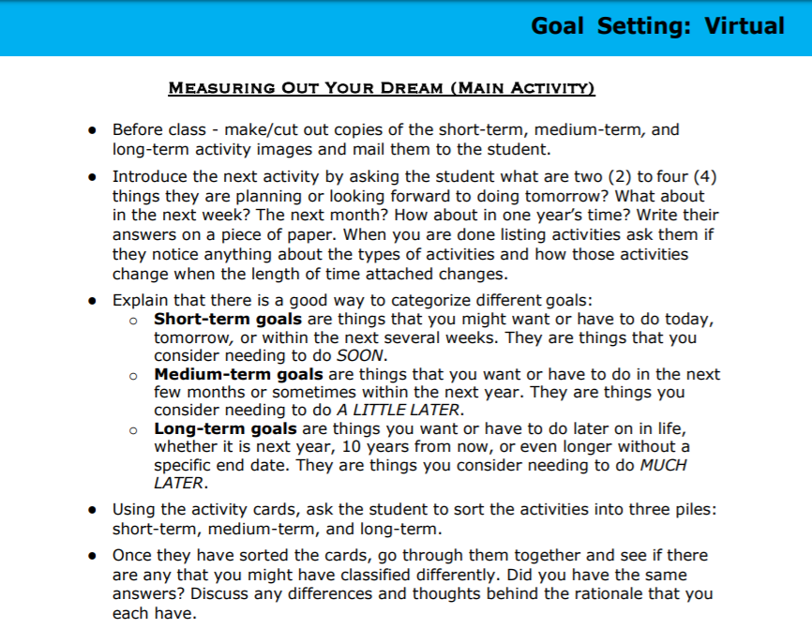
Goal Setting

Slide 51
Goal Setting
QUESTIONS?
(add your contact info here)
www.osymigrant.org
Notes:
This page can be the wrap up for State Specific wrap up
Add your contact information and any other resources you want to share.

