Slide 1
Technical Support Team Meeting
January 26-28, 2021
www.osymigrant.org

Slide 2
Welcome to the second meeting of iSOSY’s Technical Support Team.
Please keep your mic muted at all times
unless you need to ask or answer a question.
All labeled materials may be found
at this link:
https://drive.google.com/drive/folders/1B2jsQtq7a7kESfph6IIBRY5Da_s2ftwp?usp=sharing

Slide 3
Agenda –January 26
Welcome, Introduction, and Icebreaker
Data, Fidelity of Implementation Index (FII), and other tools (Marty Jacobson)
GOSOSY APR
Review iSOSY FII- Where we are now?
Local Data Collection Spreadsheet
Year 1 Data Collection and Reporting
Discuss at-risk secondary students data and profile
OVERVIEW: OSY Engagement & Relationship Building
TST Work Groups and Responsibilities
Update Work Group Action Plans
Work overview
Timeline
DISCUSSION: Pathways Work Group Questions
Time for questions
Meeting Objectives
Receive training on multiple relevant topics.
Provide feedback on Pathways questions to guide the group work.
Learn about data collection forms and due dates.
Discuss secondary at-risk students’ characteristics and needs.
Provide Work Group time/action plan completion.
Prepare pilot materials and SST meeting materials.
Set dates for upcoming meetings.
www.osymigrant.org

Slide 4
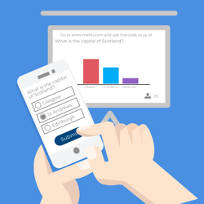
Icebreaker
Use your cell phone browser to open:
menti.com
Then enter code:
14 51 71 6
www.osymigrant.org

Slide 5
Instructional Services
for OSY and Secondary Youth
The iSOSY MEP Consortium Incentive Grant (CIG) is designed to address the needs of migratory youth supported by new and innovative technology. Because we are leveraging resources and structures in 18 iSOSY States and our collaborating partners, we are poised to assist our states to expand their capacity at both the state and local level to support the success of migratory OSY and secondary-aged youth at risk of dropping out of high school.
www.osymigrant.org

Slide 6
iSOSY Objectives
Objective 1: Each year, 70% of migratory OSY and secondary youth at risk of dropping out who participate in iSOSY instructional support will demonstrate 5% growth on iSOSY curriculum-based assessments.
iSOSY lessons with curriculum-based assessments include life skills lessons, personal wellness lessons, reading and math lessons, some of the English lessons, and others that are in development.
TST and evaluator will work on a glossary of terms and local data collection tools.
www.osymigrant.org

Slide 7
iSOSY Objectives
Objective 2: By the end of Year 3, iSOSY States will support 144 migratory youth (average increase of 3 per state over baseline) to obtain an HSED or regular high school diploma.
This Objective is cumulative over three years.
We want to know about migratory youth who achieve this with assistance from MEP instructional services.
www.osymigrant.org

Slide 8
iSOSY Objectives
Objective 3: By the end of Years 2 and 3, 80% of staff participating in iSOSY professional development (PD) will increase knowledge and understanding of strategies to promote graduation and attainment of postsecondary credentials appropriate for the needs of their students.
We will be measuring this directly in Year 2 after new professional development has been created and implemented.
We will still collect results of professional development provided in Year 1 via the staff training survey.
www.osymigrant.org

Slide 9
GOSOSY Annual Performance Review Results
Performance Measure 1a:75% of OSY participating in project-directed instructional services will score 80% or above on content-based assessment post-tests.
16 states reported results
92% of students scored 80% or above
www.osymigrant.org

Slide 10
State | Number Assessed | Number Scoring 80% | Percent Scoring 80%
AL | 15 | 15 | 100%
GA | 2 | 2 | 100%
IA | 0 | -- | --
IL | 16 | 5 | 31%
KS | 35 | 35 | 100%
KY | 48 | 47 | 98%
MA | 49 | 41 | 84%
MS | 4 | 4 | 100%
NC | 32 | 29 | 91%
NE | 22 | 21 | 95%
NH | 4 | 4 | 100%
NJ | 2 | 2 | 100%
NY | 24 | 24 | 100%
PA | 42 | 42 | 100%
SC | 11 | 9 | 82%
TN | 0 | -- | --
VT | 39 | 37 | 95%
Total | 345 | 317 | 92%

Slide 11
GOSOSY Annual Performance Review Results
Performance Measure 1b: 75% of OSY with a Learning Plan will attain 50% of the needs-based learning/achievement objectives specified in their plan.
14 states reported results
70% of students completed half or more of the steps toward their goal
www.osymigrant.org

Slide 12
State | # OSY with Learning Plan | Average number of steps toward goal | Average number of steps completed | # (%) completing 50% or more of the steps
GA | 19 | 6.7 | 4.8 | 15 (79%)
IA | 26 | 3.6 | 2.7 | 23 (89%)
IL | 3 | 4.0 | 4.0 | 3 (100%)
KS | 36 | 3.9 | 2.3 | 23 (64%)
KY | 3 | 4.7 | 3.3 | 2 (67%)
MA | 34 | 4.0 | 3.3 | 33 (97%)
MS | 2 | 4.5 | 4.5 | 2 (100%)
NE | 5 | 4.2 | 3.0 | 3 (60%)
NH | 4 | 6.8 | 1.5 | 0 (0%)
NJ | 1 | 1.0 | 1.0 | 1 (100%)
NY | 153 | 4.7 | 2.3 | 78 (51%)
PA | 87 | 3.7 | 2.4 | 69 (79%)
TN | 10 | 3.8 | 2.8 | 9 (90%)
VT | 32 | 7.3 | 5.9 | 29 (91%)
All | 415 | 4.6 | 2.9 | 290 (69.9%)

Slide 13
GOSOSY Annual Performance Review Results
Performance Measure 1c: Annually, 51 OSY (average of 3 per state X 17 states) will participate in Goal Setting Workshops (GSWs) and attain 80% on a GSW project-based activity rubric.
11 states reported results for 133 OSY
51 students participated in a GSW and attained 80% or higher
on the rubric
www.osymigrant.org

Slide 14
State | # Attending GSW | # Scoring 80% on the GSW Rubric | % Scoring 80% on the GSW Rubric
AL | 3 | 2 | 67%
IA | 3 | 3 | 100%
KS | 36 | 21 | 58%
KY | 2 | 2 | 100%
MS | 2 | 2 | 100%
NC | 32 | * | N/A
NH | 4 | 4 | 100%
PA | 78 | 12 | 15%
SC | 3 | * | N/A
TN | 10 | * | N/A
VT | 5 | 5 | 100%
Total | 133** | 51 | 38%
*Follow-up to GSWs could not be completed due to COVID-19.
**Total includes only states able to determine progress.

Slide 15
GOSOSY Annual Performance Review Results
Performance Measure 2a: Annually, 75% of staff participating in GOSOSY professional learning activities will rate their use of strategies and materials as a 4 or above on the 5-point GOSOSY Implementation Rubric.
312 responses were collected (increase of 101 from Year 4)
90% rated use of materials and strategies 4 or higher
Note: results are not broken out by state because surveys include multi-state trainings
www.osymigrant.org

Slide 16
Training Survey Results
Survey Item | N | Not used at all (1) | Used a little (2) | Used some (3) | Used a lot (4) | Used extensively (5) | % 4 or 5
To what extent did you use ideas or materials you learned about at the GOSOSY training? | 312 | 1 (<1%) | 1 (<1%) | 30 (10%) | 167 (54%) | 113 (36%) | 90%
www.osymigrant.org

Slide 17
GOSOSY Annual Performance Review Results
Performance Measure 2b: Annually, 75% of GOSOSY states will report that at least 5 mutually-beneficial collaborations on professional learning and mentoring are in place in their state with other CIGs, National HEP/CAMP Association, World Education, Inc., and other agencies and entities.
All states reported collaborations
All states had 5 or more
Over 200 collaborations reported with an average of 13 per state
www.osymigrant.org

Slide 18
State | # Collaborations | 5 or more collaborations
AL | 6 | 🗹
GA | 15 | 🗹
IA | 15 | 🗹
IL | 9 | 🗹
KS | 20 | 🗹
KY | 15 | 🗹
MA | 17 | 🗹
MS | 9 | 🗹
NC | 15 | 🗹
NE | 25 | 🗹
NH | 16 | 🗹
NJ | 7 | 🗹
NY | 25 | 🗹
PA | 10 | 🗹
SC | 6 | 🗹
TN | 7 | 🗹
VT | 16 | 🗹

Slide 19
GOSOSY Annual Performance Review Results
Performance Measure 3a: Annually, all GOSOSY states will adopt/adapt two products and provide feedback on two key products designed specifically for OSY.
All states reported on products used
All states adopted/adapted 2 or more
On average states adopted 13.7 products out of the possible 26
www.osymigrant.org

Slide 20
State | Total Adopted or Adapted | 2+ Products adopted or adapted
AL | 18 | 🗹
GA | 7 | 🗹
IA | 14 | 🗹
IL | 10 | 🗹
KS | 13 | 🗹
KY | 18 | 🗹
MA | 8 | 🗹
MS | 7 | 🗹
NC | 20 | 🗹
NE | 24 | 🗹
NH | 16 | 🗹
NJ | 14 | 🗹
NY | 17 | 🗹
PA | 9 | 🗹
SC | 18 | 🗹
TN | 13 | 🗹
VT | 7 | 🗹

Slide 21
GOSOSY Annual Performance Review Results
Performance Measure 3b: 75% of staff participating in GOSOSY training of trainers will rate the training as useful for instructing local staff in the implementation of GOSOSY activities with a 4 or above on the 5-point GOSOSY Training of Trainers Rubric.
94% of respondents indicated that the ToT was useful
83% indicated that strategies and materials from the website were useful
www.osymigrant.org

Slide 22
Training Survey Results
Survey Item | N | 1 | 2 | 3 | 4 | 5 | % 4 or 5
To what extent was the training useful for instructing local staff about GOSOSY materials? | 18 | 0 (0%) | 0 (0%) | 1 (6%) | 8 (44%) | 9 (50%) | 94%
To what extent are the strategies and materials from the website useful for instructing OSY? | 18 | 0 (0%) | 0 (0%) | 3 (17%) | 7 (39%) | 8 (44%) | 83%
www.osymigrant.org

Slide 23
Cover Sheets
OME changed cover sheet requirements in late December and also changed the due date for the Final Performance Report to 1/29/21.
We have data security statements and signed cover sheets from
AL, KS, KY, MS, NJ, PA, and VT.
We need cover sheets and statements from
GA, IL, IA, MA, NE, NH, NY, NC, SC, and TN.
www.osymigrant.org

Slide 24
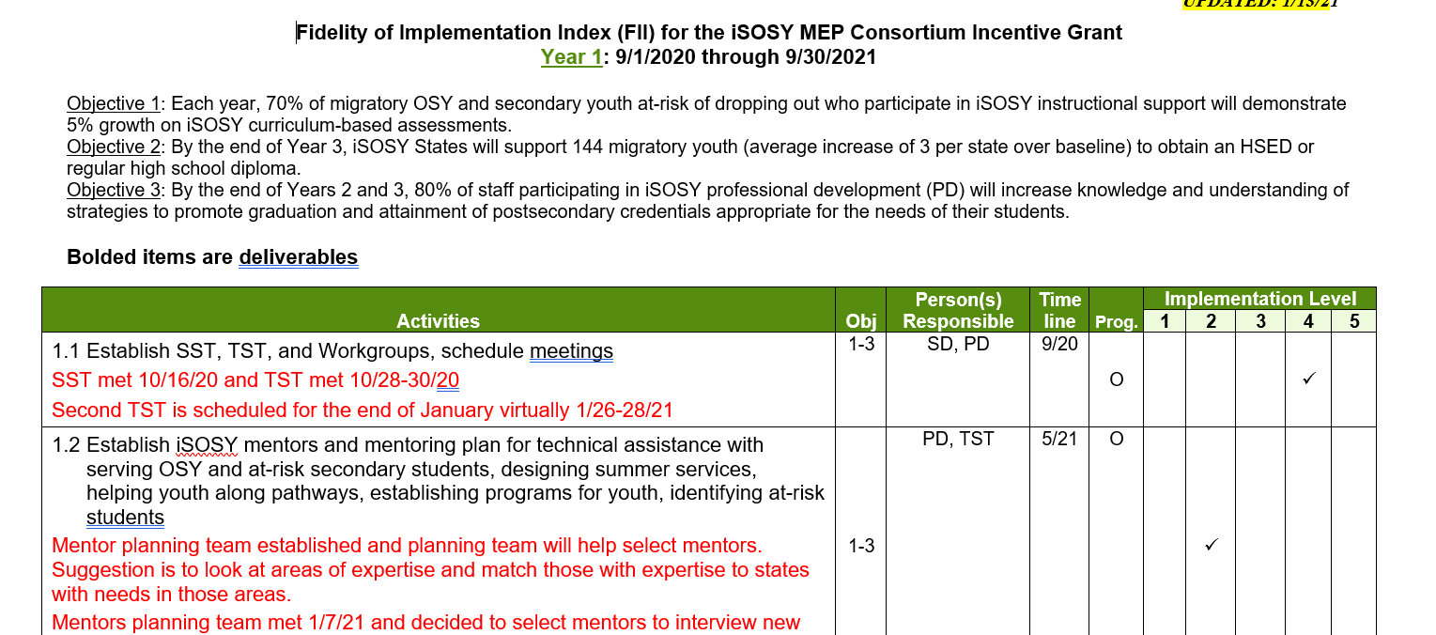
FII Update
Most items are currently in the planning stages but should be updated after this meeting through work done by each of the Work Groups.
It would be helpful if they gave an update on where they are with FII items they are responsible for.
1=Not implemented, 2=Planning stage, 3=Initial implementation, 4=Nearing completion, 5=Complete
www.osymigrant.org

Slide 25
Data Collection
Checklist includes state responsibilities and
a list of forms.
Form 1: Director/coordinator report (required)
Form 2: Post-training survey (required)
Local data collection spreadsheet (NEW—optional)
www.osymigrant.org

Slide 26
At-Risk Secondary Profile
Number of all secondary students identified by grade level (9-12)
Number of at-risk secondary students identified by grade level (9-12)
Risk factors and number of students in each category (will not add to total and students may fall into more than one category)
Below proficient on state assessments in reading and math
EL status
Overage for grade or retained
Dropped out (and not yet coded as OSY)
Any other factors states use (we can expand this list as needed)
www.osymigrant.org

Slide 27
At-Risk Secondary Checklist
Addresses risk factors
Instructionally focused
Used to design additional support/interventions
Local/Regional/State level
www.osymigrant.org

Slide 28
Group Discussion Questions
1. How does your state/program determine if a secondary student is “at risk”?
2. What do you think is the best way(s) to determine if a secondary student is “at risk”?
3. What are the important risk factors that need to be addressed?
4. What are some not-as-obvious questions we can ask students to help determine their risk (beyond grades, attendance, etc.)?
www.osymigrant.org
Notes:
States have an option on how to define this. Here are two possible definitions.
Migratory students in grades 9-12 who are priority for services (PFS).
Migratory students in grades 9-12 who meet the at-risk definitions your state has outlined for PFS (but not necessarily the move within 1-year period part).

Slide 30
Training
OSY Engagement
and Relationship Building
www.osymigrant.org

Slide 31
Notes:
Forms a heart shape-appropriate!

Slide 32
www.osymigrant.org
Notes:
What has come from this is a booklet and guide to help you and your colleagues work together to identify team goals as well as strengths and areas to improve to create the appropriate environment for you and your team to have productive relationships with your OSY

Slide 33
The Role We Play Creating an Inviting Environment Building Relationships with OSY Cultural Competence and Unconscious Bias Questioning Strategies Effective Listening Effective Communication with OSY Effective Advocacy for Migrant Youth Engaging Youth and Young Adults The Importance of Self-Care
Top Ten Practices to Engage with OSY
www.osymigrant.org
Notes:
States have an option on how to define this. Here are two possible definitions.
Migratory students in grades 9-12 who are priority for services (PFS).
Migratory students in grades 9-12 who meet the at-risk definitions your state has outlined for PFS (but not necessarily the move within 1-year period part).

Slide 34
The Role We Play
It is important to understand what role each person is playing in a relationship.
In our work with OSY, it is a balance between establishing a trusting, supportive relationship but maintaining a professional manner.
Be reliable and easy to talk to, someone they can trust, but also there to help them accomplish something and to hold them accountable, while also respecting each other’s boundaries.
This section helps us think about some important roles we can play and how they can help us with that balance.
www.osymigrant.org

Slide 35
Creating an Inviting Environment
Students are more likely to engage in activities and share in conversation if they feel relaxed in the setting.
Creating an inviting atmosphere will increase student participation.
The effect of “room” design may vary with the users but there are several considerations when creating a safe and inviting space.
This can also be applied to the meeting space in which you choose to work.
Wherever we are - we can create a welcoming place by our genuine acceptance and caring.
www.osymigrant.org

Slide 36
Building Relationships
Thriving adult and peer relationships are essential to the success of out-of-school youth.
Youth need to feel connected to a nurturing, supportive adult in order to meet all of their goals.
To create a strong relationship with your students, consider the following: being honest, being authentic, communicating in ways that work, building trust, being flexible and committed
www.osymigrant.org

Slide 37
Cultural Competence and Unconscious Bias
One should know and recognize one’s own feelings and assumptions of others.
One should have the ability to communicate effectively across cultures, be aware of one’s own world view, develop positive attitudes towards differences and gain knowledge of different cultural practices and world view and build understanding between people in a respectful and open manner to different perspectives.
Unconscious bias is countered by being aware of learned stereotypes that are automatic, unintentional, and deeply ingrained in our beliefs affecting our behavior toward cultures and beliefs different from our own and adjust our behavior accordingly.
www.osymigrant.org

Slide 38
Questioning Strategies
The ability to formulate and respond to questions about situations, concepts, and ideas.
Asking the right question is the heart of effective communication.
Gathering better information and learning more enables stronger relationships.
Questioning effectively is a powerful way of learning, relationship building, avoiding misunderstanding, and defusing problems.
www.osymigrant.org

Slide 39
Effective Listening
Effective listening skills are the ability to actively understand information provided by the speaker and to demonstrate a genuine interest in what is being said.
A key factor to re-engagement with young people is the presence of a trusting relationship, and being a good listener is foundational to this.
Concentration and determination are essential to become an effective listener.
www.osymigrant.org

Slide 40
Effective Communication with OSY
A review of essential strategies from the Center for Parent-Teen Communication, including ways to:
• Control reactions
• Be a good listener
• React little
• Turn off the alarm
• Don’t catastrophize
• Avoid over-empathizing
• Offer constructive feedback
The vast majority of teenagers engage with friends via digital communication: texting (88%), Instant Messaging (79%), social media (72%), and video chat (59%)
Lenhart et al.,2015.
www.osymigrant.org

Slide 41
Effective Advocacy for Migratory Youth
Effective advocates influence public policy, laws, and budgets by using facts, their relationships, the media, and messaging to educate government officials and the public on the changes that are needed for children and their families
Principles of advocacy:
Confidentiality
Person-centered
Empowerment
Accountability
Accessibility
Safeguarding
www.osymigrant.org

Slide 42
Engaging Youth and Young Adults
Ten ways to easily engage youth and young adults
-Ask how they are doing -Make the conversation about them
-Do something active -Give them a choice
-Let teens “teach” you -Get them to “perform”
-Set them a challenge -Use culture
-Be Yourself -Remember that technology is an ingrained part of life
Source: Youth Dynamics
www.osymigrant.org

Slide 43
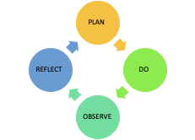
Our Approach
As a Group
Review an area of practice and how it could look in your program.
As an Individual
Complete the self-reflection based on the group’s goal.
Identify areas of strength and areas of growth and needed areas of support.
REFLECT
PLAN
DO
OBSERVE
www.osymigrant.org

Slide 44
Our Approach
As a Group
Working together, establish what it should be (goal).
Ideal _______ with OSY in our program will look like ______________________________________.
To accomplish this, we will __________________.
As an Individual
Using your strengths and areas of work, develop an action plan reflecting how you will support the group to work towards their goal and how you can support others and how they can support you.
PLAN
REFLECT
DO
OBSERVE
www.osymigrant.org

Slide 45
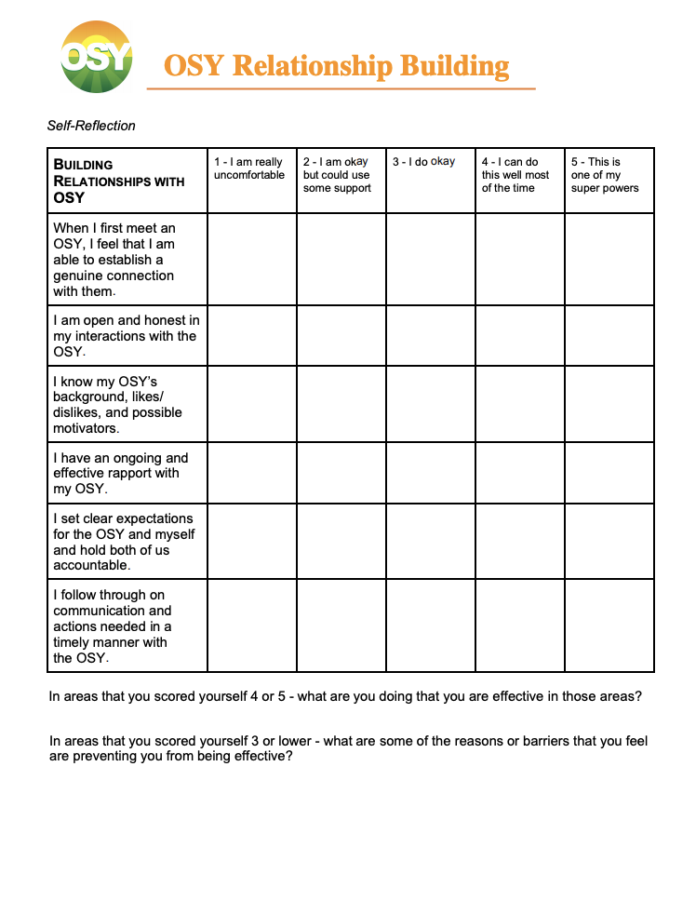
Notes:
What has come from this is a booklet and guide to help you and your colleagues work together to identify team goals as well as strengths and areas to improve to create the appropriate environment for you and your team to have productive relationships with your OSY

Slide 46
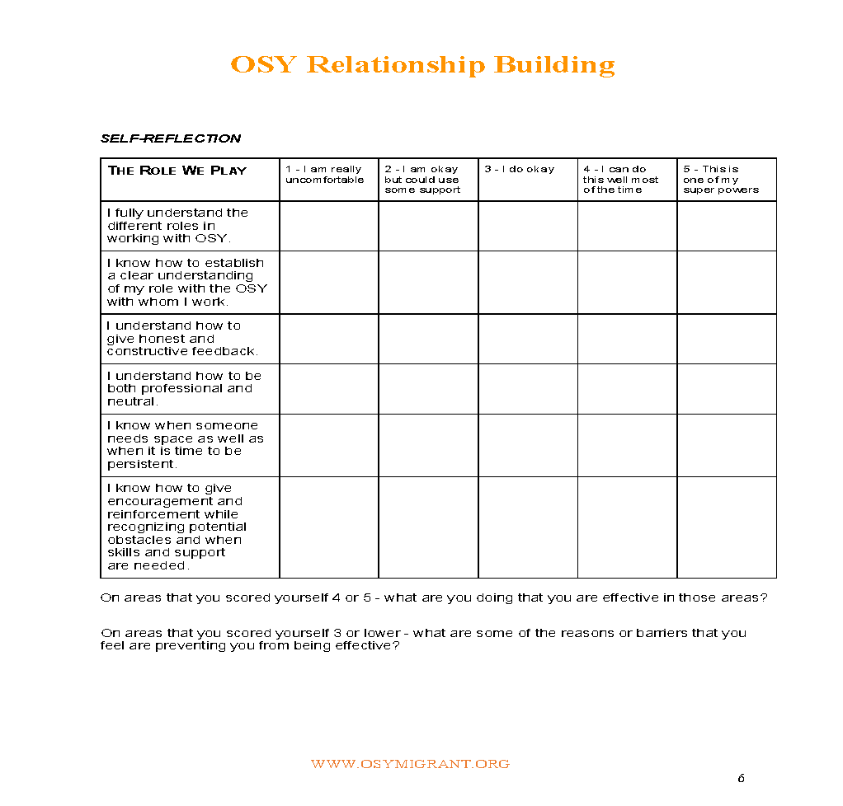
Group 1:The Role We Play

Slide 47
Group 2: Building Relationships with OSY

Slide 48
Group 3: Effective Listening

Slide 49
Group 4: Effective Communication with OSY

Slide 50
Group 5: Engaging Youth and Young Adults

Slide 51
The Importance of Self-Care
Why does self-care matter? It is important to make sure you take good care of your body, mind and soul every day. This is key to being a good support for OSY and being a good support for yourself! Important keys to self-care are the following:
-Enough sleep -Exercise daily -Eat right
-Take care of your gut -Learn to say “No” -Get away
-Go outside -Get a pet -Get organized
-Cook at home -Self-care reading -Time for you
www.osymigrant.org

Slide 52
All Together: The Importance of Self-Care

Slide 53
Who are You?
What is the role that you are playing in this process?
Are you there as a stakeholder or not?
Are you working with people who are your subordinates or supervised by your subordinates?
How are you viewed by the people you are going to be working with on this?
To do this process with efficacy people are being asked to be:
Authentic
Honest +
Vulnerable
How are you going to create the space for this to happen?
www.osymigrant.org

Slide 54
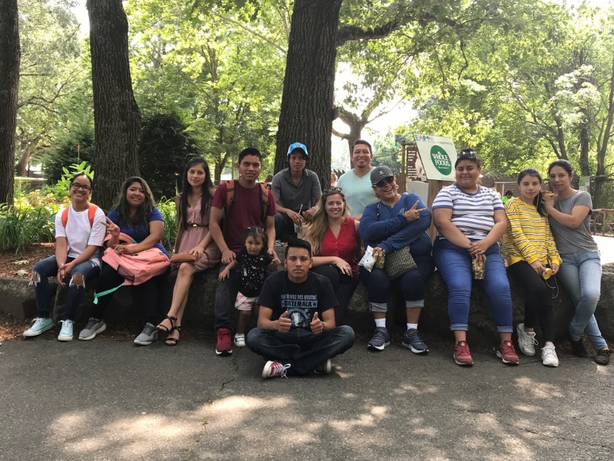
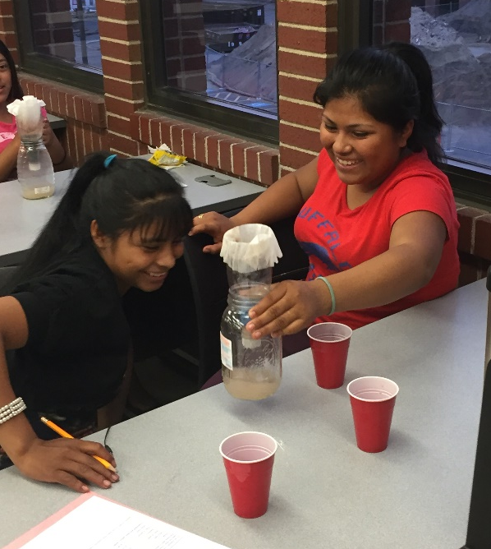
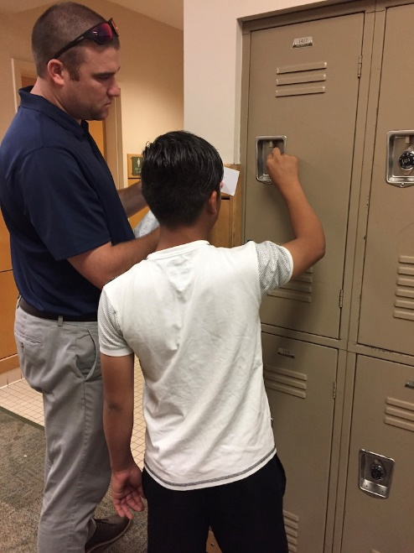
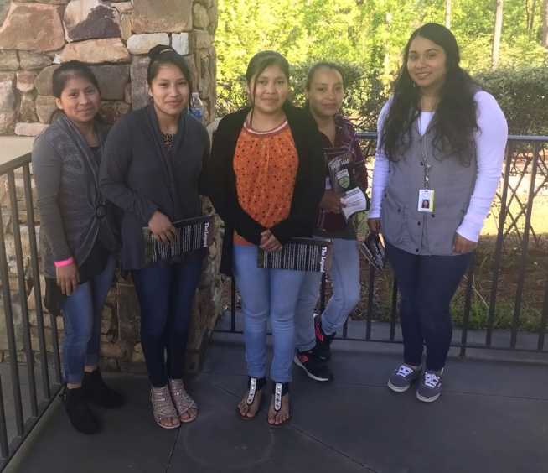
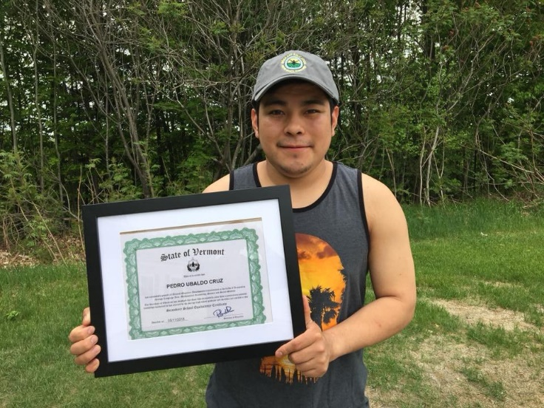
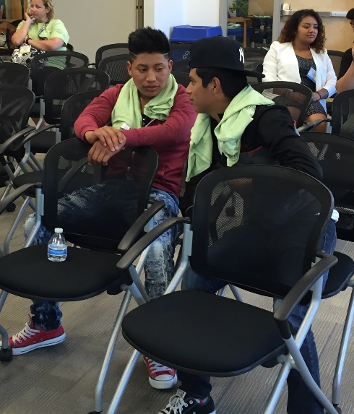
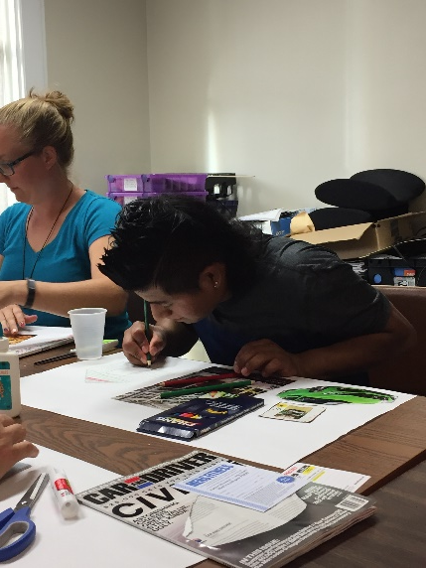
Remember, the whole purpose is to work together to accomplish powerful and long-lasting change in the program and in the lives of the students we work for and our own.
www.osymigrant.org

Slide 55
TST Responsibilities
Participate in virtual and in-person TST meetings.
Participate in assigned Work Group activities and meetings.
Review products for efficacy and equity.
Use the FII to guide direction of the group.
Meet to update State MEP Director after each TST meeting.
Consistency—in attendance and participation.
Be fully committed to the work and demonstrate this commitment by meeting agreed upon deadlines, participating/ attending meetings and calls until outcomes/goals are fully met.
Leave each meeting with tangible products/achievements synthesizing our meeting outcomes.
Use included reflection time to promote spontaneous, creative discussion.
www.osymigrant.org

Slide 56
TST Work Group Expectations
Updated action plan with accomplishments, timeline, and work flow
Summary of what needs to be shared at the upcoming SST meeting in March
Scheduled meeting times with Tracie
www.osymigrant.org

Slide 57
TST Work Group Action Plans
OBJECTIVE | TASK | TIMELINE | RESPONSIBLE
1.
2.
3.
4.
www.osymigrant.org

Slide 58
TST Work Groups
Pathways
Members:
FII indicators: 1.6, 1.7, 1.8, and 1.14
1.6 Develop Pathways Guide to HSED and credentials that includes information about prerequisite skills and assessments (instructor version).
1.7 Prepare guide for students on a pathway to HSED exams that includes information about benefits of an HSED, resources, and direction to instruction.
1.8 Prepare guide for students on a pathway to credential programs that includes benefits of various programs (including FSCC programs), resources, and direction to instruction.
1.14 Develop training materials/webinars on pathways to HSED and credentials.
Emily Hoffman (lead-MA)
Janet Reynolds (KS)
Hunter Ogletree (NC)
John Farrell (KS)
Bruce Lack (MI)
www.osymigrant.org

Slide 59
TST Work Groups
Curriculum
Members:
FII indicators: 1.5
1.5 Prepare initial catalog of lessons for wide array of academic backgrounds and identify assessment and instructional materials appropriate for various pathways and methods of instruction including asynchronous, synchronous, and summer.
Finalize English for Daily Life revisions and lesson plans.
Review English Language Screener feedback and make recommendations for revisions.
Develop Life Skills lesson on COVID-19.
Brenda Pessin (lead- iSOSY)
Veronica Hill (NE)
C. Hope Derry (NC)
Lori Potutschnig (PA)
Wilson Kendrick (MS)
Laurie Stewart (LA)
www.osymigrant.org

Slide 60
TST Work Groups
Professional Learning
Members:
FII indicators: 1.16
1.16 Develop training materials for distance education (how to use virtual learning tools for students and service providers).
Develop survey on Professional Learning needs and webinar ideas.
Sabrina Rivera-Pineda (lead- GA)
Odilia Coffta (NY)
April Dameron (IA)
April Roberts (GA)
www.osymigrant.org

Slide 61
TST Work Groups
Career Awareness and Goal Setting
Members:
FII indicators: 1.9
1.9 Develop goal setting and career awareness materials (include materials to assess progress or attainment of lesson objectives).
Emily Williams (lead- SC)
Joyce Bishop (AL)
Shantella Singleton (PA)
Mary Speyrer (LA)
Merriam Massey (AZ)
Lizy Garcia Ramirez (IL)
www.osymigrant.org

Slide 62
TST Work Groups
Personal Wellness
FII indicators: 1.10 and 1.17
1.10 Develop materials to enhance personal wellness (include materials to assess progress or attainment of lesson objectives).
1.17 Develop training materials regarding impact of trauma.
Members:
Lysandra Alexander
(lead- PA)
Lora Thomas (iSOSY)
Susana Das Neves (IL)
Valeria Peña (IA)
www.osymigrant.org

Slide 63
TST Work Groups
Technology and Student Portal
Members:
Travis Williamson (lead - NY)
Sarah Braun-Hamilton (VT)
Andy Wallace (IN)
Michelle Mattson (MI)
Emily Salinas (IN)
Iggy Campos (NM)
FII indicators: 1.11 and 1.12
1.11 Plan and design student portal with resources that can be used with and without instructional support and options for synchronous and asynchronous instruction.
1.12 Create a plan and processes for transferring Learning Plans state to state.
www.osymigrant.org

Slide 64
Pathways Breakout Session
Please note:
All participants should use camera during Discussion Breakouts.
Choose one member to record the group’s answers/ideas on
the Google Document.
Consult the list of questions in the Google Drive:
https://docs.google.com/document/d/1IERpMrD7O3_5R-FxU87-OZ_KnYQlN-oJ8Ep9x2OcIKI/edit?usp=sharing

Slide 65
Pathways Breakout Session
1. What career and/or credentialing programs are available to Secondary Students and Out-of-School Youth in your state (Please specify to whom the programs are targeted)? Are the types of programs offered based on high wage/economic need in your state?
2. What process do you follow when a student expresses an interest in credential, certification, or vocational programs? Is this a state-wide process with resources available? If your state/community has a promising program model that would be helpful to share with other MEPs, please let this group know!
3. What funding sources have you found for undocumented youth and/or OSY that can be used for career/credentialing programs?
.4 What prerequisites into these programs are barriers to OSY and at-risk secondary students from entering career training programs? Have you found or created materials/programs to address this?
5. Have there been any community networks established with employers, labor unions, trade/vocational schools and the MEP? Do you have a relationship with career counselors, community agencies, vocational/technical schools, businesses, labor unions that assist in career/credentialing opportunities?
6. Do you have migratory MS/HS students and/or OSY that express a desire for credential, certificate programs, or career pathways? What percentage/number would you estimate?
7. Do you have students that express an interest in one day owning their own business or being their own boss? Have you connected them with any programming that supports that interest?

Slide 66
Agenda – January 27
Overview of Day 2 expectations
TRAINING: Using the English for Daily Life Shopping Lesson Plan and support videos (Michelle Bastiani)
Training Evaluation
Action Plan update, outline of work, meeting time, and SST written update
Virtual Instructional Support: ED Puzzle (Travis Williamson)
Work Group Time
www.osymigrant.org

Slide 67
SAVE for Michelle Bastiani
www.osymigrant.org

Slide 68
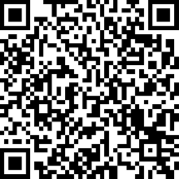
TRAINING Evaluation
www.osymigrant.org

Slide 69
TST Work Group Action Plans
OBJECTIVE | TASK | TIMELINE | RESPONSIBLE
1.
2.
3.
4.
www.osymigrant.org

Slide 70
Work Group Meeting Schedule
Curriculum | 10:00-10:20 am | Professional Learning | 10:20-10:40 am
Pathways | 10:40-11:00 am | Career Awareness & Goal Setting | 11:00-11:20 am
Technology & Student Portal | 11:20-11:40 am | Personal Wellness | 11:40 am -12:00 pm
www.osymigrant.org

Slide 71
EdPuzzle
Williamson 2021
www.osymigrant.org

Slide 72
EdPuzzle
Benefits of EdPuzzle
Your students watch the video at their own pace.
See who’s watching and who answers the questions. They won’t be able to skip ahead or open other tabs.
Get 100% student participation!
www.osymigrant.org

Slide 73
EdPuzzle
What Can You Do with EdPuzzle?
Choose any video from YouTube.
Embed your own assessment questions .
Track your students’ progress.
Choose curriculum already created.
www.osymigrant.org

Slide 74
EdPuzzle
Getting Started
www.osymigrant.org

Slide 75
EdPuzzle
Getting Started
www.osymigrant.org

Slide 76
EdPuzzle
Getting Started
www.osymigrant.org

Slide 77
EdPuzzle
How Much Does it Cost?
3 Tiers: Basic, Pro Teacher, Schools & Districts
Basic: Free
Access to 5 million videos
Create your own interactive video lessons
Add questions, audio and notes
See detailed analytics on your students' results
Get storage space for 20 videos Increase storage when you refer Edpuzzle to colleagues
Pro Teacher: $11.50/mo
Same features as Basic plus unlimited storage of videos
Schools & Districts: Request quote
Pro Teacher for everyone
Get all teachers on the same secure video-streaming platform
Streamline curriculum across your district
a dedicated School Success Manager to help you onboard teachers to Edpuzzle & integrate with your LMS
www.osymigrant.org

Slide 78
How to Reach Tracie:
785-249-9219
www.osymigrant.org

Slide 79
Work Group Breakouts
Please note:
All participants should use camera during Work Group Breakouts.
Complete the Action Plan found in your Work Group’s Google Drive folder (at link below).
Choose one member to present a 15-minute summary to the entire TST on Thursday morning.
All materials may be found at this link:
https://drive.google.com/drive/folders/1bffsySwZ1vD6ULvs9d4gJJDBu_6_ASWs?usp=sharing

Slide 80
Agenda – January 28
Cross Collaboration and Work Group Time
Mentoring Update and Rubric
OVERVIEW - COVID 19 Lesson (Veronica Hill)
Summer Planning
Finalize Work Group Action Plans
Work Group Presentations
TRAINING - Personal Wellness – Self-Care (Lysandra Alexander and Lora Thomas)
Training Evaluation
Future meeting dates
www.osymigrant.org

Slide 81
Mentoring Committee Update
Committee members: Zach Taylor (SC), Joyce Bishop (AL), Emily Hoffman (MA), Michelle Williams (MI), Hunter Ogletree (NC), and Odilia Coffta (NY)
Addressed Fidelity Implementation Index indication:
1.2 Establish iSOSY mentors and mentoring plan for technical assistance with serving OSY and at-risk secondary students, designing summer services, helping students along pathways, establishing programs for students, identifying at-risk students
Developed draft rubric
www.osymigrant.org

Slide 82
Mentor Planning Team
Level I, Clients
Levels
Of
Concern
Level II, Staff
Level III, State Systems
www.osymigrant.org

Slide 83
Previous Concerns
GED and GED prep materials are used somewhat or rarely with OSY.
Only some or a few OSY participate in programs leading to GED or graduation.
Some or few staff used consortium health instruction materials.
Assessments are somewhat or rarely used to determine appropriate instructional services.
Services are sometimes are rarely provided with technology.
Staff are sometimes or rarely trained in the use of consortium materials.
www.osymigrant.org

Slide 84
Identifying Current Systems or Staff Concerns
The plan is to have mentors talk to new states and new directors about what is in place for OSY and at-risk secondary students.
Prior to that, what do we need to ask mentors to talk about?
Think about critical systems that need to be in place.
What other concerns do you have?
www.osymigrant.org

Slide 85
Mentor Project
Is your state completing the OSY Profile?
Does your staff understand the needs of OSY?
Does your state support the use of Goal Setting and Learning Plans with OSY and at-risk secondary students?
Do you have processes in place for identifying at-risk secondary students?
Are MEP staff in your state trained in the use of OSY consortium materials?
Are summer instructional services provided to OSY in your state?
Are at-risk secondary students included in your State’s CNA, SDP, and evaluation?
www.osymigrant.org

Slide 86
Systems and Areas of Concerns for
New States/Directors
Good to include focus on local programs
Issues around delivery model (H2 A workers)
How to address leadership- implementation plans/address how leaders can be engaged.
Consistency in use of materials in states
Streamline data
How to train staff to use lessons (TOT to build capacity)
www.osymigrant.org

Slide 87
Systems and Areas of Concerns from Previous Mentoring
Creative problem solving: rigid systems designed around K-12 do not necessarily work for OSY. We need to recognize barriers but need to go the extra step to solve problems and provide appropriate services.
Lack of assessment data
Mentors need to take time to understand the state they are working with.
What is currently being done for at-risk secondary students and how does the MEP provide supplemental support? Also OSY.
Prioritizing CIG activities
Identify what capacities exist and identify what needs to be in place.
Existing concerns 1-4 are good. New states need to figure out where the challenges are.
Tiers of implementation: services and programs can be implemented at a variety of levels.
www.osymigrant.org

Slide 88
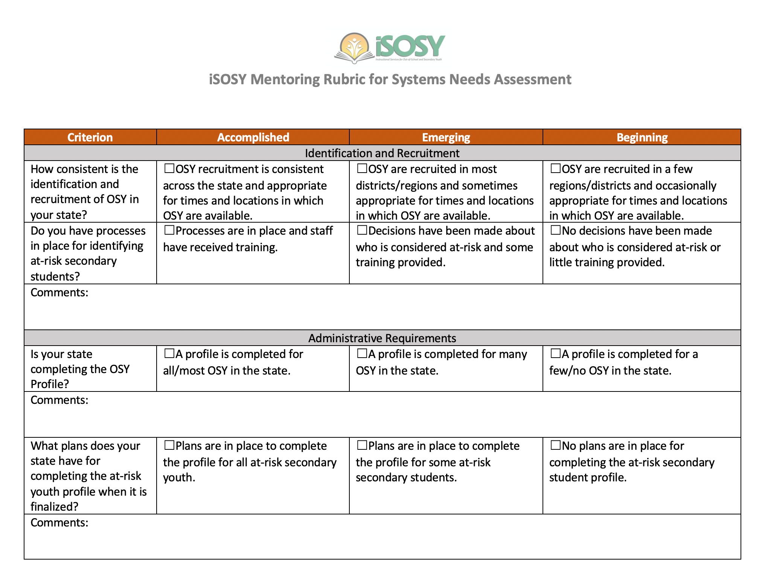
Draft Mentoring Rubric for
Identifying Concerns
www.osymigrant.org

Slide 89
TRAINING Evaluation
www.osymigrant.org

Slide 90
TST Meeting Dates
www.osymigrant.org

