Slide 1

Technical Support Team Meeting
October 12-13, 2011
Asheville, NC

Slide 2
Agenda: Day One
Welcome and Introductions
Opening Activity
VISTA Presentation
Update on SOSY Activities
Data and Performance Measures Discussion
Curriculum and Material Review Bob, Brenda, Kelsey, Lupe and Dee
Review Agricultural and OSY Literature Review Jessica
Discussion of SOSY Pilot Process
Group Discussion and Input
Redesign of the SOSY website
Technology Ideas/SOSY Video/TOT Video Clips Tim
Working Lunch: Meeting of the Dissemination Event Planning Committee
Work Group Time

Slide 3
Update on OSY Activities
Share one success story with the group.
Reflect back on one thing you would do differently this year.
How have you used materials/resources from the Consortium?
Notes:
Discuss work to date: update website, information clearinghouse, form TST, working on health lesson plans, SST meeting, newsletters, updating forms, planning webinar for new states, planning conversations with each state director in regard to OSY

Slide 4
Data and Performance Measures Discussion
How are states collecting the data?
Do additional tracking tools need to be created?
Are states using the SOSY tracking form? SOSY student evaluation form?

Slide 5
OSY STUDENT PROFILE
Notes:
Each state participating in the SOSY project is required to complete the OSY Student Profile sheet on as many OSY students as possible. The minimum data elements are contained on the OSY Profile but states are free to add additional data elements if desired. This form, in English and Spanish, can be adapted by the State MEP. The OSY Student Profile sheet is used to gather essential data at both the individual student and state levels. At the individual level, the OSY Profile is the starting point for planning the services that best match the needs and availability of each youth identified. At the state level, the OSY Profile helps gather information about the OSY population in the state which aids in the planning and implementation of programs, allocation of funds, and coordination with other relevant service providers.
Provides more data on supportive services/demographic information on needs than traditionally available in a K-12 setting--
Makes the case at the local, state, and national level
-helped many states like KS and IL expand their services (the need was demonstrable)

Slide 6
Uses of the OSY Profile
Individual Level
    Plan educational and supportive services to address needs and interests
    Leads to SOSY Services Plan
State Level
    Develop statewide (and local) profile of characteristics and needs of OSY
    Leads to update of State CNA and MPOs targeted to OSY (recovery and here-to-work)
Notes:
By Area: Instructional vs. Support services
By Group: Recovery vs. Here-to-Work
By Service: English, GED, literacy, etc.
By Instructional Setting: Home-based, in-camp, or center-based

Slide 7
SOSY STUDENT SERVICES PLAN
Notes:
SOSY Student Services Plan is an optional form developed as a resource for states.
The SOSY Student Services Plan may be used by states to help identify goals and resources to support OSY and plan for service delivery. The form can be adapted as needed by State MEP.

Slide 8
MAINTAINING GOOD RECORDS:
SOSY TRACKING FORM
An easy way to document services by youth served
Helpful for developing a state profile
Essential for SOSY Consortium reporting
Data will be incorporated into the SOSY annual performance report

Slide 9
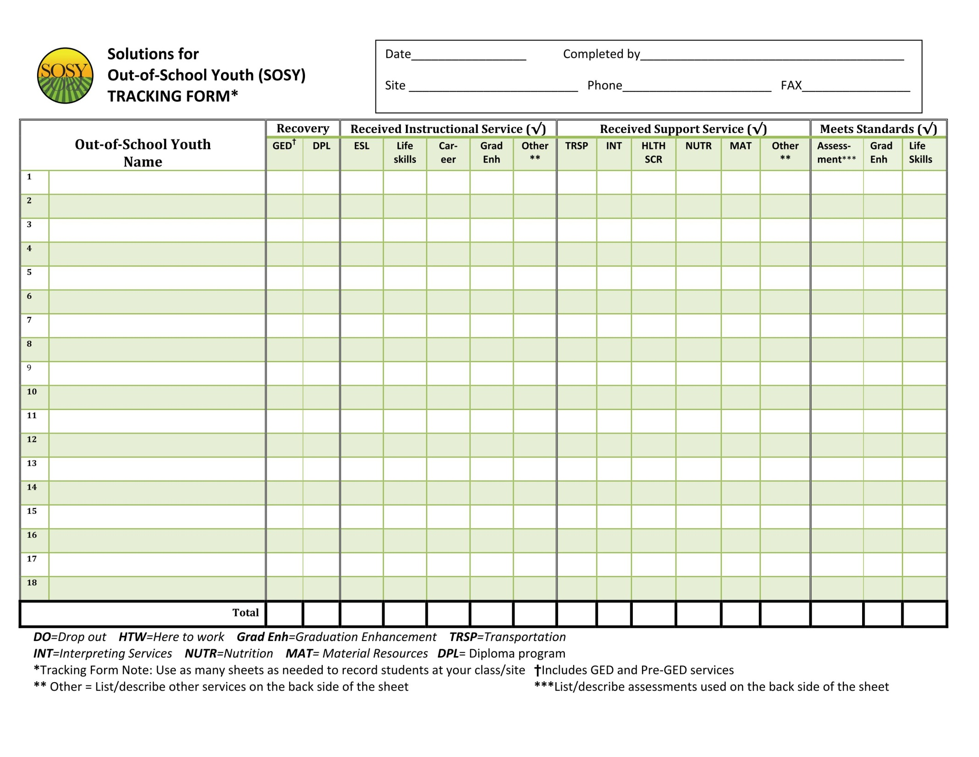

Slide 10
Curriculum and Material Review
Bob, Brenda, Kelsey, Lupe and Dee
Legal Lessons
Career Exploration Lessons
Parent Lessons
Reading on the Move
  Welcome to Olga
  Discussion of the pilot process with HEP/CAMP

Slide 11
Literature Review
Agricultural Trends Jessica
Update OSY Literature Review
What additional information needs to be addressed in the reviews?
How will the information be used?
How will it be disseminated?

Slide 12
Discussion of SOSY Pilot Process
How will materials be piloted in year 2?
What states are willing to pilot the materials?
How will the information be tracked?
How will be feedback be submitted?
How will materials be revised as a result?

Slide 13
Group Discussion and Input
Redesign of SOSY website
Use of technology
SOSY video/TOT video clips Tim

Slide 14
Work Group Assignments
ID&R- Review and discuss the creation of 2 new documents
TA- Review and finalize the HTW and Recovery Matrices (including introduction)
Training- Review current materials, develop trainer guides and develop timeline for remaining work
Curriculum-Review and update Educational Resource Rubric. Prepare report for SSST meeting and discuss input from TST.

Slide 15
Agenda: Day Two
8:00 am Working Breakfast- TOT Planning Committee Meeting
8:30 am Networking and Technical Assistance Topic: Safety and Professionalism TJ and Tracie
Check in with work groups
Report to SSST meeting on November 15
Discuss conference call schedule
Other issues

Slide 16
Networking and Technical Assistance Topic
Topic: Safety and Professionalism
What are the issues around safety you are seeing in your state?
What are the issues around professionalism you are seeing in your state?
How do you set boundaries for OSY and staff? Expectations for OSY and staff?
What training is currently provided to staff?
What training or tools need to be developed in the future by the Consortium?

