Slide 1
Technical Support Team Meeting
April 9-10, 2019
Omaha, NE
www.osymigrant.org

Slide 2
Member States
Alabama
Florida
Georgia
Illinois
Iowa
Kansas
Kentucky
Massachusetts
Mississippi
Nebraska
New Hampshire
New Jersey
New York
North Carolina
Pennsylvania
South Carolina
Tennessee
Vermont
www.osymigrant.org

Slide 3
Partner States
Alaska
Arkansas
California
Colorado
Idaho
Maryland
Minnesota
Missouri
Montana
Oregon
Washington
Wisconsin
www.osymigrant.org

Slide 4
Technical Support Team
Expectations
Membership
State Director expectations
Requirements
2-3 meetings per year
Conference calls
Work assignments
Team Lead meeting
Collaboration and coordination across groups
Work Norms
Be fully committed to the work and demonstrate this commitment by meeting agreed upon deadlines, participating/attending meetings and calls until outcomes/goals are fully met.
Leave each meeting with tangible products/achievements synthesizing our meeting outcomes.
Use included reflection time to promote spontaneous, creative discussion.
www.osymigrant.org
Notes:
Purpose- responsibilites
Who to send?
Mentoring Pilot- World Education
Tracie will ask MA, TN, VT, GA, and CA
Mental Health-- KS
Goal Setting – TOT Work Group – Sonja Williams (lead)—Ernesto?
PD- Develop training to certified and non-certified staff – Jessica Castaneda (Lead)
ID&R – in collaboration with IRRC—Jennifer Almeda (lead)
Develop web-accessible lessons- Material Development—Bob Lynch and Brenda Pessin-- leads
With support and guidance from World Ed – Andy Nash
OSY Learning Plan—Emily Hoffman
With Steve Quonn

Slide 5
Welcome and Introductions
Welcome and Introductions
Sue Henry, State MEP Director
www.osymigrant.org

Slide 6
Agenda – Day 1
Welcome and Introductions
NE MEP Welcome and Overview
GOSOSY Year 4 and Fidelity Implementation Index Update
Mental Health
TOT expectations and follow up
Mental Health Resource documents
Survey data
Review and discuss draft Drop Out Prevention Strategies Literature Review—Jessica Castaneda
Interstate Collaboration Work Group Survey data overview and response
Review of ESL Lessons
LUNCH ON YOUR OWN
Work group assignments
Work group meetings

Slide 7
Welcome to Nebraska and the NE MEP
Sue Henry, State MEP Director
Nebraska NE MEP staff
www.osymigrant.org

Slide 8
GOSOSY Updates
February SST meeting in Alabama
OME Annual Directors’ Meeting
Year 5 of GOSOSY
New competition in FY 2020
Latest Fidelity Implementation Index
www.osymigrant.org

Slide 9
Google Analytics
November 2018 to April 2019
GOSOSY Site
www.osymigrant.org

Slide 10
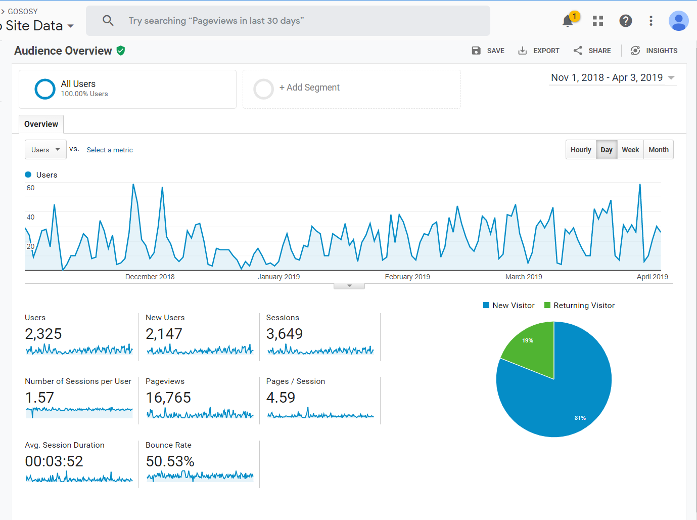

Slide 11
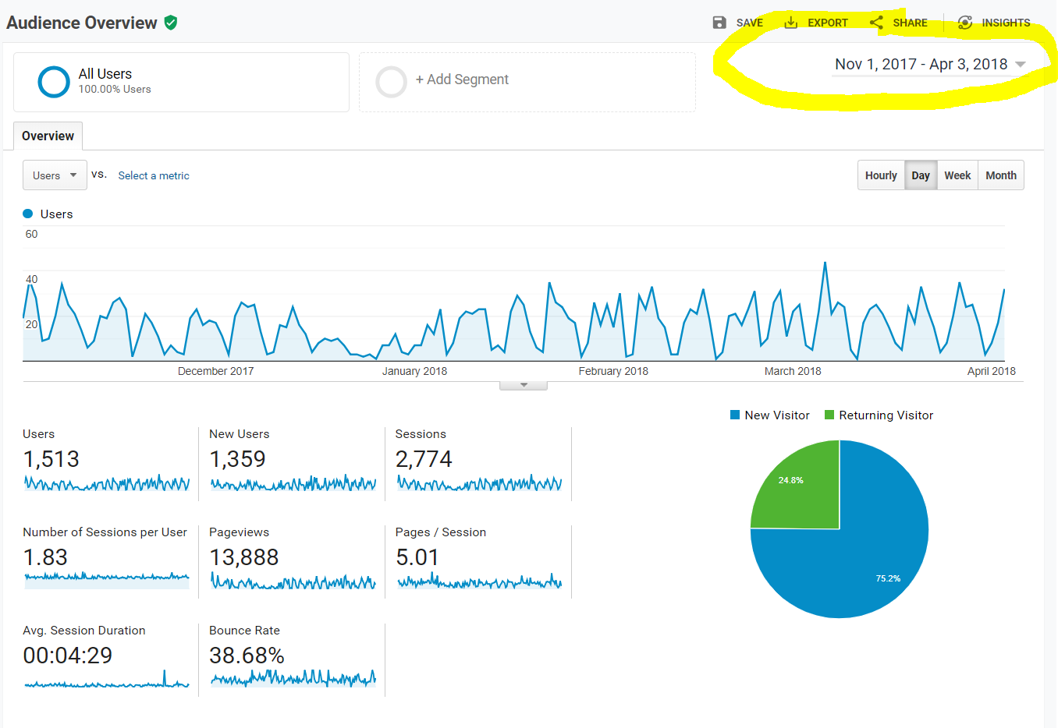

Slide 12
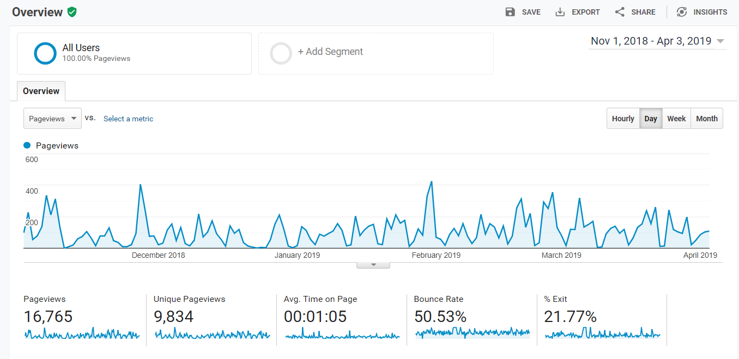

Slide 13
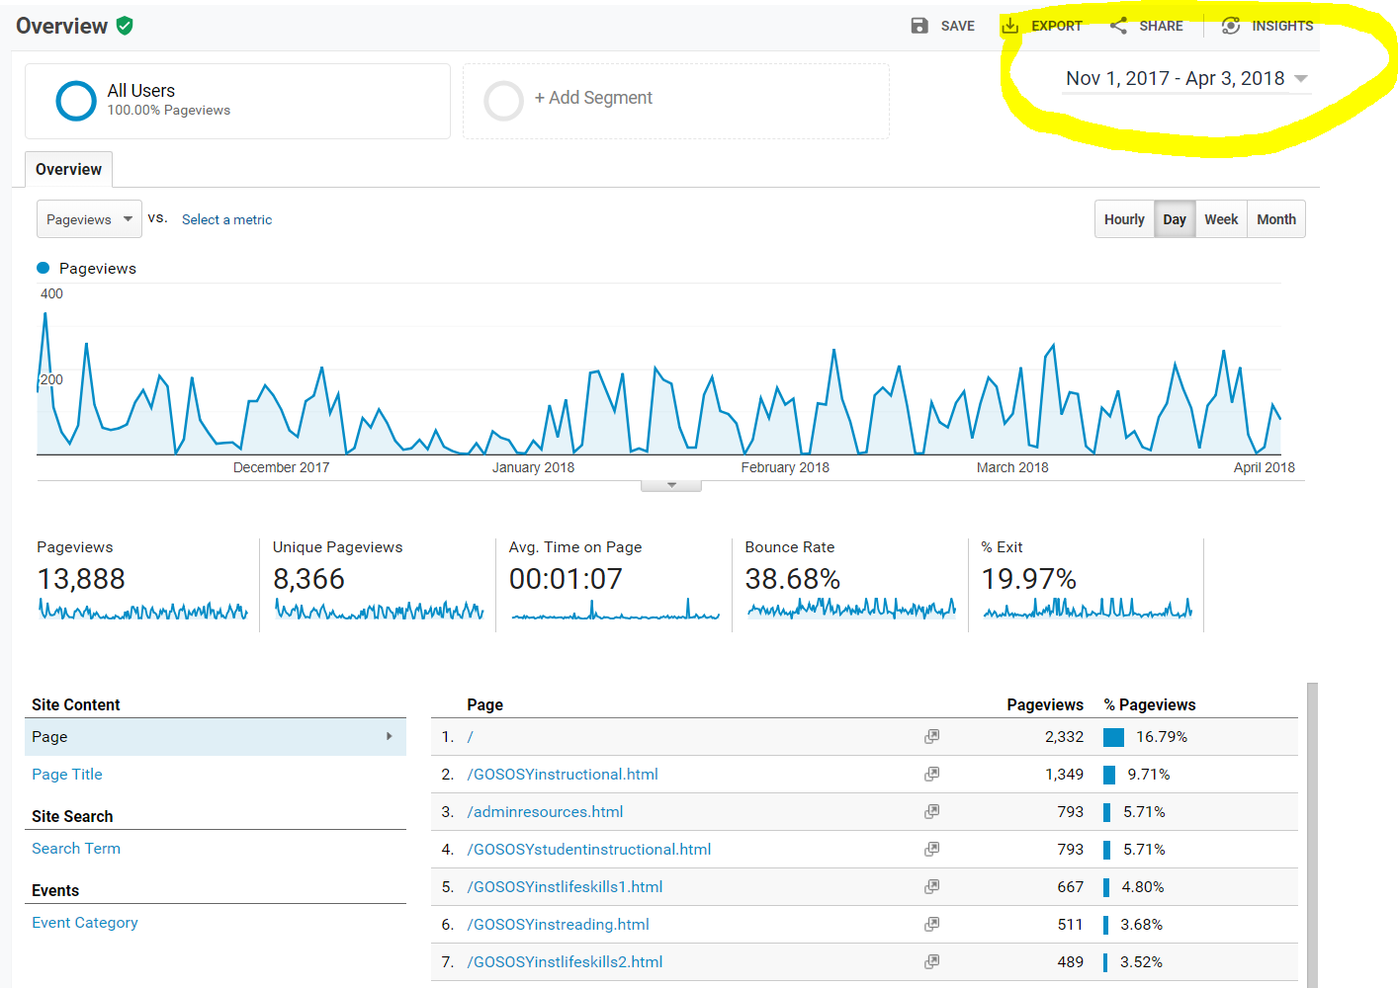

Slide 14
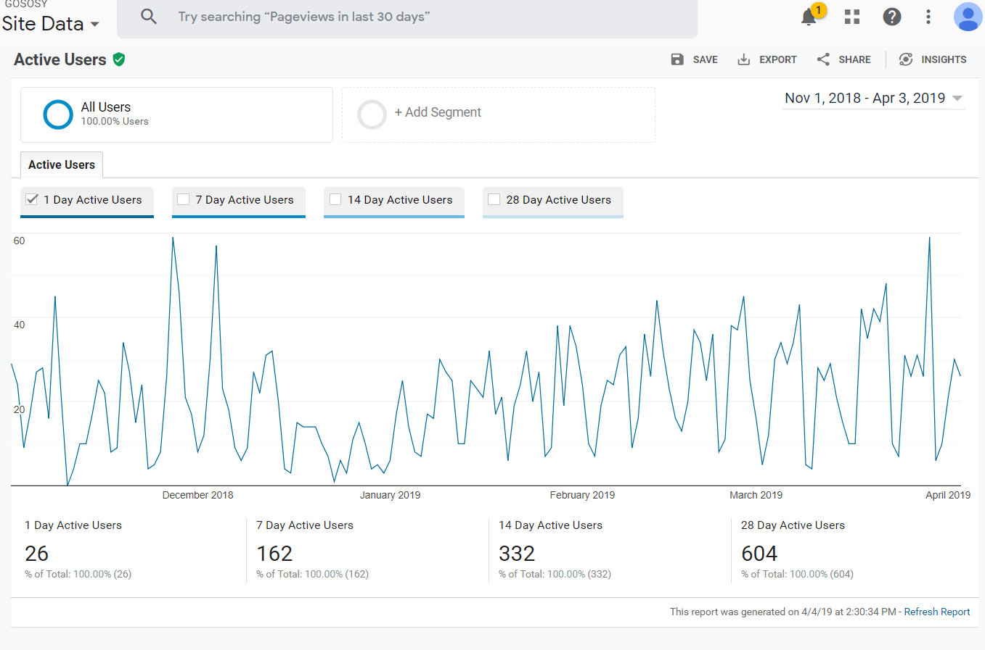

Slide 16
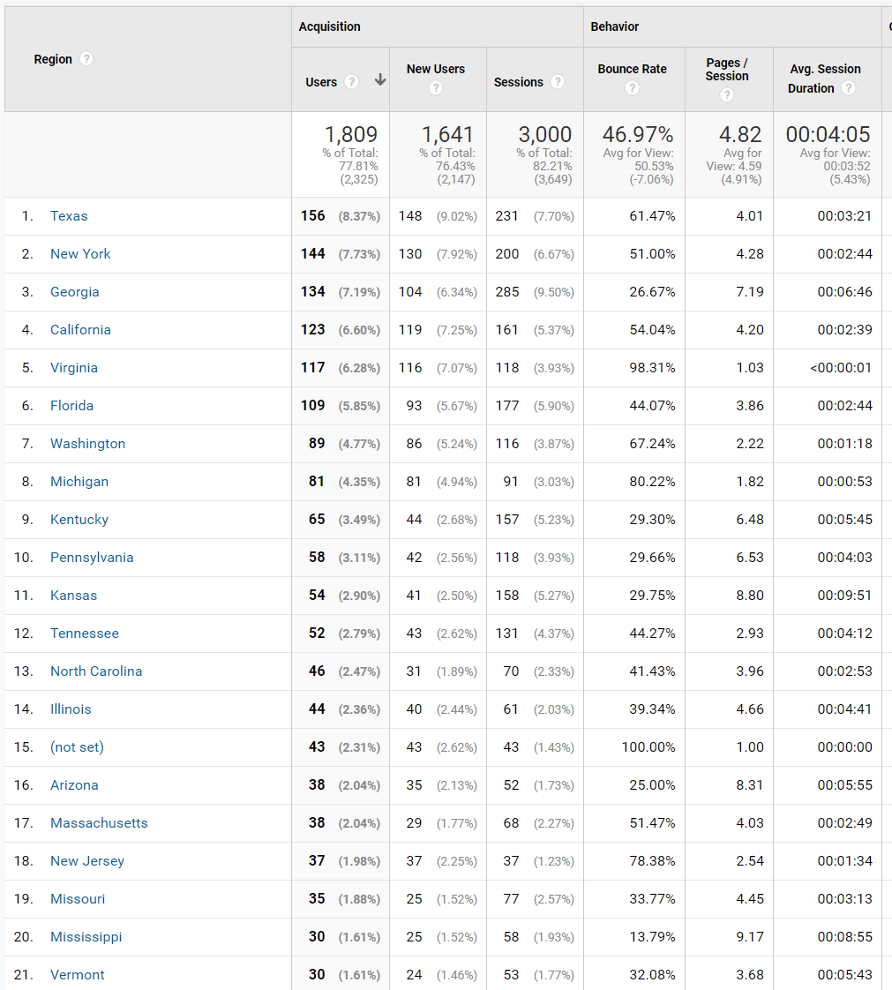

Slide 17
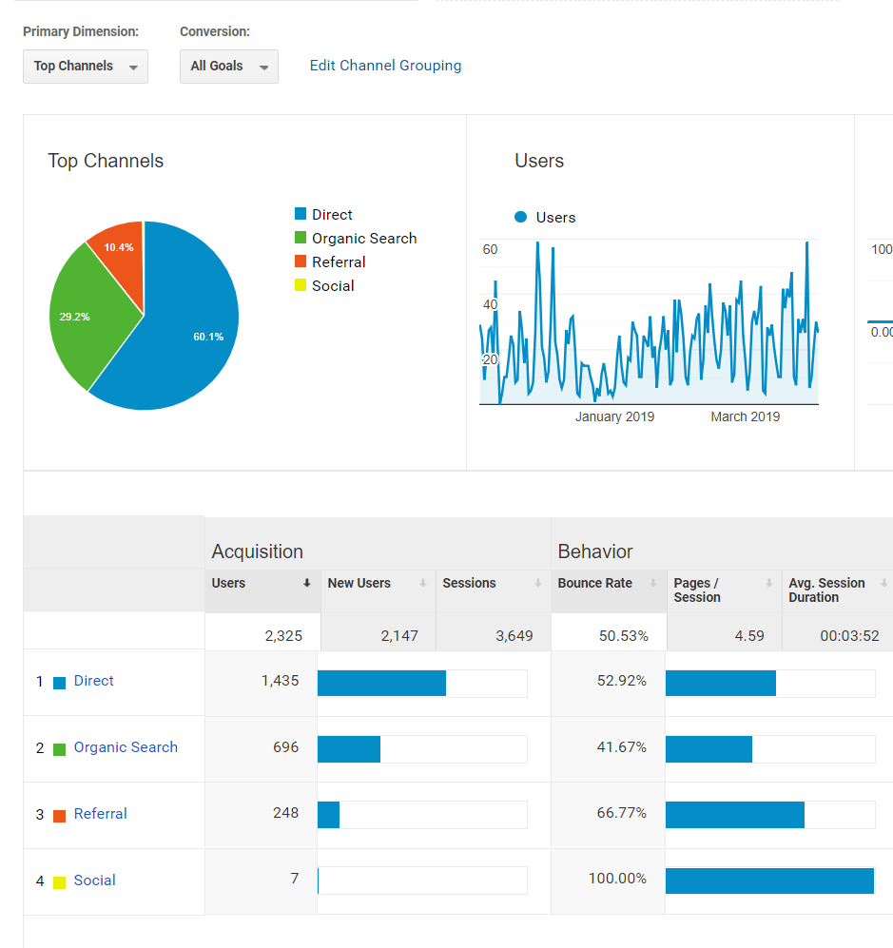

Slide 18
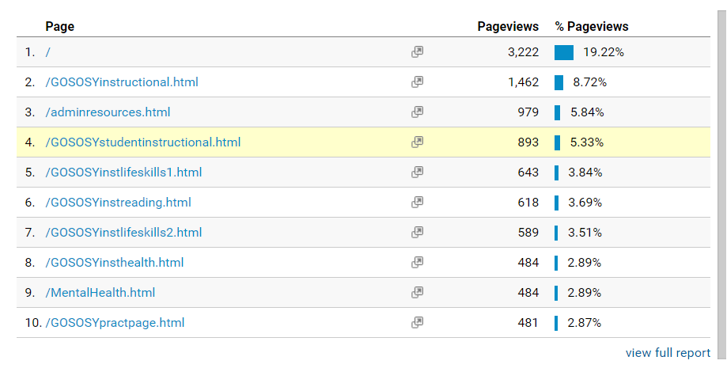

Slide 19
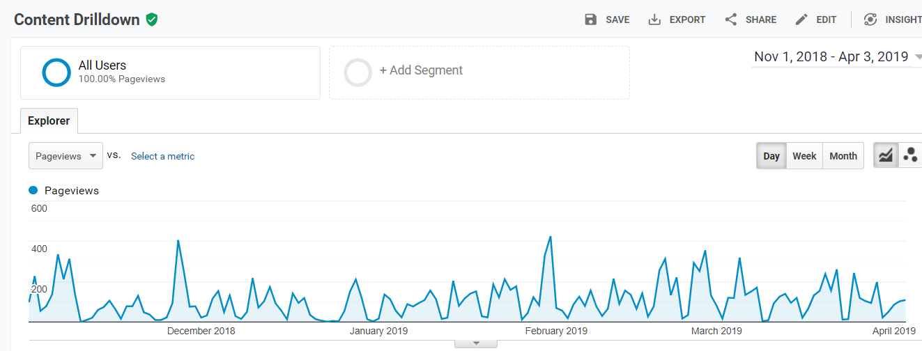

Slide 20
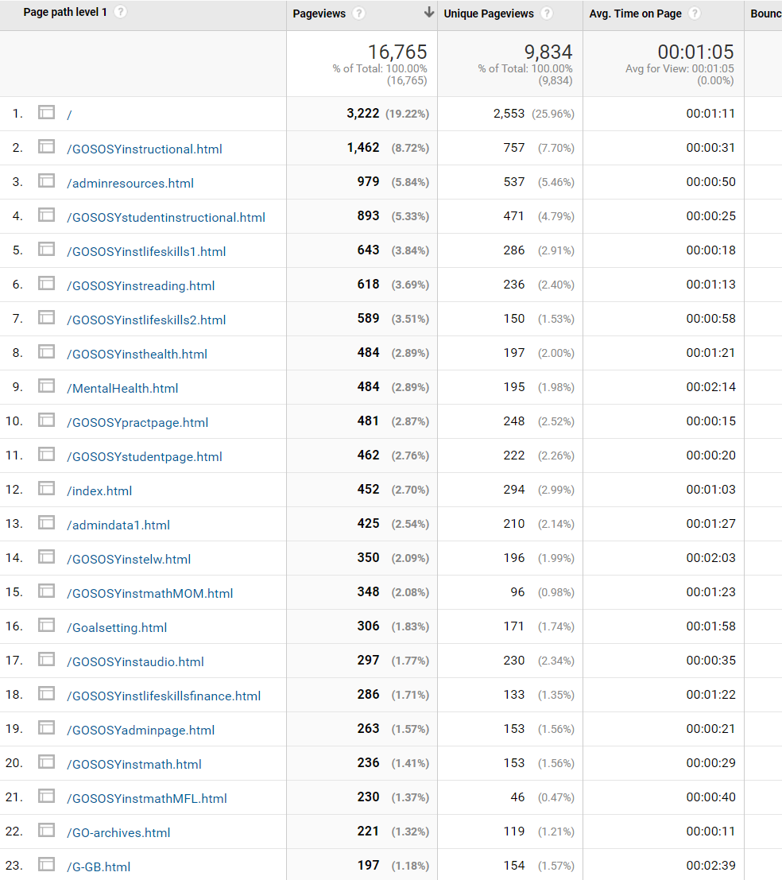

Slide 21
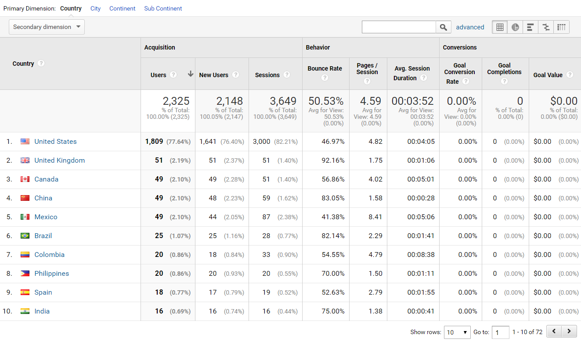

Slide 22
www.osymigrant.org

Slide 23
TOT Follow Up
On a scale of 1 – 10 (least to most important), how important would you rate the issue of mental health in the migrant student community?
What are the top three things you learned from this TOT?
Do you feel better equipped from this TOT to discuss mental health with migrant students?
Do you feel better equipped to explain the issue of mental health in the migrant student community to peers and other parties?
Do you find valuable the TOT resources provided for offering the appropriate assistance to migrant students?
What additional resources would be helpful/more valuable?
What do you believe is the most important next step for GOSOSY’s mental health professional development training?
What do TOT trainers need most for support as they return to their states to host their own training?
www.osymigrant.org

Slide 24
GOSOSY Student Mental Health/ACEs Survey
Mental Health/Trauma Work Group
Includes information about state needs related to:
Mental health needs in migrant student population
Training needs for statewide staff
Barriers to mental health services
Use of GOSOSY Mental Health Life Skill Lessons
Access to appropriate and available resources
Answers will be used to inform the objectives for Year 5 and future materials.
www.osymigrant.org

Slide 25
Mental Health Needs
Purpose: determine the scope of Adverse Childhood Experiences (ACEs) among migratory youth according to MEP service provider perceptions.
Responses: 272 total responses from MEP staff in 23 states. Sixteen (16) of the 18 GOSOSY states responded.
www.osymigrant.org

Slide 26
MEP Staff who Know of Migratory Youth Have Experienced:

Slide 27
Scope of the Issue
Within the previous year, 74% of staff worked with youth who had experienced ACEs.
50% said some or many of the youth they worked with experienced ACEs.
www.osymigrant.org

Slide 28
Impact of ACES
Almost all staff who know that children have ACEs say that the experiences have negatively impacted education.
www.osymigrant.org

Slide 29
Talking About Traumatic Experiences
Staff were mixed regarding when they speak with migratory youth about traumatic experiences.
41% said they spoke with youth sometimes, with other staff reporting more or less communication.
Comments indicated that staff felt these types of discussions were beyond their capabilities and roles as educators.
www.osymigrant.org

Slide 30
Availability of Services
48% of staff indicated mental health services were mostly or almost always unavailable.
Another 27% said services were available about half the time.
www.osymigrant.org

Slide 31
Barriers to Accessing Mental Health Services

Slide 32
Helping Staff Work with Youth
Staff reported that the most beneficial assistance would include:
Training about available mental health resources
Lists of mental health providers for referrals
Training in talking about mental health
Training and networking regarding best ways to work with mental health providers
Strategies for teaching youth who have adverse childhood experiences (ACEs)
www.osymigrant.org

Slide 33
GOSOSY Mental Health Lessons
Most respondents (69%) had not used GOSOSY lessons on mental health.
Between 13% and 22% had used one of the following lessons:
Stress
Alcohol
Depression
Anxiety
Mental Health
www.osymigrant.org

Slide 34
Suggestions Going Forward
Healing from trauma is a long term proposition that is beyond the purview of staff.
Immediate and important steps include:
Assistance in recognizing the impact of trauma on behaviors in educational settings
Training in appropriate responses when personal information is shared
Information about when and how to make referrals that will positively impact youth
www.osymigrant.org

Slide 35
Literature Review: Dropout Prevention
https://padlet.com/sparkedinnovations/DropoutPrevention
www.osymigrant.org

Slide 36
GOSOSY Member State Resource Survey
Interstate Collaboration Work Group
Includes information about state needs related to:
OSY services
Recruitment
Current practices
Most-used languages
Answers will be compiled and shared in online forum available to all states.
www.osymigrant.org

Slide 37
GOSOSY State Member Resources
Survey Responses
www.osymigrant.org

Slide 38
GOSOSY State Member Resource
Survey Responses
28 responses from 17 states
FL, GA, and KS each submitted more than one response
IL, KY, MA, MS, NE, NH, NJ, NY, NC, PA, SC, TN, VT each submitted one response

Slide 39
GOSOSY State Member Resource
OSY Services – Delivery Method

Slide 40
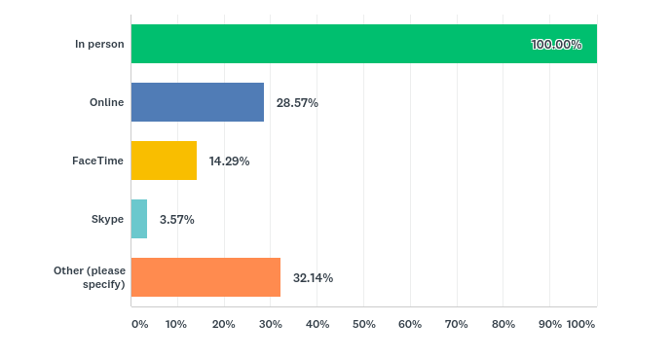
GOSOSY State Member Resource
OSY Services – Modality

Slide 41
GOSOSY State Member Resource
OSY Services – Service Setting

Slide 42
GOSOSY State Member Resource
Access to Services – Is transportation provided to OSY?

Slide 43
GOSOSY State Member Resource
What are your state’s needs related to providing service to OSY?

Slide 44
GOSOSY State Member Resource
Recruitment Setting

Slide 45
GOSOSY State Member Resource
Recruitment Leads

Slide 46
GOSOSY State Member Resource
What are your state’s needs related to recruiting OSY?

Slide 47
Work Group Tasks
Team leads meeting
Assignments given
Check ins
Dates to Tracie
www.osymigrant.org

Slide 48
Agenda- Day 2
8:30 am
Finalize work group reports/action plans
Preview new ESL Resource
Interstate Collaboration and Coordination:
HEP/MEP Presentation
Discussion of GOGOSY Year 5 and the Big Ideas of What’s Next—Marty Jacobson
Work group reports
Goal Setting Facilitator Training Update
Future planning and prep for SST meeting
NASDME presentation overview
Future meeting dates

Slide 49
Year 5 Planning Discussion
https://goo.gl/sGY5Av
www.osymigrant.org

Slide 50
TST Structure and Work Discussion Questions
1. How should the TST be structured to achieve its objectives in Year 5?
2. What are the ideal qualities for TST WG members and team leads?
3. How much time is reasonable to expect each TST WG member to devote to achieving WG goals and objectives?
4. What is the best way to communicate TST efforts and achievements to the SST? Entire organization?
www.osymigrant.org

Slide 51
NASDME Presentations
NASDME sessions:
Creating Trauma-Informed Care and Education of Migrant Students – May 3 1:30-3:00 pm
MEP and HEP: Partnering for Migrant Student Success–May 2 3:30-5:00 pm
www.osymigrant.org

Slide 52
Future Meeting Dates
State Steering Team Meeting dates
October 16, 2019 at IMEC Symposium
Tentative TST Meeting Dates:
Week of November 12
November 13-14– GOSOSY
November 14-15-- IRRC
Week of February 10--
www.osymigrant.org

Slide 53
VOTE!

