Slide 1
GOSOSY Technical Support Team
February 8-9, 2017
Montgomery, AL
www.osymigrant.org

Slide 2
Agenda– February 8
8:30 am- 5:00 pm
Welcome and Introductions – Tracie
Welcome to Alabama and Overview of AL MEP
TST Agenda Review
Discussion of upcoming SST meeting
Updates from GOSOSY – Tracie Kalic and Others
GOSOSY website (Google Analytics)
Updates and suggestions to Student Site
GOSOSY participation at ADM
NASDME presentations
Examination and Discussion of APR data
Training on Professional Development Module 1
Lunch on your own
Expectations of Work Groups and Assignments
Tasks outlined and Work Group time
www.osymigrant.org

Slide 3
Welcome to Alabama
Cyndi Townley, MEP State Director, AL
Peggy Haveard, MEP, State Coordinator, AL
Joyce Bishop, GOSOSY Specialist, AL
www.osymigrant.org

Slide 4
GOSOSY ALABAMA
February 8 and 9, 2017
Montgomery, Alabama

Slide 5
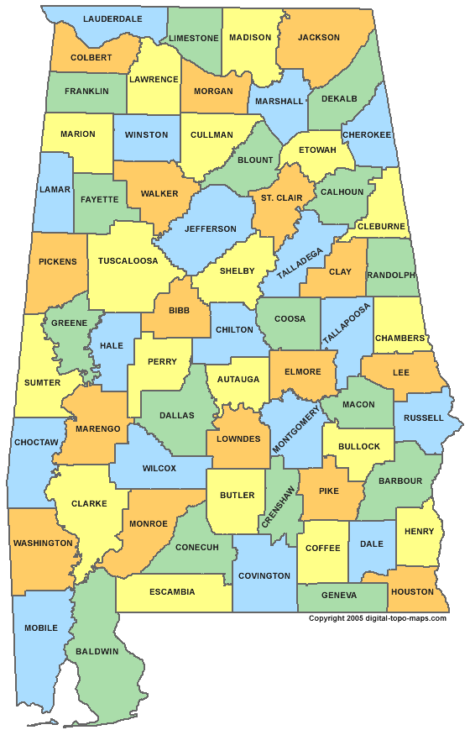
Alabama Counties
OSY Client Services

Slide 6
Mobile County
Classes meet at the Unitarian Universalist Church on Old Shell Road in Mobile. Classes are a part of the outreach of the church allowing ESL classes, GED classes and our GOSOSY classes to be held there on Wednesday evenings. Childcare is provided by volunteers.

Slide 7
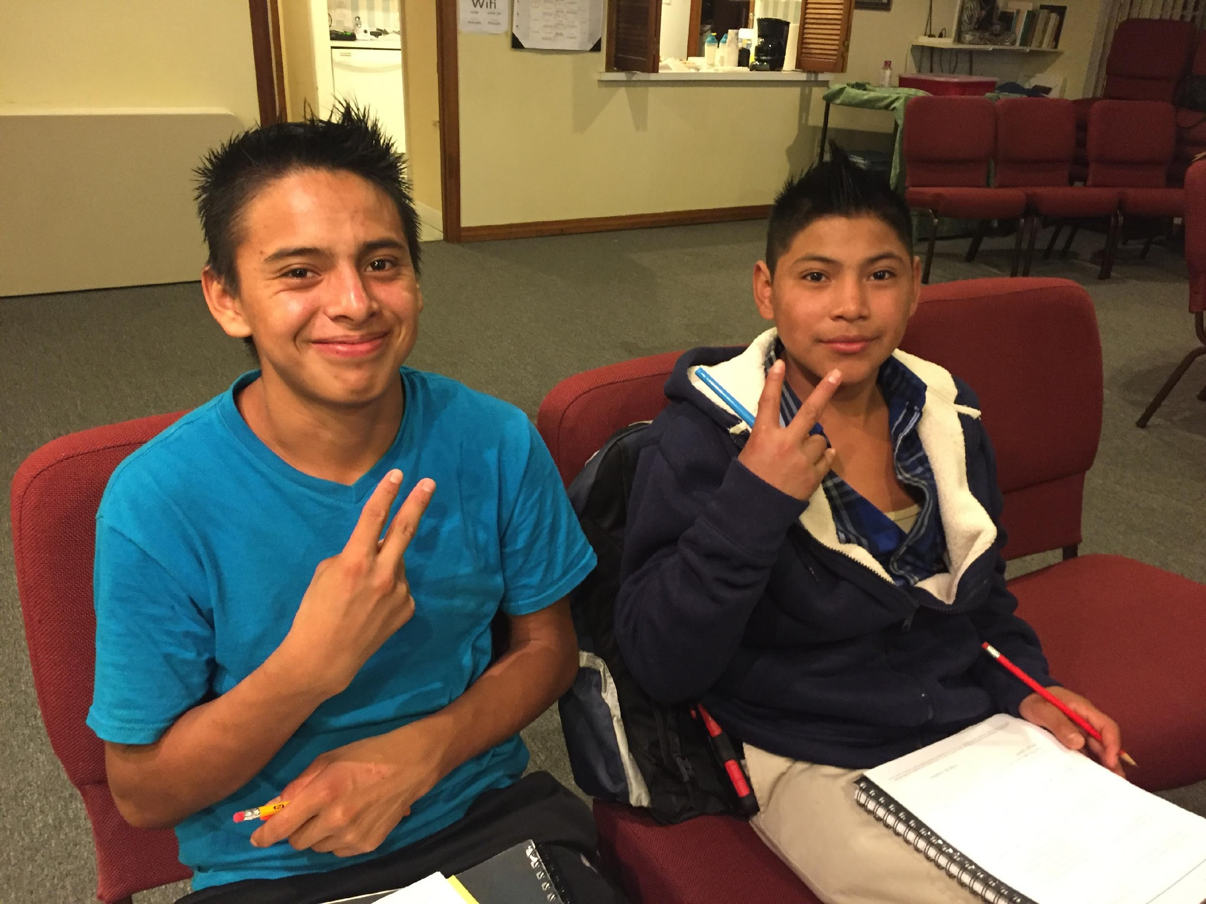
Mobile Class
These young men were recruited on this evening. Their jobs are in landscaping in north Mobile County.

Slide 8
Angie and Yoanna
Teaching the budgeting class from the Financial Literacy Modules.

Slide 9
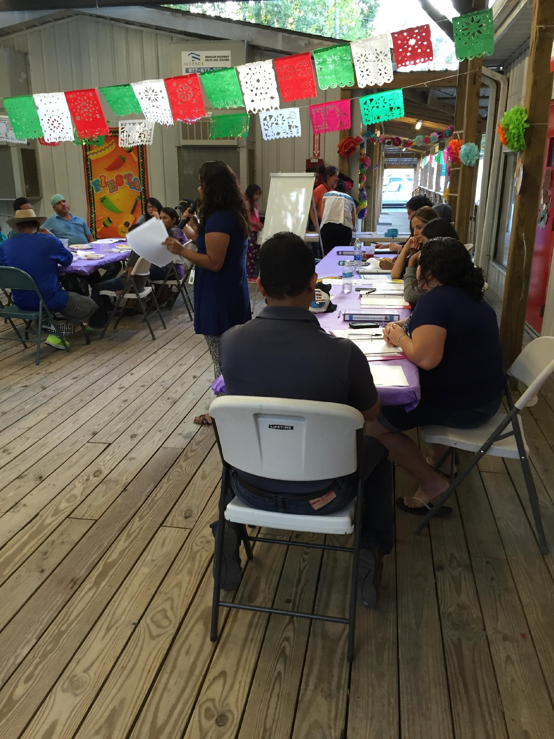
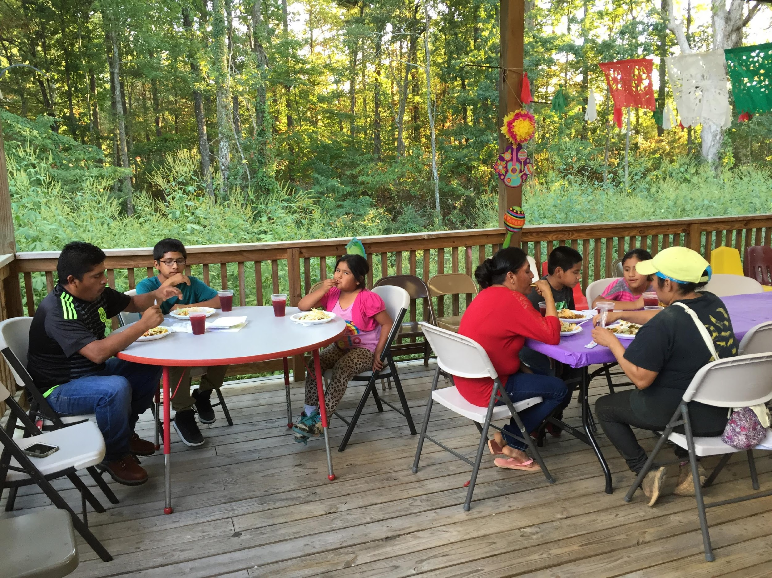
Chilton County- Chandler Mountain

Slide 10
Yolanda from DeKalb County. Recruiting a family and “found” a potential OSY client.

Slide 11
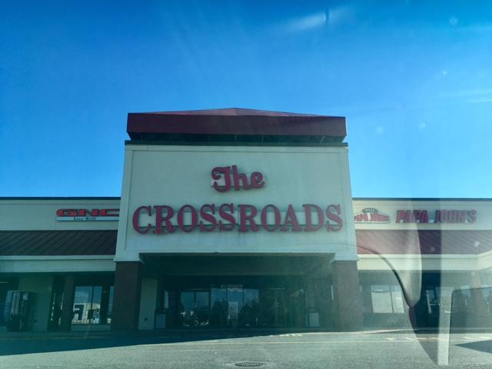
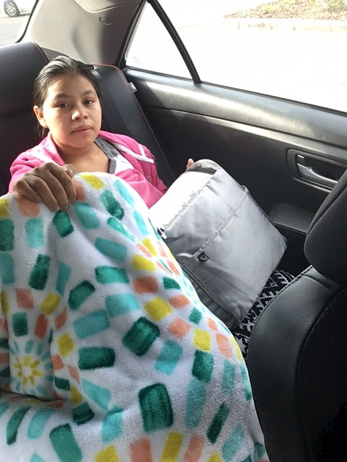

Slide 12
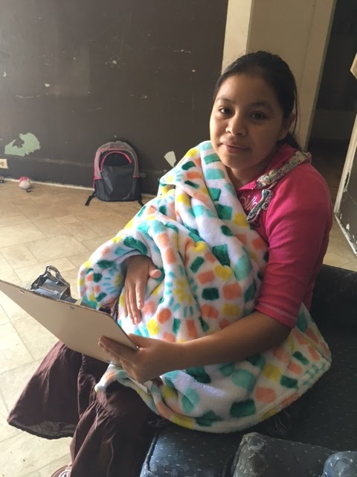
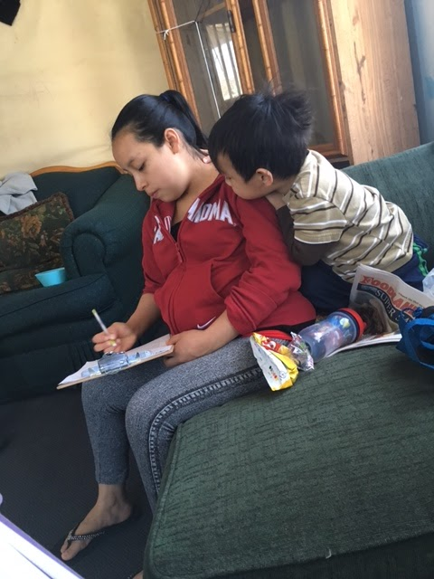
Mini Lessons at home with Maria and Melinda

Slide 13
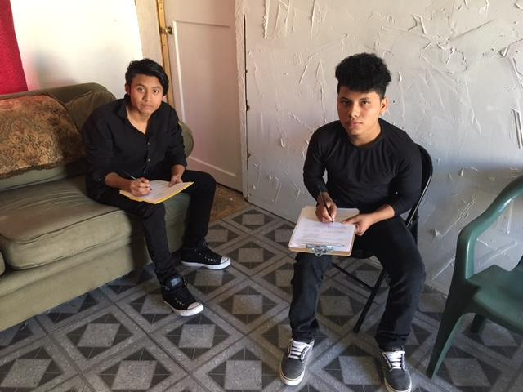
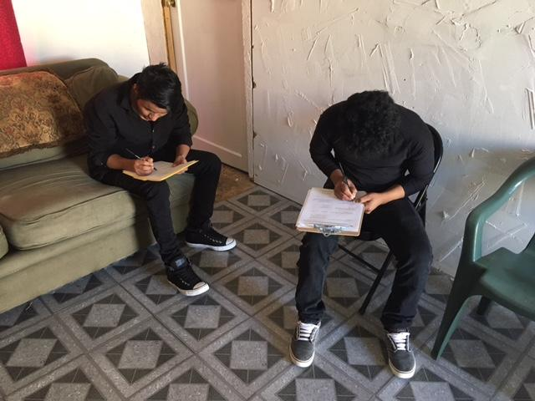
Alex and Mario

Slide 14
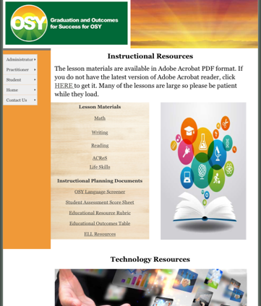
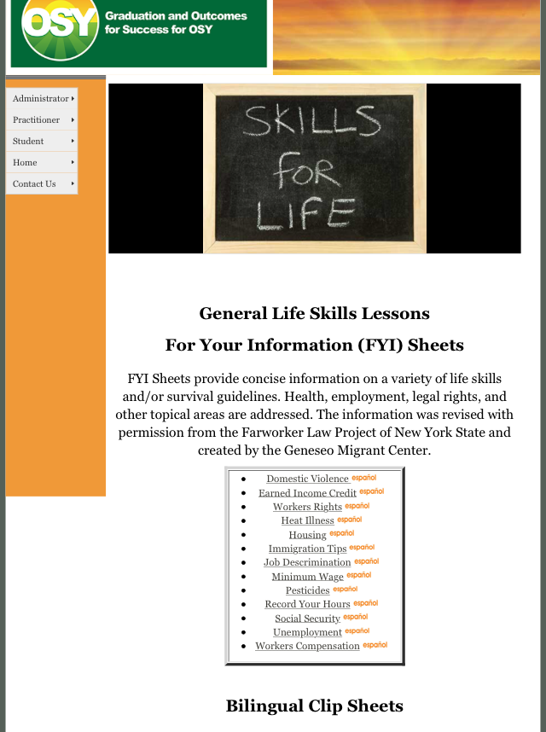
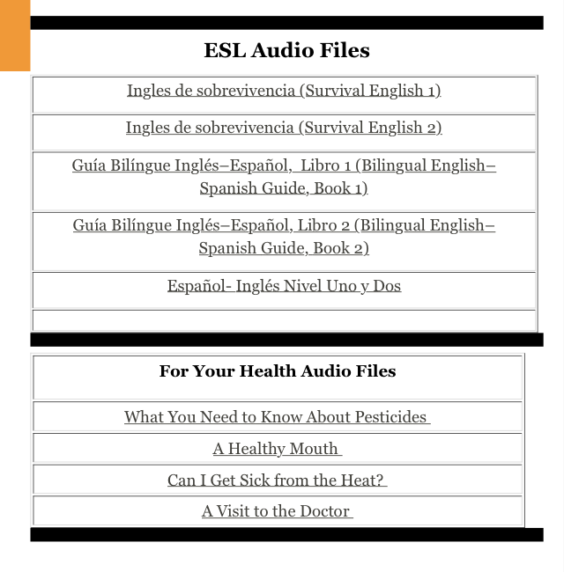
Graduation and Outcomes for Success for OSY

Slide 15
Member States
Alabama
Florida
Georgia
Illinois
Iowa
Kansas
Kentucky
Massachusetts
Mississippi
Nebraska
New Hampshire
New Jersey
New York
North Carolina
Pennsylvania
South Carolina
Tennessee
Vermont
www.osymigrant.org

Slide 16
Partner States
Alaska
Arkansas
California
Colorado
Idaho
Maryland
Minnesota
Missouri
Montana
Oregon
Washington
Wisconsin
www.osymigrant.org

Slide 17
Technical Support Team
Expectations
Membership
State Director expectations
Requirements
3 meetings per year
Conference calls
Work assignments
Team Lead meeting
Collaboration and coordination across groups
Work Norms
Be fully committed to the work and will demonstrate this commitment by meeting agreed upon deadlines, participating/attending meetings and calls until outcomes/goals are fully met.
Leave each meeting with tangible products/achievements synthesizing our meeting outcomes.
Use included reflection time to promote spontaneous, creative discussion.
www.osymigrant.org
Notes:
Purpose- responsibilites
Who to send?
Mentoring Pilot- World Education
Tracie will ask MA, TN, VT, GA, and CA
Mental Health-- KS
Goal Setting – TOT Work Group – Sonja Williams (lead)—Ernesto?
PD- Develop training to certified and non-certified staff – Jessica Castaneda (Lead)
ID&R – in collaboration with IRRC—Jennifer Almeda (lead)
Develop web-accessible lessons- Material Development—Bob Lynch and Brenda Pessin-- leads
With support and guidance from World Ed – Andy Nash
OSY Learning Plan—Emily Hoffman
With Steve Quonn

Slide 18
Work Groups
OSY Learning Plan
Goal Setting
Professional Development
Material and Curriculum Development
Identification and Recruitment
OSY Literature Review
www.osymigrant.org
www.osymigrant.org

Slide 19
Expectations of Our Time
Provide feedback on agenda items, including lesson drafts and material development
Complete work group tasks, outline timelines, and establish follow-up conference calls
Review APR data and the GOSOSY performance measures
Prepare for SST materials
Finalize the participants on the TST Dissemination Event Committee and discus structure of event
www.osymigrant.org

Slide 20
GOSOSY Updates
GOSOSY SST Meeting– March 6, 2017
Round table discussion at ADM– March 8, 2017
OME Monitoring– February 14, 2017
NASDME proposals
GOSOSY Website Updates
Google Analytics
discussion of student site
Year 2 Fidelity Implementation Index Review
www.osymigrant.org

Slide 21
GOSOSY Website Updates
www.osymigrant.org

Slide 22
Google Analytics
A review of the GOSOSY site between November to January 2017
www.osymigrant.org

Slide 23
Overview of Sessions & Users on GOSOSY site

Slide 24
What countries are people from that are visiting the site….

Slide 25
Active Users

Slide 26
Demographics

Slide 27
Engagement

Slide 28
Devices

Slide 29
Where they are going to on the site

Slide 30
Where they are going to on the site

Slide 31
Updating the Student Section
Of the GOSOSY Website

Slide 32
We want to ensure the student section is accessed and used by OSY
Currently there are a lot of hits on the first page of the STUDENT section but it doesn’t go much farther than that.
We are pretty sure no OSY are accessing it.
Need to change these trends.
www.osymigrant.org

Slide 33
What should be housed on the site?
We need to ensure they meet the needs of OSY.
Resources need to be relevant and updated as needed.
We need to find the most valuable sites and resources to share.
The site needs to be something that instructors can refer their students to.
www.osymigrant.org

Slide 34
Can you think of specific resources you think should be included in this section?
Should the site be in multiple languages?
Should there be separate pages for each language?
What specific content should be included?
www.osymigrant.org

Slide 35
What we know OSY Usually Request…
ELL Resources
Life Skills
Health Information
GED/HiSET
We have compiled a resource of many helpful sites that we can include in the student section.
We would like your feedback.
www.osymigrant.org

Slide 36
www.osymigrant.org

Slide 37
Year 2 Fidelity Implementation Index
www.osymigrant.org

Slide 38
Objective 1: Achievement & Learning Plans
Outcome | Measurement Tool | Timeline
1.1 75% of OSY participating in project-directed instructional services will demonstrate a 20% average gain between pre/post | Student Assessment Score Sheet (SASS) available on osymigrant.org | Annually, Year 1 data due in September 2016
1.2 75% of OSY with a Learning Plan will attain an average of 50% of the learning/achievement objectives | Learning Plan Templates will be available by 5/15/16 on osymigrant.org | Annually, Year 1 data due in September 2016
1.3 Attendance by 54 OSY (consortium wide) at Goal Setting Workshops and attain acceptable or above average score on GSW rubric | Verified Attendance Rosters; Goal Setting Workshop Rubric available by 6/15/16 on osymigrant.org | Annually, Year 1 data due in September 2016
www.osymigrant.org
Notes:
The SOSOSY Training Manual has been designed to assist states in the development of systems to support Out-of-School Youth. SOSOSY Training Manual has been created to assist states in creating a system to identify, recruit and provide services to OSY. This document serves as a workbook for states to develop or improve their current services and support programs for OSY. It outlines the steps to gather and analyze OSY data, plan for service delivery, access best practices in curriculum and instruction, as well as create education plans and address advocacy needs of the OSY population.

Slide 39
Objective 2: Professional Development
Outcome | Measurement Tool | Timeline
2.1 75% of staff completing PD increase skills by 10% between pre- and post-assessment | Staff Skills Assessment available on osymigrant.org by 1/30/16 | Annually, Year 1 data due in September 2016
2.2 75% of states average of 5 PD/mentoring collaborations | Director/Coordinator Form on osymigrant.org | Annually, Year 1 data due in September 2016
2.3 75% of recruiters tested achieve “proficient” on OSY ID&R skills assessment | ID&R Skills Test developed in collaboration with ID&R consortium | Annually, Year 1 data due in September 2016
www.osymigrant.org
Notes:
The SOSOSY Training Manual has been designed to assist states in the development of systems to support Out-of-School Youth. SOSOSY Training Manual has been created to assist states in creating a system to identify, recruit and provide services to OSY. This document serves as a workbook for states to develop or improve their current services and support programs for OSY. It outlines the steps to gather and analyze OSY data, plan for service delivery, access best practices in curriculum and instruction, as well as create education plans and address advocacy needs of the OSY population.

Slide 40
Objective 3: State Processes
Outcome | Measurement Tool | Timeline
3.1 Five products developed/ adapted/vetted/adopted by 18 states | Quality of Implementation Tool available by 9/30/2017 | Year 3, QI due by 9/30/2018
3.2 GOSOSY Dissemination Event (DE) for 200+ staff is planned, implemented, evaluated | Dissemination Event survey in Year 3 | End of Year 3
www.osymigrant.org
Notes:
The SOSOSY Training Manual has been designed to assist states in the development of systems to support Out-of-School Youth. SOSOSY Training Manual has been created to assist states in creating a system to identify, recruit and provide services to OSY. This document serves as a workbook for states to develop or improve their current services and support programs for OSY. It outlines the steps to gather and analyze OSY data, plan for service delivery, access best practices in curriculum and instruction, as well as create education plans and address advocacy needs of the OSY population.

Slide 41
APR Highlights
71% of OSY received services (5% increase)
835 OSY demonstrated a 20% gain on post assessments (84.5%)
184 training sessions to service providers and staff (2366 participants- duplicated count)
www.osymigrant.org

Slide 42
APR Data and GOSOSY Objectives
Does the data tell the whole story? Please review your data.
What does the data tell us about how your state is providing services to OSY?
What are your state’s strengths and challenges based upon the data review?
Thinking about service delivery in your state, what are the challenges you face to provide meaningful implementation and positive learning experiences? How is your state working to overcome the challenges?
As a result of reviewing your state’s data, how can the Consortium and the work of the TST help your state move forward in improving the quality of services to all identified OSY in your state?
www.osymigrant.org

Slide 43
Professional Development
GOSOSY Professional Development for OSY Instructors:
Implementing the OSY Instructional Action Plan
www.osymigrant.org

Slide 44
Acknowledgements
GOSOSY Professional Development Group and Contributors
Lysandra Alexander (PA); Susanna Bartee (KS); Joan Geraci (NJ); Lori Houck (KS); Lindsay Ickes (NE); Tracie Kalic (KS); Hillary Maitlen (TN); Sabrina Pineda (GA); Kiowa Rogers (NE); John Wight (GA).
Kansas MEP: John Farrell, Paige Inman and John Fink.
GOSOSY PD Reviewers and Technical Support Team members and the State Steering Support Team
www.osymigrant.org

Slide 45
Introduction to the OSY Instructional Action Plan
www.osymigrant.org

Slide 46
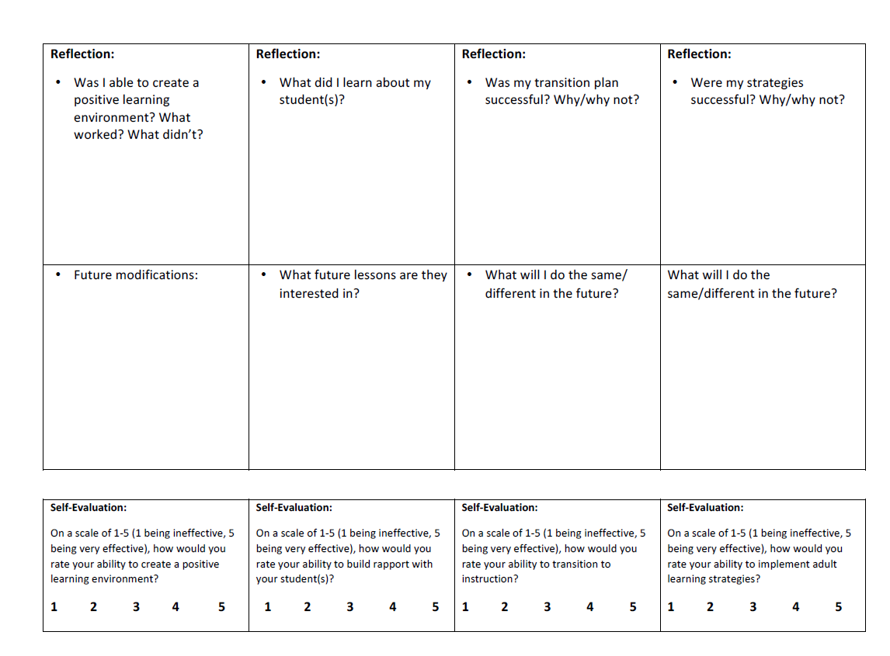
Introduction to the OSY Instructional Action Plan Continued
www.osymigrant.org

Slide 47
Main Components OSY Instructional Action Plan
STEP 1
Creating an Effective Learning Environment
STEP 2
Building Rapport
STEP 3
Transition to Instruction
STEP 4
Young Adult Learning Strategies
www.osymigrant.org

Slide 48
Step 1: Creating an Effective Learning Environment
Guiding Questions: | Tips:
Where may you conduct the lesson? What distractions or challenges may you encounter? How will you address these? | Find an effective location Minimize distractions (turn off TV, phones, radio, etc.) Have supplies readily available for use Ensure there is proper lighting
www.osymigrant.org

Slide 49
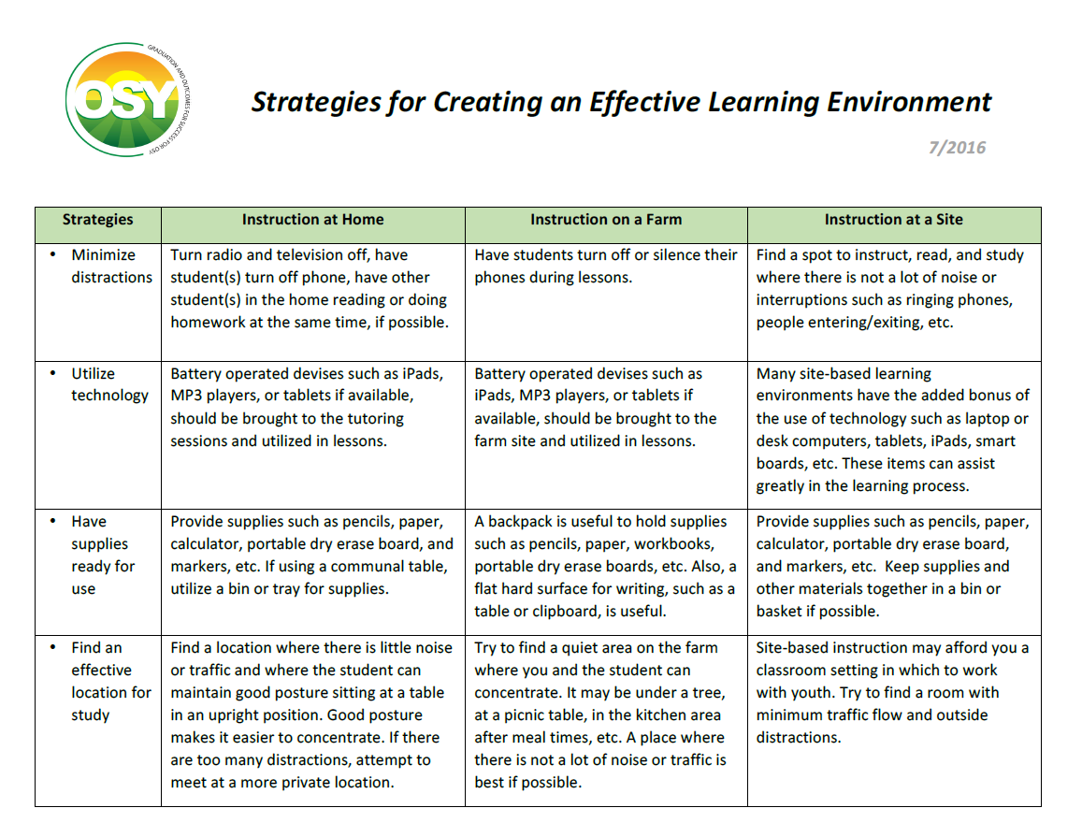
Step 1: Creating an Effective Learning Environment
For the full document, see Strategies for Creating an Effective Learning Environment Resource Guide
www.osymigrant.org
Notes:
In Voiceover, point out that this is a screenshot of the resource guide for Step 1: Creating an Effective Learning Environment

Slide 50
Stop-and-Do: Step 1
www.osymigrant.org
Notes:
Change fillable form to effective
Introduce the concept of actively participating… refer to OSY Instructional Action Plan
Explain Stop and Do.

Slide 51
Stop-and-Do: Step 1
Describe what you would do to create an effective learning environment on a farm:
Where may you conduct the lesson?
What distractions or challenges may you encounter?
How will you address these?
www.osymigrant.org
Notes:
Explain pencil?

Slide 52
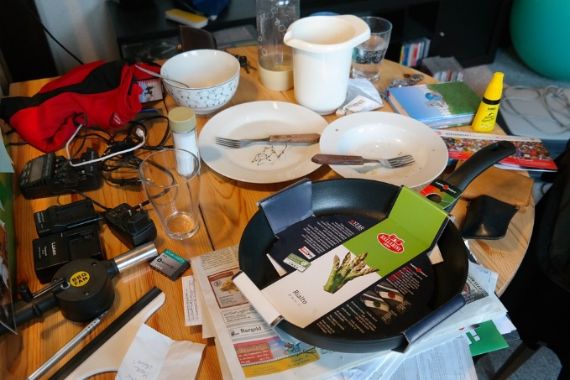
Effective Learning Environment In Summary…
Minimize Clutter
Minimize Distractions
Have Supplies
Ready for Use
Ensure Proper Lighting
Utilize Technology
www.osymigrant.org
Ensure Proper Lighting

Slide 53
Step 2: Building Rapport
Guiding Questions: | Tips:
What conversation starters/questions will you use to build rapport with OSY? What are specific lessons that would be helpful/applicable for the OSY? | Ask student(s): What is something you would like to learn more about? Why? What is an activity or subject that you never get tired of talking about? If you have time and resources to achieve your dreams, what would your dreams be?
www.osymigrant.org

Slide 54
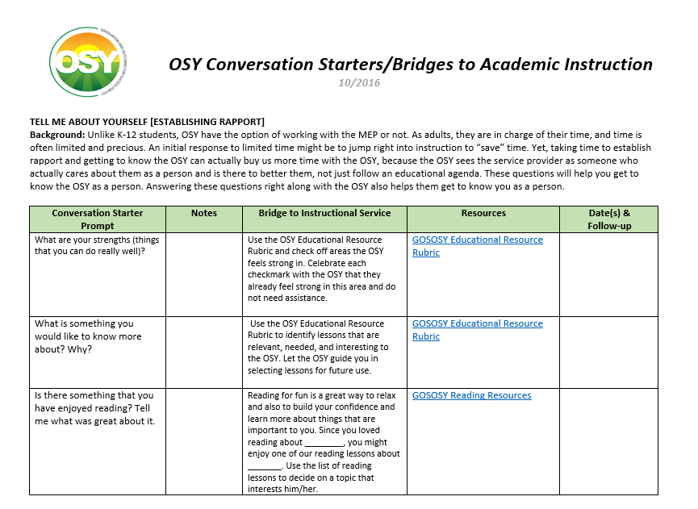
Step 2: Building Rapport
For more information, see OSY Conversation Starters/Bridges to Academic Instruction Resource Guide
www.osymigrant.org
Notes:
Explain that step 2 is all about conversation starters and will lead to bridge to instructional services in step 3

Slide 55
Stop-and-Do: Step 2
www.osymigrant.org
Notes:
Change fillable form to effective

Slide 56
Stop-and-Do: Step 2
Describe what you would do to build rapport prior to instruction with a youth who needs motivation:
What conversation starters/questions will you use to build rapport with OSY?
Use this time to determine if there are specific lessons that would be helpful/applicable.
www.osymigrant.org

Slide 57
Building Rapport In Summary…
What is something you would like to learn about?
What are your dreams for the future?
?
?
?
What interests you?
www.osymigrant.org
Ensure Proper Lighting

Slide 58
Step 3: Transition to Instruction
Guiding Questions: | Tips:
How will you transition from the rapport building to the instructional lesson? | Review material from previous lesson Relate lesson to the interest expressed in previous conversations Create interest and enthusiasm in the topic you’re about to present
For more information, see OSY Conversation Starters/Bridges to Academic Instruction Resource Guide
www.osymigrant.org

Slide 59
Step 3: Transition to Instruction
For more information, see OSY Conversation Starters/Bridges to Academic Instruction Resource Guide
www.osymigrant.org
Notes:
Explain that step 2 is all about conversation starters and will lead to bridge to instructional services in step 3

Slide 60
Stop-and-Do: Step 3
www.osymigrant.org
Notes:
Change fillable form to effective

Slide 61
Transition to Instruction In Summary…
instruction
Create interest and enthusiasm
Review content
interests
Relate to interests
www.osymigrant.org
Ensure Proper Lighting

Slide 62
Stop-and-Do: Step 3
Describe what you would do to transition from building rapport to instruction with the student:
How will you redirect the conversation from being informal to introduce and begin your lesson?
www.osymigrant.org

Slide 63
Step 4: Young Adult Learning Strategies
Young Adults Learn: | Tips:
When they want to or feel a need to learn When learning is practical and related to real life By doing/experiencing In a variety of ways | Make sure the lesson is relevant and useful to the student Provide immediate practice and feedback Adjust learning to the student’s needs/level Incorporate as many senses as possible
www.osymigrant.org
Notes:
Give examples of senses in voiceover–
Young Adults Learn:
Tips:
In a variety of ways
Visual (through looking at materials)
Auditory (through hearing)
Kinetic (through movement)
Present ideas in different ways
Some repetition is OK
Incorporate as many senses as possible in a lesson (e.g. looking, hearing, using hands-on materials)
Encourage interaction
Incorporate Technology, when possible (tablet, smartphone, etc.)
By Doing
If youth are actively involved in the process, they:
Learn quicker
Retain the information
Relate learning to what they know
Provide immediate practice and feedback
Use graphic organizers and other visuals
Use frequent comprehension checks
Adjust learning to the student’s needs/level

Slide 64
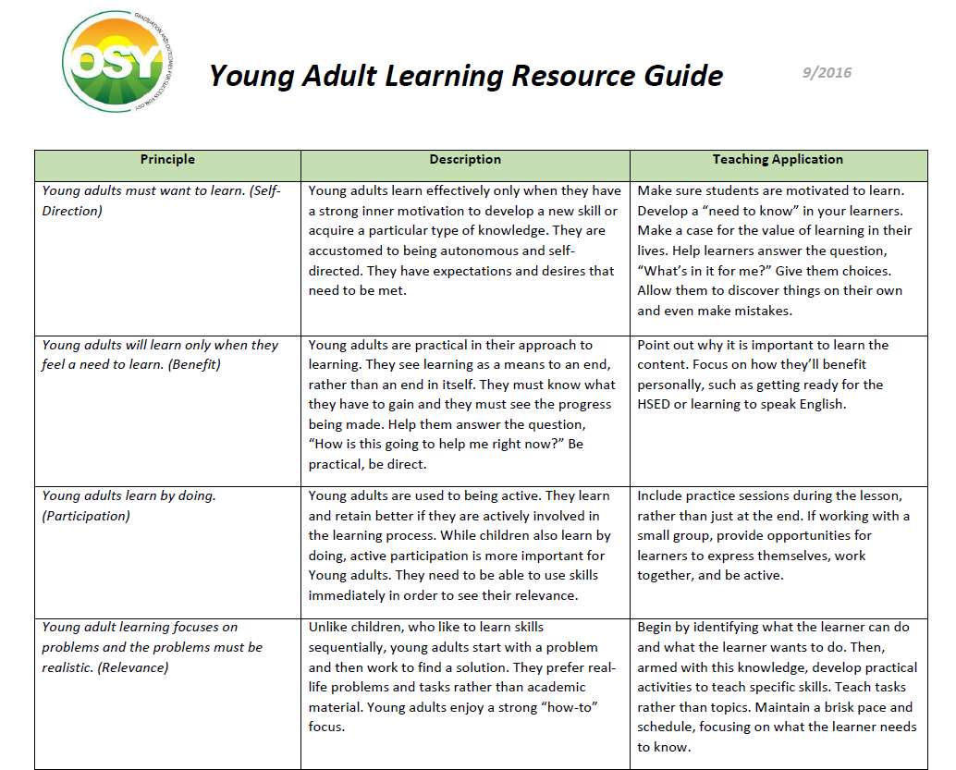
Step 4: Young Adult Learning Resource Guide
For the full document, see Young Adult Learning Resource Guide
www.osymigrant.org
Notes:
Explain that step 2 is all about conversation starters and will lead to bridge to instructional services in step 3

Slide 65
Stop-and-Do: Step 4
www.osymigrant.org
Notes:
Change fillable form to effective

Slide 66
Stop-and-Do: Step 4
Describe what young adult learning strategies you would use in a Life Skill Lesson on basic calendar skills:
Identify the specific learning strategies you plan to use.
Where and how will you implement these strategies?
www.osymigrant.org

Slide 67
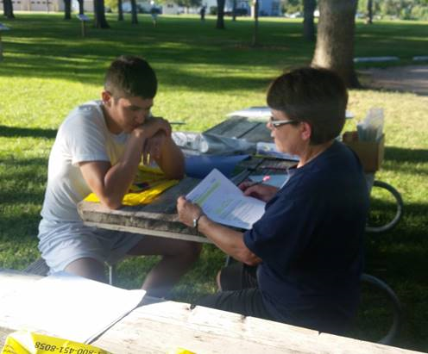
Learning Strategies In Summary…
Relevant and Useful
Adjust to meet needs
instruction
Incorporate many senses
Practice and Feedback
interests
www.osymigrant.org
Ensure Proper Lighting

Slide 68
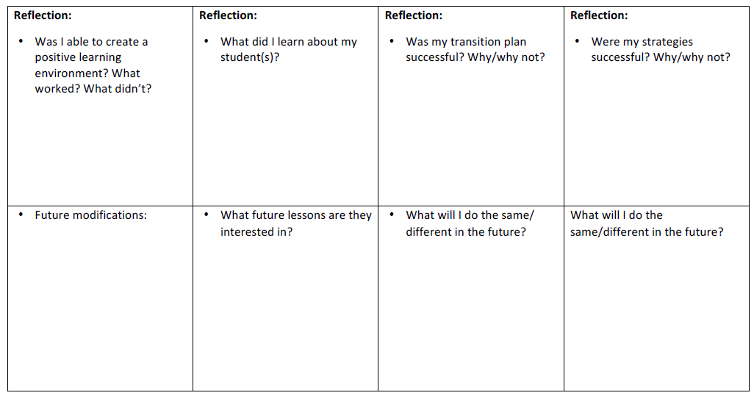
OSY Instructional Action Plan Reflection
Review the questions in the reflection section to evaluate the success of your lesson and determine future modifications.
www.osymigrant.org

Slide 69
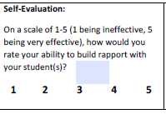
OSY Instructional Action Plan Evaluation
Self Evaluation:
On a scale of 1-5, how would you rate your ability to…
Create a positive learning environment?
Build rapport with your student(s)?
Transition to instruction?
Implement young adult learning strategies?
www.osymigrant.org
Notes:
Explanation of scale 1 being…

Slide 70
General Tips: Planning
Be Prepared, organized and consistent
Make sure you know the student level:
English Language
Identify and frontload essential vocabulary
As related to the topic/subject
Last grade attended in home country or in US
Understand that each student is different
Understand that students have various personalities, learning styles and attention spans
www.osymigrant.org
Notes:
Planning ahead before you move ahead with instruction… here’s what you would do

Slide 71
General Tips: Lesson Activity Essentials
Preparation
Have materials ready
Prepare copies in advance
Have technology ready to be utilized
Pacing
Know the length of the lesson
Know how long each activity takes
Know how to adjust lesson on-the-fly
Creating a Positive Learning Environment Wherever you are
Encourage student participation
Engage your student
Recognize and commend OSY on effort and progress
www.osymigrant.org
Notes:
Use this as a mini-summary or highlights—quick overview

Slide 72
General Tips: Materials
What Do You Need to Implement the Lesson You Designed?
On Hand:
Books, magazines, articles
Websites and other online resources
Paper, pencils, pens, markers, crayons, scissors
Copies of all handouts
Need to Requisition/Purchase Ahead of Time
Projector
Hot spot
Computers
Lesson specific needs (games, cards, marbles, beakers, etc.)
White boards, dry erase markers, erasers
www.osymigrant.org
Notes:
Shameless plug GOSOSY– life skill lessons, etc.

Slide 73
Closing: OSY Instructional Action Plan
For more information, see Sample OSY Action Plan
www.osymigrant.org
Notes:
Now that you’ve completed the action plan…select a student with whom you’ve been working and develop an action plan.

Slide 74
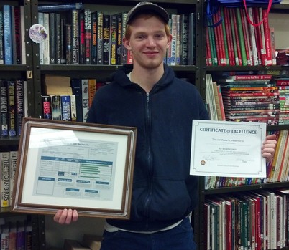
Success in Action
“Every new lesson offers another step to success”
- Terry Mark
www.osymigrant.org

Slide 75
Participant Feedback
Fill out the Survey Monkey:
How will you be using this with your youth?
Will it be helpful?
What would you include?
www.osymigrant.org

Slide 76
Work Group Assignments: Material and Curriculum
Review and revise LIA current lesson
Outline LIA lessons for this year
Set up pilot for LIA/parameters and possible states
Review pilot comments from Life Skills lessons/next steps
Discuss need for post secondary/career awareness piece
Review of final MH lesson
Review comments on lessons
Work with ALRC to determine lessons to use
Disseminate the MH lessons
NASDME presentation
ADM/format change
www.osymigrant.org

Slide 77
FII Links
1.1 g Pilot a beginning ESL series of lessons for OSY
1.1.h Conduct post-secondary and career awareness activities

Slide 78
Work Group Assignments: Professional Development
Review comments from TST members to finalize Module 1
Plan how we want to disseminate the PD module
Begin development of Module 2
Outline tasks and make assignments
www.osymigrant.org

Slide 79
FII Links
2.1 b Provide TA on designing services to OSY through TST work groups
2.1 c Convene the TST for instructional staff PD material development
2.1 d Continue creation of materials for certified and non-certified staff

Slide 80
Work Group Assignment: ID&R
Finalize OSY ID&R materials and discuss dissemination strategy
Review professional development video
Discuss how to continue partnering with IRRC for training (OSY in the field training)
Discuss Dissemination Event
Assign tasks and deadlines
www.osymigrant.org

Slide 81
FII Links
2.3 a Update OSY recruiter skills competency materials
2.3 b Collaborate/conduct OSY in-the-field recruiter trainer (with IRRC)
2.3 c Administer OSY recruiter skills competency tools (with IRRC)

Slide 82
Work Group Assignment: OSY Learning Plan
Finalize OSY Learning Plan (OLP)
Plan for integrating OLP with Goal Setting group
Plan training and develop any necessary materials
Discuss how materials will be shared at SST meeting
www.osymigrant.org

Slide 83
FII Links
1.1e Review results from Learning Plan templates
1.2 a Update the OSY Learning Plan template
1.2b Work with OSY to complete the Learning Plan

Slide 84
Work Group Assignment: Goal Setting
Develop pacing guide
Finalize training materials and manual
Plan for work with OSY Learning Plan group
Review mastery activity
Discuss and review Voice Thread
www.osymigrant.org

Slide 85
FII Links
1.3a Convene work groups to plan GSW
1.3 b Arrange logistics
1.3 c Train facilitators for GSW
1.3 d Design a mastery activity
1.3 e Conduct GSWs

Slide 86
OSY Literature Review
Review relevant research and determine what to include in lit review
Discuss the format of lit review
Create dissemination plan of the review and materials
Discuss any possible tie-in with mental health lessons
www.osymigrant.org

Slide 87
www.osymigrant.org

Slide 88
Agenda- February 9
Individual State OSY data review
Interwork group Assignments and conference calls
Networking and discussion
SST Reporting Assignments
Work group report outs
Dissemination Event planning and organization
Meeting dates finalized
www.osymigrant.org

Slide 89
State OSY Data
www.osymigrant.org

Slide 90
Interwork Group Networking
PD and Curriculum
Goal Setting and OSY Learning Plan
www.osymigrant.org

Slide 91
TST Networking Discussion
www.osymigrant.org

Slide 92
Dissemination Event Updates
FL, IL, KS, KY, MA, NE, NH, NJ, NC, TN
Meeting with IRRC and PI
Working on registration process
Fee
www.osymigrant.org

Slide 93
Future Meeting Dates
Future Meetings:
Spring meeting: April 5-6, 2017, Chicago, IL
Team Lead Conference Calls: scheduled prior to next meeting
www.osymigrant.org

