Slide 1

GOSOSY Technical Support Team Meeting
April 11-12, 2018
Saratoga Springs, NY
www.osymigrant.org

Slide 2
Agenda April 11, 2018
Welcome and Introductions – Tracie
Welcome to New York and Overview of NY MEP
TST Agenda Review and Expectations for Our Time
Updates from GOSOSY – Tracie Kalic and Others
Future Planning—Marty Jacobson
Discussion and feedback on Professional Development Module
Discussion of and feedback on ACeS Strategies for Supporting OSY
Lunch on your own
Expectations of Work Groups and Assignments and Tasks outlined/ Work Group time
www.osymigrant.org

Slide 3
www.osymigrant.org

Slide 4
GOSOSY Updates
SST Meeting on March 4
Latest newsletter
Planning for the future
Google analytics
www.osymigrant.org

Slide 5


Google Analytics
January 1, 2018 to March 29, 2018
GOSOSY Site
www.osymigrant.org

Slide 6
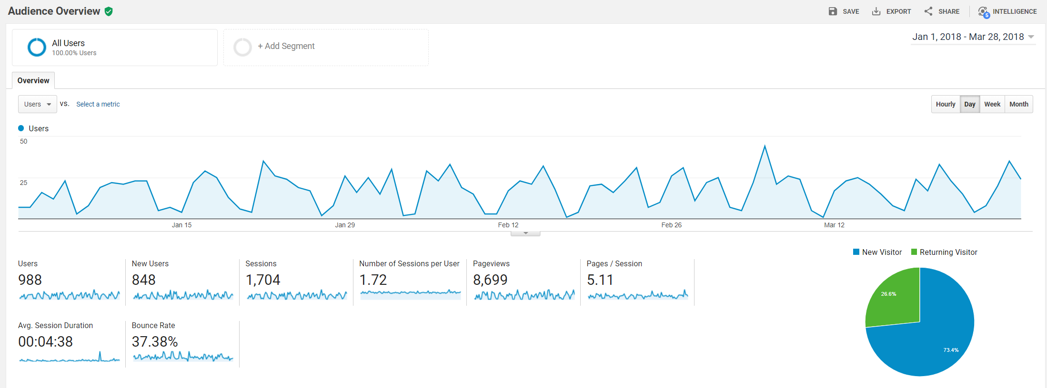
Site Audience Overview
www.osymigrant.org

Slide 7
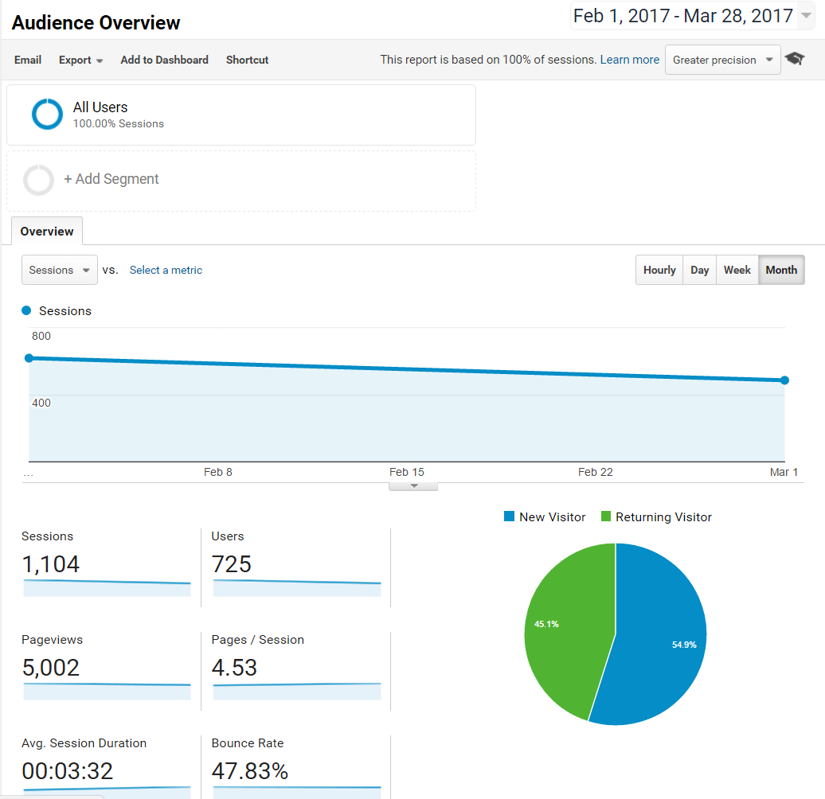
Overview of sessions & users on GOSOSY site- last year
www.osymigrant.org

Slide 8
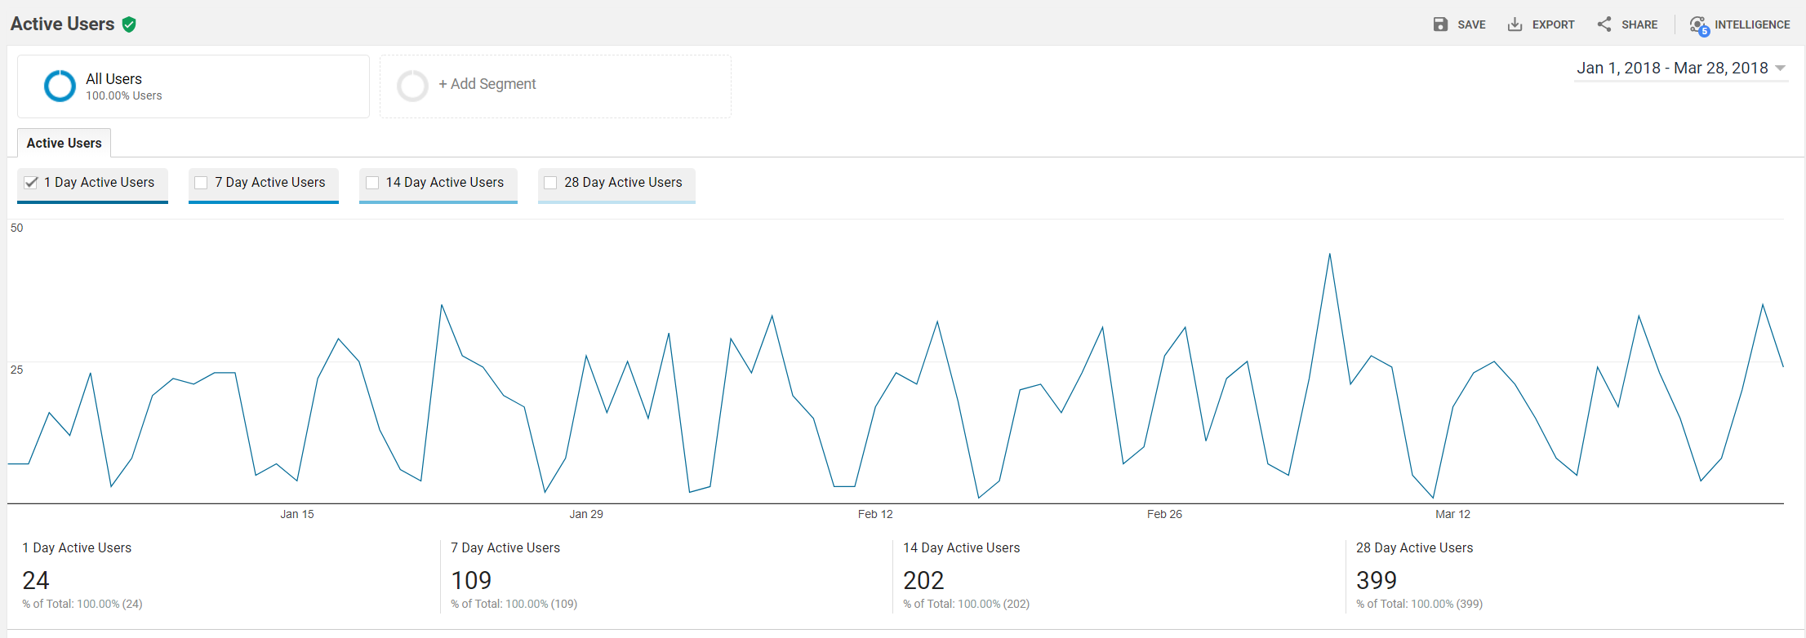
Active Users
www.osymigrant.org

Slide 9
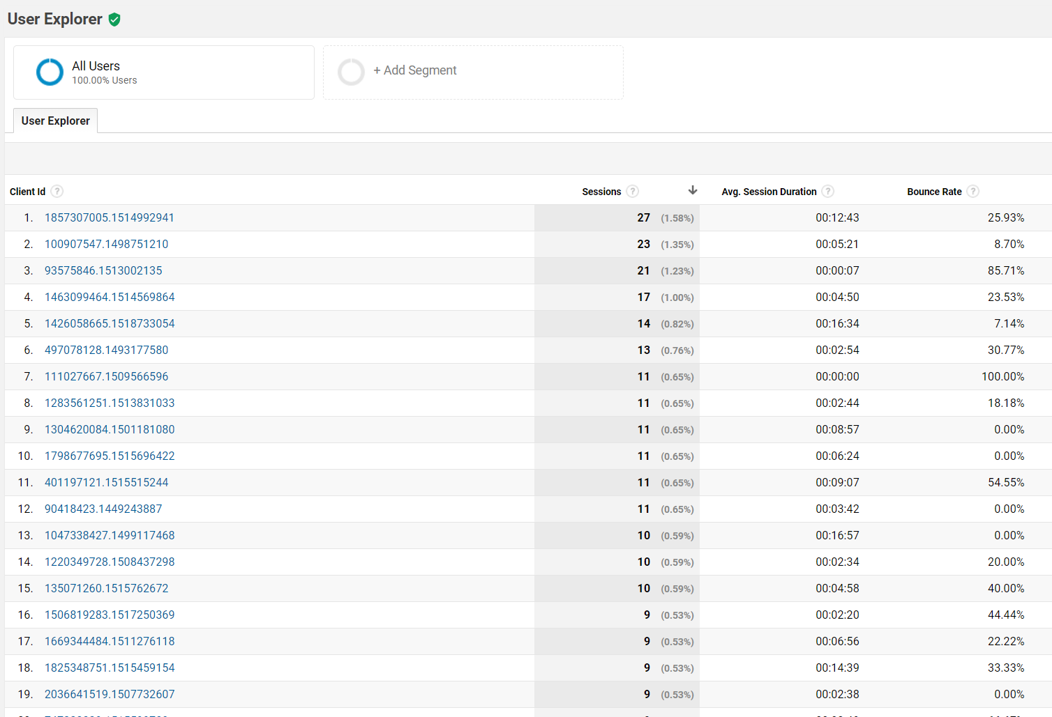
All the way to IP address??!?

Slide 10
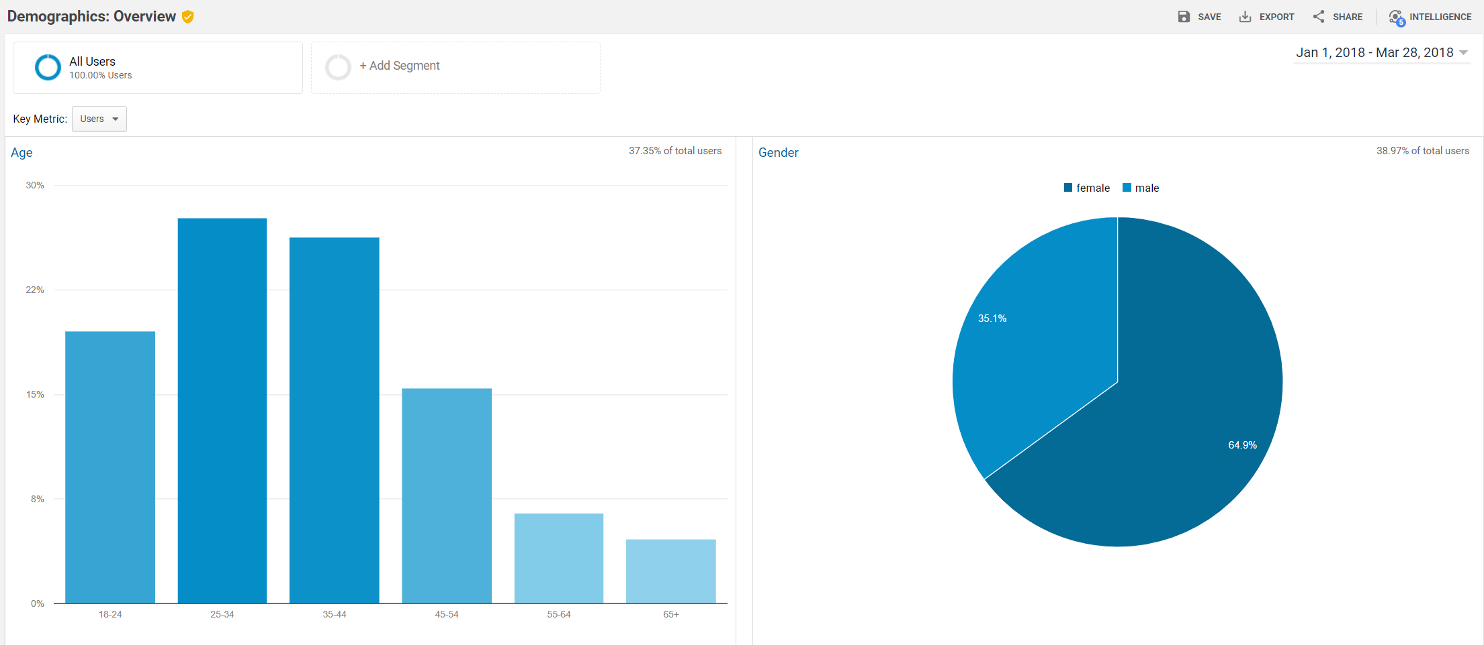
Demographic Overview
www.osymigrant.org

Slide 11
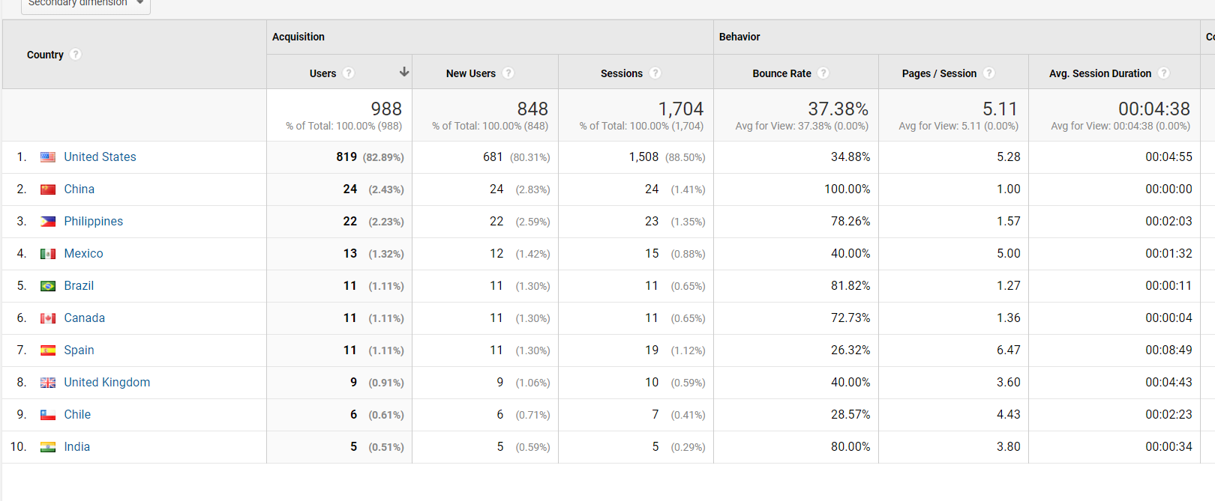
Our audience comes from:
www.osymigrant.org

Slide 12
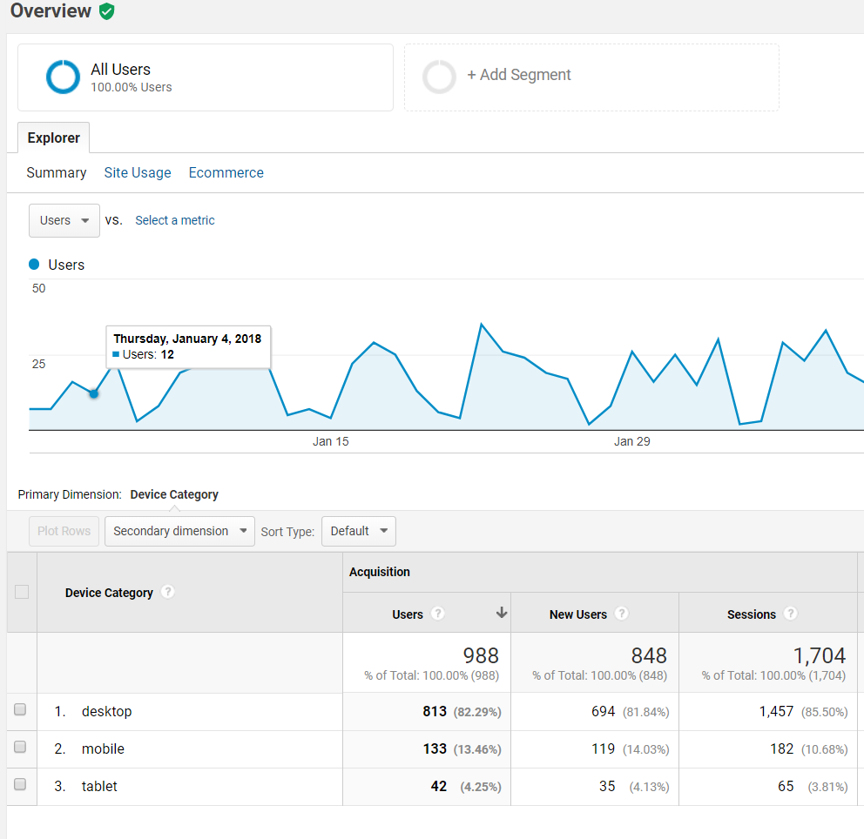
What devices they are using
www.osymigrant.org

Slide 13
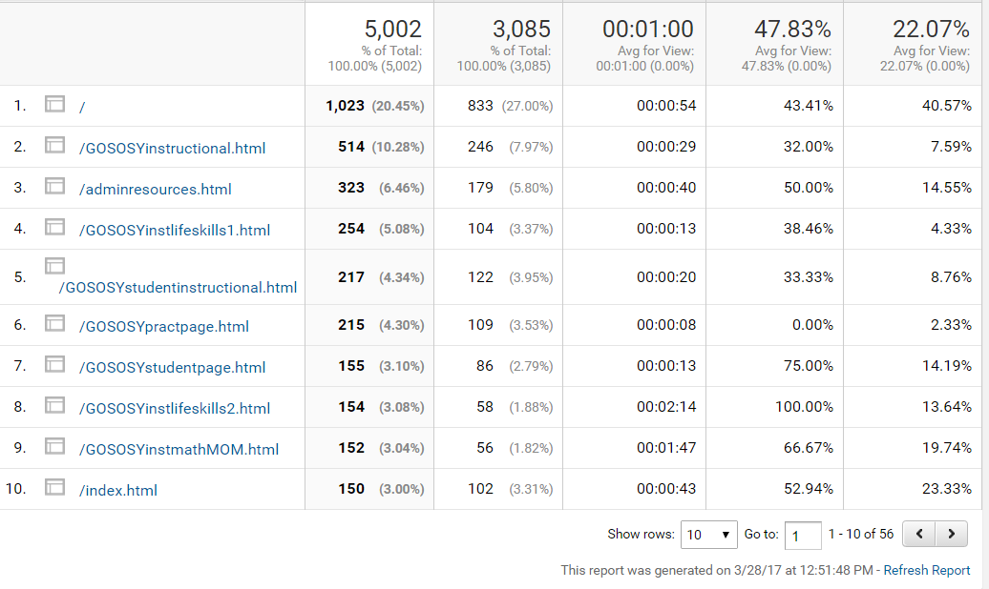
Where they are going on the site- last year
www.osymigrant.org

Slide 14
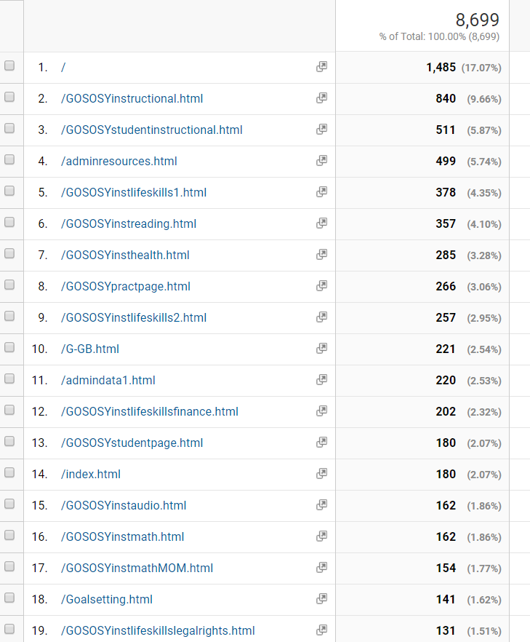
Most visited pages:

Slide 15
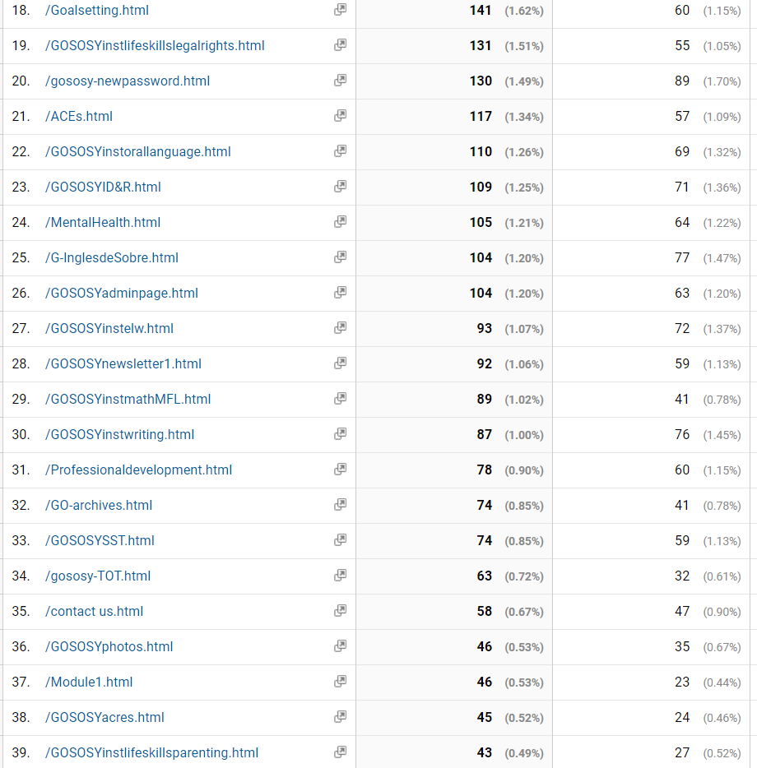
Most visited pages continued:
Notes:
We’d like to begin by thinking about the challenges that face our OSY. While we tend to think of challenges to participating in instructional activities, it’s valuable to think about the whole range of challenges our students face.

Slide 16
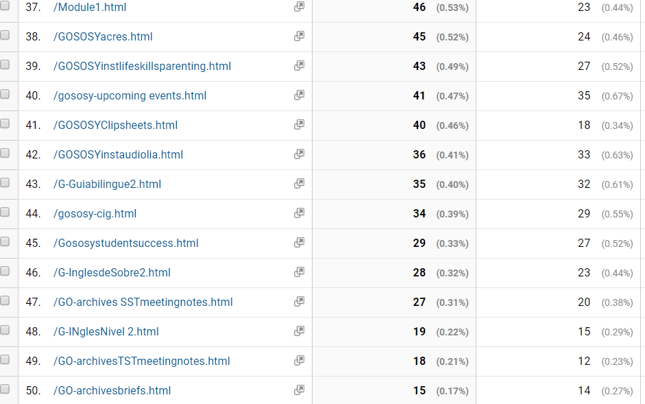
Most visited pages continued:
Notes:
We’d like to begin by thinking about the challenges that face our OSY. While we tend to think of challenges to participating in instructional activities, it’s valuable to think about the whole range of challenges our students face.

Slide 17
Future Planning
Marty Jacobson, GOSOSY Evaluator, META & Associates
Next CIG? Possible 4th Year
Options for our work
www.osymigrant.org

Slide 18

Professional Development
GOSOSY Professional Development
for OSY Instructors:
Using Differentiation Strategies when Working with Various Learning Styles
www.osymigrant.org

Slide 19

Acknowledgements
GOSOSY Professional Development Group and Contributors
Lysandra Alexander (PA); Susanna Bartee (KS); Odilia Coffta (NY); Joan Geraci (NJ); Tracie Kalic (KS); Sabrina Pineda (GA); Kiowa Rogers (NE)
GOSOSY PD Reviewers and Technical Support Team members and the State Steering Support Team
www.osymigrant.org

Slide 20

Statement of Purpose
This module will teach you how to provide effective lessons when instructing groups of students with varying levels and learning styles.
www.osymigrant.org

Slide 21


A differentiated lesson is one where all students are learning the same material in different ways.
To create an effective lesson using differentiated instruction, it is important to have a balance between what you are teaching and how the students are learning.
Differentiated Instruction: What is it?
learning
teaching
www.osymigrant.org

Slide 22

Before the Lesson: Elements to Consider
The students level of readiness - how prepared they are to learn specific
information or skills. An informal assessment should be conducted to make this determination.
Interest – What appeals to the students’ interests?
If they are interested in what they are being taught they will be more motivated to learn.
Determine what they like, their hobbies, which sports, places, or food they enjoy
Learning Profile – How the student approaches learning and learns best:
visual, auditory, kinesthetic, multi-modality.
www.osymigrant.org

Slide 23
In order to achieve balance for an effective lesson, the following four elements need to be considered:
Before the Lesson: Elements to Consider
Content: What does the student need to learn?
Process: How the student makes sense of the content being taught. Students have
different ways of learning such as
 Visual – Student learns better by seeing (pictures, photographs, textbooks)
 Auditory – Student learns better by listening (audio books, music, lecture)
 Kinesthetic – Student learns better by using hands-on activities and movement
 Multi-modality – students learn by a combination of more than one learning style
continued
www.osymigrant.org

Slide 24

3. Product: How the student demonstrates what they have learned.
 quizzes/tests
 projects
 activities
 oral reports and/or written reports, etc.
Before the Lesson: More Elements to Consider
4. Affect: The feelings and attitudes that impact the students’ learning.
Create a safe and supportive environment
Be respective of the students’ thoughts and feelings
Lessons should be interesting and challenging
If the students are interested in the subject matter and feel supported by their teacher and peers, they will be motivated to learn
www.osymigrant.org

Slide 25



During the Lesson:
Creating Successful Differentiated Group Instruction
Flexible grouping can be used to ensure success. Groups don’t always have to be the same; they can continually change.
Here are some suggestions:
Group according to academic level
Group according to learning styles (visual, auditory, or kinesthetic)
Group based on prior knowledge (how much the students know about the topic)
Group according to interests
Group based on English language skills
For more ideas: See One-on-One and Small Group Instruction
  One on One and Small Group Instruction
www.osymigrant.org

Slide 26
During the Lesson:
Creating Successful Differentiated Group Instruction
A Learning Community is a group of people who share common goals and attitudes. They help foster success among students with different ability levels and learning styles.
Here are some suggestions for building a learning community:
Encourage students to collaborate. Allowing them to share individual strengths can increase productivity in the group as they learn from each other.
Encourage students to have a voice in how the learning community works and take responsibility for solving problems.
Encourage different viewpoints and ideas.
Consider that relationships may already exist between students. Remember that many OSY live and work together and bring their life experience to the learning setting. Understanding and working with these relationships can impact the success of your group.
www.osymigrant.org

Slide 27

Strategies for Differentiated Instruction
RAFT – is a writing strategy that can be used in all content areas and offers students a choice in how to focus and complete their writing assignments.
R is for Role – the person or thing that the students will become.
A is for Audience – the person or people who will be reading the finished product.
F is for Format – the way in which the writing will be done. Examples might
include letter, brochure, memo, speech, comic or advertisement.
T is for Topic – what the writing will discuss. Students can demonstrate their
mastery of content knowledge in this matter.
RAFT allows for differentiated instruction because students get a choice in their assignments based on their interest and preferred style of learning.
www.osymigrant.org

Slide 28

An Example of RAFT
Example: Topic – Popular Place
Teacher reads aloud to all students a paragraph on a popular place they all said they want to visit, sharing important facts about the location.
RAFT activity:
Advanced students - take the role of a travel agent and the format of creating a travel brochure for an audience of tourists
Intermediate students - take the role of a tourist writing and addressing the format of a postcard to the audience of friends
Beginner students – take the role of the interesting place creating the format of a poster to encourage the audience of potential tourists to visit
www.osymigrant.org

Slide 29

An Example of RAFT with GOSOSY Lesson
Example: Topic - Healthy Mouth Lesson
Lesson can be found at: http://osymigrant.org/For%20Your%20Health%20HealthyMouth.pdf
RAFT activity:
Advanced students - take the role of a dentist with the format of writing a small brochure highlighting instructions on proper dental hygiene for an audience of patients
Intermediate students - take the role of a patient with the format of a written list of questions to be asked of the dentist, their audience
Beginner students – take the role of the instructor and create the format of a poster with labels of the parts of the mouth to show proper dental hygiene to their roommates or other OSY as their audience
www.osymigrant.org

Slide 30

Strategies for Differentiated Instruction- continued
Graphic Organizer - uses visual symbols to give information, concepts, thoughts or ideas and show the relationship between them.
Example:
A Venn diagram is a drawing that shows the relationship between and among sets or groups of objects that share something in common.
www.osymigrant.org

Slide 31
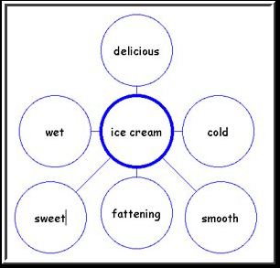
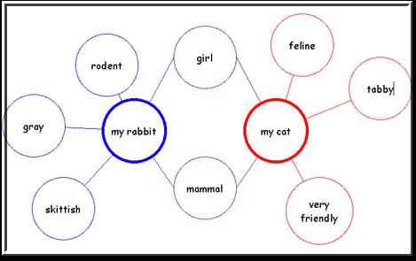
Strategies for Differentiated Instruction- continued
Examples: Bubble Map, double bubble map, flow chart
www.osymigrant.org

Slide 32
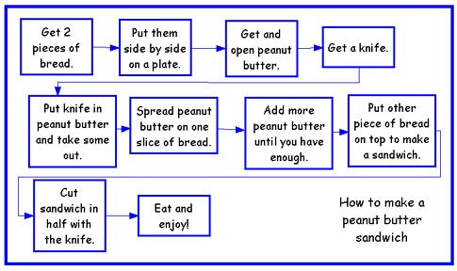
Strategies for Differentiated Instruction- continued
Example: Flow chart
www.osymigrant.org

Slide 33
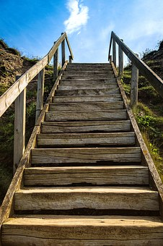
Strategies for Differentiated Instruction
-continued
Tiered Instruction:
all students learn the same skills but at different levels.
Teachers make slight adjustments within the same lesson to meet needs of the students.
The activities challenge students at their ability level.
Example: Teacher reads aloud to all students a paragraph on a popular place they all said they want
to visit, sharing important facts about the location.
 Advanced students – can write a paragraph describing the place, what they found interesting and surprising and why.
 Intermediate students - can list the facts they found most interesting or
surprising and write a sentence for each fact, stating what they found interesting/
surprising.
 Beginner students – give students a Double Bubble graphic organizer. One bubble is labeled
“interesting” and the other labeled “surprising.” Have students select words from a fact
word bank you have provided and copy the words into the correct bubbles (interesting/surprising), in which they believe the words belong.

Slide 34

Strategies for Differentiated Instruction- continued
Technology – Technology-based lessons (iPads, laptops, computers) are useful in teaching
students of various learning styles.
Examples: SAS Curriculum Pathways, Moby Max
Online resources that provides interactive lessons, videos, audio tutorials, and apps for English language arts, mathematics, science, social studies, and Spanish.
Through the various interactive resources students learn, practice skills, and have assessments to email, print, or save.
This information helps teachers continue to group students based on their needs.
https://www.sascurriculumpathways.com
www.mobymax.com
www.osymigrant.org

Slide 35
After the Lesson: Assessment
Providing continual assessment helps you see what information has been learned and where further instruction is needed. Assessments help you plan grouping and activities based on your students’ levels.
Here are some suggestions:
Review assessment results regularly to gauge student progress
Change instruction as needed based on assessment results
Use creative ways to help students prepare for assessments
  Create charts or posters that can be left on display
  Develop or have students create study guides
  Leave instructional materials with students (flashcards, games, etc.)
www.osymigrant.org

Slide 36
After the lesson: Assessment
There are two types of assessment: formal and informal
Formal assessments are given to students individually that systematically measure learning and can be scored.
Examples of formal assessments:
Tests and quizzes
May be written, oral, multiple choice, etc.
Formal assessments available on the GOSOSY website are linked below
www.osymigrant.org

Slide 37

After the lesson: Assessment
Informal assessments enable an instructor to evaluate students’ performance. They can be interactive, engaging, and hands-on.
Examples of informal assessments:
Thumbs up / thumbs down hand response to questions
Quick write (students write the answer on a whiteboard, note card etc.)
Holding up a yes / no card
Turn and share with a partner
Role play activities
Oral questions to which the student responds
Be creative and have fun with your informal assessments!
www.osymigrant.org

Slide 38

Experts in differentiated instruction recommend:
The teacher’s role in the differentiated classroom is to continually ask him/herself:
“What does this student need at this moment in order to be able to learn and progress with this content?”
“What do I need to do to make that happen?”
Tomlinson and Imbeau (2010)
www.osymigrant.org

Slide 39
Helpful Differentiated Instruction Websites
http://education.ky.gov/educational/diff/documents/strategiesthatdifferentiateinstruction4.12.pdf
https://www.cultofpedagogy.com/starter-kit-differentiated-instruction/
https://www.edutopia.org/stw-differentiated-instruction-replication-tips
www.osymigrant.org

Slide 40
Participant Feedback
Fill out the GOSOSY online evaluation below:
  https://www.surveymonkey.com/r/PGY5NK5
  Facilitator follow-up questions for group training:
  What did you learn?
  What did you find most helpful or beneficial?
  How will you be using this with your youth?
  What recommendations do you have for future training?
www.osymigrant.org

Slide 41
Professional Development
GOSOSY Professional Development for OSY Instructors:
One-on-One and Small Group Instruction
www.osymigrant.org

Slide 42

Acknowledgements
GOSOSY Professional Development Group and Contributors
Lysandra Alexander (PA); Susanna Bartee (KS); Odilia Coffta (NY); Joan Geraci (NJ); Tracie Kalic (KS); Sabrina Pineda (GA); Kiowa Rogers (NE)
GOSOSY PD Reviewers and Technical Support Team members and the State Steering Support Team
www.osymigrant.org

Slide 43
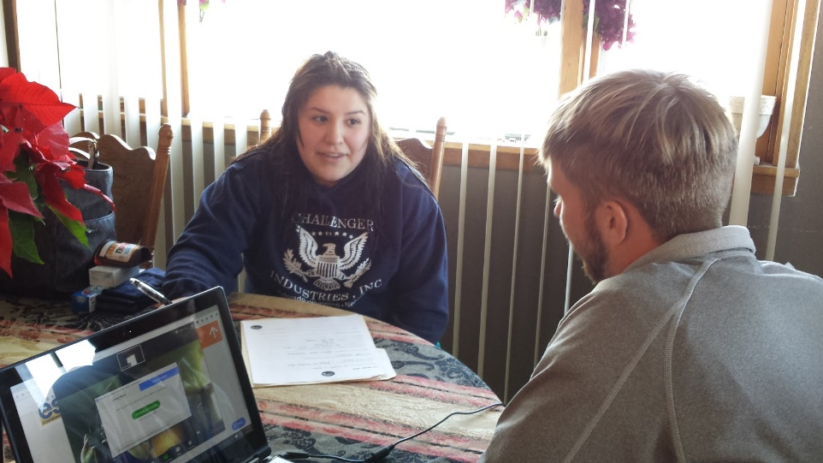
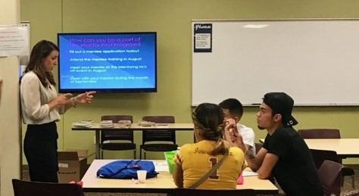
Purpose
This module will instruct you on teaching strategies to use with your OSY in one-on-one or small group settings.
www.osymigrant.org

Slide 44
Tips & Techniques
Relax and be yourself
Establish rapport
Respect your students
Maintain confidentiality
Be sensitive to individual needs
Be informative without being intimidating
Be positive – praise students’ efforts and successes
Encourage independent learning (teach them to fish)
Be patient
Use effective questioning (ask rather than give answers)
Be flexible
Focus on “learning how to learn”
Be a good listener
www.osymigrant.org

Slide 45
Questions to Ask Yourself:
Before Instruction
What does my student or group already know?
What does my student or group need to know?
What does my student or group hope to learn?
How can I best meet the needs of my student or group without giving the answer?
How can I conduct myself so I make the learning experience a positive one?
www.osymigrant.org

Slide 46
Comparing Instructional Settings
One-on-One
Small Group
Time allows the individual student to ask specific questions
Student is instructed and lessons paced at his/her level
Goals are established to meet the individual student’s needs
Allows for individual perspectives and approaches
Students may interact more with each other, less with instructor
Multiple abilities and backgrounds require adjusted pacing
Goals are designed for the general needs of the group
Allows for multiple perspectives and approaches
www.osymigrant.org

Slide 47
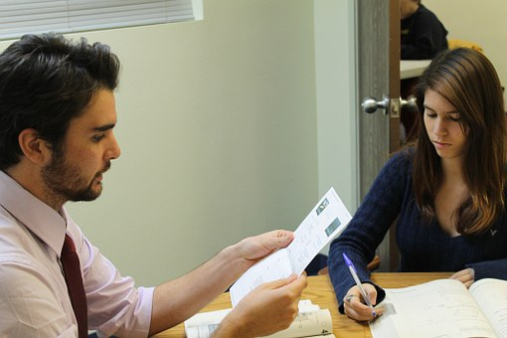
Tips for One-on-One Instruction
Keep your lesson real and relatable
Help students apply learning to their daily life
Make sure to vary your approach to keep it fresh
Utilize humor
Tailor lessons to student’s interests or needs
Foster independent learning
Pause frequently and wait for student to respond to questions
www.osymigrant.org

Slide 48
Tips for One-on-One Instruction (continued)
Encourage creativity
Assess through games
Seek feedback (ask the student whether he or she is finding the lessons valuable and how to improve)
Cater the lesson to the student’s learning style
  For more information on identifying a student‘s learning style and strategies for that style, click on the link below
  Using Differentiation Strategies When Working with Various Learning Styles
www.osymigrant.org

Slide 49
Tips for Small Group Instruction
Make sure everyone in the group gets a chance to participate
    Use a circular seating arrangement
    Provide opportunities for quiet/shy students to speak
    Ensure that every student can see the instructor and materials
Be aware of students’ abilities and adjust lesson as needed
  For more strategies on teaching a group of students with different ability levels, see the link below
  Using Differentiation Strategies When Working with Various Learning Styles
www.osymigrant.org
Notes:
Be willing to adjust the lesson on the fly – blank stare example

Slide 50
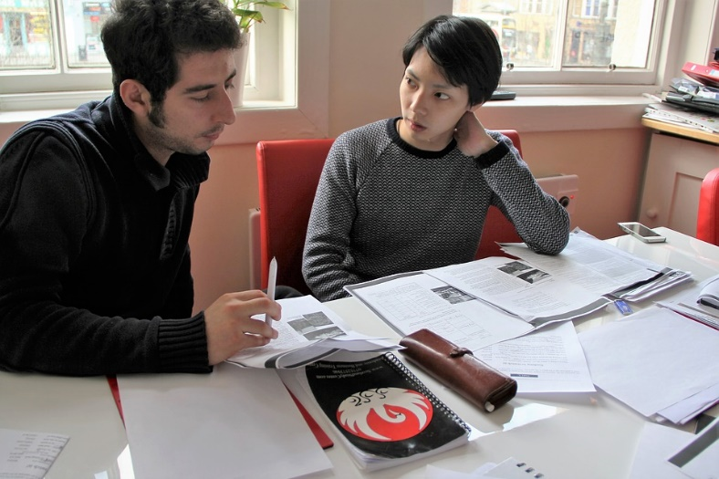
Tips for Small Group Instruction
(continued)
Pair students with strong skills with students whose skills are developing
Have students explain answers, concepts and definitions to each other
Summarize everyone’s contribution
www.osymigrant.org
Notes:
Be willing to adjust the lesson on the fly – blank stare example

Slide 51
After Instruction:
Questions to Ask Yourself
Did I build on what my student or group already knew?
Did I address what my student or group needed to know?
Did I meet my student or group’s learning objectives?
Did I support the needs of my student or group without giving the answers?
Did I make the learning experience a positive one?
www.osymigrant.org

Slide 52
After Instruction
Questions to Ask Yourself
How did student(s) feel about the learning session?
How did student(s) respond to the topic of the lesson?
How do I need to modify my lesson next time?
What instructional materials could I bring next time?
  For more information on planning and evaluating lessons, see the link below
  OSY Instructional Action Plan
www.osymigrant.org

Slide 53

Success in Action
“Every new lesson offers another step to success”
- Terry Mark
www.osymigrant.org

Slide 54
Participant Feedback
Fill out the GOSOSY online evaluation below:
  https://www.surveymonkey.com/r/PGY5NK5
  Facilitator follow-up questions for group training:
  What did you learn?
  What did you find most helpful or beneficial?
  How will you be using this with your youth?
  What recommendations do you have for future training?
www.osymigrant.org

Slide 55

Literature Review
Activities
Continued research into Adverse Childhood Experience (ACEs) study and materials available.
Draft was completed and is under revision for completion this year.
Strategies for use with OSY will be presented at the TST meeting in April
Members
Jessica Castañeda (KS-lead)
Susanna Bartee
John Farrell
www.osymigrant.org

Slide 56
Work Group Expectations
Finalize current work
Decide what is ready for dissemination on website
Plan for Dissemination Event presentations
www.osymigrant.org

Slide 57
Agenda– April 12
Work Group Time
ACEs Strategies and Discussion
Goal Setting and Learning/Action Plan Training of Trainers
Year 3 Evaluation and Requirements
Dissemination Event planning and organization
Work group report outs
Fall planning and future meeting dates
www.osymigrant.org

Slide 58
Goal Setting and OSY Learning Plan
Members
Emily Hoffman (MA-lead)
Margot Di Salvo (FL)
Sarah Braun-Hamilton (VT)
Joyce Bishop (AL)
April Dameron (IA)
Activities
OSY Learning Plans (Student version and Provider version) were implemented over the summer with more than 300 OSY completing a Learning Plan.
Goal Setting Implementation Guide was amended per pilot feedback.
Almost 200 OSY were involved in summer the Goal Setting Pilot throughout all 18 member states.
www.osymigrant.org

Slide 59
GOSOSY Year 3
Evaluation and Data Collection
www.osymigrant.org

Slide 60
FII Review (State Responsibilities)
1.1d Provide instructional services using GOSOSY lessons/materials
1.1f Monitor OSY for progress toward graduation/career plans
1.1h Conduct post-secondary and career awareness activities for OSY
1.1i Conduct pre/post assessments of OSY
1.1k Offer credit recovery programs (e.g., PASS)
www.osymigrant.org

Slide 61
FII Review (State Responsibilities)
1.2b Work with OSY to complete Learning Plans
1.2c Provide instruction to OSY using GOSOSY materials aligned with Learning Plans
1.3c Train GSW facilitators (when not all staff working on goal setting can attend GOSOSY training)
1.3e Conduct GSWs and evaluate progress using the GSW mastery activity
www.osymigrant.org

Slide 62
FII Review (State Responsibilities)
2.2a Continue collaborations with CIGs, HEPs/CAMPs, other agencies and organizations
2.2c Continue OSY mentoring programs with pilot states
2.3c Conduct OSY in-the field recruiter training; may be in collaboration with IRRC for state in both consortia
2.3d Administer OSY recruiter skills competency tool and analyze/summarize results; states may use IRRC tool or their own
www.osymigrant.org
Notes:
The SOSOSY Training Manual has been designed to assist states in the development of systems to support Out-of-School Youth. SOSOSY Training Manual has been created to assist states in creating a system to identify, recruit and provide services to OSY. This document serves as a workbook for states to develop or improve their current services and support programs for OSY. It outlines the steps to gather and analyze OSY data, plan for service delivery, access best practices in curriculum and instruction, as well as create education plans and address advocacy needs of the OSY population.

Slide 63
FII Review (State Responsibilities)
3.1a Review list of GOSOSY products and select at least 5
3.1c Adapt/adopt and use GOSOSY products
3.2d Participate at the GOSOSY Dissemination Event
3.2e Participate on SST/TST to review GOSOSY deliverables
www.osymigrant.org

Slide 64
Evaluation Data Collection
All data is due by September 28, 2018.
Three required forms:
  Form 1: Director/Coordinator Report
  Form 2: OSY Professional Learning Activity Evaluation Form
  Form 3: New Product Review Form
www.osymigrant.org

Slide 65
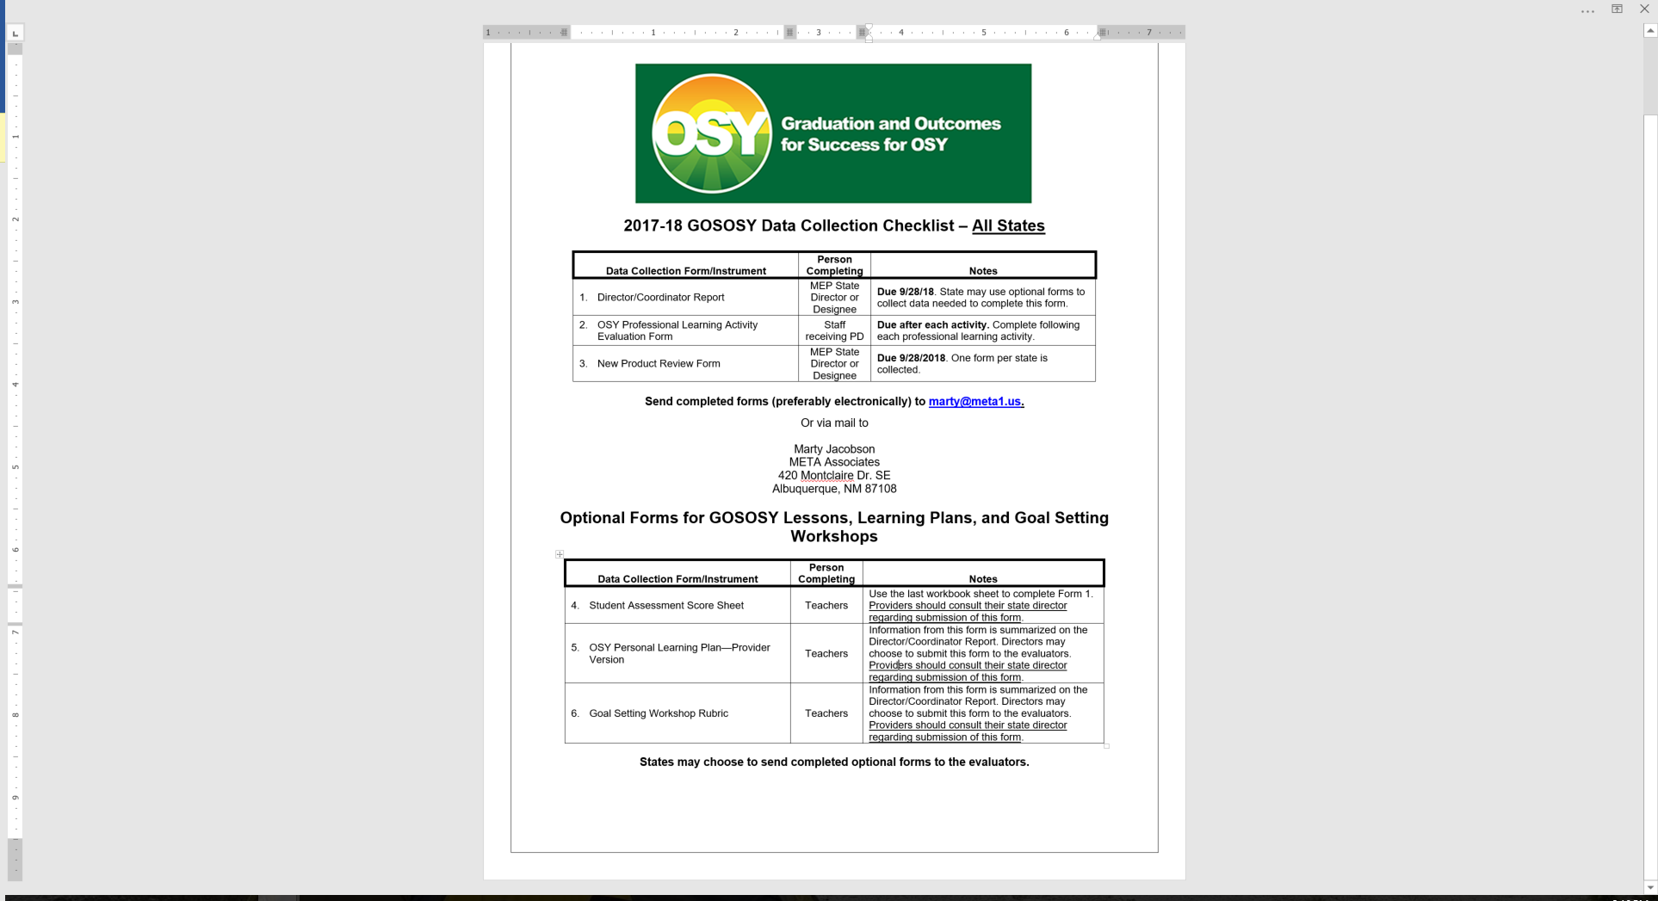
2017-18 Checklist

Slide 66

Performance Measure 1.1
Each year, 75% of OSY participating in project-directed instructional services will demonstrate a 20% gain between pre- and post on content-based assessments.
www.osymigrant.org

Slide 67

Timeline
Results (number assessed and number gaining 20%) are recorded on Form 1.
Form 1 is due September 28, 2018.
www.osymigrant.org

Slide 68
Performance Measure 1.2
By 9/20/18, 75% of OSY with a Learning Plan will attain 50% of the needs-based learning/ achievement objectives.
www.osymigrant.org

Slide 69
Timeline
Learning Plans are completed throughout 2017-18.
Results (number reaching 50% of goals) are recorded on Form 1.
Form 1 is due September 28, 2018.
www.osymigrant.org

Slide 70
Performance Measure 1.3
By 9/20/18, 54 OSY (average of 3 per state X 18 states) will attend goal-setting workshops (GSW) and attain an acceptable or above score on a GSW project-based activity rubric.
www.osymigrant.org

Slide 71
Timeline
GSW activities and rubrics are completed throughout 2017-18.
Results (number successfully completing the mastery activity) are recorded on Form 1.
Form 1 is due September 28, 2018.
www.osymigrant.org

Slide 72
Performance Measure 2.1
Each year, 75% of staff participating in GOSOSY professional learning activities will increase their capacity to deliver instruction and services to OSY by 10%.
www.osymigrant.org

Slide 73
Performance Measure 2.2
Each year, 75% of GOSOSY States will report that at least 5 mutually-beneficial collaborations on professional learning and mentoring are in place in their state with other CIGs, National HEP/CAMP Association, World Education, Inc., and other agencies and entities.
www.osymigrant.org

Slide 74

What is a collaboration?
Collaborations include
  memorandums of understanding (MOUs) for data or resource sharing
  presentations at joint meetings
  guest speakers
  collaborative workgroups
  representation in CNA/SDP/Evaluation meetings
  participation in one of the other Consortium Incentive Grants (CIGs) or use of products from another CIG
  other substantial collaboration efforts
www.osymigrant.org

Slide 75
Timeline
Collaborations are reported on Form 1.
Form 1 is due September 28, 2018.
www.osymigrant.org

Slide 76
Performance Measure 2.3
By 9/20/18, 75% of recruiters will participate in professional development regarding the ID&R of OSY and demonstrate proficiency on state recruiting assessments that incorporate this area.
www.osymigrant.org

Slide 77
Timeline
Recruiter training materials and skills competency tools are used throughout 2017-18.
Competency exam results are reported on Form 1.
Form 1 is due September 28, 2018.
www.osymigrant.org

Slide 78
Performance Measure 3.1
By 9/20/18, 5 GOSOSY key products designed specifically for OSY will be developed or adapted, vetted, shared with key stakeholders, and adopted by CIG states.
www.osymigrant.org

Slide 79
Timeline
Product review form is available on osymigrant.org.
Products used at any time throughout the three years of the consortium should be selected as adopted or adapted.
By 9/28/18, state director/coordinators will report the products used on Form 3.
www.osymigrant.org

Slide 80
Performance Measure 3.2
3.2 By 9/30/18, build states’ capacity to deliver instruction reflective of evidence-based practices for OSY through a GOSOSY Dissemination Event.
www.osymigrant.org

Slide 81
Product Pilot Review
Lists all products developed by GOSOSY.
States are asked to adopt or adapt 5 by the end of the project.
19 possible products are listed on the Pilot Product Review Form.
The form is now available on osymigrant.org.
Each state will submit ONE form.
www.osymigrant.org

Slide 82
2018 Dissemination Event
Planning Committee
Florida
Illinois
Kansas
Kentucky
Massachusetts
Nebraska
New Hampshire
New Jersey
North Carolina
www.osymigrant.org

Slide 83
Ideas We Are Working On
more informal
networking
Special focus on including OSY
CIG
integration
vendors
electronic
evaluations
record presentations
www.osymigrant.org
Notes:
State directors should have the discretion to select who in their state they would like GOSOSY to support (whether this is a presenter/facilitator or state director)

Slide 84
2014
Dissemination Event
Feedback
Overall rating was 4.7 out of 5.
What worked best?
Registration process
Opening session
What needs improvement?
Networking and discussion time
www.osymigrant.org
Notes:
Involvement of OSY
Attend the keynote session and work with John
Leadership Academy
Public speaking
Choose younger staff who are tech savvy to gain input from OSY on website, materials, tools, etc.
Delegates representing OSY- help us figure out how best to help the Consortium move forward
Goal Setting
OSY Panel

Slide 85
Dissemination Event Discussion
Breakout session topics?
Better networking ideas?
Anything else on which to focus?
www.osymigrant.org
Notes:
Day 1: opening session
Welcome—when people are taking their seats—Michael and Tracie could welcome
Serve lunch- 30 minutes
Preset salad and desert on the table –
Allow time for networking
Welcome to FL—Dihn
OME Welcome-- Lisa
Keynote 45 minutes
12:00-2:00 pm Opening session/Lunch
5 meeting rooms available
(PI and OSY will each have a meeting room for a total of 7 rooms)
2:30- 3:15 pm Networking
3:30-5:00 pm Breakout #1
Day 2
8:30- 10:00 Breakout #2
10:15- 11:45 am Breakout #3
12:00- 1:30 pm Lunch on your own
1:45- 3:15 pm Breakout #4
Break
3:30 pm Closing Session
Raffle off other books or something to lure folks
Punch card?
Snapchat—Tracie will mention this during opening
OSY who are invited – we’ll ask to Snapchat their experiences/ video and photos

Slide 86
NASDME Presentations
Implementing an Instructional Action Plan for Out-of-School Youth
The Benefits of Mentoring OSY
Mental Health and Adverse Childhood Experiences (ACEs) in the Migrant Student Population
www.osymigrant.org

Slide 87
Upcoming Meetings
CIG Dissemination Event: September 18-20
IRRC: September 18-19
GOSOSY: September 19-20
PI embedded throughout the event
Fall SST Meeting: September 21, 2018 in Clearwater, FL
Fall possible TST Meeting: November 14-16, 2018
www.osymigrant.org

