Slide 1
Professional Learning
Identifying and Addressing
the Needs of OSY:
Working with Language Learners
www.osymigrant.org

Slide 2
Acknowledgements
Professional Development Group and Contributors:
Lysandra Alexander (PA), Susanna Bartee (KS), Odilia Coffta (NY), Joan Geraci (NJ), Tracie Kalic (KS), Sabrina Pineda (GA), Kiowa Rogers (NE)
Professional Development Reviewers and Technical Support Team members and the State Steering Support Team
www.osymigrant.org

Slide 3
Statement of Purpose
This module is intended to assist service providers who are tasked with working with OSY who are English Learners (ELs).
www.osymigrant.org

Slide 4
Learner Characteristics
There are different levels of language ability.
Social English may be acquired quickly.
Academic English takes years to master.
Students learn language at their own pace.
ELs need practice in listening, speaking, reading, and writing.
The best language learning occurs when students are comfortable in the learning environment.
www.osymigrant.org

Slide 5
Learner Characteristics
Every person goes through these specific Stages of Language Learning after they are exposed to a new language.
The Stages of Language Learning and timeframes for learning are as follows:
Pre-Production (silent period) - 0-6 months
Early Production (low beginner) - 6-12 months
Speech Emergence (high beginner) - 1-3 years
Intermediate Fluency - 3-5 years
Fluent - 5-7 years
For detailed information see the Stages of Language Learning chart pictured in the next slide
www.osymigrant.org

Slide 6
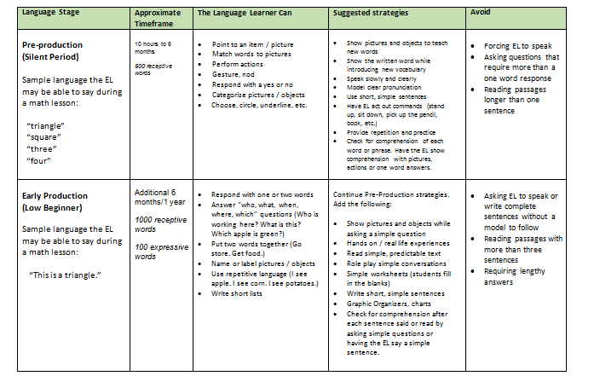
Learner Characteristics
Adapted from: http://www.ascd.org/publications/books/108052/chapters/The-Stages-of-Second-Language-Acquisition.aspx
www.osymigrant.org

Slide 7
Learner Characteristics
Language learners need to develop listening, speaking, reading, and writing skills.
Receptive skills:
Listening
Reading
Productive skills:
Speaking
Writing
Each skill needs practice and support in every lesson.
Adapted from: http://www.ascd.org/publications/books/108052/chapters/The-Stages-of-Second-Language-Acquisition.aspx
www.osymigrant.org

Slide 8
Before the Lesson
Know the EL’s language level. Utilize a screening tool to determine the language level.
The OSY English Language Screener (linked below) is a good resource.
http://osymigrant.org/GOSOSYinstorallanguage.html
This is a basic assessment for beginners. If this screener is too easy for the EL, talk to your supervisor about other assessment options.
Refer to the Stages of Language Learning chart for strategies to implement and avoid at the EL’s language level.
Find out whether the EL is literate in his or her first language. If so, using bilingual materials may be helpful.
www.osymigrant.org

Slide 9
Before the Lesson
Identify key vocabulary.
Prepare visual aids to teach vocabulary:
Real objects
Images
Flashcards
Dry erase board, markers, sketch pad and pens to
draw vocabulary
Think of simple phrases to describe or explain key vocabulary.
Plan activities that the EL can do to practice vocabulary:
Games
Simple worksheets
Conversation starters
Role plays
vocabulary

Slide 10
During the Lesson
Help the EL feel at ease:
Relax.
Show confidence that you can communicate.
Use positive body language (i.e. smile, nod).
Focus on communication rather than grammar or pronunciation:
Encourage the EL to respond and speak.
Model correct grammar and pronunciation.
Rephrase rather than overtly correct mistakes.
Use a dictionary or online translation site.
Provide opportunities for the EL to interact and show understanding in a variety of ways:
Through pictures
Through actions
Through verbal responses
www.osymigrant.org

Slide 11
During the Lesson
After asking a question, allow plenty of wait time for the EL to respond:
8 seconds is recommended as a minimum.
Encourage a response, even if it is not the correct one; but…
Don’t rush students to respond.
Watch the student’s body language. If s/he seems confused (fearful look, blank stare) or doesn’t respond as expected, try a different approach:
Present the question in a different manner (rephrase, write, draw).
Allow the EL to respond non-verbally by:
Pointing, gesturing, acting out a response
Selecting from a group of pictures
Choosing a word card
www.osymigrant.org

Slide 12
During the Lesson
In the next slide, we will provide an example of how you would modify a lesson according to the stage of language learning your OSY demonstrates.
The lesson used in this example is:
Protect Your Back While Working found at:
http://www.osymigrant.org/For%20Your%20Health%20back.pdf
(Take a moment to review the lesson prior to moving to the next slide.)
www.osymigrant.org

Slide 13
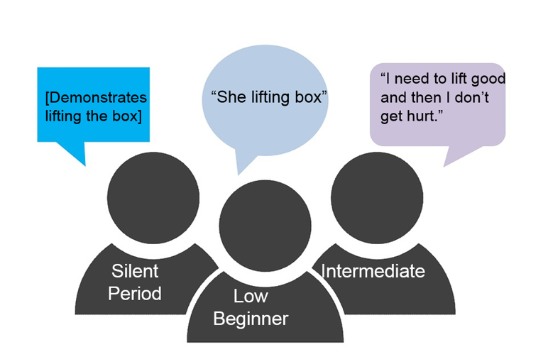
During the Lesson: Working with Language Learners
Step 1: Present the lesson referenced in the previous slide.
Step 2: Check for understanding by adapting what you ask of each OSY as follows:
Teacher to student in silent period: “Lift the box.”
Teacher to low beginner: “What is she doing?”
Teacher to intermediate student: “Why do we need to lift correctly?”
Step 3: Expect your OSY to respond according to their stage of language learning as shown in this example:
www.osymigrant.org

Slide 14
Checking for Understanding
Step 4: Review the vocabulary you taught.
Check for understanding by having the OSY:
Match pictures to words (pre-production, early production).
Use the word in a sentence (high beginner).
Do a role play activity using the target vocabulary words (speech emergence, intermediate).
Describe or explain the words (fluent).
www.osymigrant.org

Slide 15
After the Lesson: Working with Language Learners
Learn from your OSY!
Reflect on how their responses can help you improve the way you communicate with the EL in the future:
Which strategies did the EL seem to embrace the most?
What other topics / vocabulary has the EL expressed interest in?
Reflect on what opportunities you can give the ELs to communicate effectively with you:
With which response type did they seem most comfortable?
(drawing, selecting pictures, actions, role play, writing, etc.)
Adapt future lessons based on your observations, OSY’s responses, and the abilities they demonstrated during the lesson.
www.osymigrant.org

Slide 16
After the Lesson: Working with Language Learners
You can adapt your assessment after a lesson based on your students’ stages of language learning.
This is an example of how you would do this for the Protect Your Back While Working lesson we used previously:
Example:
Silent period: Ask OSY to match the pictures to the correct words in the word bank below.
Low beginner: Ask OSY to use the words in the word bank to complete the sentence: “___________ a box correctly keeps your back safe”.
Intermediate: Ask OSY to write the steps to correctly lift a box.
Word Bank:
Joint
Lifting
Stretch out
Squat
Pressure
www.osymigrant.org

Slide 17
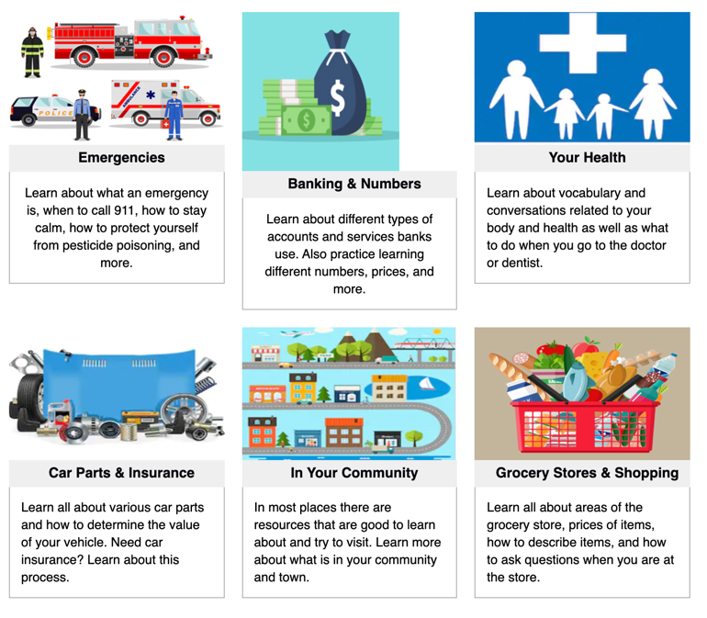
After the Lesson: Working with Language Learners
Encourage your OSY to practice English in between sessions by directing them to the following interactive English for Daily Life modules on a variety of topics:

Slide 18
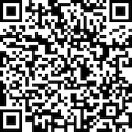
Evaluation
How will you be using this with your OSY?
Will it be helpful?
What would you include?
www.osymigrant.org

