Slide 1

Professional Learning
Implementing the OSY
Instructional Action Plan
www.osymigrant.org

Slide 2
Acknowledgements
Professional Development Group and Contributors
Lysandra Alexander (PA), Susanna Bartee (KS), Joan Geraci (NJ), Lori Houck (KS), Lindsay Ickes (NE), Tracie Kalic (KS), Hillary Maitlen (TN), Sabrina Pineda (GA), Kiowa Rogers (NE), Odilia Coffta (NY)
Kansas MEP: John Farrell, Paige Inman, and John Fink.
Professional Development Reviewers and Technical Support Team members and the State Steering Support Team
www.osymigrant.org

Slide 3
Introduction to the
OSY Instructional Action Plan
www.osymigrant.org

Slide 4
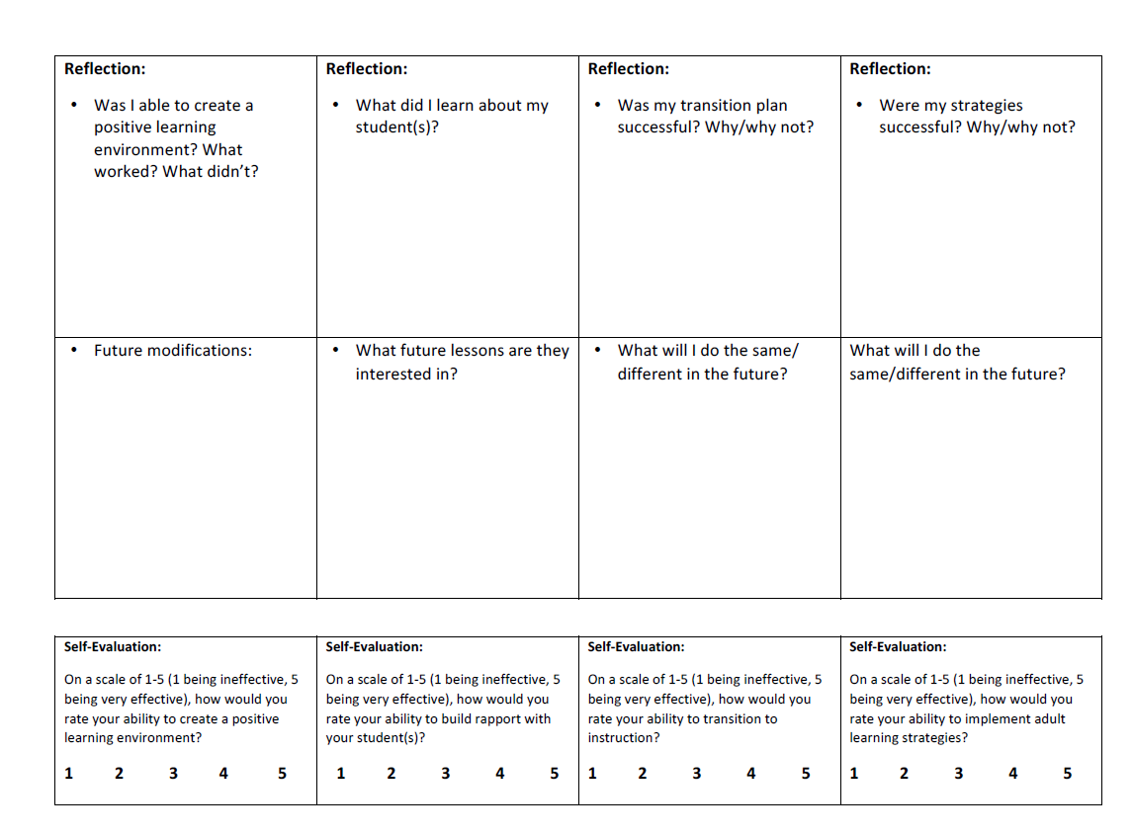
Introduction to the
OSY Instructional Action Plan cont…
www.osymigrant.org

Slide 5
Student Scenario: Introducing Paw
Paw is a 17-year-old OSY. She moved here with her boyfriend who worked in a feedlot a year ago. Not long after moving, she found out she was pregnant. She and her boyfriend are no longer together and her family lives in a different state. She completed her freshman year of high school and then dropped out. Her English proficiency is intermediate. She is unfamiliar with the area and needs medical services during her pregnancy. After her pregnancy, she will need childcare as she is planning on going back to her job in a dairy. She has also expressed a desire to obtain her GED.
www.osymigrant.org

Slide 6
Student Scenario: Introducing Yordano
Yordano is an 18-year-old OSY. He just recently moved out of his parents’ house and is working for a local farmer. Money is very tight in his household and therefore he cannot afford a car. He attended school all the way up to the first semester of 12th grade. He is proficient in English. He dropped out because he missed the state test and was not going to be on track to graduate. Because of the lack of transportation, he is unable to have a stable means to get to and from a school.
www.osymigrant.org

Slide 7
Main Components:
OSY Instructional Action Plan
STEP 1
Creating an Effective Learning Environment
STEP 2
Building Rapport
STEP 3
Transition to Instruction
STEP 4
Young Adult Learning Strategies
www.osymigrant.org

Slide 8
STEP 1
www.osymigrant.org

Slide 9
STEP 1: Creating an
Effective Learning Environment
Guiding Questions: | Tips:
Where may you conduct the lesson? What distractions or challenges may you encounter? How will you address these? | Find an effective location Minimize distractions (turn off TV, phones, radio, etc.) Have supplies readily available for use Ensure there is proper lighting
www.osymigrant.org

Slide 10

STEP 1: Creating an
Effective Learning Environment
  For the full document, see Strategies for Creating an Effective Learning Environment Resource Guide
www.osymigrant.org

Slide 11
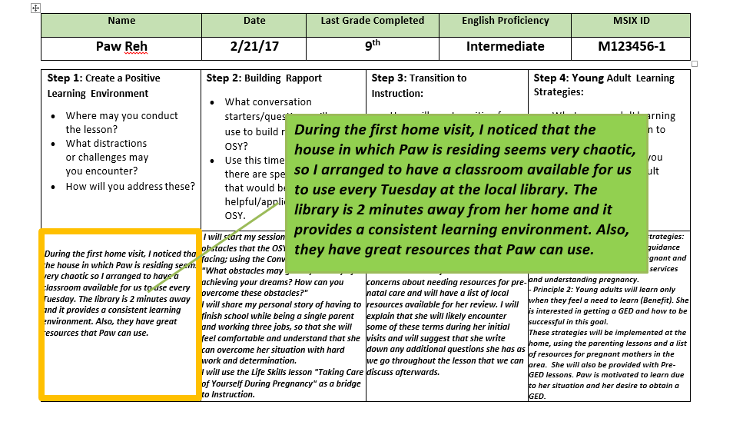
SAMPLE: OSY Instructional Action Plan for Paw
www.osymigrant.org

Slide 12

STOP AND DO: Step 1
Describe what you would do to create an effective learning environment for Yordano on the farm where he works and lives:
Where may you conduct the lesson?
What distractions or challenges may you encounter?
How will you address these?
www.osymigrant.org

Slide 13
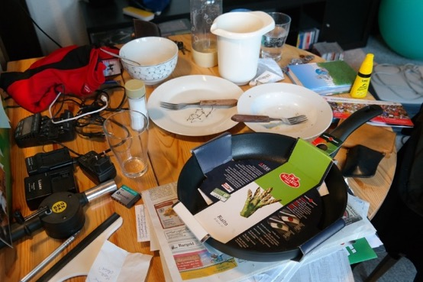


Effective Learning Environment in Summary
Minimize Clutter
Minimize Distractions
Ensure Proper Lighting
Utilize Technology
Have Supplies Ready for Use
www.osymigrant.org

Slide 14
STEP 2
www.osymigrant.org

Slide 15
STEP 2: Building Rapport
Guiding Questions: | Tips:
Where may you conduct the lesson? What distractions or challenges may you encounter? How will you address these? | Find an effective location Minimize distractions (turn off TV, phones, radio, etc.) Have supplies readily available for use Ensure there is proper lighting
www.osymigrant.org

Slide 16
STEP 2: Building Rapport
  For more information, see OSY Conversation Starters/Bridges to Academic Instruction Resource Guide

Slide 17
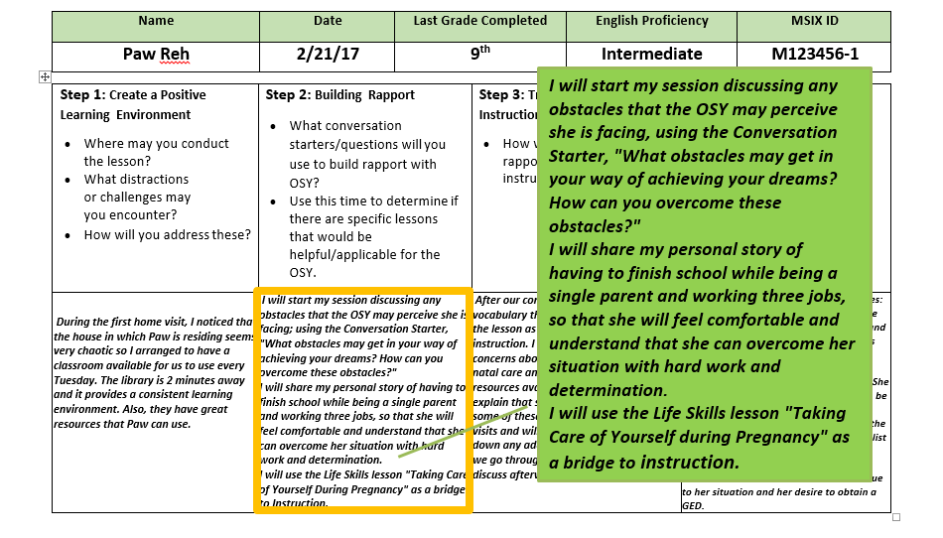
SAMPLE: OSY Instructional Action Plan for Paw
www.osymigrant.org

Slide 18
STOP AND DO: Step 2
Describe what you would do to build rapport with Yordano prior to instruction, knowing that he has limited availability in his schedule:
What conversation starters/questions will you use to build rapport with OSY?
Use this time to determine if there are specific lessons that would be helpful/applicable.
www.osymigrant.org

Slide 19

Building Rapport in Summary
What are your dreams for the future?
What is something you would like to learn about?
?
?
?
What interests you?
www.osymigrant.org

Slide 20
STEP 3
www.osymigrant.org

Slide 21
STEP 3: Transition to Instruction
Guiding Questions: | Tips:
How will you transition from the rapport building to the instructional lesson? | Review material from previous lesson Relate lesson to the interest expressed in previous conversations Create interest and enthusiasm in the topic you’re about to present
  For more information, see OSY Conversation Starters/Bridges to Academic Instruction Resource Guide
www.osymigrant.org

Slide 22
STEP 2: Transition to Instruction
  For more information, see OSY Conversation Starters/Bridges to Academic Instruction Resource Guide

Slide 23
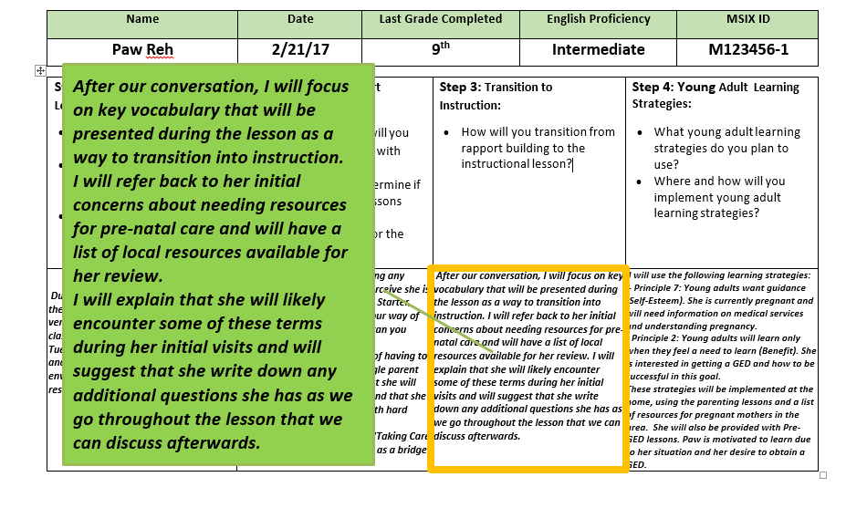
SAMPLE: OSY Instructional Action Plan for Paw
www.osymigrant.org

Slide 24
STOP AND DO: Step 3
Describe what you would do to transition from building rapport to instruction with Yordano, knowing that his goal is to complete high school and that he was very close to doing so:
How will you redirect the conversation from being informal to introduce and begin your lesson?
www.osymigrant.org

Slide 25

Transition to Instruction in Summary
instruction
Create interest and enthusiasm
Review content
interests
Relate to interests
www.osymigrant.org

Slide 26
STEP 4
www.osymigrant.org

Slide 27
STEP 4: Young Adult Learning Strategies
Young Adults Learn: | Tips:
When they want to or feel a need to learn When learning is practical and related to real life By doing/experiencing In a variety of ways | Make sure the lesson is relevant and useful to the student Provide immediate practice and feedback Adjust learning to the student’s needs/level Incorporate as many senses as possible
www.osymigrant.org

Slide 28

STEP 4: Young Adult Learning Resource Guide
  For the full document, see Young Adult Learning Resource Guide

Slide 29
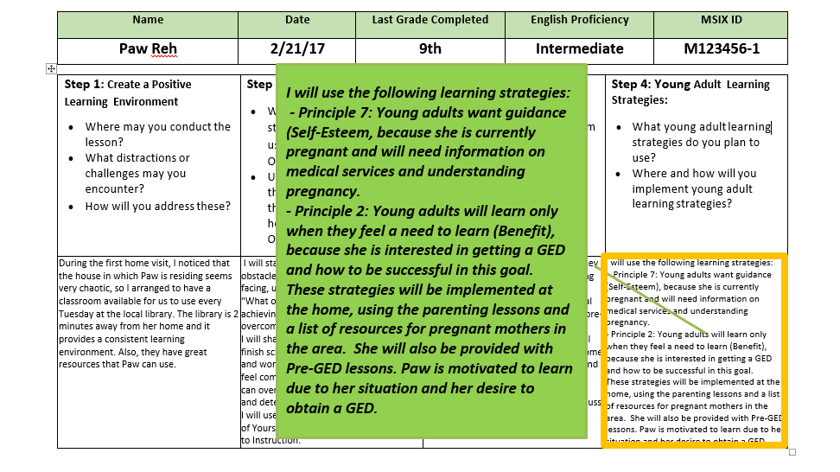
SAMPLE: OSY Instructional Action Plan
for Paw

Slide 30
STOP AND DO: Step 4
Describe what young adult learning strategies you would use with Yordano, knowing obtaining his diploma may lead to better opportunities:
Identify the specific learning strategies you plan to use.
Where and how will you implement these strategies?
www.osymigrant.org

Slide 31
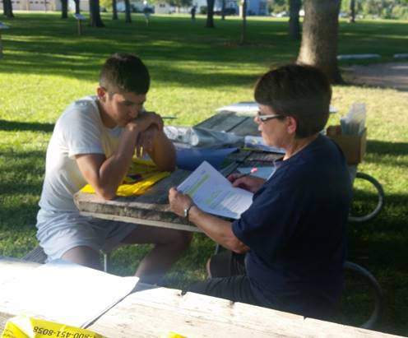
Learning Strategies in Summary
Relevant and Useful
Adjust to meet needs
Practice and Feedback
Incorporate many senses
www.osymigrant.org

Slide 32
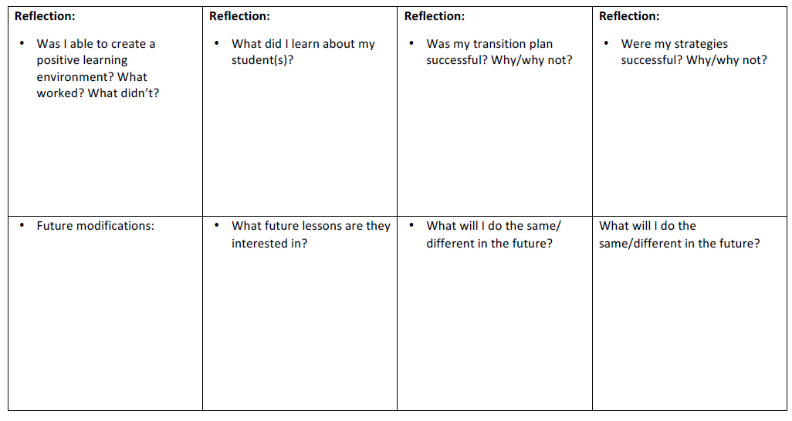
OSY Instructional Action Plan Reflection
Review the questions in the reflection section to evaluate the success of your lesson and determine future modifications.
www.osymigrant.org

Slide 33
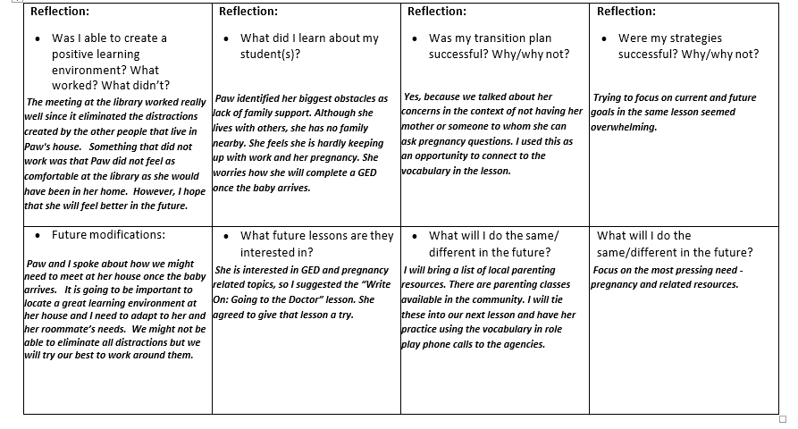
SAMPLE: OSY Instructional Action Plan
for Paw
www.osymigrant.org

Slide 34
STOP AND DO: Reflection
Take a few moments to consider these components of reflection:
Reflection is critical. It enables you to construct valuable future lessons.
Use your reflection to set goals for yourself.
Reach out for help from a supervisor, trusted colleague, or utilize community resources.
Be flexible - don’t hesitate to change your future lesson plan based on the OSY’s response.
Reflection is vital to your rapport with the OSY, as it enables you to stay in tune with their changing needs.
www.osymigrant.org

Slide 35
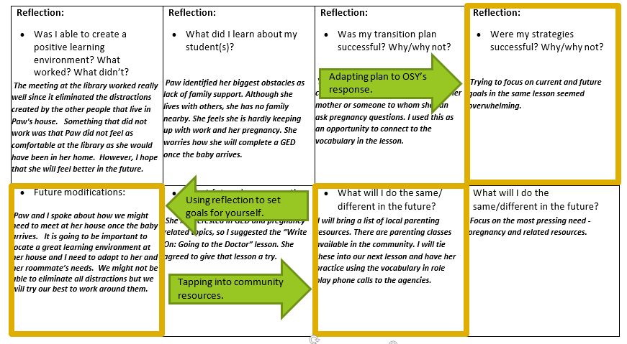
STOP AND DO: Reflection
Now take a moment to note these components on Paw’s Learning Plan Reflection:
www.osymigrant.org

Slide 36
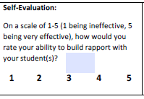
STOP AND DO: Reflection
Now take a moment to note these components on Paw’s Learning Plan Reflection:
Create a positive learning environment?
Build rapport with your student(s)?
Transition to instruction?
Implement young adult learning strategies?
Self Evaluation:
On a scale of 1-5, how would you rate your ability to…
www.osymigrant.org

Slide 37
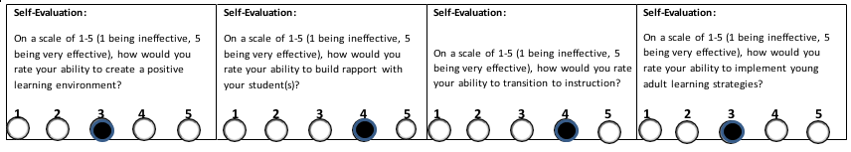
SAMPLE: OSY Instructional Action Plan
Evaluation for Paw
Be honest in the evaluation process; learn from what didn’t work and build on what did!
Incorporating my personal story really helped put Paw at ease with me and open up about her own family situation.
I was able to easily transition into the lesson I had planned since we had such a great conversation about her needs.
I planned too many strategies for this particular lesson. I will need to revisit the second strategy at a later time.
While working at the library was great in theory, Paw did not feel comfortable there.
www.osymigrant.org

Slide 38
Closing: OSY Instructional Action Plan
  For more information, see Sample OSY Action Plan
www.osymigrant.org

Slide 39
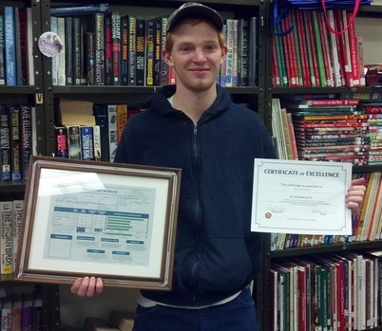
Success in Action
“Every new lesson offers another step to success”
- Terry Mark
www.osymigrant.org

Slide 40
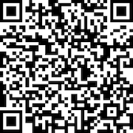
Evaluation
  How will you be using this with your OSY?
  Will it be helpful?
  What would you include?
www.osymigrant.org

