Slide 1
Technical Support Team Meeting
January 25-26, 2011
Kansas City, MO

Slide 2
Agenda: Day One
9:00-9:30 Welcome, Introductions, Overview of the Agenda, Opening Activity
9:30-10:00 Keeping the Momentum Going: How to Involve New and Experienced States
10:00-10:30 Discussion and Analysis of Survey Monkey Results
10:30-10:45 Break
10:45-11:45 Update on OSY Activities
11:45-1:00 Lunch
1:00-2:00 Discussion of Fidelity of Implementation Index and Timeline
2:00-3:15 Work Groups/Creation of Action Plans
3:15-3:30 Break
3:30-4:00 Continue Work Groups
Wrap Up and Adjourn for the Day
Notes:
Today we will be initially moving through a series of activities that are designed to help guide the work of the TST as a whole and each individual work group. We will be forming 4 work groups today that will be focused on ID&R, TA, Training, and Curriculum/Material Development. Keep this in the back of your mind as we focus our work this morning on the following agenda.
Find a partner/ someone you do not know. Ask them the following questions: name/state/capacity/ what would they be doing if they could do anything in the world? You will then introduce your partner to the rest of us.

Slide 3
Consortium States
Colorado
Florida
Idaho
Illinois
Kansas
Maryland
Massachusetts
Minnesota
Mississippi
Montana
Nebraska
New Hampshire
New Jersey
New York
North Carolina
Pennsylvania
South Carolina
Tennessee
Vermont
Washington
Wisconsin
Notes:
15 states currently participating: CO, FL, IL, KS, NE, NH, NJ, MT, NY, NC, PA, SC, TN, TX, VT
New states: Idaho, Maryland, Massachusetts, Minnesota, Mississippi, Washington

Slide 4
Collaborating Partners
Partner States
Partner Organizations
National Center for Farmworker Help (NCFH)
Adult Learning Resource Center (ALRC)
National PASS Center (NPC)
National HEP/CAMP Associations
Alaska
Arkansas
California
Indiana
Kentucky
Missouri
Texas
Notes:
HEP: High School Equivalency
CAMP: College Assistance Migrant Program

Slide 5
E Expectations of Consortium Member States
Collaborate with other member states and maintain ongoing communication
Participate in annual SST meetings
Collect data from SOSY State Directors, staff receiving training through SOSY and OSY
Implement SOSY activities
Notes:
Meetings will be held in conjunction with national MEP conferences in fall and spring
Activities include: SOSY website, piloting SOSY materials/strategies, SOSY training, sharing successful strategies/lessons learned
Results of data collection: analyze and use to refine programs/make adjustments as necessary
part of the responsibilities of SOSY member states. States will be expected to participate in 2 annual meetings. These meetings will be held in conjunction with the National MEP conferences in the spring and fall. In order for SOSY to meet its objectives, states must ensure continued collaboration and communication as well as working to implement SOSY activities (piloting SOSY materials, sharing successful strategies/lessons learned about OSY). As a result, states will be asked to provide feedback on all SOSY products and materials. Data will also be collected and reported to determine if progress is being made and ultimately to help refine SOSY resources and technical assistance

Slide 6
Expectations of Consortium Member States
Collect and report member state data
Provide feedback on all SOSY products and resources
Collaborate with SOSY Response Team to receive onsite TA, as requested
Recommend a representative to participate on the TST
Participate in Professional Development

Slide 7
Solutions for Out-of-School Youth
The goal of SOSY is to design services to improve the educational attainment of out-of-school migratory youth whose education is interrupted.
Notes:
Focus for services is twofold: Recovery youth and here-to-work youth as each group has very different needs
To support this goal, SOSY uses an organizing framework that focuses on systems to serve both “recovery youth” and “here-to-work” youth and the migrant staff who support them. SOSY uses innovative technology across all aspects of the project design, a SOSY clearinghouse to support audio files containing lessons and resources, packaged materials, strategies, and services that result in State capacity building and portability.

Slide 8
SOSY Objectives
Increase the number of OSY identified and recruited
Serve a larger number of OSY (includes OSY who are recovered from drop out, enrolled in programs leading to graduation, GED, and/or pursuing identified education or career goals)
Increase the number of OSY who meet performance standards on state-identified achievement assessments or identified education or career goals.
Notes:
Each year of the project, increase the number of OSY identified and recruited
Each year of the project, serve a larger number of OSY (includes OSY who are recovered from drop out, enrolled in programs leading to graduation, GED, and/or pursuing identified education or career goals)
Between the beginning and end of the project, increase the number of OSY who meet performance standards on state-identified achievement assessments or identified education or career goals.

Slide 9
Organizing Framework for SOSY
ID&R, staff development, technical assistance, communication/ collaboration, needs assessment, program administration, State capacity building, outreach/ awareness, evaluation
ID&R, PD, TA, communication/ collaboration, NA, program admin, State capacity building, outreach/awareness, evaluation
Needs, profile, plan of action, curriculum, assessment, progress monitoring, OSY activities
Systems
SOSY 2010
Staff from OSY, partner states, local MEPs in each state
Students
Staff

Slide 10
Responsibilities of the Technical Support Team
In order to achieve the goal of the SOSY consortium, a Technical Support Team (TST) will be created.
Comprised of recognized experts noted for their work with OSY or for their technical expertise in curriculum, graduation/career planning, technology, health education, ESL and/or GED/pre-GED.
Will complete the activities outlined in the Consortium’s Fidelity Implementation Index (FII):
Notes:
Technical Support Team plays a prominent role and meets or conference calls prior to each Steering Team meeting
The members of the TST and the SOSY Director will provide MEP staff and other state MEP directors with a training-of-trainers to improve MEP staff skills for meeting the educational needs of migrant OSY

Slide 11
Key features of OSY 2010
New and innovative technology across all aspects of the project
Systems
for OSY
success
Develop/
adapt,
materials
Loaded
MP3
players
Living
website
Student
performance
standards
Model for
developing
collabora-
tions
Portability
of OSY &
adaptability
Gover-
nance
structure/
involve-
ment
Reading
and
Math pre-
GED
Continued emphasis on ESL, life skills, and health lessons
Clearinghouse to support podcasts and other lessons and resources

Slide 12
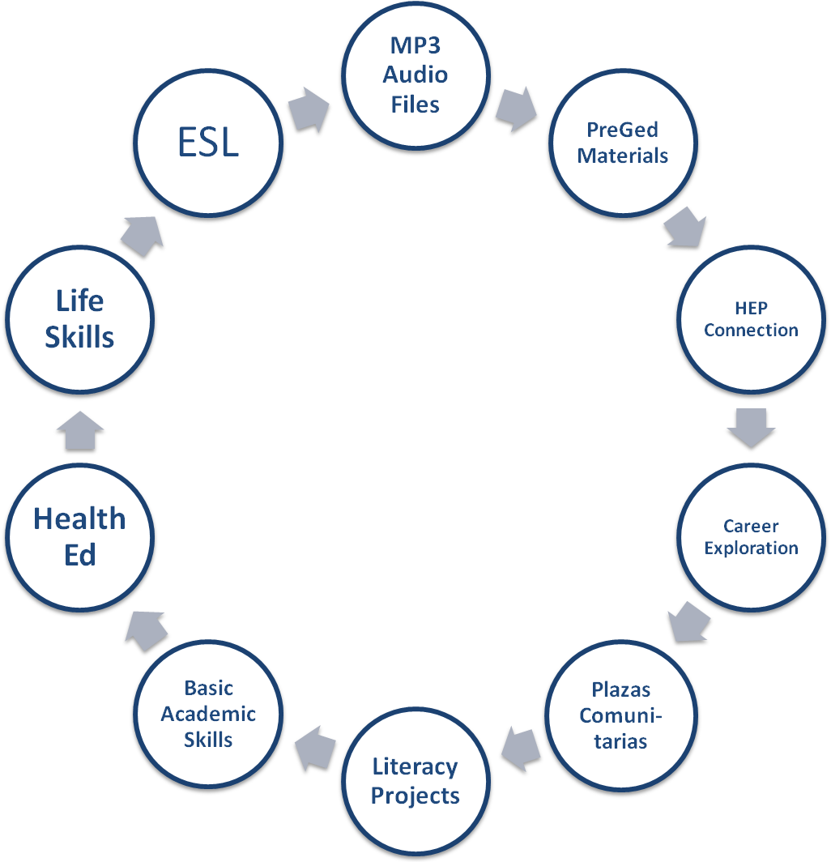
Areas of Support for Instruction
Instructional Support
OSY 2011

Slide 13
Keeping the Momentum Going
How to best involve new states
How to best increase involvement of experienced states
What do we need to focus on to move support for OSY forward in all states?

Slide 14
Survey Monkey Results
Highlights:
52.4% of respondents have accessed the SOSY website 10-15 times in the last 6 months
45% of respondents have recommended the SOSY website 10-15 times in the last 6 months
80% of respondents want increased types of resources provided
80% also want more curricula
Notes:
The survey was designed with a 2 fold purpose: elicit information from states in regard to how often the website is used/what types of resources are still needed/ part of the FII as you will see requires the creation of an information clearinghouse. The other purpose was to find out exactly what types of curricula are needed.
Each of you should have 5 dots in front of you. Take your 5 dots and highlight what you consider the most important places for the Curriculum work group to begin their discussion.
Wanted feedback from Consortium members in terms of how often they accessed website, what they want, their use, their recommendations of the website in order to move forward with creating an information clearinghouse.
38.1% have only accessed it 1-5 times
15% not at all
Store all of this information in the back of your minds as we move into a discussion of the FII

Slide 15
Survey Monkey Activity
Notes:
Dot activity: using the five dots you have in front of you, place them where you note areas of high need/importance or areas that you want the C&MD workgroup to explore in more depth.

Slide 16
Update on OSY Activities
How are you currently supporting OSY?
Share one strategy for getting started and/or one strategy that has been successful in providing services to OSY
How have you used materials/resources from the Consortium?
What technical assistance does your state need from SOSY?
Notes:
Discuss work to date: update website, information clearinghouse, form TST, working on health lesson plans, SST meeting, newsletters, updating forms, planning webinar for new states, planning conversations with each state director in regard to OSY

Slide 17
Fidelity Implementation Index
Review of FII
Deadlines and expectations
Fleshing out the indicators
Interest level
Expectations
Assignments

Slide 18
Fidelity Implementation Index Activity
Notes:
Dot activity: using the five dots you have in front of you, place them where you note areas of high need/importance or areas that you want the C&MD workgroup to explore in more depth.

Slide 19
Work Group Facilitators
1. Identification and Recruitment:
Bruce Wright and Jessica Castaneda
2. Curriculum and Material Development:
Bob Lynch and Brenda Pessin
3. Technical Assistance:
Margarita Colindres
4. Training:
Sonja Williams and TJ Sparling

Slide 20
Which Work Group?
Name | State | Position |  | Area of Expertise/Special Skills
Tracie Kalic | MO | SOSY Director
Frequency of Meetings |  |  | Team Responsibilities

Slide 21
Team Temperament: Thinkers, Shakers, Feelers, and Doers
Where Do you BEST fit?
Decide which description best describes you.
Go to that corner of the room and meet up with folks that have decided that they deal with situations much like you do
Discuss the following 3 questions.
Elect a “spokesperson” to share your results.
THINKERS Likes the big picture. Can see possibilities but would rather wait. “Let’s think about this awhile!”
DOERS Like details figured out.”Who is doing It?” “What will happen?” “ When are we starting?” Where are we going to do it?” “Why are we doing this now?”
FEELERS “It’s important that everyone feels good about this decision.”
SHAKERS Go for it! Active. “Give it a try!”, ” Let’s try this.” “We’ll figure out the details later!”
Notes:
What 3 words best describe your group’s strengths?
What 3 words describe your group’s weaknesses?
What 3 words best describe what others need to know about your group in order to work with you?

Slide 22
The 3 Questions
What 3 words best describe your group’s strengths?
What 3 words describe your group’s weaknesses?
What 3 words best describe what others need to know about your group in order to work with you?

Slide 23
Leadership Team Norms How did that experience:
Allow participants to have an honest discussion?
Ensure that everyone is heard?
Enable participants to openly address individual issues?
Ensure that everyone agrees to let go of personal agendas for the benefit of the immediate agenda and vision?
Meet on a consistent basis?
Ensure appropriate communication?
Notes:
1) Think about a successful collaborative experience
Writing norms helps create groups that are able to have honest discussions that enable everyone on the team to participate and be heard. Team members openly identify and address their individual issues, agreeing to let go of personal agendas for the sake of the team’s agenda and to become a genuine part of the leadership team. Creation of “ground rules” is the key purpose.

Slide 24
Creating Leadership Team Norms
When doing this consider:
Time
Listening
Confidentiality
Participation
Expectations
Accountability
Notes:
Materials : Note cards, Large sheets of paper
Time :
30 min.
Instructions:
During norming, the team finds a way to channel its chaotic energy into more productive means of communication and problem solving. Norming involves the decision to be a genuine part of the team and a willingness to let go of old patterns, unfinished business, past hurts and resentments and a need to control the outcome. (Conzemius and O’Neill, 2002)
Indicate to the group that effective teams usually have a set of norms that govern the group’s behavior, keeps the work fluid and enables the group to accomplish any task.
Give 5 note cards notes to each member of the group. This activity works best if everyone has similar writing tools.
Ask each person to reflect and record behaviors they consider ideal behaviors for a group. Have them write one idea on each of the cards. Time 10 minutes.
When doing this consider:
Time: When do we meet? Will we set a beginning and ending time? Will we start and end on time?
Listening: How will we encourage listening? How will we discourage interrupting?
Confidentiality: Will the meetings be open? Will what we say in the meeting be held in confidence? What can be said after the meeting?
Participation: How will we encourage everyone’s participation? Will we have an attendance policy? Is it allowable for anyone to not participate in the conversation?
Expectations: What do we expect from members? Are there requirements for participation?
Shuffle all the cards together.
Turn cards face up and read each card aloud. Allow time for the group members to discuss each idea. Tape each card to a display board so that all group members can see it. As each card is read aloud, ask the group to consider if it is similar to any other idea that has been expressed. Similar cards should be grouped together.
When all the cards have been sorted into groups, have the group write the norm suggested by the group of cards. Have one member record these new norms onto a large sheet of paper.
Review the proposed norms with the group. Determine whether the group can support the norms before the group adopts them.

Slide 25
Action Plans
FII Indicator | Person(s) Responsible | Activities | Timeline/Deadline | Communication Plan
Objective 1- Increased number of services to OSY
1.11 Train 2 staff per state on SOSY using a TOT model (7/11)
Objective 2-Larger number of OSY served
2.11 Train service providers on school/community resources (5/11)
Objective 3-Increased number of OSY who met performance standards on state-identified achievement assessments and/or identified education or career goals
3.7 Prepare a state training-of-trainers guide (3/12)

Slide 26
Action Plan Work Groups
4 work groups: ID&R, Curriculum & Materials, Technical Assistance, and Training
Creation of Action Plan
Outlines how each work group will address the specified indicator on the FII
Lists person(s) responsible
Timeline for completion
Backward mapping
My role on each work group
Lead Facilitator and Co-Facilitator

Slide 27
Agenda: Day Two
8:00-8:30 Breakfast
8:30-9:00 Review of previous day’s activities and outcomes
9:00-10:30 Review Work Group action plans and discussion
10:30-10:45 Break
10:45-12:00 Discussion of:
Communication plan
SOSY website
review of documents, data collection
report to SST
NASDME presentation
schedule additional meetings and conference calls, other issues
Wrap Up and Adjourn

