Slide 1

GOSOSY Technical Support Team
November 2-3, 2017
Louisville, KY
www.osymigrant.org

Slide 2

Welcome and Introductions
KY MEP Staff
Marty Jacobson
Lora Thomas, IL
www.osymigrant.org

Slide 3
Welcome to Kentucky
Christina Benassi, MEP Director, KY
Jessica Sanderson: KDE Migrant Consultant
Pedro Santiago: Northern Regional Recruiter
www.osymigrant.org

Slide 4
Member States
Alabama
Florida
Georgia
Illinois
Iowa
Kansas
Kentucky
Massachusetts
Mississippi
Nebraska
New Hampshire
New Jersey
New York
North Carolina
Pennsylvania
South Carolina
Tennessee
Vermont
www.osymigrant.org

Slide 5
Partner States
Alaska
Arkansas
California
Colorado
Idaho
Maryland
Minnesota
Missouri
Montana
Oregon
Washington
Wisconsin
www.osymigrant.org

Slide 6
Agenda–November 2
8:30 am- 5:00 pm
Welcome and Introductions – Tracie
Welcome to Kentucky and Overview of KY MEP
TST Agenda Review and Expectations for Our Time
Where Have We Been: Examination of and Discussion of APR data—Marty Jacobson
Where Are We Going: Discussion of the Future—Marty Jacobson
Updates from GOSOSY – Tracie Kalic and Others
Discussion and feedback on Professional Development Module
Discussion and feedback on Goal Setting and Learning Plans Samples
Feedback on ACeS Lit Review
Lunch on your own
Expectations of Work Groups and Assignments and Tasks outlined/ Work Group time
www.osymigrant.org

Slide 7
Technical Support Team
Expectations
Membership
State Director expectations
Requirements
  2-3 meetings per year
  Conference calls
  Work assignments
  Team Lead meeting
  Collaboration and coordination across groups
Work Norms
Be fully committed to the work and will demonstrate this commitment by meeting agreed upon deadlines, participating/attending meetings and calls until outcomes/goals are fully met.
Leave each meeting with tangible products/achievements synthesizing our meeting outcomes.
Use included reflection time to promote spontaneous, creative discussion.
www.osymigrant.org
Notes:
Purpose- responsibilites
Who to send?
Mentoring Pilot- World Education
Tracie will ask MA, TN, VT, GA, and CA
Mental Health-- KS
Goal Setting – TOT Work Group – Sonja Williams (lead)—Ernesto?
PD- Develop training to certified and non-certified staff – Jessica Castaneda (Lead)
ID&R – in collaboration with IRRC—Jennifer Almeda (lead)
Develop web-accessible lessons- Material Development—Bob Lynch and Brenda Pessin-- leads
With support and guidance from World Ed – Andy Nash
OSY Learning Plan—Emily Hoffman
With Steve Quonn

Slide 8
Expectations of Our Time
Provide feedback on agenda items, including training materials and material development
Complete work group tasks, outline timelines, and establish follow-up conference calls
Review evaluation data and the GOSOSY performance measures
Discuss structure of and plan the Dissemination Event
Learn about the impact of ACEs and mental health issues on OSY
Be able to use the Mental Health Lessons
www.osymigrant.org

Slide 9
GOSOSY Evaluation Data Collection
Marty Jacobson
META Associates
www.osymigrant.org

Slide 10
Objective 1: Achievement & Learning Plans
Performance Measure | Results
1.1 75% of OSY participating in project-directed instructional services will demonstrate a 20% gain between pre/post | 88% made a 20% gain (4% increase from Year 1) 2% more OSY received services compared to the baseline 18 states and 1,792 OSY used GOSOSY lessons (decreased from Year 1 because of very large decreases in a few states)
www.osymigrant.org
Notes:
The SOSOSY Training Manual has been designed to assist states in the development of systems to support Out-of-School Youth. SOSOSY Training Manual has been created to assist states in creating a system to identify, recruit and provide services to OSY. This document serves as a workbook for states to develop or improve their current services and support programs for OSY. It outlines the steps to gather and analyze OSY data, plan for service delivery, access best practices in curriculum and instruction, as well as create education plans and address advocacy needs of the OSY population.

Slide 11
Use of GOSOSY Materials
State | Year 1 | Year 2 | Change
 | # Using Materials | # Using Materials
AL | 40 | 22 | -18
FL | 921 | 250 | -671
GA | 8 | 62 | 54
IL | 9 | 85 | 76
IA | 0 | 6 | 6
KS | 215 | 200 | -15
KY | 142 | 44 | -98
MA | 10 | 41 | 31
MS | 8 | 56 | 48
NC | 210 | 362 | 152
NE | 27 | 15 | -12
NH | 27 | 13 | -14
NJ | 98 | 88 | -10
NY | 133 | 99 | -34
PA | 152 | 204 | 52
SC | 22 | 152 | 130
TN | 30 | 34 | 4
VT | 102 | 59 | -43
Total | 2,154 | 1,792 | -362

Slide 12
Year 2 Assessment Results
 | # Pre/ Post-Tested | # (%) Gaining 20%
AL | 22 | 19 (86%)
FL | 192 | 164 (85%)
GA | 52 | 33 (63%)
IL | 27 | 27 (100%)
IA | 3 | 3 (100%)
KS | 75 | 69 (92%)
KY | 44 | 43 (98%)
MA | 34 | 28 (82%)
MS | 8 | 3 (38%)
NC | 99 | 91 (92%)
NE | 8 | 3 (38%)
NH | 4 | 4 (100%)
NJ | 53 | 46 (87%)
NY | 71 | 67 (94%)
PA | 117 | 115 (98%)
SC | 152 | 128 (84%)
TN | 15 | 12 (80%)
VT | 42 | 40 (95%)
Total | 1,018 | 895 (88%)

Slide 13
Objective 1: Achievement & Learning Plans
Performance Measure | Results
1.2 75% of OSY with a Learning Plan (LP) will attain an average of 50% of the learning/achievement objectives | 79% met half of the objectives. Average LP had 4.1 goals and 2.7 were completed.
1.3 Attendance by 54 OSY (consortium wide) at Goal Setting Workshops and attain acceptable or above average score on GSW rubric | 161 attended with acceptable GSW rubric score, which was 83.4% of those attending. 11 states had 3 or more attending.
1.4 Rating 4 or above on 95% of Year 1 FII activities | All activities were fully implemented
www.osymigrant.org
Notes:
The SOSOSY Training Manual has been designed to assist states in the development of systems to support Out-of-School Youth. SOSOSY Training Manual has been created to assist states in creating a system to identify, recruit and provide services to OSY. This document serves as a workbook for states to develop or improve their current services and support programs for OSY. It outlines the steps to gather and analyze OSY data, plan for service delivery, access best practices in curriculum and instruction, as well as create education plans and address advocacy needs of the OSY population.

Slide 14
 | # OSY with Learning Plan | Average number of steps toward goal | Average number of steps completed | # (%) completing 50% or more of the steps
AL | 2 | 5.0 | 3.0 | 2 (100%)
FL | 14 | 4.2 | 2.6 | 9 (64%)
GA | 27 | 2.9 | 2.8 | 25 (93%)
IA | 3 | 5.0 | 4.3 | 3 (100%)
IL | 7 | 6.0 | 6.0 | 7 (100%)
KS | 12 | 3.7 | 2.8 | 11 (92%)
KY | 5 | 4.6 | 4.6 | 5 (100%)
MA | 2 | 8.0 | 0.0 | 0 (0%)
MS | 45 | 4.0 | 2.4 | 45 (100%)
NC | 13 | 3.3 | 2.7 | 12 (92%)
NE | 5 | 3.0 | 3.0 | 5 (100%)
NH | 4 | 4.0 | 2.5 | 3 (75%)
NJ | 113 | 4.2 | 2.6 | 79 (70%)
NY | 11 | 4.4 | 2.1 | 4 (36%)
PA | 2 | 3.0 | 2.0 | 2 (100%)
SC | 20 | 5.0 | 2.5 | 12 (60%)
TN | 4 | 4.3 | 2.5 | 3 (75%)
VT | 0 | -- | -- | --
All | 289 | 4.1 | 2.7 | 227 (78.5%)

Slide 15
 | # Attending GSW | # Scoring proficient on the GSW Rubric | % Scoring proficient on the GSW Rubric
AL | 2 | 2 | 100%
FL | Not Available* | Not Available | N/A
GA | 35 | 35 | 100%
IA | 11 | 11 | 100%
IL | 7 | 7 | 100%
KS | 12 | 10 | 83%
KY | 0** | N/A | N/A
MA | 2 | 1 | 50%
MS | 3 | 2 | 67%
NC | 115 | Not Available*** | N/A
NE | 14 | 12 | 86%
NH | 5 | 5 | 100%
NJ | 4 | 4 | 100%
NY | 44 | 30 | 68%
PA | 12 | 8 | 67%
SC | 2 | 2 | 100%
TN | 20 | 12 | 60%
VT | 20 | 20 | 100%
All | 193 | 161 | 83%

Slide 16
Objective 2: Professional Development
Performance Measure | Results
2.1 75% of staff completing PD increase skills by 10% between pre- and post-assessment | 77% made a 10% gain (8% decrease) 234 trainings in 18 states 2,862 participants trained (486 increase)
2.2 75% of states average of 5 PD/mentoring collaborations | 100% had 5 or more collaborations
2.3 75% of recruiters tested achieve “proficient” on OSY ID&R skills assessment | 85% were proficient 4 states did not report results for Year 2 (2 of those reported in Year 1)
2.4 Rating 4 or above on 95% of Year 1 FII activities | All activities were fully implemented
www.osymigrant.org
Notes:
The SOSOSY Training Manual has been designed to assist states in the development of systems to support Out-of-School Youth. SOSOSY Training Manual has been created to assist states in creating a system to identify, recruit and provide services to OSY. This document serves as a workbook for states to develop or improve their current services and support programs for OSY. It outlines the steps to gather and analyze OSY data, plan for service delivery, access best practices in curriculum and instruction, as well as create education plans and address advocacy needs of the OSY population.

Slide 17
 | # Recruiters Assessed | # (%) Proficient | Assessment Used
AL | 15 | 15 (100%) | IRRC
FL | ** | ** | --
GA | 111 | 81 (73%) | IRRC
IA | 6 | 6 (100%) | IRRC
IL | 39 | 39 (100%) | IL MEP Recruiter Competency-Based Skill Assessment
KS | 18 | 18 (100%) | IRRC
KY | 16 | 11 (69%) | IRRC
MA | 5 | 5 (100%) | MA State Recruiter Assessment
MS | 3* | 3 (100%) | MS State Recruiter Assessment
NC | 24 | 24 (100%) | NC Practical Assessment
NE | 13 | 9 (69%) | MEP ID&R Competency Skills Assessment
NH | 2 | 2 (100%) | IRRC
NJ | 19* | 17 (89%) | IRRC
NY | 1 | 1 (100%) | IRRC
PA | ** | ** | --
SC | 3 | 2 (67%) | IRRC
TN | 8 | 7 (88%) | MEP Skills Assessment
VT | 5 | 5 (100%) | SOSOSY Knowledge Assessment
Total | 288 | 245 (85%)
*Year 1 Results **No assessment results reported

Slide 18
Objective 3: State Processes
Performance Measure | Results
3.1 Five products developed/ adapted/vetted/adopted by 18 states | Year 3
3.2 GOSOSY Dissemination Event (DE) for 200+ staff is planned, implemented, evaluated | Year 3
3.3 Rating 4 or above on 95% of Year 1 FII activities | All activities were fully implemented
www.osymigrant.org
Notes:
The SOSOSY Training Manual has been designed to assist states in the development of systems to support Out-of-School Youth. SOSOSY Training Manual has been created to assist states in creating a system to identify, recruit and provide services to OSY. This document serves as a workbook for states to develop or improve their current services and support programs for OSY. It outlines the steps to gather and analyze OSY data, plan for service delivery, access best practices in curriculum and instruction, as well as create education plans and address advocacy needs of the OSY population.

Slide 19
Cover Sheets
All states will have a copy of the performance report and cover sheet by 10/27
The only thing states need to complete is the signature and date
Please start the process immediately upon receipt to avoid holiday vacations
Cover sheets should be sent UPS or FedEx to arrive by Friday December 1, 2017
www.osymigrant.org

Slide 20
What’s New in Year 3
New Fidelity of Implementation Index (FII)
1.1g Disseminate lists of ESL materials and provide tips for use
3.1a Disseminate catalog of materials for selection and adoption of 5 products
3.1b disseminate the lit review on OSY research/promising practices
3.2b Carry out logistics for the GOSOSY Dissemination Event
3.2d Participate and present at the GOSOSY Dissemination Event
www.osymigrant.org

Slide 21
Product Pilot Review
Lists all products developed by GOSOSY
States are asked to adopt or adapt 5 by the end of the project
20 possible products are listed on the Pilot Product Review Form
We will send this form to all states in the spring
Each state will submit ONE form
www.osymigrant.org

Slide 22
GOSOSY Year 3 FII

Slide 23
Planning for the Future
New CIG competition in 2018
Reviewing draft objectives today
Call with all interested states to finalize participation expectations, timelines, and objectives in November or December
www.osymigrant.org

Slide 24
Big Ideas
OME is interested in dropout prevention
Greater emphasis for more collaboration with HEP/CAMP
Many states have expressed interest in using materials with secondary youth as well as OSY
www.osymigrant.org

Slide 25
Draft Objectives
Objective 1: Increase OSY and secondary youth academic skills through direct instructional services. Prepare youth for careers through mentoring and goal setting.
  Key activities: Create website update with student section, expand mentoring, and continue use of life skills lessons with addition of secondary youth.
www.osymigrant.org

Slide 26
Draft Objectives
Objective 2: Improve quality of strategy implementation through staff development and follow-up.
  Key activities: package materials by linking components, create a follow-up guide for checking in on implementation, train practitioners in mentoring skills, and promotion of youth self-advocacy
www.osymigrant.org

Slide 27
Draft Objectives
Objective 3: Build systems for collaboration through connections with HEP/CAMP, WIA, NFJP, and among states.
  Key activities: collaboration among CIGs, map of services providers and eligibility for other programs, develop list of best practices from all states, and create plans for collaboration with project level MOUs.
www.osymigrant.org

Slide 28
GOSOSY Updates
GOSOSY SST Meeting– October 18, 2017
OME Quarterly Monitoring
State OSY Profile reports
GOSOSY Website
  Success Stories
GOSOSY newsletter
  State articles
  State Spotlight
www.osymigrant.org

Slide 29

GOSOSY Website
www.osymigrant.org

Slide 30
OSYMigrant.net
Google Analytics
January 1 – September 14, 2017
www.osymigrant.org

Slide 31
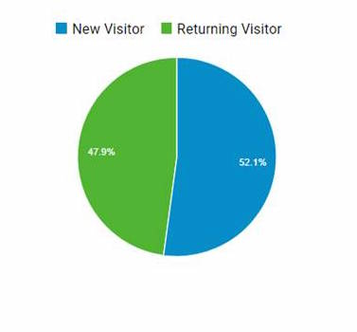
Visitors
2,737 total
www.osymigrant.org

Slide 32
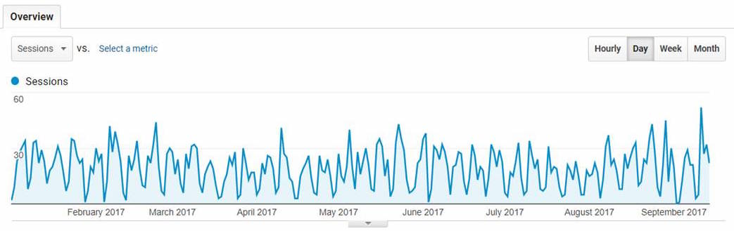
Overview
www.osymigrant.org

Slide 33
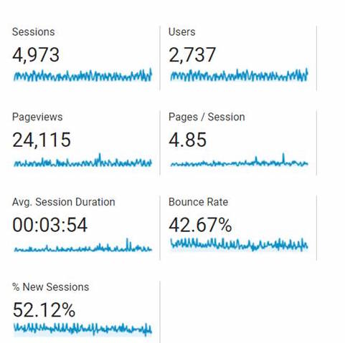
Statistics
www.osymigrant.org

Slide 34
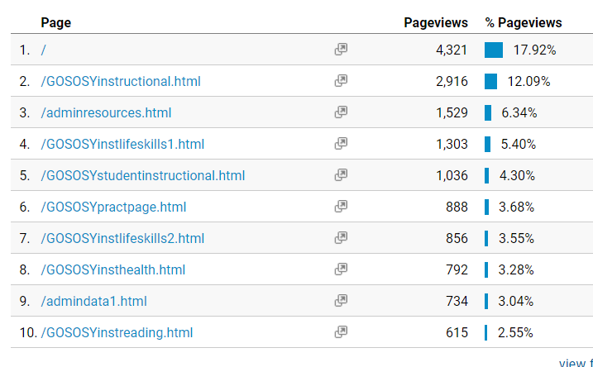
Pages
www.osymigrant.org

Slide 35
Work Groups
  OSY Learning Plan
  Goal Setting
  Professional Development
  Material and Curriculum Development
  Identification and Recruitment
  OSY Literature Review
www.osymigrant.org
www.osymigrant.org

Slide 36

OSY Learning Plan
Members
Emily Hoffman (MA-lead)
Margot Di Salvo (FL)
Sarah Braun-Hamilton (VT)
Activities
OSY Learning Plans (Student version and Provider version) were implemented over the summer with more than 300 OSY completing a Learning Plan.
www.osymigrant.org

Slide 37
Goal Setting Workshop
Members
Joyce Bishop (AL)
April Dameron (IA)
Carmen Anderico (MS)
Activities
Goal Setting Implementation Guide was amended per pilot feedback.
Almost 200 OSY were involved in summer the Goal Setting Pilot throughout all 18 member states.
www.osymigrant.org

Slide 38
Goal Setting and Learning Plans
Activity and Discussion
From the examples provided, as well as how your state may have used the goal setting/learning plan activities:
  How were the materials used?
  Suggestions for modifications or additional pieces?
  Who do you suggest implement these materials?
  Who do you see these materials having the strongest impact with?
www.osymigrant.org

Slide 39
Professional Development
Members
Kiowa Rogers (NE - lead)
Joan Geraci (NJ – lead)
Sabrina Rivera-Pineda (GA)
Odilia Coffta (NY)
Lysandra Alexander (PA)
Activities
Completed Module 1, Implementing the OSY Action Plan, and released on GOSOSY website.
Completed three Resource Guides to accompany Module 1:
    Strategies for Creating an Effective Learning Environment Resource Guide
    OSY Conversation Starters/Bridges to Academic Instruction Resource Guide
    Young Adult Learning Resource Guide
Began development of five “mini modules” for presentation to TST members in November. To include:
  An Introduction to Out-of-School Youth
  Strategies for One-on-One and Small Group Instruction
  Addressing the Specific Needs of OSY with Limited Formal Schooling
  Using Differentiation Strategies when Working with Various Learning Styles
  Working with Language Learners

Slide 40
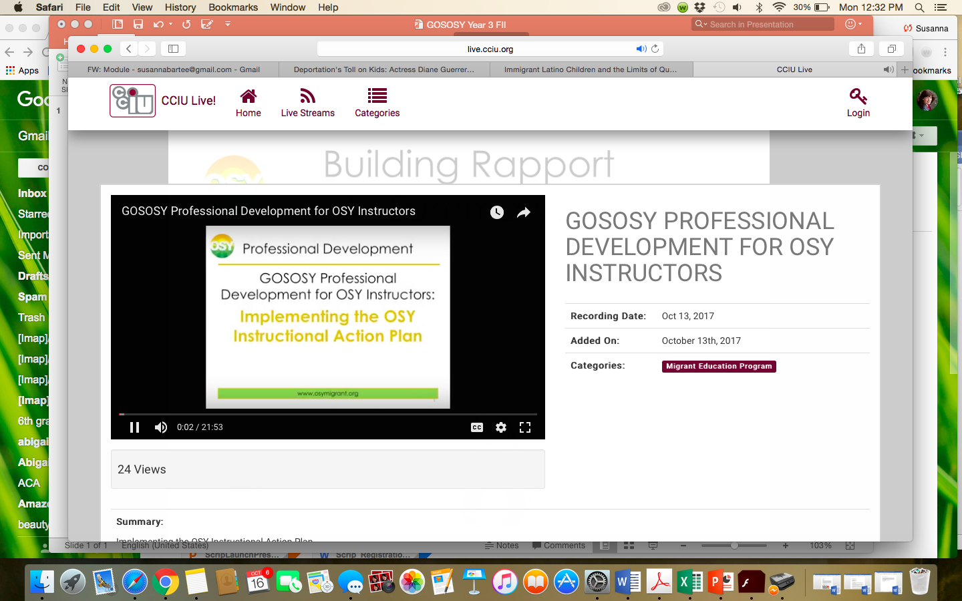
Professional Development Video

Slide 41

Professional Development
GOSOSY Professional Development for OSY Instructors:
Identifying and Addressing the Needs of OSY:
Working with Language Learners
www.osymigrant.org

Slide 42
Acknowledgements
GOSOSY Professional Development Group and Contributors
Lysandra Alexander (PA); Susanna Bartee (KS); Odilia Coffta (NY); Joan Geraci (NJ); Tracie Kalic (GOSOSY); Sabrina Pineda (GA); Kiowa Rogers (NE)
GOSOSY PD Reviewers and Technical Support Team members and the State Steering Support Team
www.osymigrant.org

Slide 43
Statement of Purpose
This module is intended to assist service providers who are tasked with working with OSY who are English Learners (ELs).
www.osymigrant.org
Notes:
Given the understanding that all students are different and learn in a variety of ways and that there is no “magic formula” to working with students; this module is intended to provide a framework for providing support.
Getting to know your students on an individual basis and tailoring your lessons to their specific needs is always the best approach to take when working with any at-risk population.

Slide 44
Learner Characteristics
There are different levels of language ability
Social English may be acquired quickly
Academic English takes years to master
Students learn language at their own pace
ELs need practice in Listening, Speaking, Reading and Writing
The best language learning occurs when students are at ease
www.osymigrant.org
Notes:
Given the understanding that all students are different and learn in a variety of ways and that there is no “magic formula” to working with students; this module is intended to provide a framework for providing support.
Getting to know your students on an individual basis and tailoring your lessons to their specific needs is always the best approach to take when working with any at-risk population.

Slide 45

Learner Characteristics
The Stages of Language Learning are as follows:
  Pre-production (silent period)
  Early Production (low beginner)
  Speech Emergence (high beginner)
  Intermediate Fluency
  Fluent
For detailed information see the Stages of Language Learning chart pictured in the next slide
  For the full document, see Stages of Language Learning document
www.osymigrant.org
Adapted from: http://www.ascd.org/publications/books/108052/chapters/The-Stages-of-Second-Language-Acquisition.aspx
Notes:
Insert new picture once document is updated

Slide 46
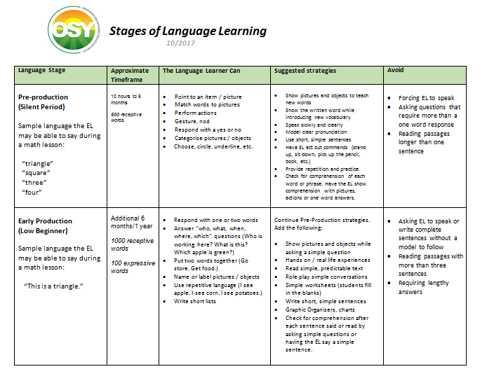
Learner Characteristics
  For the full document, see Stages of Language Learning document
www.osymigrant.org
Adapted from: http://www.ascd.org/publications/books/108052/chapters/The-Stages-of-Second-Language-Acquisition.aspx
Notes:
Insert new picture once document is updated

Slide 47
Working with English Learners:
Before the Lesson
Know the EL’s language level. Utilize a screening tool to determine the language level.
The OSY English Language Screener (linked below) is a good resource.
  http://osymigrant.org/GOSOSYinstorallanguage.html
  This is a basic assessment for beginners. If this screener is too easy for the EL, talk to your supervisor about other assessment options.
Refer to the Stages of Language Learning chart for strategies to implement and avoid at the EL’s language level.
Find out whether the EL is literate in his or her first language. If so, using bilingual materials may be helpful. If not, the following module may be helpful: Addressing the Specific Needs of OSY with Limited Formal Schooling.
  For the full module, see Addressing the Specific Needs of OSY with Limited Formal Schooling
www.osymigrant.org

Slide 48
Working with English Learners:
Before the Lesson
Identify key vocabulary
Prepare visual aids to teach vocabulary:
  Real objects
  Images
  Flashcards
  Dry erase board, markers, sketch pad and pens to draw vocabulary
Think of simple phrases to describe or explain key vocabulary
Plan activities that the EL can do to practice the vocabulary:
  Games
  Simple worksheets
  Conversation starters
  Role plays
www.osymigrant.org

Slide 49
Working with English Learners:
During the Lesson
Help the EL feel at ease:
  Relax
  Show confidence that you can communicate
  Use positive body language (i.e. smile, nod)
Focus on communication rather than grammar or pronunciation:
  Encourage the EL to respond and speak
  Model correct grammar and pronunciation
  Rephrase rather than overtly correcting mistakes
  Use a dictionary or online translation site
Provide opportunities for the EL to interact and show understanding in a variety of ways:
  Through pictures
  Through actions
  Through verbal responses
www.osymigrant.org

Slide 50
Working with English Learners:
During the Lesson
After asking a question, allow plenty of wait time for the EL to respond:
    8 seconds is recommended as a minimum
    Encourage any response, but don’t rush students to respond
Watch the student’s body language. If s/he seems confused (fearful look, blank stare), be ready to modify the way you are presenting the lesson.
Try a different approach if the EL doesn’t respond as expected:
    Present the question in a different manner (rephrase, write, draw)
    Allow the EL to respond non-verbally by:
      Pointing, gesturing, acting out a response
      Selecting from a group of pictures
      Choosing a word card
www.osymigrant.org

Slide 51
Checking for Understanding
Review the vocabulary you taught. Check for understanding by having the OSY:
  Match pictures to words (pre-production, early production)
  Use the word in a sentence (high beginner)
  Do a role play using the vocabulary words (speech emergence, intermediate)
  Describe or explain the words (fluent)
For additional ideas, see the Stages of Language Learning document linked below
  For the full document, see Stages of Language Learning document
www.osymigrant.org

Slide 52
Working with English Learners:
After the Lesson
Learn from your students:
  Reflect on how their responses can help you improve the way you communicate with the EL in the future:
      Which strategies did the EL seem to embrace the most?
      What other topics / vocabulary has the EL expressed interest in?
Reflect on what opportunities you can give the ELs to communicate effectively with you:
      With which response type did they seem most comfortable?
      (drawing, selecting pictures, actions, role play, writing, etc.)
Use student responses and ability to select materials for the next lesson.
Do not hesitate to change/adjust future lessons based on what you observed.
www.osymigrant.org

Slide 53
Participant Feedback
Fill out the GOSOSY online evaluation below:
  https://www.surveymonkey.com/r/PGY5NK5
  Facilitator follow -up questions for group training:
  What did you learn?
  What did you find most helpful or beneficial?
  How will you be using this with your youth?
  What recommendations do you have for future training?
www.osymigrant.org

Slide 54

Professional Development
GOSOSY Professional Development for OSY Instructors:
Using Differentiation Strategies when Working with Various Learning Styles
www.osymigrant.org

Slide 55

Acknowledgements
GOSOSY Professional Development Group and Contributors
Lysandra Alexander (PA); Susanna Bartee (KS); Odilia Coffta (NY); Joan Geraci (NJ); Tracie Kalic (KS); Sabrina Pineda (GA); Kiowa Rogers (NE)
GOSOSY PD Reviewers and Technical Support Team members and the State Steering Support Team
www.osymigrant.org

Slide 56
Statement of Purpose
This module will teach you how to provide effective lessons when instructing groups of students with varying levels and learning styles.
www.osymigrant.org

Slide 57

Differentiated Instruction: What is it?
A differentiated lesson is one where all students are learning the same material in different ways.
To create an effective lesson using differentiated instruction, it is important to have a balance between what you are teaching and how the students are learning.
www.osymigrant.org

Slide 58

Before the Lesson: Elements to Consider
The students level of readiness - how prepared they are to learn specific
information or skills. An informal assessment should be conducted to make this determination.
Interest – What appeals to the students interests?
If they are interested in what they are being taught they will be more motivated to learn.
Determine what they like, their hobbies, which sports, places or food they enjoy
Learning Profile – How the student approaches learning and learns best:
visual, auditory, kinesthetic, multi-modality.
www.osymigrant.org

Slide 59
In order to achieve balance for an effective lesson, the following four elements need to be considered:
Before the Lesson: Elements to Consider
Content: What does the student need to learn?
Process: How the student makes sense of the content being taught. Students have
different ways of learning such as:
 Visual – Student learns better by seeing (pictures, photographs, textbooks)
 Auditory – Student learns better by listening (audio books, music, lecture)
 Kinesthetic – Student learns better by using hands-on activities and movement
 Multi-modality – students learn by a combination of more than one learning style
continued
www.osymigrant.org

Slide 60
3. Product: How the student demonstrates what they have learned.
 quizzes/tests
 projects
 activities
 oral reports and/or written reports, etc.
Before the Lesson: More Elements to Consider
4. Affect: The feelings and attitudes that impact the students’ learning.
Create a safe and supportive environment
Be respective of the students thoughts and feelings
Lessons should be interesting and challenging
If the students are interested in the subject matter and feel supported by their teacher and peers, they will be motivated to learn
www.osymigrant.org

Slide 61

During the Lesson: Creating Successful Differentiated Group Instruction
Flexible grouping can be used to ensure success. Groups don’t always have to be the same; they can continually change.
Here are some suggestions:
Group according to academic level
Group according to learning styles (visual, auditory or kinesthetic)
Group based on prior knowledge (how much the students know about the topic)
Group according to interests
Group based on English language skills
For more ideas: Link to One on One and Small Group Instruction Powerpoint
www.osymigrant.org

Slide 62
During the Lesson: Creating Successful Differentiated Group Instruction
A Learning Community is a group of people who share common goals and attitudes. They help foster success among students with different ability levels and learning styles.
Here are some suggestions for building a learning community:
Encourage students to collaborate. Allowing them to share individual strengths can increase productivity in the group as they learn from each other.
Encourage students to have a voice in how the learning community works and take responsibility for solving problems.
Encourage different viewpoints and ideas.
Consider that relationships may already exist between students. Remember that many OSY live and work together and bring their life experience to the learning setting. Understanding and working with these relationships can impact the success of your group.
For more information on Learning Communities: (links)
www.osymigrant.org

Slide 63
Strategies for Differentiated Instruction
RAFT – is a writing strategy that can be used in all content areas and offers students a choice in how to focus and complete their writing assignment.
R is for Role – the person or thing that the students will become.
A is for Audience – the person or people who will be reading the finished product.
F is for Format – the way in which the writing will be done. Examples might
include letter, brochure, memo, speech, comic or advertisement.
T is for Topic – what the writing will discuss. Students can demonstrate their
mastery of content knowledge in this matter.
RAFT allows for differentiated instruction because students get a choice in their assignment based on their interest and preferred style of learning.
www.osymigrant.org

Slide 64

An Example of RAFT
Example: Teacher reads aloud to all students, a paragraph on a popular place they all said they want to visit, sharing important facts about the location.
RAFT activity:
Advanced students - take the role of a travel agent and the format of creating a travel brochure for an audience of tourists on the topic of the popular place
Intermediate students - take the role of a tourist writing and addressing the format of a postcard to the audience of friends
Beginner students – take the role of the interesting place identified with the audience of potential tourists, in creating the format of a poster to encourage people to visit them
www.osymigrant.org

Slide 65

Strategies for Differentiated Instruction-continued
Graphic Organizer - uses visual symbols to give information, concepts, thoughts or ideas and show
the relationship between them.
Example:
www.osymigrant.org

Slide 66
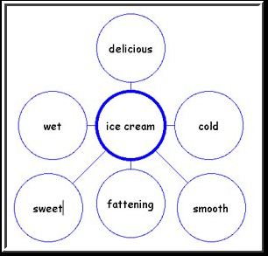
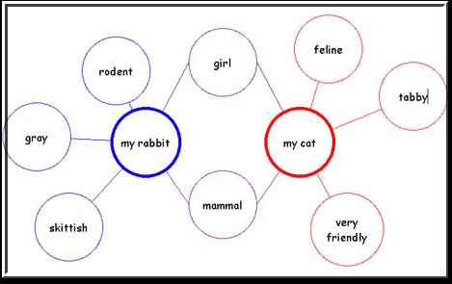
Strategies for Differentiated Instruction-continued
Examples: Bubble Map, double bubble map, flow chart
www.osymigrant.org

Slide 67
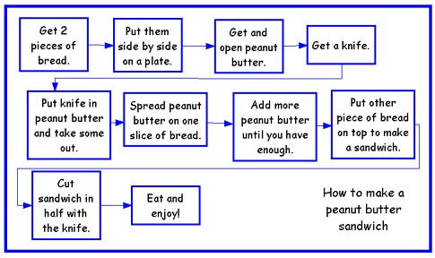
Strategies for Differentiated Instruction-continued
Example: Flow chart
www.osymigrant.org

Slide 68
Strategies for Differentiated Instruction-continued
Tiered Instruction:
all students learn the same skills but at different levels.
Teachers make slight adjustments within the same lesson to meet needs of the students.
The activities challenge students at their ability level.
Example: Teacher reads aloud to all students, a paragraph on a popular place they all said they want
to visit, sharing important facts about the location.
 Advanced students – can write a paragraph describing the place, what they found interesting and surprising and why.
 Intermediate students - can list the facts they found most interesting or
surprising and write a sentence for each fact, stating what they found interesting/
surprising.
 Beginner students – give students a Double Bubble graphic organizer. One bubble is labeled
“interesting” and the other labeled “surprising.” Have students select words from a fact
word bank you have provided and copy the words into the correct bubbles (interesting/surprising), in which they believe the words belong.
www.osymigrant.org

Slide 69
Strategies for Differentiated Instruction-continued
Technology – Technology based lessons (iPads, laptops, computers) are useful in teaching
students of various learning styles.
Examples: SAS Curriculum Pathways, Moby Max
Online resources that provides interactive lessons, videos, audio tutorials, and apps for English language arts, mathematics, science, social studies, and Spanish.
Through the various interactive resources students learn, practice skills, and have assessments to email, print, or save.
This information helps teachers continue to group students based on their needs.
https://www.sascurriculumpathways.com
www.mobymax.com
www.osymigrant.org

Slide 70
After the Lesson: Assessment
Providing continual assessment helps you see what information has been learned and where further instruction is needed. Assessments help you plan grouping and activities based on your students’ levels.
Here are some suggestions:
Review assessment results regularly to gauge student progress
Change instruction as needed based on assessment results
Use creative ways to help students prepare for assessments
  Create charts or posters that can be left on display
  Develop or have students create study guides
  Leave instructional materials with students (flashcards, games, etc.)
www.osymigrant.org

Slide 71
After the lesson: Assessment
There are two types of assessment: formal and informal.
Formal assessments are given to students individually that systematically measure learning and can be scored.
Examples of Formal Assessments:
Tests and quizzes
May be written, oral, multiple choice, etc.
Formal assessments available on the GOSOSY Website are linked below
www.osymigrant.org

Slide 72
After the lesson: Assessment
Informal assessments enable an instructor to evaluate students’ performance. They can be interactive, engaging, and hands-on.
Examples of Informal Assessments:
Thumbs up / thumbs down hand response to questions
Quick write (students write the answer on a whiteboard, note card etc.)
Holding up a Yes / No card
Turn and share with a partner
Role play activities
Oral questions to which the student responds
Be creative and have fun with your informal assessments!
www.osymigrant.org

Slide 73
Experts in differentiated instruction recommend:
The teacher’s role in the differentiated classroom is to continually ask him/herself:
“What does this student need at this moment in order to be able to learn and progress with this content?”
“What do I need to do to make that happen?”
Tomlinson and Imbeau (2010)
www.osymigrant.org

Slide 74
Helpful Differentiated Instruction Websites
http://education.ky.gov/educational/diff/documents/strategiesthatdifferentiateinstruction4.12.pdf
https://www.cultofpedagogy.com/starter-kit-differentiated-instruction/
https://www.edutopia.org/stw-differentiated-instruction-replication-tips
www.osymigrant.org

Slide 75
Literature Review
Members
Jessica Castañeda (lead)
Susanna Bartee
John Farrell
Activities
Continued research into Adverse Childhood Experience (ACEs) study and materials available.
Draft was completed and is under revision for completion this year.
www.osymigrant.org

Slide 76

Adverse Childhood Experiences
ACEs

Slide 77

We need an Understanding of how
Adverse Childhood Experiences
Impact OSY

Slide 78



Slide 79

Adverse events or experiences that occur early in childhood can have lifelong consequences for both physical and mental well-being.

Slide 80

Only recently have medical investigators in primary care settings begun to examine associations between childhood abuse and adult health risk behaviors and disease.

Slide 81

Traumatic experiences during childhood, including physical abuse and the adversities that accumulate for children reared in persistent poverty, may disturb the neurobiological systems that guide physiological and behavioral responses to stress, potentially for the remainder of a persons life.

Slide 82
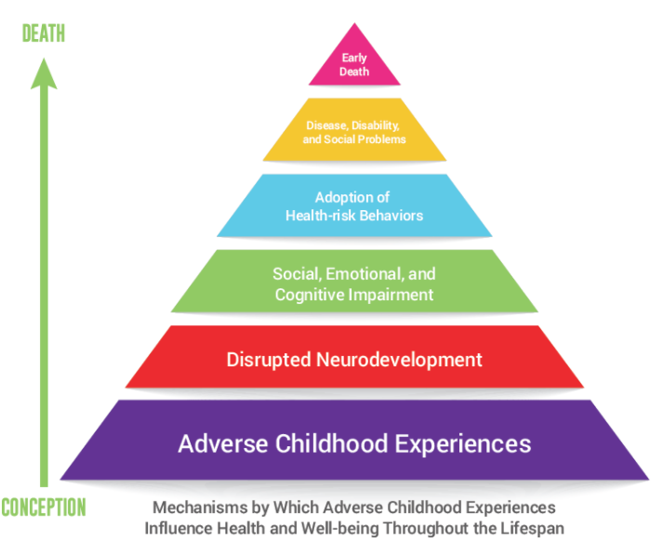

Slide 83

In 1985, Dr. Vincent Felitti, chief of Kaiser Permanente’s revolutionary Department of Preventive Medicine in San Diego, CA, could not figure out why more than half of the people in his obesity clinic dropped out each year for five years straight.

Slide 84

Public health experts, social service workers, educators, therapists, and policy makers commonly regard addiction as a problem. Some, however, are beginning to understand that turning to drugs is an expected response to serious childhood trauma, and that telling people who smoke or overeat or overwork that they should stop because these things are bad for them does not work when those behaviors provide a temporary, but gratifying, solution to a bigger problem.

Slide 85

Kaiser Permanente in San Diego was a perfect place to do a mega-study. More than 50,000 members came through the department each year for a comprehensive medical evaluation.

Slide 86

Anda and Felitti developed a scoring system for ACEs. Each type of adverse childhood experience counted as one point. If a person had none of the events in her or his background, the ACE score was zero. If someone was verbally abused thousands of times during his or her childhood, but no other types of childhood trauma occurred, this counted as one point in the ACE score. If a person experienced verbal abuse, lived with a mentally ill mother and an alcoholic father, his ACE score was three.

Slide 87

Things start getting serious around an ACE score of 4. Compared with people with zero ACEs, those with four categories of ACEs had a 240% greater risk of hepatitis, were 390% more likely to have chronic obstructive pulmonary disease (emphysema or chronic bronchitis), and a 240% higher risk of a sexually-transmitted disease.

Slide 88

People with high ACE scores are more likely to be violent, to have more marriages, more broken bones, more drug prescriptions, more depression, more auto-immune diseases, and more work absences.

Slide 89
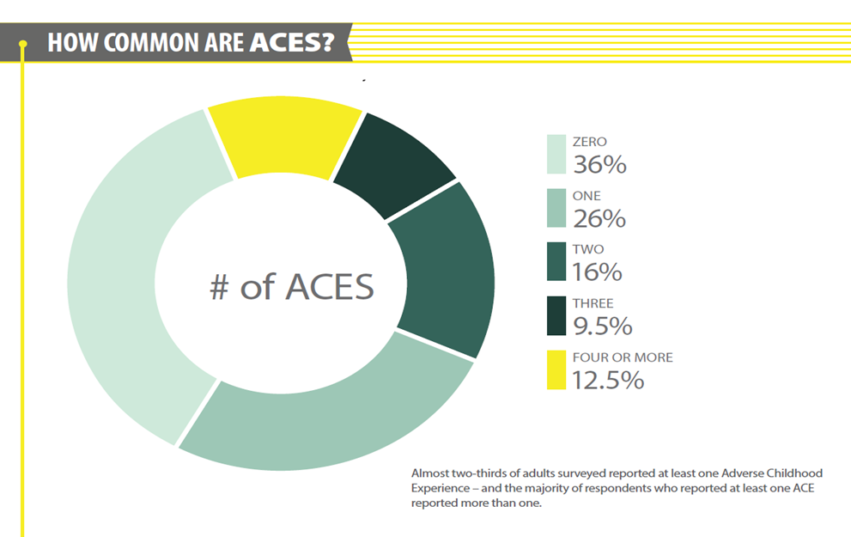

Slide 90
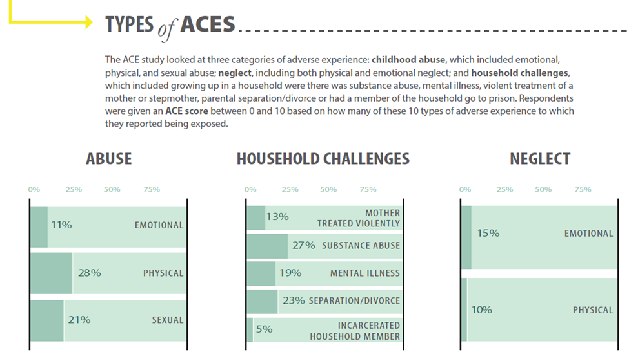

Slide 91
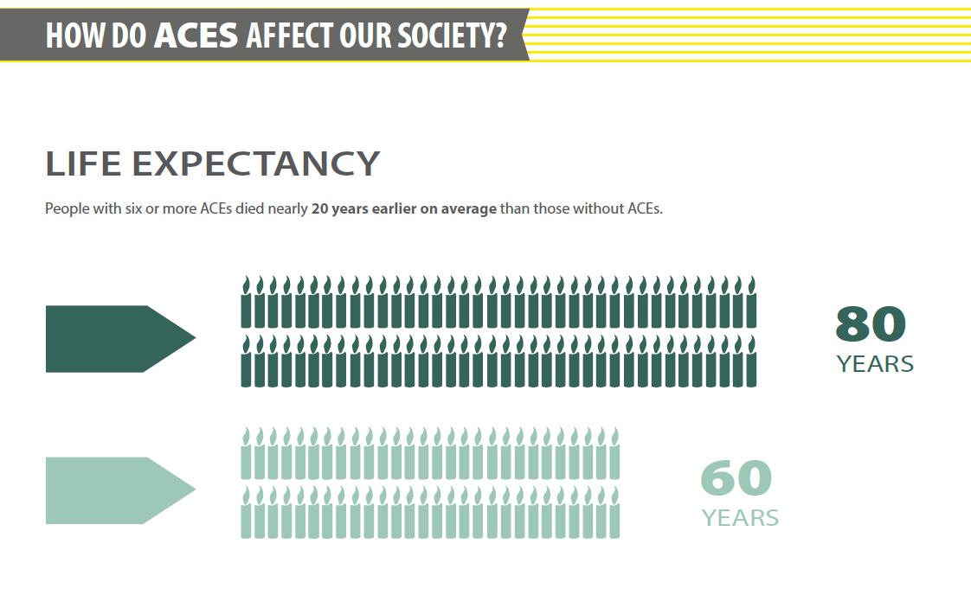

Slide 92

As the number of ACEs increases so does the risk for the following:
Alcoholism and alcohol abuse
Chronic obstructive pulmonary disease
Depression
Fetal death
Health-related quality of life
Illicit drug use
Ischemic heart disease
Liver disease
Poor work performance
Financial stress
Risk for intimate partner violence
Multiple sexual partners
Sexually transmitted diseases
Smoking
Suicide attempts
Unintended pregnancies
Early initiation of smoking
Early initiation of sexual activity
Adolescent pregnancy
Risk for sexual violence
Poor academic achievement

Slide 93
As the number of ACEs increases so does the risk for the following:
Alcoholism and alcohol abuse
Chronic obstructive pulmonary disease
Depression
Fetal death
Health-related quality of life
Illicit drug use
Ischemic heart disease
Liver disease
Poor work performance
Financial stress
Risk for intimate partner violence
Multiple sexual partners
Sexually transmitted diseases
Smoking
Suicide attempts
Unintended pregnancies
Early initiation of smoking
Early initiation of sexual activity
Adolescent pregnancy
Risk for sexual violence
Poor academic achievement

Slide 94
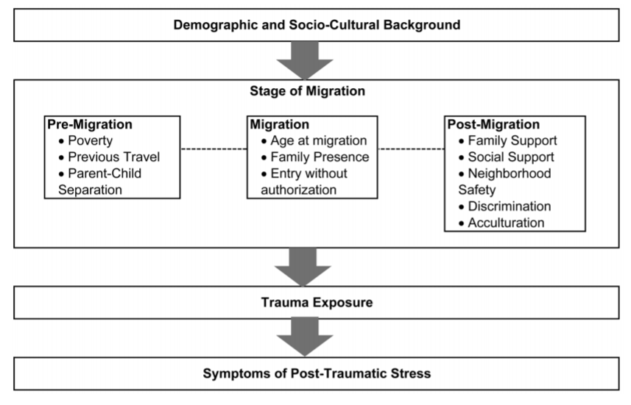

Slide 95
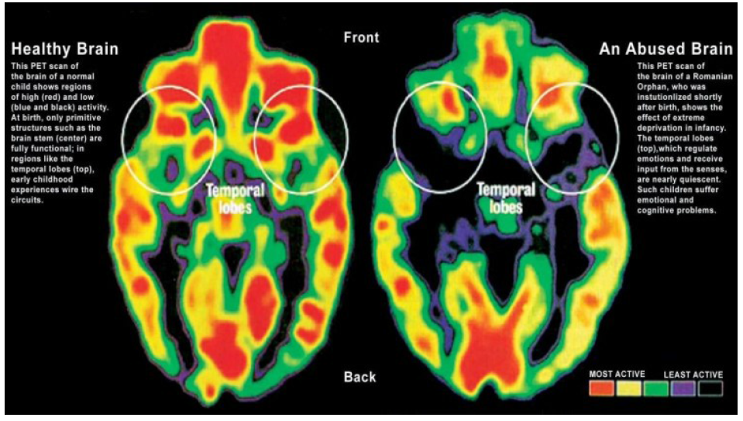

Slide 96
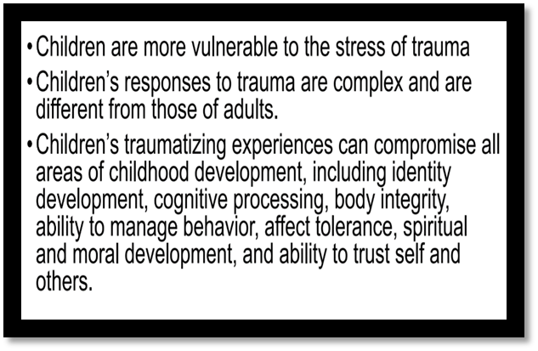

Slide 97

Project Focus
We are working to gather and provide research and tips for practitioners working with OSY that have been affected by ACEs and traumatic stress reactions.

Slide 98
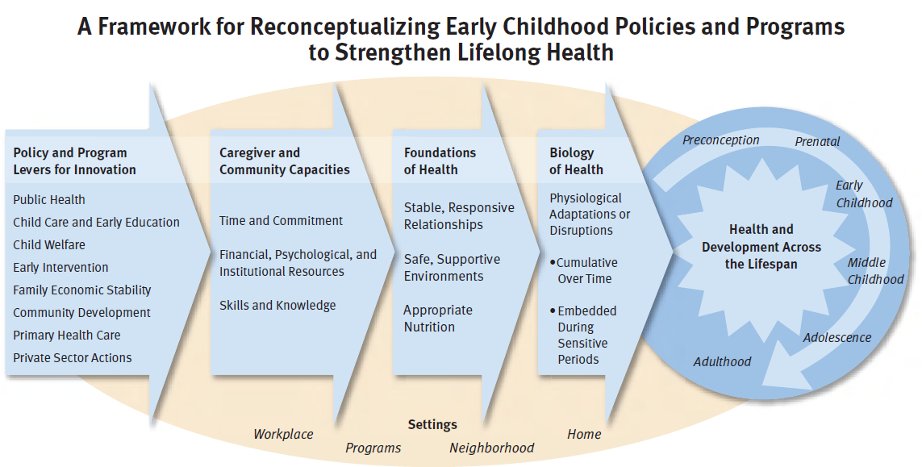

Slide 99

Timeline
We expect to have a draft to share with the TST in November and will also have some visual chapter PowerPoint summaries available on the website later this year.

Slide 100
Materials & Curriculum
Members
Brenda Pessin (IL - lead)
Chris Norton (NY – lead)
Peggy Haveard (AL)
Activities
Four Mental Health Life Skills Lessons were completed and released on the GOSOSY website.
Lesson 5: Let’s Talk About Stress is under final review and will be released this year; will include optional activity on coping plan.
English Language Resource Rubric draft is completed for presentation to TST in November.
Living in America lesson “Using Money” drafted for presentation to TST in November.
www.osymigrant.org

Slide 101
Expectations of Work Group Time– Curriculum
Living in America– feedback and other lessons
Finalize ELL Resource document
Stress lesson
Discuss pre/post assessments
Ideas for NASDME sessions
www.osymigrant.org

Slide 102
Identification & Recruitment
Members
Jennifer Almeda (SC-lead)
Ray Melecio (FL)
Pedro Santiago (KY)
Barbie Patch (NH)
Deke Showman (PA)
Activities
Field-Based Recruiting and ID&R Tip Sheet both updated and available on GOSOSY website.
2. PREZI resource developed for professional development using recruitment tools on GOSOSY website.
3. Continued collaboration with IRRC on Recruiter Competency Skills Assessment and now developing training with IRRC.
www.osymigrant.org

Slide 103
Expectations of Work Group Time– ID&R
Diversity of OSY—what are the core similarities and commonalities as well as the differences
Diversity of needs and addressing cultural awareness of recruiters
What are the successful models? Statewide? School-based?
How do states move from a school-based model to one that embraces the identification and recruitment of OSY?
Look at the training manual/ID&R module. How can this be updated and disseminated?
And finally, what are the key points to convince OSY to participate in the MEP?
www.osymigrant.org

Slide 104
Expectations of Work Group Time– Lesson Plan and Goal
Combine efforts into unified training
Student handouts or manual
Growth Mindset
Revise GS manual
www.osymigrant.org

Slide 105
Expectations of Work Group Time–
www.osymigrant.org

Slide 106
Expectations of Work Group Time–
www.osymigrant.org

Slide 107
Agenda–November 3
Work Group Time
Mental Health Lessons: Helping with the Next Steps--- Lora Thomas
Dissemination Event planning and organization
Mentoring in 2 States: What We Have Learned- Kiowa Rogers and April Dameron
Work group report outs
Spring Meeting date
www.osymigrant.org

Slide 108
www.osymigrant.org

Slide 109
Dissemination Event Planning
SOSOSY
2014
Dissemination
Event
feedback
and discussion
Even
better
GOSOSY
2018
Dissemination Event
www.osymigrant.org

Slide 110
Ideas We Are Working On
electronic
evaluations
more time for
informal
networking
vendors
record presentations
www.osymigrant.org

Slide 111
What were the pros and cons of the structure used in the past (break out sessions with no repeats)?
What are some suggestions for structuring the overall conference and sessions?
What is the best way to include OSY attending so that the entire event is maximized for them?
How should we integrate/facilitate more networking?
What is the #1 aspect we must keep? What is the one aspect we must eliminate?

Slide 112
Dissemination Event Planning
2014
Dissemination Event
Feedback
Overall rating was 4.7 out of 5.
What worked best?
Registration process
Opening session
What needs improvement?
Networking and discussion time
www.osymigrant.org

Slide 113
Dissemination Event Planning Update
Committee Members:
FL, IL, KS, KY, MA, NE, NH, NJ, NC, TN
Overall structure-
  Length of GOSOSY portion/number of sessions
  Collaborate with IRRC and PI
  Combined keynote session
  Registration process
    Online process
    Fee
What is non-negotiable?
OSY participation-
  Leadership institute or strand of sessions/experiences for OSY throughout the event
  Maximize the OSY panel
Keynote speaker-
  Potential speakers

Slide 114
Video Clip
http://abcnews.go.com/2020/video/abc-news-john-quinones-lessons-30752956?cid=share_facebook_widget
www.osymigrant.org

Slide 115
CIG Collaboration
CIG Dissemination Event
Common calendar
Bridging activities
NASDME presentation
www.osymigrant.org

Slide 116
Mentoring Pilot
AL, KY, IL, MA, and IA
Participate in 6 week summer program
Webinar training
Follow up throughout the summer
www.osymigrant.org

Slide 117
Future Meeting Dates
TST Meeting Dates
  November 2-3, 2017 in Louisville, KY
  April 11-12, 2018 in Saratoga Springs, NY
SST Meeting during ADM
www.osymigrant.org

