Slide 1
Hybrid Lesson
Combining Distance Learning
with In-Person Materials
iSOSY Professional Learning Work Group
www.osymigrant.org

Slide 2
How to Use Various Techniques to Support Learning
Use the Language Experience Approach
Integrate a creative outlet - art lesson
Materials given to OSY, giving them something tangible
Teach using video-enabled social media app like Zoom, etc.
www.osymigrant.org

Slide 3
Blended Learning
Blended approach using the materials and videos included in the Art Lessons provided by NY State MEP
Using adapted techniques from the Language Experience Approach (LEA)
Providing supplies needed to complete lessons and expand learning
www.osymigrant.org

Slide 4
Hybrid Approach using Art Workshops
Decide on Art Lesson to use with learner.
Set date for lesson with learner.
Gather supplies and deliver/mail to learners (consider printing resources to go with each lesson - Visual Guides included as resources).
Send virtual resources (each art lesson has videos that can be shared with learners in English and Spanish).
Consider preparing an example to show learner of each art project.
Prepare how you will deliver the lesson – video-enabled app.
www.osymigrant.org

Slide 5
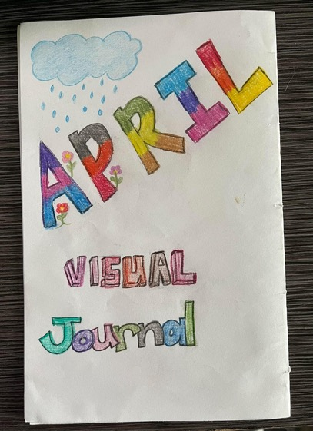
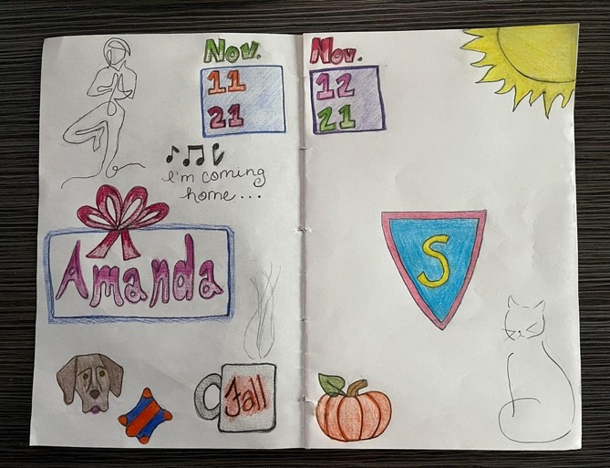
Examples of Art Project - Book Binding
www.osymigrant.org

Slide 6
Examples of Art Project - Book Binding
https://www.nysmigrant.org/resources/library/artworkshops/bookbinding
Supplies list
Canson "XL" Mixed Media paper: 11x14 or 18x24
#2 pencil
Yarn
Colored pencils
Scissors (optional)
Scotch tape (optional)
How to source supplies
Dollar store- #2 pencil, colored pencils, yarn, scissors, tape
Walmart- drawing paper, yarn
Mailing/delivering supplies to OSY
Manila envelopes or first class envelopes (free at US Post Office)
www.osymigrant.org

Slide 7
Pros/Cons - Results
Pros -
OSY will have something to take away from the lesson.
Engaging OSY in services - have OSY pick something they are interested in, helps to engage in further services.
Engaging to service provider – this is something different to offer OSY that may be here for a short period of time.
Save time and money in gas driving to have OSY not available or weather factors play a role.
Cons -
Costs are associated with supplies and mailing if necessary.
Short window of time to offer this service if mailing supplies is needed.
Internet connection is necessary.
www.osymigrant.org

Slide 8
Problem Solving for Offering Hybrid Lessons & Using Technology
To mitigate costs, try sourcing materials for less or having learners use basic materials they have at home, e.g., paper, pencils, markers, etc.
Choose an alternative lesson, e.g. family tree activity that only needs paper and pencil; a photo-based project only requires a cell phone.
Use your network - mail supplies to a service provider/recruiter that lives in the area to deliver.
Consider in-person lessons if you find internet connection is an issue.
Print resources, including visual guides and/or English/Spanish instructions provided with each lesson to send to learner and offer the lesson by phone if internet is not an option.
Find out what works well for the learner, e.g. uploading videos to YouTube, sending links to videos to watch ahead of lesson, learner can use wifi at library, etc.
www.osymigrant.org
Notes:
“Complaining about a problem without posing a solution is called whining” —Teddy Roosevelt

Slide 9
Extension Activities Using Language Experience Approach Techniques
Choose the experience you want learners to have
Examples could include book binding, photo journaling, shape poetry, drawing, collage-making, etc.
Organize the activity
Curate supplies and provide them to the learner (porch drop, USPS mail, in person, etc.)
Set a date/time to meet; have a “Plan B” if internet doesn’t work, e.g., text pictures of project, speak by phone, etc.
Share resources with the learner, e.g., videos, instructions, visual guides, exemplars, etc.
Conduct the experience
Learner does the activity (ideally with a service provider, but he may work alone, in a group, virtually, etc.)
Discuss the experience
Talk with the learner about what he did during the activity. Have the learner explain the steps he went through to complete the project. Let the learner share questions, funny anecdotes, what was easy or hard. It is okay to prompt the learner with questions, hints, or cues if he is a reluctant speaker.
Notes:
The LEA was developed primarily for reading development but can be used to support listening, speaking and writing as well. (CAL.org)
Add links to examples showing what this is. Create an infographic using canva or venngage to include as a resource with our PP’s, videos, etc.

Slide 10
Extension Activities Using Language Experience Approach Techniques
5. Develop a written account
Depending on learner’s abilities, the instructor may ask him to write, or the learner can dictate, and the instructor scribes what he says. Alternatively, a learner can record himself and send it to the service provider to transcribe later. Grammar is not important at this stage; record with fidelity the learner’s words.
Read the written account
The teacher or learner will read the account aloud, focusing on key words and phrases. Learners can read and follow silently on their own if they are not able to read or if there is more than one learner present. Virtually, this can be shared on-screen in a Word document, if in person on paper, or even mailed or texted to the learner. The narrative becomes a “leveled” text with which the service provider and learner work.
7. Extend the experience
Activities for beginning learners may include students copying the story, matching words with pictures or definitions, completing a cloze activity, unscrambling key words, or putting scrambled sentences in sequential order.
Activities for advanced learners could include learning grammar, vocabulary, or punctuation, revising and editing, generating comprehension questions, reading other related texts, or writing about similar experiences. (CAL.org) (iSOSY website resource: Reading on the Move)
Notes:
The LEA was developed primarily for reading development but can be used to support listening, speaking and writing as well. (CAL.org)
Add links to examples showing what this is. Create an infographic using canva or venngage to include as a resource with our PP’s, videos, etc.

Slide 11
Resources for the Learning Experience Approach
orientation to esl literacy: Language Experience Approach (esolliteracy.blogspot.com)
This one is with adults. How could their experiences with preparing food be used with other topics like art projects?
Language Experience Approach - YouTube
A tutor who works with adults shows how he uses the LEA with a photo or other prompt.
Language Experience Approach - YouTube
A teacher works with teens on a science lesson after an experiment students conducted.
www.osymigrant.org

Slide 12
Book Binding: Videos and Resources to Support Lessons
Videos from New York website for art session with OSY:
Session 1: English
Session 1: Spanish
Session 2: English
Session 2: Spanish
Session 3: English
Session 3: Spanish
www.osymigrant.org
Notes:
Flipped classroom- ideas: have student watch videos ahead of lesson.

Slide 13
References
Taylor, M. (1992, June). The Language Experience Approach and Adult Learners. In www.cal.org. Retrieved from https://www.cal.org/caela/esl_resources/digests/LEA.html
New York State Migrant Education Program. (2020). Instructional Arts Videos. In www.nsymigrant.org. Retrieved from https://www.nysmigrant.org/resources/library/artworkshops
www.osymigrant.org
Notes:
Flipped classroom- ideas: have student watch videos ahead of lesson.

Slide 14
Please complete a short evaluation via the QR code:
www.osymigrant.org

