Slide 1
iSOSY Personal Wellness
Trauma-Informed Support and Practices for Young Adults
There’s Hope!
Presenter, title, organization
www.osymigrant.org
Notes:
The purpose of this presentation is to provide Migrant Education Service Providers with strategies and support practices that are trauma-informed.
The strategies we will present have been carefully chosen as they can be taught or modeled with students.
There is a good chance you are familiar with Adverse Childhood Experiences – or ACEs – and understand the effects of trauma.
This presentation is focused on what you can do now to help.

Slide 2
Trauma-Informed Best Practices
Today you will learn:
The right- and left-brain functions/relation to trauma
Evidence-based strategies for working with young adults who have experienced trauma:
Resources available for emotional support
Connect and Redirect
SIFTing
Co-Regulation
HEAL
Building Self-Awareness
Creating Safe Spaces
www.osymigrant.org
Notes:
In today’s training we will learn about strategies to use with students who have experienced trauma.
The right- and left-brain functions will be presented as they relate to students experiencing an initial trauma, as well as a trigger or retraumatizing event that occurs later.
The evidence-based supports and practices that we will learn about are:
• Connect and Redirect
• SIFTing
• Co-Regulation
• HEAL
• Building Self-Awareness
and
• Creating Safe Spaces

Slide 3
Trauma-Informed Best Practices
Part I: Right Brain and Left Brain
www.osymigrant.org
Notes:
The right and left brain have different functions.
Let’s learn about the different hemispheres of the brain.

Slide 4
Right Brain Left Brain
Trauma-Informed Best Practices
VS.
Emotion/Feelings
Responsible for emotions
Sends and receives non-verbal communications, like facial expressions
Remembers the big picture of an event (including its meaning and feel)
Stores images and personal memories
Logical/Words
Logical, literal, linear
Likes order
Understands cause and effect
Names and labels objects
Clear about personal actions (“I ate the cookie; I didn’t chew it.”)
Note: A person experiencing a traumatic or re-traumatizing event operates out of the right brain!
The Whole-Brain Child: 12 Revolutionary Strategies to Nurture Your Child’s Developing Mind by Daniel Siegel and Tina Payne Bryson
Notes:
These are the different functions of the brain that control both the emotions and logic:
Right Brain – Emotion: responsible for sending and receiving non-verbal communications, like facial expressions, tone of voice, or gestures. It also specializes in understanding the big picture of an experience, its meaning and general feel, as well as images and personal memories.
Left Brain – Logic: logical, literal, likes words, and is linear, that is, it likes to put things in order. It excels in understanding cause and effect (“I push this button and the cow pops up.”), naming and labeling objects, and being clear about personal actions (“I ate the cookie; I didn’t chew it.”).
A person experiencing a traumatizing or retraumatizing event operates initially out of the right brain.
That means that they are most likely not able to think logically or understand the consequences of their behavior in the moment.
In order to help the student, we have to wait to provide logical strategies until they are no longer working out of right brain.
The strategies that follow can be taught to the students we work with so they can use the tools when they need them in the future.

Slide 5
Right Brain Left Brain
Trauma-Informed Best Practices
VS.
Young minds are right-brain dominant (the brain does not finish developing until age 25).
Connection and integration of the brain can be very much influenced by experience (nurturing, learning, interactions).
The relationships the student has with you and other people are the most effective ways to facilitate brain integration.
www.osymigrant.org
Notes:
Young minds are right-brain dominant.
Emotions and living in the moment trump the left brain’s emerging efforts to use language and logic to navigate the world.
The extent and strength of the connections between brain cells and parts of the brain, and how well they are integrated, can be influenced heavily by experience (nurturing, learning, interactions).
Relationships are key. You can make a difference.

Slide 6
Right Brain Left Brain
Trauma-Informed Best Practices
Activity:
VS.
www.osymigrant.org
Notes:
Objective:
Illustrate the difficulty in engaging in left-brain (logical) activities when a person is operating under the right-brain (emotions) due to adverse circumstances or trauma.
Materials:
Two short literary passages from a non-fiction book or article
Noise makers (i.e. drums, bells, whistles, etc.)
Steps:
Ask one participant to read one of the passages without interruption.
Ask the reader to summarize the paragraph.
Ask the same participant to read another passage, this time with at least two other participants making distracting noises nearby.
Ask the reader to summarize the passage.
Discuss:
The distractions illustrated that it is very difficult to learn or think logically when the brain is operating out of the right hemisphere (emotions).
Ask the reader:
How difficult was concentrating with all the noise?
Ask audience:
How does this illustrate the likelihood that students are ready to learn if they are having/have had traumatic experiences?

Slide 7
Trauma-Informed Best Practices
Part II: Connect, Then Redirect
www.osymigrant.org
Notes:
The first strategy that we’re going to talk about is Connect, Then Redirect.
This strategy enables you to connect with the student in an emotional way (right brain) before introducing logic (left brain) to modify response and behavior.

Slide 8
Connect, Then Redirect
Trauma-Informed Best Practices
When the student has a trauma response, connect first to the emotions: “You look like you feel sort of mad.”
If there is an affirmative response, ask what they are mad about.
First provide empathetic responses: “Of course you feel that way.”
“You seem really frustrated/angry/worried.”
Then normalize the feeling: “I get frustrated about things like that too.” “That sounds hard/frustrating/scary.”
www.osymigrant.org
Notes:
This strategy was first discussed in Daniel Siegel's book The Whole Brain Child.
As stated previously, connecting first to the emotions (right brain) allows the student to calm down before you introduce discussion about ways to apply logic and cause/effect (left brain).
You may need to prompt a student to open the discussion. “You look like you’re feeling sort of mad.” If you receive an affirmative response, ask what they are mad about.
Provide an empathetic response and then normalize their feeling. The message is, “I see you and I hear you.”

Slide 9
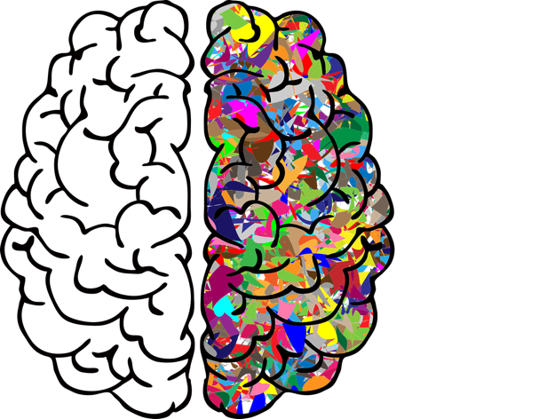
Connect with the Right Brain (Emotional, Nonverbal, Experiential, Autobiographical)
Trauma-Informed Best Practices
Logic is not the primary vehicle to calm our brains.
Feelings and emotions are are real and important.
Use nonverbal signs:
Physical touch
Empathetic facial expressions
Nurturing tone of voice
Nonjudgmental listening
www.osymigrant.org
Notes:
In order to understand this strategy, we start with a basic review of brain structure and function.
Our brain has two hemispheres, the left and the right, which are connected through a pathway of nerves.
Although no task, action, or thinking process is conducted solely in one hemisphere, each hemisphere has an expertise or a type of processing which it dominates.
The left hemisphere tends to dominate linear, literal, and logical thinking. It likes to solve puzzles, especially using order and reason, and serves in linguistic expression.
The right hemisphere is often thought of as the more creative side of the brain. It dominates non-verbal communication, emotions, and creative expression through activities such as art or dance.
The Connection part of the process creates calm for the student’s emotions and allows them to feel, and name, whatever emotion they are experiencing.
That increasing calm offers the ability to soothe the student.
Nonverbal cues are often effective.
Then you can engage in the next step of introducing logic..

Slide 10
Redirect with the Left Brain (Logical, Linguistic, Literal)
Trauma-Informed Best Practices
“Name It to Tame It”
Sometimes the emotional waves just need to crash until the storm passes.
Student may simply need to eat or get some sleep.
Rules about respect and behavior still apply.
Inappropriate behavior remains off-limits even in moments of high emotion.
Good idea to discuss misbehavior and its consequences after the student has calmed down.
www.osymigrant.org
Notes:
When our brain's right hemisphere (emotional) has control, it does not always communicate with our left (logical) hemisphere.
When we are flooded with emotions, there is little space for the logical reasoning of the left brain. Although it may be tempting for us to respond to an emotional student in a way that applies primarily logic and reason to a situation, this approach will most likely lead to frustration for everyone.
Analysis and strategic thinking are activities dominated by the left brain. In the throes of emotion, there’s little access to that left brain.
According to the ”Connect and Redirect" strategy, we must first use our right brain (empathy) to connect with their situation, i.e. acknowledge and empathize with the student’s feelings.
Empathy allows them to "feel felt" and relax. Once the student has calmed down, the left hemisphere is more available to participate in the crisis.
It might not be possible until several hours later, or perhaps even the next day.
Only when the emotional flooding has subsided, and the student has calmed down, can we redirect them by helping them analyze what happened.
By connecting with the right brain and subsequently redirecting with the left brain, we integrate both sides of the brain, training the neuropathways to do this independently somewhere down the road.
To summarize the second step, when the student can name an accurate emotion, and not just any emotion, this will further help to calm the brain and help them make sense of their feelings.
There is something powerful about understanding the science of how this works. When we have such understanding, we are more likely to use it.

Slide 11
Connect, Then Redirect
Trauma-Informed Best Practices
It is important to integrate words into emotions and name the feelings.
Only redirect once you have connected to the feelings.
Later you can figure out:
Why did the student act this way?
What coping strategy do I want to teach?
How can I best teach it?
www.osymigrant.org
Notes:
As stated earlier, redirection can happen only when one has already helped the student connect to their feelings.
It is important to wait until the student is ready to understand why the behavior happened and is ready to consider what to do next.
Connection (aka relationships) can do wonders to keep lines of communications open and support the emotional development of students.
By using these scientific findings, we can guide students to navigate emotional issues, help wire their brains to deal with similar future situations, and improve our connection with them.

Slide 12
Trauma-Informed Best Practices
Part III: SIFTing
www.osymigrant.org
Notes:
SIFTing is another right-brain/left-brain strategy that students can apply to themselves. It also comes from Dr. Dan Siegel’s work,

Slide 13
Activity: SIFTing to Calm Your Brain
Trauma-Informed Best Practices
SIFTing is:
Training your brain to pause and allow the rational brain (frontal lobe) to give guidance to the emotional brain (limbic system)
Intentionally taking a moment to consciously calm your brain’s instinctual reaction
Based on the concept of neuroplasticity
www.osymigrant.org
Notes:
With SIFTing, one is intentionally taking a moment to consciously calm the brain's instinctual reaction.
Because of neuroplasticity, over time and with repetition SIFTing can teach the brain to be less reactive and remain in a responsive mode.
It is really a mindfulness practice.
SIFTing was originally developed for parents/adults to take a moment before they act or interact with a child/student.
It is a strategy that students can be taught to do when those feelings resulting from trauma arise.
It requires them to take a pause when they are experiencing difficulties.
Basically, the method is training the brain to have new connections when faced with adversity - the process is called neuroplasticity.
With repetition over time the brain can continue to experience neuroplasticity at any age.

Slide 14
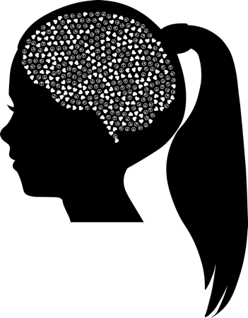
SIFTing to Calm Your Brain
Trauma-Informed Best Practices
The four-step exercise to teach your brain to be less reactive and remain in a responsive mode:
Sensations
Images
Feelings
Thoughts
www.osymigrant.org
Notes:
The brain has two basic settings, reactive and responsive.
Reactive is the mode that is wired into our DNA – survival mode. This is the fight or flight response that helped our ancestors survive but may have negative consequences for us.
A responsive brain is actually the goal. This creates a calm brain, making one feel safe, relaxed, and peaceful.
The four-step process is called SIFTing.
It is a process of intentionally taking a moment to consciously calm the brain’s instinctual reaction:
Sensations – Be aware of your body’s reactions. Is your heart rate raising? Are you flushed?
Images – What images are running through your head? Do they relate to past experiences? Become aware of and identify any images that exist so that you can have greater control over them. Question their authenticity for you and reframe them if needed.
Feelings – What feeling do you experience when you have these sensations and images? It is important to name our feelings as a way of diffusing them. Work on accepting and exploring your feelings — not judging them.
Thoughts – Observe and identify your thoughts. Why are you reacting this way? Are the thoughts valid?
With SIFTing, one may learn to calm the brain and body in a specific moment.

Slide 15
Trauma-Informed Best Practices
Part IV: Co-Regulation
www.osymigrant.org
Notes:
Co-Regulation is the idea that one person can influence another person’s regulation by modeling regulation in themselves.
The purpose of this activity is, again, to take a moment to calm the brain.
Participants may close their eyes if they choose to do so.
Guide the participants:
Register your sensations. Is your heart racing?
Identify the images that are running through your head in this moment. Do they relate to past experiences? Are they valid?
Name your feelings related to your thoughts and images.
Observe and identify your thoughts.
Discuss:
This technique was originally created for parents and other adults to calm their brains before speaking to their children.
With time and practice, brains can be rewired through repetition. This rewiring of the brain is called neuroplasticity.
How can this practice be helpful when working with students?

Slide 16
Co-Regulation
Trauma-Informed Best Practices
Self-regulation is the ability to manage thoughts and feelings in yourself.
Co-regulation is the supportive process between caring adults and youth that fosters self-regulation development.
Help the student recognize early signs, physical indicators, thought patterns, and emotions.
Source: Duke Center for Child and Family Policy for the Administration for Children and Families (ACF)
www.osymigrant.org
Notes:
Self-Regulation is the ability to manage thoughts and feelings to enable actions that are needed to succeed in education and life.
Co-regulation is a process between an adult and student to encourage self-regulation.
It is helpful for the student to become aware of their early signs of de-regulation, as well as the emotions involved.

Slide 17
Co-Regulation
Trauma-Informed Best Practices
Message: “You’re safe with me.”
How?
Responsive/warm relationship
Structured environment
Teach/coach self-regulation skills
Mirror neurons
www.osymigrant.org
Notes:
The brain is a social organ. People can help others regulate their emotions by sharing their own.
The most important point is being able to assure the students that they are safe by building a relationship with them.
[Later in the presentation we’ll go into creating safe spaces.]
Co-Regulation is based on the concept of mirror neurons – when someone performs an action and another observes the behavior, that action may be “mirrored” in the person observing.

Slide 18
Co-Regulation for Young Adults
Trauma-Informed Best Practices
Provide a warm, supportive relationship.
Provide comfort and empathy; provide prompt and supportive coping strategies.
Encourage effective planning, awareness of consequences, and task completion.
Share perspective and provide coaching for complex problem-solving and decision-making.
Allow space for the young adult to make his or her own decisions and experience the consequences.
www.osymigrant.org
Notes:
Co-Regulation in youth or young adults is fostered by:
Providing a warm, supportive relationship
Providing comfort and empathy; prompt and supportive coping strategies
Encouraging effective planning, awareness of consequences, and task completion
Sharing perspective and providing coaching for complex problem-solving and decision-making
Allowing space for the student to make their own decisions and experience the consequences

Slide 19
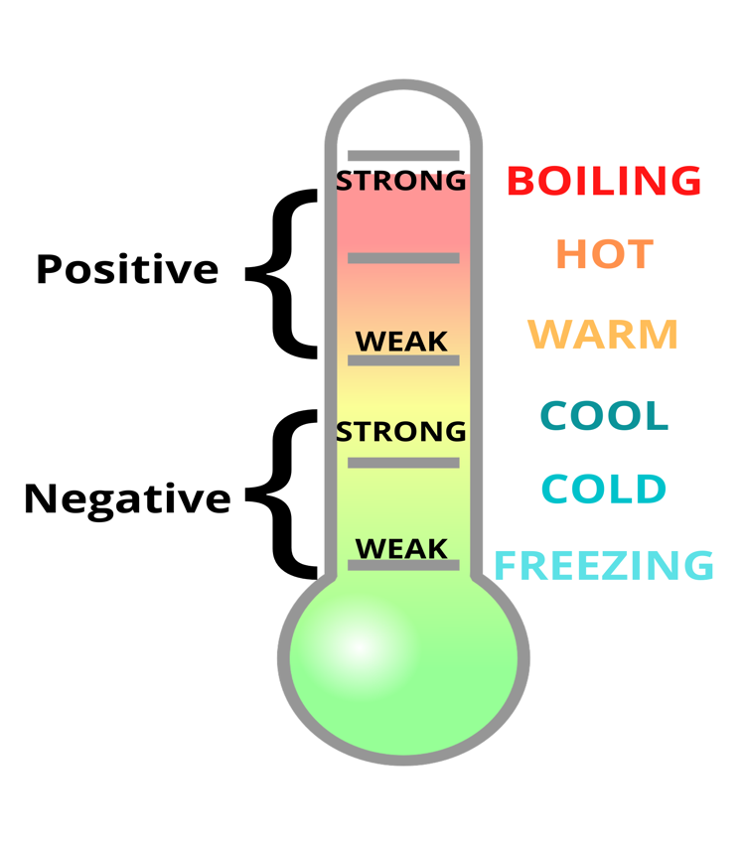
Activity: Co-Regulation - Recognizing Freezing and Boiling Points
Trauma-Informed Best Practices
www.osymigrant.org
Notes:
Reflect on circumstances that make you feel out of control and overwhelmed or that, conversely, relax you to the point of stopping you on your tracks.
Steps:
Print a copy of the Freezing and Boiling Point Handouts for each participant.
Ask the participants to think about the prior month.
What things made them upset, out of control, and overwhelmed (i.e. having to teach my child while working from home)?
What things made them relax, but also froze them from the outside world (i.e. checking social media)?
Discuss:
Sometimes when we are in either of these extremes, we need to recharge our batteries. That may mean finding alone time or doing some breathing/grounding exercises, doing something we love, or pausing to see the big picture.
Co-regulation is about helping someone else regulate. In order to be prepared for this, we need to self-regulate first.
Ask participants to think about how it would be useful in their work with migratory students to identify these extremes.

Slide 20
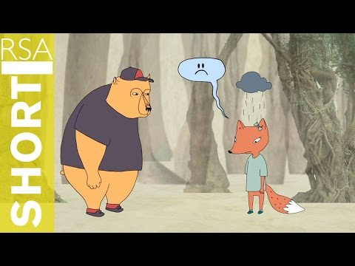
Activity: Empathy vs. Sympathy Video
Trauma-Informed Best Practices
www.osymigrant.org
Notes:
Let’s watch this video to learn about the difference between empathy vs. sympathy. We aim for empathy. It’s all about connection.

Slide 21
Empathy vs. Sympathy
Trauma-Informed Best Practices
According to the work of Dr. Brené Brown, to grow deeper relationships one must understand the difference:
Empathy - experiencing someone else’s feelings. It comes from the German Einfühlung, or ‘feeling into.’ It requires an emotional component of really feeling what the other person is feeling.
Sympathy - understanding someone else’s suffering. It is more cognitive in nature and keeps a certain distance.
“Empathy fuels connection, and sympathy drives disconnection.”
www.osymigrant.org
Notes:
Social psychologist Brené Brown suggests one key to growing deeper relationships is to understand the differences of empathy vs. sympathy.
While the concepts are similar and definitely related, there are crucial differences that lead to very different outcomes.
According to Brown: “Empathy fuels connection, and sympathy drives disconnection.”

Slide 22
Empathy Characteristics
Trauma-Informed Best Practices
Develop perspective
Stay out of judgment
Recognize the emotions
What makes something better is the connection!
Use empathy with balance - your personal story can lend to over/ under involvement! (excessive response)
Say:
“I don’t know what to say, but I’m glad you told me.”
“I can’t imagine…”
“That sounds so…”
“I’m here to support you.”
www.osymigrant.org
Notes:
Connections make a difference in improving outcomes for students who experience an adverse event.
Take the perspective of the student.
Do not make judgments or assumptions.
Make sure to recognize their valid emotions and do not just look to point out a “silver lining” as that can be hurtful.
Say:
“I don’t know what to say, but I’m glad you told me.”
“I can’t imagine…”
“That sounds so…”
“I’m here to support you.”
Make sure not to over-empathize as that can make matters worse for you and for them.
Do not project your own feelings onto a student.
Remember that everyone’s experience is different.

Slide 23
Trauma-Informed Best Practices
Part V: HEAL
www.osymigrant.org
Notes:
The HEAL strategy deals with mindfully “taking in the good” to promote positivity and brain resilience.

Slide 24
Activity: HEAL - Changing Your Brain from Reactive to Responsive
Trauma-Informed Best Practices
The HEAL technique is another strategy to change the brain from reactive to responsive.
The four-step process for “taking in the good” is:
Have a positive experience
Enrich it
Absorb it
Link positive and negative material
Based on Dr. Rick Hanson’s Hardwiring Happiness: The New Brain Science of Contentment, Calm, and Confidence
www.osymigrant.org
Notes:
Your mind gives more importance and reacts more intensely to unpleasant experiences than to pleasant ones.
We can train our brains to be more responsive by intentionally internalizing positive experiences into our brains.
The four-step process for “taking in the good” is:
Have a positive experience – Notice a positive experience in the present or actively create one by becoming aware of positive situations or experiences in your life.
Enrich it – Once you have identified the experience, apply attention to it and sustain it.
Absorb it – Heighten the positive experience by prolonging and intensifying it. Sense or visualize the good. Taking in the good is like building a fire. Step 1 is lighting it. Step 2 is adding fuel to keep it going, and step 3 is feeling its warmth.
Link positive and negative material – It’s normal to have positive and negative feelings all at once. Be aware that they are not mutually exclusive. Practice keeping the positive experience more prominently in your thoughts.
By practicing the HEAL strategy, you will enable neuroplasticity to help your brain move from reactive to responsive.

Slide 25
Trauma-Informed Best Practices
Part VI: Promoting Self-Awareness
www.osymigrant.org
Notes:
Self-awareness means being in “the now” and calming our thoughts and feelings when we are experiencing adversity.

Slide 26
Activity: Teach Self-Awareness
Trauma-Informed Best Practices
5-4-3-2-1 grounding technique using all senses:
5 things you can see
4 things you can feel
3 things you can hear
2 things you can smell
1 thing you can taste
Breathing technique:
Inhale for 4
Hold for 5
Exhale for 6
5-finger breathing technique:
Trace each finger with a finger from the opposing hand, inhale every time you go up, exhale each time you go down.
www.osymigrant.org
Notes:
There are several self-awareness techniques that involve breathing:
Inhale for 4, hold for 5, exhale for 6
5-finger breathing technique – trace each finger, inhale as you go up, exhale as you go down
The 5-4-3-2-1 technique uses all 5 senses and includes noticing:
5 things you can see
4 things you can feel (touch)
3 things you can hear
2 things you can smell
1 thing you can taste

Slide 27
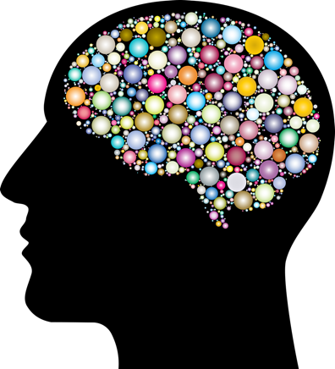
Challenging Unhelpful Thoughts
Trauma-Informed Best Practices
Unhelpful or negative thoughts should be
challenged and replaced with balanced thoughts.
The best way to change your thoughts in the
moment is through affirmations (thoughts you
intentionally come up with).
Coupled with a visualization, affirmations can change your
mood.
www.osymigrant.org
Notes:
As already discussed in some of the techniques, negative thoughts are our most common and prominent thoughts.
Negative thoughts must be challenged.
Affirmations are the best way to change your thoughts.
You can identify your negative thought and then replace it with a balanced one.
Affirmations, also called self-affirmations, are thoughts you intentionally come up with to support, encourage, and calm your brain and body in the moment.

Slide 28
Affirmation Examples
Trauma-Informed Best Practices
I am strong and resilient!
I will get through this!
It’s okay not to be okay.
I am safe.
Tomorrow is another day.
My mistakes do not define me.
Can you come up with some more?
www.osymigrant.org
Notes:
There are several good affirmations you can say to yourself to enhance your positivity. Here are some examples:
I am strong and resilient.
I will get through this!
It’s okay not to be okay.
I am safe.
Tomorrow is another day.
My mistakes do not define me.
Let’s take a moment to come up with some more.

Slide 29
Trauma-Informed Best Practices
Activity: Think of something unhelpful that often crosses your mind.
Can you identify:
Evidence to contradict?
Patterns?
Would you say this to a friend?
Benefits/costs of this thinking?
How will you feel in six months?
Is there another way to look at it?
Balanced thought: “I have curves in all the right places!”
”I am fat.”
www.osymigrant.org
Notes:
Using the Unhelpful Thoughts worksheet, think of a negative thought that often crosses your mind.
Can you identify:
Evidence to contradict?
Patterns?
Would you say this to a friend?
Benefits/costs of this thinking?
How will you feel in 6 months?
Is there another way to look at it?
Here’s an example:
“I am fat."
Now: Can you come up with a balanced thought?
Ex. “I have curves in all the right places!”

Slide 30
Activity: Self-Awareness - Uncovering What’s Below the Surface
Trauma-Informed Best Practices
Notes:
It is important to be self-aware and dig deep to determine why we feel the way we do.
We need to be specific.
This is important for growth.
When you have a feeling, ask yourself a question about it, remembering that our feelings are just the tip of the iceberg.
Activity: Complete the self-awareness test on https://inlpcenter.org/self-awareness-test/ (requires each participant to be in a device and connected to the internet).
Takes 15-20 minutes.

Slide 31
Trauma-Informed Best Practices
Part VII: Creating Safe Spaces
www.osymigrant.org
Notes:
You can be a safe space or promote a safe space by ensuring a student’s thoughts can be shared freely within that space.

Slide 32
Trauma and Attachment
Trauma-Informed Best Practices
Young adults who have their defenses up usually have had these experiences:
Unreliable, untrustworthy adults
Adults who are not dependable and not to be trusted
Do not know how to ask for help
As a result, they act like porcupines – pushing people away; they have their “quills” (defenses) up.
Creating safe spaces is a must to wear down those defenses.
A safe space is place free of bias, conflict, criticism, or potentially threatening actions, ideas, or conversations.
A person can be a “safe space.”
Adapted from The Body Keeps the Score by B Van Der Kolt
www.osymigrant.org
Notes:
Students who have experienced trauma have trouble trusting others.
They lack trust and have their defenses up (just like a porcupine).
One strategy to wear down those defenses is creating a safe space.
A safe space is place free of bias, conflict, criticism, or potentially threatening actions, ideas, or conversations.
You can be a “safe space.”

Slide 33
Tips for Creating Safe Spaces
Trauma-Informed Best Practices
Create ground rules
Right to be heard
Respect
Confidentiality
Foster a caring culture
Words
Actions
Struggles
Be equitable and inclusive
Understanding
Them
Themselves
Others
Adapted from Youth Today by Gina McGovern
www.osymigrant.org
Notes:
There are 3 tips to create safe spaces:
Create ground rules
Foster a caring culture
Be equitable and inclusive
Ground rules are important. Make sure everyone has a right to be heard, to be respected, and to know that whatever they share in that space remains in that space.
Foster a caring culture where words and actions matter and the student feels comfortable/safe sharing their struggles.
Make an effort to treat everyone equally. They should be aware of themselves, their own value, and the value of others.

Slide 34
Trauma-Informed Best Practices
Part VIII: Emotional Support
www.osymigrant.org
Notes:
It is important to reach out for help as needed so we can continue to develop, grow, and thrive.

Slide 35
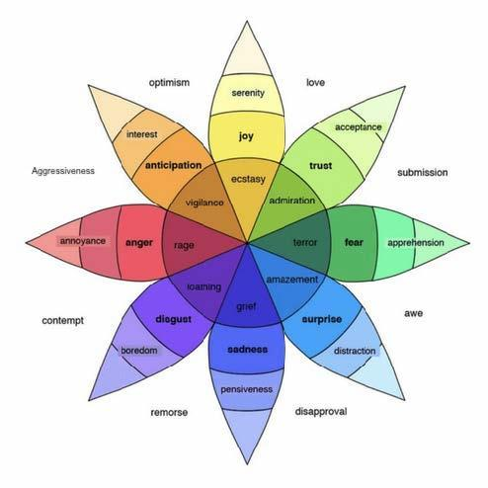
Trauma-Informed Best Practices
Activity:
Visualizing
Your Feelings
www.osymigrant.org
Notes:
Pass out paper and writing utensils to each participant.
Explain the power of visualizing our feelings.
Use one of the following prompts and give participants a chance to get creative:
If your feeling was a landscape, it would look like…
If your feeling was music, it would sound like…
If your feeling was an object, it would be…
Discuss sensations:
How does this feeling make your body feel?
Name the sensation (i.e. smooth, chill, vibrating, twitchy, dull, sharp, achy, jagged, airy, trembling, shivering, etc.).
Have participants share their image with their table groups and discuss what they learned.
As a group, look at the feeling wheel graphic and have participants name the feeling that is portrayed in their image.

Slide 36
Trauma-Informed Best Practices
Activity: Going to your happy place/
30-second vacation
www.osymigrant.org
Notes:
Give the participants paper and writing utensils and direct them to draw their happy place.
Have participants share why this is their happy place.
Discuss whether there are any commonalities in the different happy places shared.
Discuss:
In a stressful situation (i.e. taking a test), taking a brief moment to go to that happy place can put one in a better mind frame to work through it.
How could this be helpful in their work with students?

Slide 37
Tips for Seeking Emotional Support
Trauma-Informed Best Practices
Think about your support network.
Grow your support network.
Know when to seek professional help.
www.osymigrant.org
Notes:
Emotional support can come from your family, a trusted friend or mentor, or a professional.
Know people you can reach out to who will help you with your struggles.
Think about when it is enough to seek help from your network versus when additional support is needed from a counselor or other professional.

Slide 38
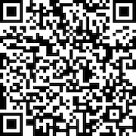
Trauma-Informed Best Practices
Please use the link to fill out an evaluation. Thank you!
www.osymigrant.org
Notes:
We appreciate your time and attention to this presentation about the importance of ACEs in the lives of migratory students. Your honest feedback is vital to our focus and efforts as iSOSY continues to move forward in the area of personal wellness and mental health. Please take just a moment to use the QR code on the screen to access a brief evaluation. Thank you.

Slide 39
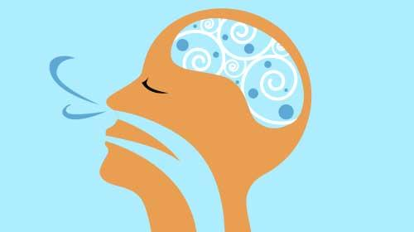
Trauma-Informed Best Practices
Presenter name
Email
Phone
www.osymigrant.org
Notes:
Thank you so much for your time and attention. Any questions/comments?

