Slide 1

Technical Support Team Meeting
January 21-22, 2015
Charleston, SC
www.osymigrant.org

Slide 2
Welcome/Introductions
Welcome to Charleston
  Jennifer Almeda
Introductions
Which SOSOSY states are represented at today’s TST meeting?
www.osymigrant.org

Slide 3
Agenda – January 21
Welcome and Introductions
SOSOSY Consortium Update
SOSOSY Dissemination Event Debriefing
ID&R Competency Assessment
APR Data Discussion- Where are we in relation to our Objectives?
Overview of the Year 3 Proposal and Year 3 Fidelity Implementation Index
Discussion of Year 3 work and refocused work groups
Work group assignments and action planning
Work Group time
Q and A session and Wrap-up 5:00 pm
www.osymigrant.org

Slide 4
Expectations
Review APR data and discuss results
Actualize the Fidelity Implementation Index activities
Align the work of the TST with the Year 3 plan
Create action plans and timelines for work groups
Establish timelines for completion of work and set work group meeting times/dates
www.osymigrant.org

Slide 5
SOSOSY Update
Successful Dissemination Event
Proposals submitted for NASDME
SOSOSY Quarterly newsletter will be out next week
Upcoming State Steering Team meeting on February 23
www.osymigrant.org

Slide 6
Hi. I am Irma Nayeli Gurrola Jimenez. I participated in the OSY event in Tampa, FL. My experience in Florida was unforgettable. I learned new things at the different sessions and from the other panelists. I wish there were more events where we had more chance to be around other migrant students. Listening to their stories made me more motivated to keep trying and to not give up.
What I liked best was when all of the students had the chance to be in the panel and talk about what has happened to each of us during our time in this country and the contact we had with the people who were asking us questions. This experience helped me to want to continue on. I learned that we have resources to make it in this country. My goal is to get my GED and to learn English to go to college and graduate. This will help me reach my goals in this country.

Slide 7
Dissemination Event Debrief
Please provide feedback on the preconference.
  Was there enough time?
  Coverage of topic
What worked well at this year’s Dissemination Event?
  Number and topic of sessions?
  Opening Session
  Closing Session
What is one specific thing you would want to keep for the next Dissemination Event?
What is one thing you would like changed?

Slide 8

Recruiter Knowledge Assessment
Erin Shea (Vermont)
Heather Rhorer (Kentucky)
www.osymigrant.org

Slide 9
History/Background of Tool
No known universal Recruiter Assessment to guage field readiness
Solicited Recruiter Assessments from as many states as possible
    MA, WA, TN, VT, MN & old CONQIR consortium
Reviewed 'the best' of each and updated for a national audience
Field tested in select consortium states
www.osymigrant.org

Slide 10
Purpose of Assessment
Comprehensive tool which covers ID&R basics
Help states target training where needed
Guage whether a Recruiter is field ready
Refresh seasoned Recruiter knowledge
www.osymigrant.org

Slide 11
Assessment Breakdown
5 Sections to the Assessment (see handout)
  Acronyms
  Multiple Choice
  Definitions
  COE Review
  Case Studies
www.osymigrant.org

Slide 12
ACTIVITY!
  COE Review
www.osymigrant.org

Slide 13
COE Review
Work together with your table group to review the COE
Context: A new recruiter leaves this COE in your mailbox to look over before he/she submits it to the office manager for processing.
Directions: Based on the information presented on the COE - Does this family qualify for MEP services?
Write down your explanation/s to share with the group
www.osymigrant.org
Notes:
Tables will have large copies of sample COEs to correct.
When a table gives us a correction we can click on that area for the correction to appear.
Check paper copy to ensure all corrections appear on the screen.

Slide 14
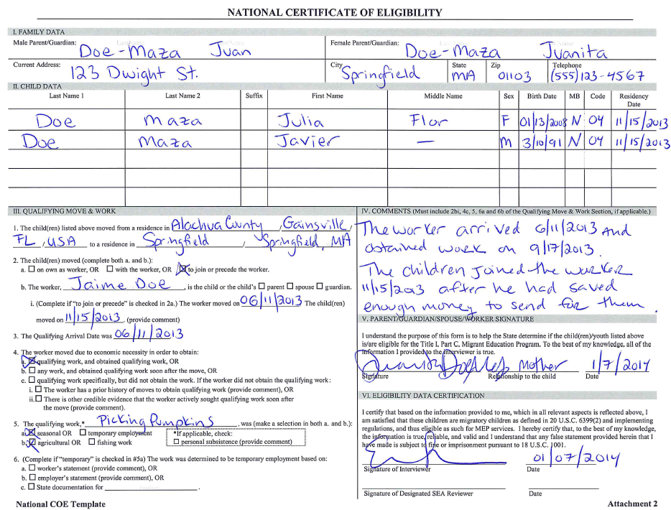
Notes:
Once the room has completed their review, ask tables to share their explanations. Highlight on the screen as errors are identified. Keep highlighted paper copy on hand to ensure all errors are noted.

Slide 15
Acronyms (Part 1)
& Fill in the Blank (Part 3)
JEOPARDY!
Categories
  Migrant Ed at the National Level
  Eligibility – The Work
  Eligibility - The People
  Service Related
  Tricky Areas
www.osymigrant.org

Slide 16


Slide 17
Questions or Comments?
www.osymigrant.org

Slide 18
Notes:
Once the room has completed their review, ask tables to share their explanations. Highlight on the screen as errors are identified. Keep highlighted paper copy on hand to ensure all errors are noted.

Slide 19
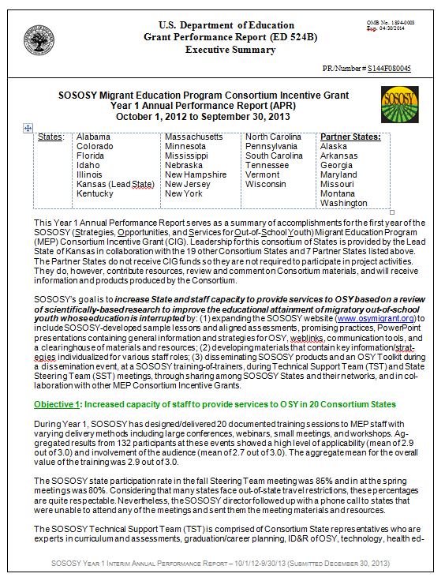
Data Reporting and SOSOSY
Year 2 APR Results
Notes:
Students completing lessons are surpassing pre/post achievement expectations set in the proposal; therefore, it appears that instructional strategies have been successful!

Slide 20
Work Group Assignments
Technology Work Group
Continuum of Services Matrix Work Group
Mentoring Work Group (new title?)
Curriculum and Materials Work Group
Training Work Group
www.osymigrant.org

Slide 21

Reflecting on Year 3
Year 3 Plan
Year 3 FII
www.osymigrant.org

Slide 22

Year 3 Plan
Overview
- Focus on implementation
- PL to support products/practices
- Enhancements to existing materials through technology and support for trainers
- Cross-training w/other CIGs
- OSY-specific management tools
Goal charts
Evaluation activities
www.osymigrant.org

Slide 23
Year 3 Goals
Goal 1: Review and revise/update strategic SOSOSY materials to support teachers, administrators, and others who serve OSY
Goal 2: Provide PD and TA to support teachers, administrators and others who serve OSY
www.osymigrant.org

Slide 24
Year 3 Goals (con’t)
Goal 3: Distribute effective and promising practices for providing services to OSY to increase capacity, communication, intra- and interstate coordination, and inter-CIG collaboration
Goal 4: Increase the achievement of OSY participating in OSY services
www.osymigrant.org

Slide 25
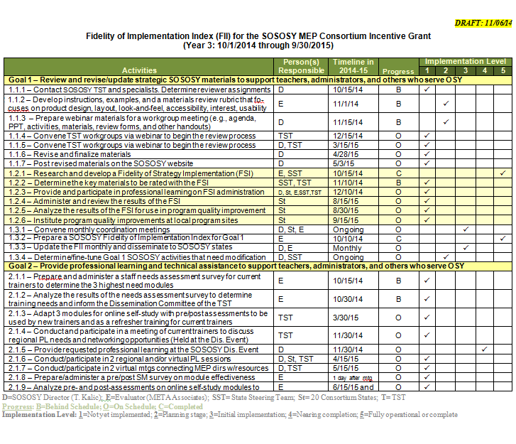
Year 3 FII
4 goals, 60 activities
On-target for most activities as of 11/6
Lots of strategic enhancements to SOSOSY
Focus on implementation
www.osymigrant.org

Slide 26
Year 3 Plan Jigsaw Activity
Review pages 1-3 of the Year 3 plan. Highlight areas that your group would need to focus on for Year 3.
Review the Year 3 objectives, activities, performance measures charts on pp. 4-8
For the Goal Areas (1, 2, 3, 4), discuss the activities and be prepared to discuss which activities should be addressed by which work group.
You have 15 minutes for discussion and 3 minutes to present
www.osymigrant.org
Notes:
Discuss what you read in terms of the work of your group.

Slide 27
Goal 1
Review and revise/update strategic SOSOSY materials to support teachers, administrators, and others who serve OSY
www.osymigrant.org

Slide 28
Measurable Outcome 1.1
Measurable Outcome (Project Objective) 1.1
By September 30, 2015, all SOSOSY products will be systematically catalogued, reviewed by TST teams, and recommendations for revisions made.
www.osymigrant.org
Notes:
Performance Measure 1.1: Strategic SOSOSY materials reviewed for accuracy, relevance, and revised based on reviewer feedback

Slide 29
Curriculum and Materials Work Group
1.1.2 – Develop instructions, examples, and a materials review rubric that focuses on product design, layout, look-and-feel, accessibility, interest, and usability
1.1.3 – Prepare webinar materials for a workgroup meeting (e.g., agenda, PPT, activities, materials, review forms, and other handouts)
1.1.4 – Convene TST workgroup via webinar to begin the review process
1.1.5 – Prepare a summary of the workgroup recommendations and distribute to the SST
1.1.6 – Revise and finalize materials
1.1.7 – Post revised materials on the SOSOSY website
www.osymigrant.org

Slide 30
Goal 2
Provide professional learning and technical assistance to support teachers, administrators, and others who serve out-of-school youth
www.osymigrant.org

Slide 31
Measurable Outcome 2.1
Measurable Outcome (Project Objective) 2.1
By September 30, 2015, 90% of staff participating in a SOSOSY professional learning will rate the activities and materials as useful for delivering services to OSY on a staff survey administered prior to and after training (useful= level 4 or above on a 5-point rubric). Statistically significant gains (p value of <.05) will be achieved between pre- and post-assessment.
www.osymigrant.org
Notes:
Performance Measure 2.1: 90% of staff participating in SOSOSY professional learning will rate the activities and materials as useful prior to and after training with a p value of <.05 achieved between pre- and post.

Slide 32
Measurable Outcome 2.2
Measurable Outcome (Project Objective) 2.2
By September 30, 2015, 90% of staff participating in SOSOSY technical assistance on project materials and strategies to states will increase their capacity for serving the needs of OSY as measured by a statistically significant gain (p<.05) on a pretest/post-test self-assessment.
www.osymigrant.org
Notes:
Performance Measure 2.2: 90% of staff participating in TA increase their capacity to provide services to OSY as measured by a statistically significant gain (p<.05) on a pre/post skills self-assessment

Slide 33
Training Work Group
2.1.1 – Prepare and administer a staff needs assessment survey for current trainers to determine the 3 highest need modules
2.1.2 – Analyze the results of the needs assessment survey to determine training needs and inform the Dissemination Committee of the TST
2.1.3 – Adapt 3 modules for online self-study with pre/post assessments to be used by new trainers and as a refresher training for current trainers
2.1.3 – Put the 3 highest need SOSOSY modules online
www.osymigrant.org

Slide 34
Training Work Group
2.1.4 – Conduct and participate in a meeting of current trainers to discuss regional PL needs and networking opportunities (Held in conjunction with the Dissemination Event)
2.1.6 – Conduct/participate in 2 regional and/or virtual professional learning sessions
2.1.8 – Prepare/administer a pre/post SurveyMonkey survey on module effectiveness
2.1.9 – Analyze pre- and post-assessments on online self-study modules to determine further training needs
3.1.11 – Prepare a self-study guide/video on the 3 modules identified as high need
www.osymigrant.org

Slide 35
Goal 3
Distribute effective and promising practices for providing services to OSY to increase capacity, communication, intra- and interstate coordination, and inter-CIG collaboration.
www.osymigrant.org

Slide 36
Measurable Outcome 3.1
Measurable Outcome (Project Objective) 3.1
By September 30, 2015, 20 consortium states will participate in at least 5 key SOSOSY dissemination/diffusion activities resulting in national diffusion of SOSOSY effective and promising practices in the planning, delivery, and evaluation of services to OSY.
www.osymigrant.org
Notes:
Performance Measure 3.1: 100% of SOSOSY States will receive a rating of 4 or 5 (out of a possible 5.0) on an SOSOSY rubric-based Quality of Strategy Implementation (QSI) tool that addresses dissemination of effective and promising practices for OSY.

Slide 37
Technology Work Group
3.1.1 – Redesign the SOSOSY website to improve/increase access to effective and promising practices and steer users to relevant areas
3.1.2 – Provide links on the SOSOSY website to the websites of the other three MEP CIGs and include explanations of the CIG purpose and goals
www.osymigrant.org

Slide 38
Continuum of Services Work Group
3.1.12 – Prepare an OSY continuum of services matrix and post on the OSY website
www.osymigrant.org

Slide 39
Goal 4
Increase the achievement of OSY participating in SOSOSY services
www.osymigrant.org

Slide 40
Measurable Outcome 4.1
By September 30, 2015, there will be a 25% increase in achievement results by OSY in SOSOSY Consortium states.
www.osymigrant.org

Slide 41
Mentoring Work Group
4.1.1 – Share effective service delivery models for OSY
4.1.2 – Share effective instructional practices for serving OSY
4.1.3 – Provide high quality services to OSY
www.osymigrant.org

Slide 42
Next Steps for Work Groups
Determine your course of action and assignments
Determine timeline for completion of work
Set follow-up work group conference call dates and inform Tracie
Report out progress
www.osymigrant.org

Slide 43
Agenda- January 22
Day 2 8:30 am -12:00 pm
State Panel Presentation
NC VISTAs
Quality of Strategy Implementation
Report out on work group progress
Group feedback and discussion
Select dates/times for TST Conference Calls
Wrap-up and meeting adjourns at 12:00 pm
www.osymigrant.org

Slide 44
State Panel
“Panel Discussion and Focused Feedback on Strategies to Provide Services to OSY"
Jennifer
Michael
Heather
Goal: Share ideas/insights on successful strategies for OSY

Slide 45



Panel Structure
Each panelist will respond to a question based on their state’s implementation of strategies to meet OSY needs.
After the panel has finished, there will be a summary.
Panelists will respond to questions and comments.
www.osymigrant.org

Slide 46
Panel Question #1
One of the objectives of SOSOSY is to provide instructional services to OSY.
How has your state integrated SOSOSY materials into your work with OSY? Please address how you are doing this at what level (state, regional, local).
www.osymigrant.org

Slide 47
Panel Question #2
Another objective of SOSOSY is related to increasing staff development to provide services to OSY.
Describe your state’s training efforts to support staff who serve OSY. What are the different ways professional development has occurred? Formats (statewide, group, individual, initial, ongoing)?
www.osymigrant.org

Slide 48
Panel Question #3
How has your state addressed the needs of youth recovered or re-enrolling in high school or attempting to earn their HSE. What follow-up or support has occurred through your program?
www.osymigrant.org

Slide 49
YOUR Questions for the Panel
www.osymigrant.org

Slide 50
Quality of Strategy Implementation
Because we have a focus on implementation, the QSI was developed to look at the quality of strategy implementation
The QSI can be administered by the State (KS model), by an outside observer (MN model), or by an observer within the district or LOA
Reporting: 5 QSI’s (large states) and 2 QSI’s (small states)
www.osymigrant.org

Slide 51
Measurable Outcome 1.2
Measurable Outcome (Project Objective) 1.2
By September 30, 2015, all SOSOSY states will implement a Quality of Strategy Implementation Index (QII) in 3 sites** to rate the implementation of key SOSOSY materials and achieve a quality rating of 4.0 or above (Rating range of 1.0-low to 5.0-high).
www.osymigrant.org

Slide 52
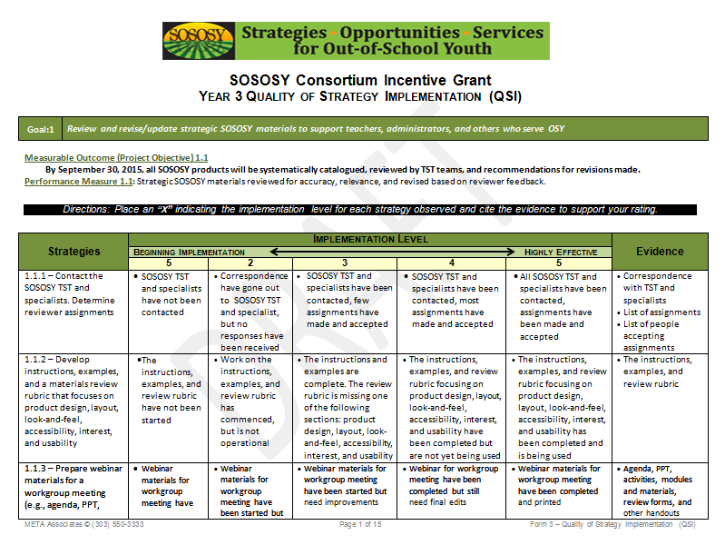
QSI
www.osymigrant.org

Slide 53
Next Steps
www.osymigrant.org

Slide 54
Future Meeting Dates
April 14-15, 2015 Santa Fe, NM
Fall meeting dates/location
www.osymigrant.org

