Slide 1
Technical Support Team Meeting
November 16-18, 2021
www.osymigrant.org

Slide 2
“Imagining something may be the first step in making it happen, but it takes the real time and real efforts of real people to learn things, make things, turn thoughts into deeds or visions into inventions.”
www.osymigrant.org

Slide 3
Created and presented multiple trainings for Suicide Prevention module.
Developed three webinars with Dr. Mona Johnson to focus on personal wellness and self-care for service providers.
Updated State Mental Health Resources sheets for 19 states and provided additional personal wellness materials including “person first language” guidance.
Created COVID-19 Lessons in six languages.
Updated existing COVID-19 Padlet and created student version of COVID-19 Padlet.
Developed several STAT (Short Targeted & Timely) Lessons.
www.osymigrant.org

Slide 4
Created detailed lesson plans and activities for two English for Daily Life lessons.
Updated Mentor Manual for Preparing for College material.
Hosted and archived more than a dozen webinars on a range of subjects available to anyone.
Hosted two-day Coaching & Training Institute to introduce and practice new resources.
Hosted onboarding seminars for new states/staff and created mentor program for those interested.
www.osymigrant.org

Slide 5
Presented iSOSY resources in multiple joint webinars/seminars including NASDME, state MEP conferences, IDRC, I2MPACT, and MPEC.
Collaborated with FSCC to create OSHA 10 General Industry Course for students across the consortium.
That’s just what is COMPLETED!
www.osymigrant.org

Slide 6
In development:
More STAT lessons
Additional Personal Wellness modules
Extra Professional Learning modules
Updated COVID-19 information
New EFDL lesson plans and activities
Launch of STUDENT PORTAL!
New Pathways Guides
www.osymigrant.org

Slide 7
“It’s really easy to fall into the trap of believing that what we do is more important than what we are. Of course, it’s the opposite that’s true: What we are ultimately determines what we do!”
www.osymigrant.org

Slide 8
“The world needs a sense of worth, and it will achieve it only by its people feeling that they are worthwhile.”
www.osymigrant.org

Slide 9
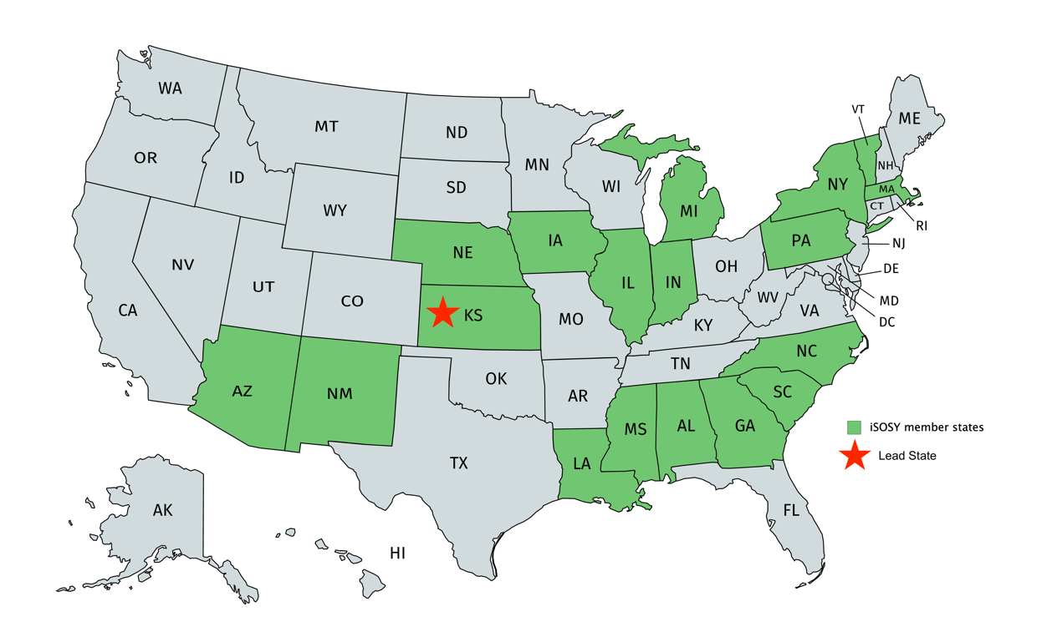
YOU are worthwhile!
www.osymigrant.org

Slide 10
“You rarely have time for everything you want in this life, so you need to make choices. And hopefully your choices can come from a deep sense of who you are.”
www.osymigrant.org

Slide 11
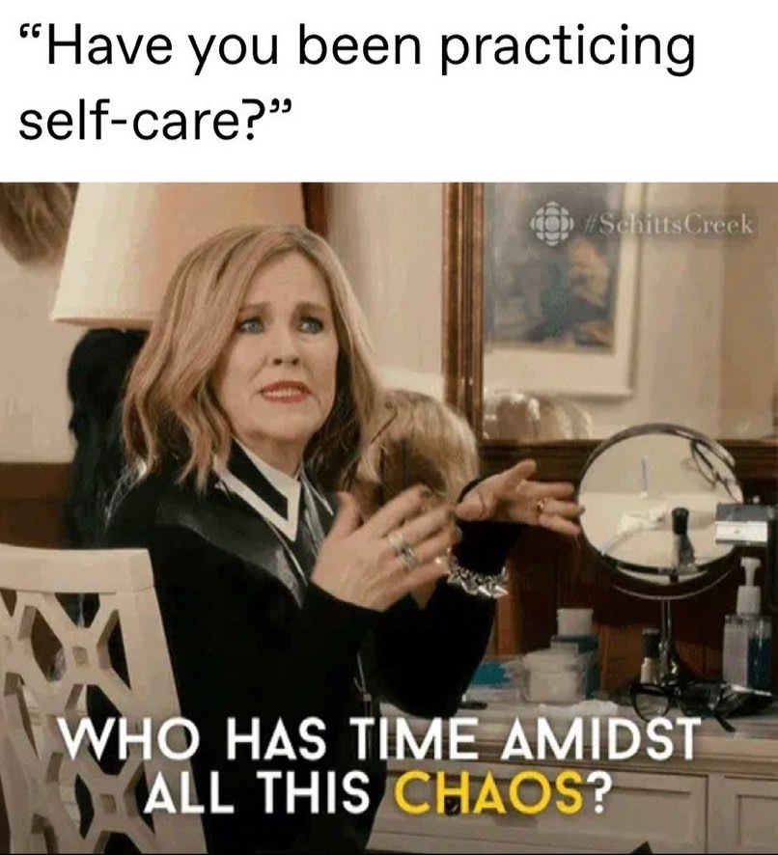
www.osymigrant.org
Notes:
Thanks to Laurie Stewart for this one.

Slide 12
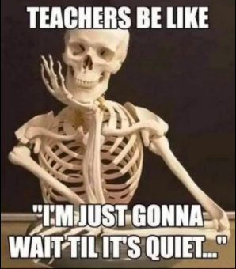
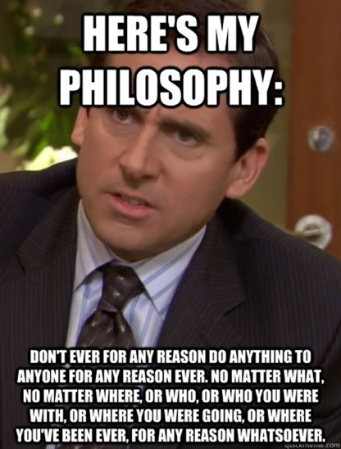
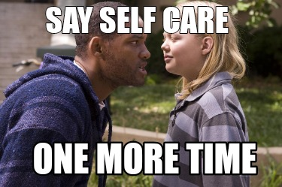
www.osymigrant.org
Notes:
Skeleton – Hope Derry
Michael Scott – Cesar Duran
“Say self- care” – April Roberts
Tweet (over self care) – I found it - maybe you can claim it? ☺

Slide 13
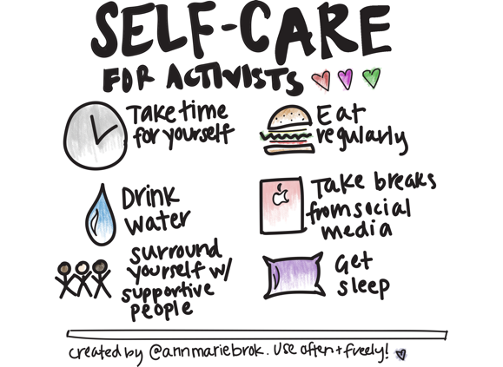
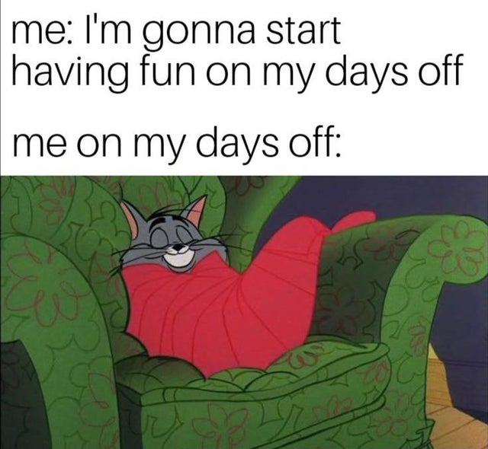
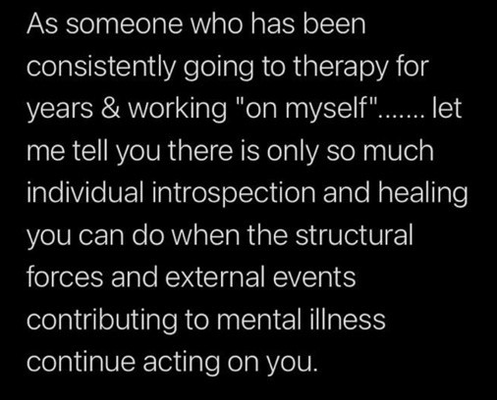
Yes, but…
www.osymigrant.org
Notes:
Left side – Emily Williams
Right side - Wilson Kendrick

Slide 14
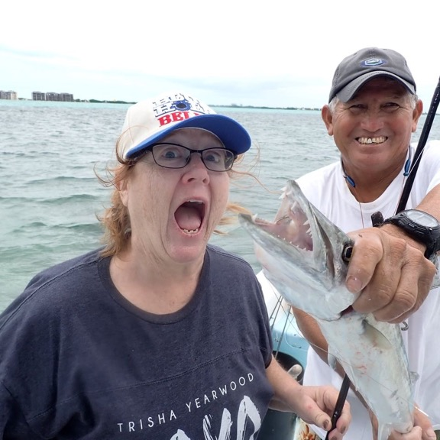
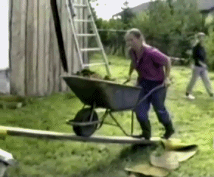
Notes:
Left side – Janet Reynolds (go have fun)
Middle – Lysandra Alexander
Right side – Laurie Stewart (how it feels sometimes)

Slide 15
www.osymigrant.org
Notes:
Right side – Shantella Singleton
Left side - April Dameron

Slide 16
Let’s Chat!
Notes:
You’ll be paired up randomly in breakout rooms and have five minutes to answer the following question:
“What’s the most self-indulgent thing you have done in the name of self-care/burnout?”
You’ll be paired up randomly again to answer the second question:
”What is the most extravagant/unusual/funny thing you have done for someone else since the pandemic began?”

Slide 17
New Website Analytics
www.osymigrant.org
Notes:
I hope you are all enjoying the new website. This was a tremendous amount of work– and i need to give a shout out to Susanna Bartee and John Fink for this significant and hugely impactful undertaking. Not only do we have a truly user friendly web design, we have easy access to make any ongoing changes or updates – not to mention the new student portal which will provide easy access to important resources for countless OSY and secondary students across the country. Please let me know what you think of the website--- and I wanted to share some analytics about the site over the last 90 days.

Slide 18
New Website Analytics
TRAFFIC OVER TIME
www.osymigrant.org
Notes:
As you can see usage has been very steady over the summer.

Slide 19
PAGEVIEWS PAST 90 DAYS
New Website Analytics
www.osymigrant.org
Notes:
Instructional resources are what is being accessed the most as you can see here.

Slide 20
New Website Analytics
www.osymigrant.org

Slide 21
COMPARISON TO SIMILAR
WEBSITES
New Website Analytics
www.osymigrant.org

Slide 22
 | TST WORK GROUPS
Pathways | Emily Hoffman (lead – MA) Hunter Ogletree (NC) John Farrell (KS) Janet Reynolds (KS)
Curriculum | Brenda Pessin (lead – iSOSY) Wilson Kendrick (MS) Hope Derry (NC) Lori Potutschnig (PA) Veronica Hill (NE) Laurie Stewart (LA)
Professional Learning | April Dameron (lead – IA) Sabrina Rivera-Pineda (GA) Odilia Coffta (NY) April Roberts (GA)
Career Awareness/Goal Setting | Emily Williams (SC) Lizy Garcia Ramirez (IL) Erika Guerrero (NE) Shantella Singleton (PA) Zujaila Ornelas (AZ) Mary Speyrer (LA)
Personal Wellness | Lysandra Alexander (lead – PA) Valeria Peña (IL) Susana Das Neves (IL) Lora Thomas (iSOSY) Mesha Patrick (AL)
Technology/Student Portal | Travis Williamson (lead – NY) Michelle Mattson (MI) Sarah Braun-Hamilton (VT) Emily Salinas (IN) Iggy Campos (NM) Andy Wallace (IN) Cesar Duran (NE)

Slide 23
iSOSY FII
www.osymigrant.org

Slide 24
iSOSY FII
www.osymigrant.org

Slide 26
What are some successes your program had this summer?
What are some challenges your program is facing/has faced?
How can iSOSY support your program as it faces these and other challenges in the coming year?

Slide 27
What are some challenges your program is facing/has faced?

Slide 28
How can iSOSY support your program as it faces these and other challenges in the coming year?

