Slide 1
Technical Support Team Meeting
February 25-26, 2020
San Diego, CA
www.osymigrant.org

Slide 2
GOSOSY Member States
Alabama
Georgia
Illinois
Iowa
Kansas
Kentucky
Massachusetts
Mississippi
Nebraska
New Hampshire
New Jersey
New York
North Carolina
Pennsylvania
South Carolina
Tennessee
Vermont
www.osymigrant.org

Slide 3
GOSOSY Partner States
Alaska
Arkansas
California
Colorado
Idaho
Maryland
Minnesota
Missouri
Montana
Oregon
Washington
Wisconsin
www.osymigrant.org

Slide 4
Technical Support Team
Expectations
Membership
State Director expectations
Requirements
2-3 meetings per year
Conference calls
Work assignments
Team Lead meeting
Collaboration and coordination across groups
Work Norms
Be fully committed to the work and demonstrate this commitment by meeting agreed upon deadlines, participating/attending meetings and calls until outcomes/goals are fully met.
Leave each meeting with tangible products/achievements synthesizing our meeting outcomes.
Use included reflection time to promote spontaneous, creative discussion.
www.osymigrant.org

Slide 5
Welcome and Introductions
Welcome and Introductions
www.osymigrant.org

Slide 6
Agenda
Day 1: 8:30 am
Welcome and Introductions
GOSOSY Updates
GOSOSY Training
Working with Students with Limited Formal Schooling
Goal Setting/Learning Plans and Portability Discussion
OSY Engagement and Relationship Building
Preparing for the College Years Discussion and Feedback
LUNCH ON YOUR OWN
Work Group Assignments
Work Group Meetings
Reconvene after work group meetings
Interstate Collaboration: IRRC and What’s New
Website Redesign
www.osymigrant.org

Slide 7
GOSOSY Updates
Year 4 Successes
SST Meeting and ADM
CIG Webinar for Interested States
GOSOSY Web Blasts: In the Field
Website Survey and Website Google Analytics
Website redesign
NASDME Proposals
www.osymigrant.org

Slide 8
GOSOSY Year 4 Successes
GOSOSY materials and strategies were implemented in all 18 consortium states with over 2,400 out-of-school youth (OSY).
• 88% of OSY scored 80% or higher on curriculum-based assessments.
• 86% of OSY with a learning plan met target goals on their plans.
• 276 OSY participated successfully in goal-setting workshops.
• Over 200 staff received intensive training in materials.
• 81% of staff surveyed reported using materials and strategies from trainings.
• All states collaborated with other agencies and organizations to provide services.
• States adopted an average of over 15 products and materials from GOSOSY.
• MEP staff in all 18 States used Dissemination Event training materials and products.
www.osymigrant.org

Slide 9
State Steering Team Meeting
Goal Setting and OSY Learning Plans
Professional Development
Personal Wellness
Interstate Collaboration
State responsibilities for Year 5
Evaluation data collection
New CIG direction planning and discussion
Discussion of SST and TST protocols
Future meeting dates
March 2 6:00- 9:00 pm
Agenda
Welcome and Introductions (Doug Boline)
Overview of agenda and expectations for meeting
Discussion of TST Work Groups tasks, processes, and outcomes
OSY Engagement and Relationship Building
Curriculum and Material Development
www.osymigrant.org

Slide 10
CIG Webinar
for Interested States
States present: Arizona, Colorado, Ohio, Oklahoma, Michigan, Missouri, New Mexico, (and New York)
Confirmed: New Mexico
Other possible interested states: Indiana, Louisiana, Maine, and Washington
Others?
www.osymigrant.org

Slide 11
GOSOSY Email Blasts
Since June 2019
Seven (7) editions sent
230 connections
Using Constant Contact
Highlighting new materials, success stories, website resources, etc.
www.osymigrant.org

Slide 12
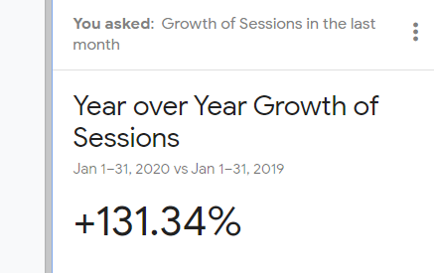
Google Analytics – GOSOSY Year 5
www.osymigrant.org

Slide 13
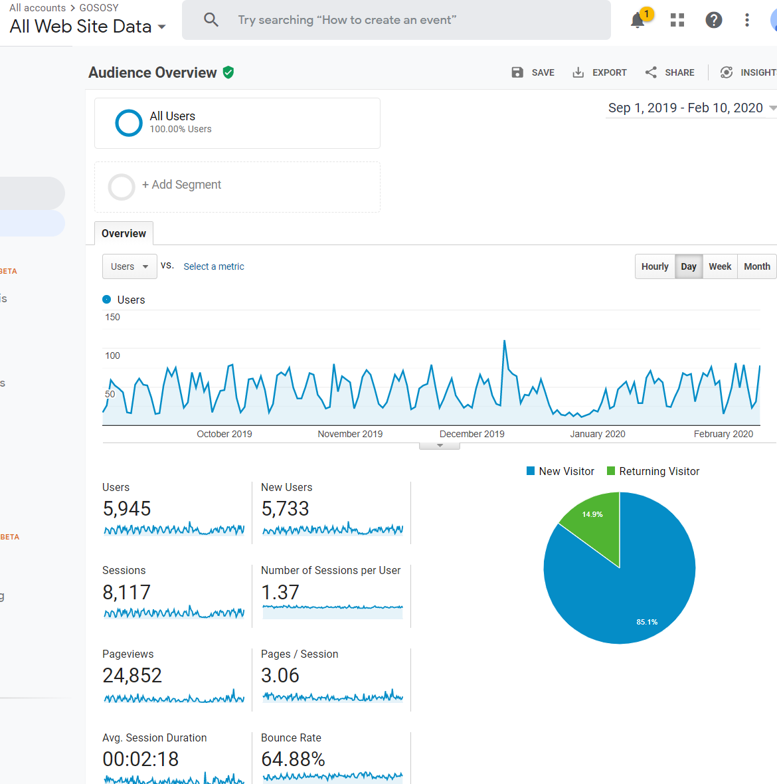

Slide 14
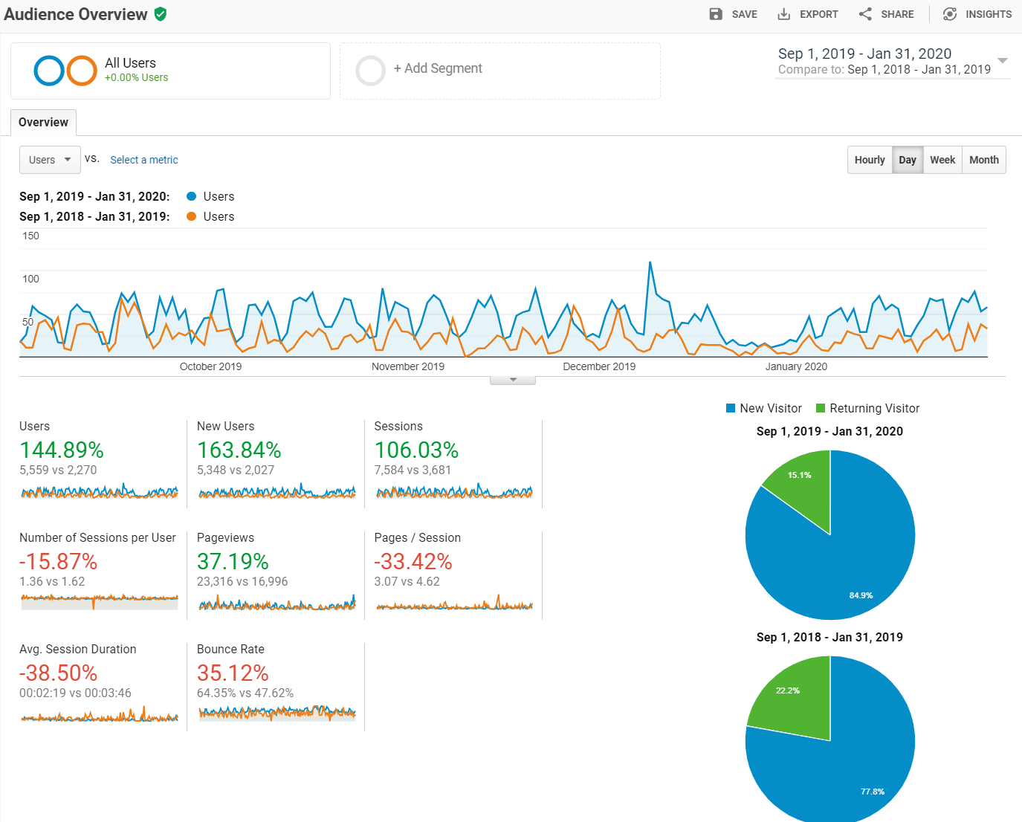

Slide 15
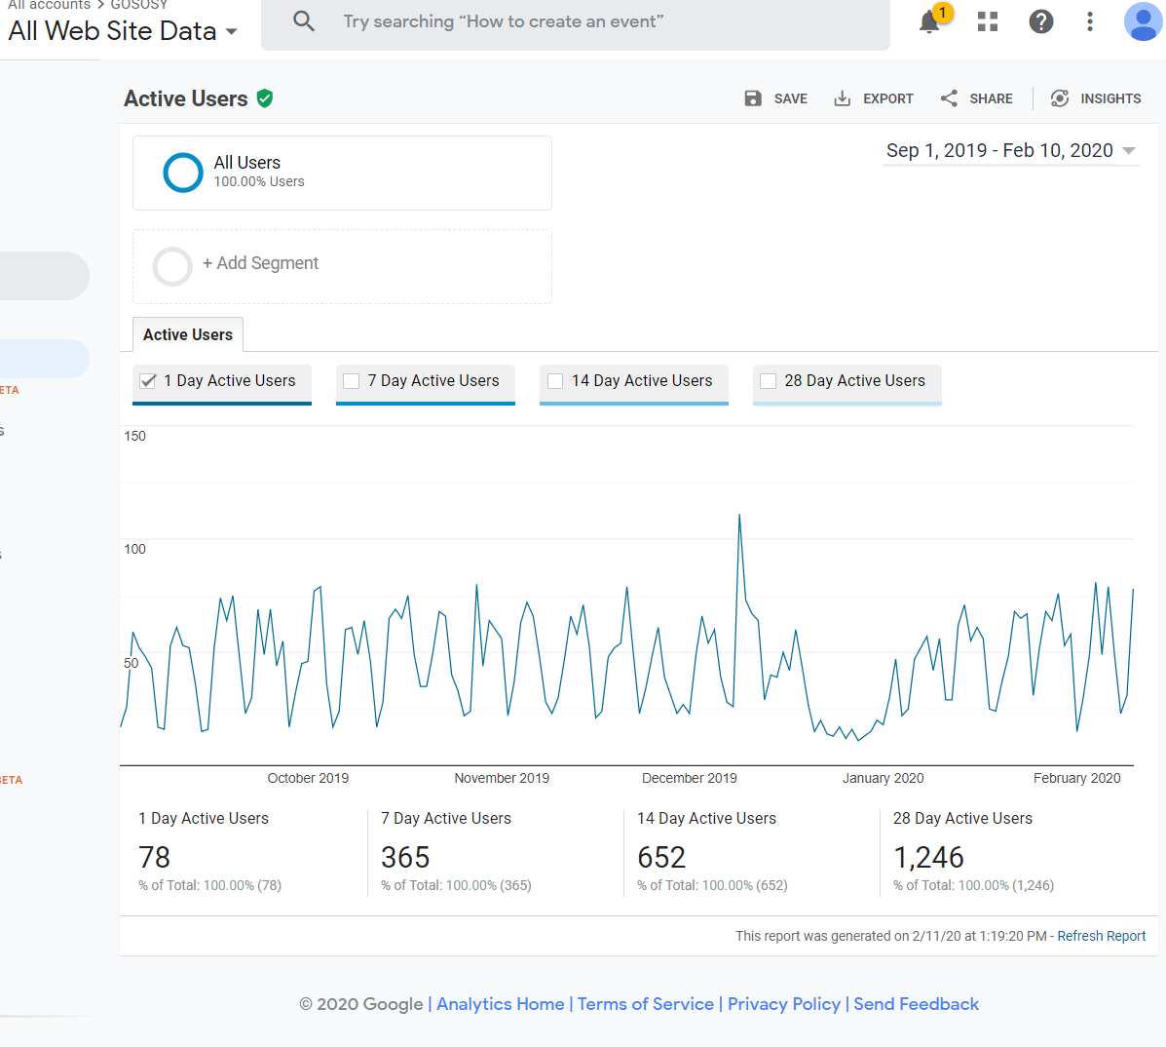

Slide 17
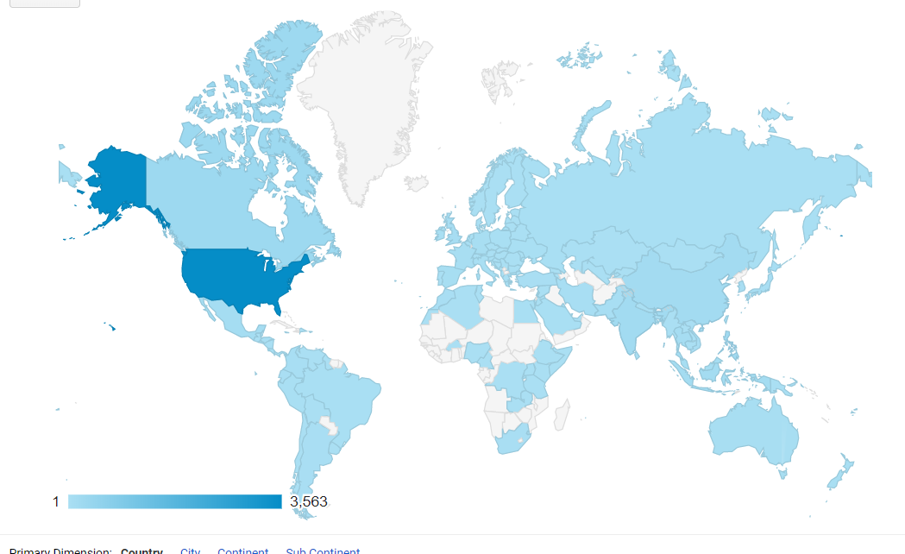

Slide 18
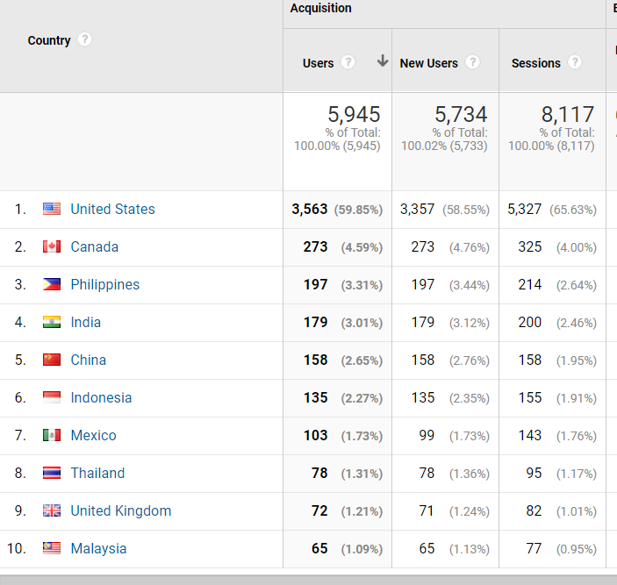

Slide 19
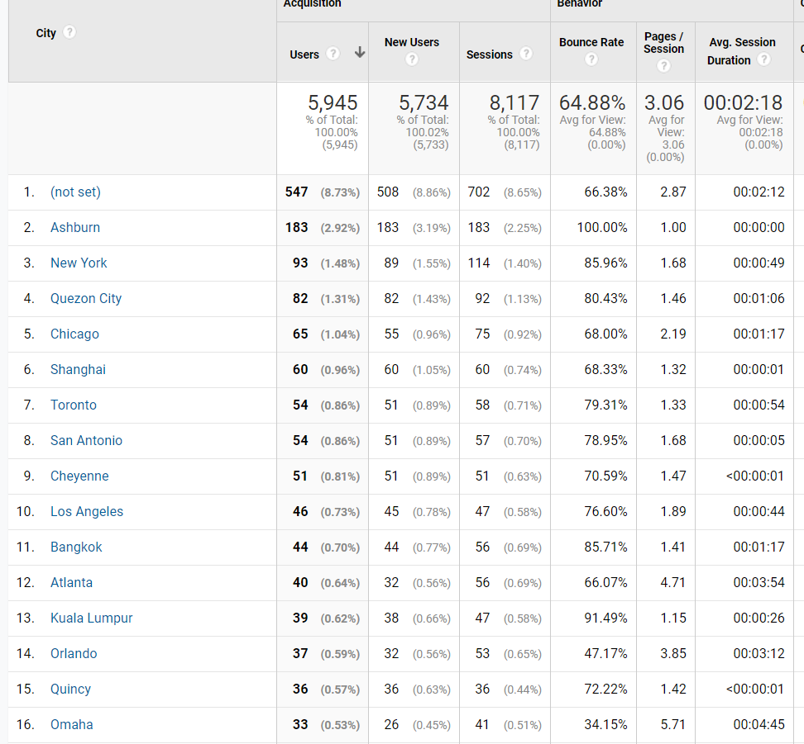

Slide 20
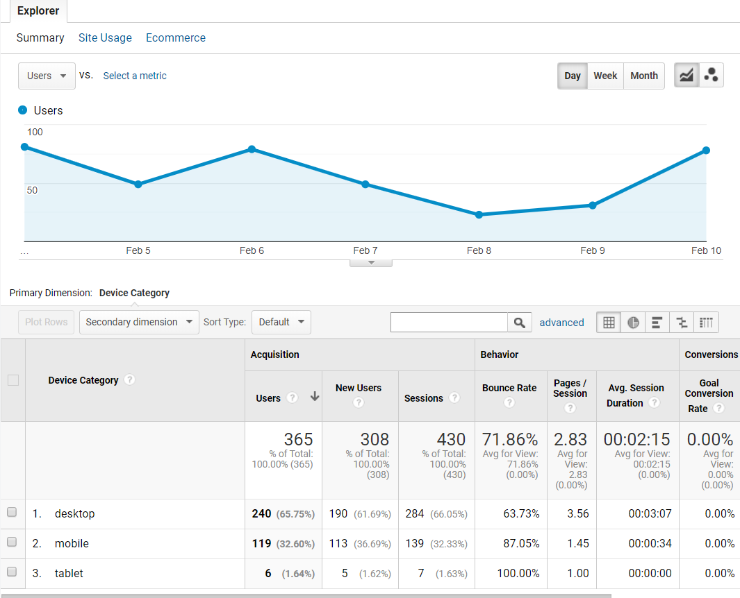

Slide 21
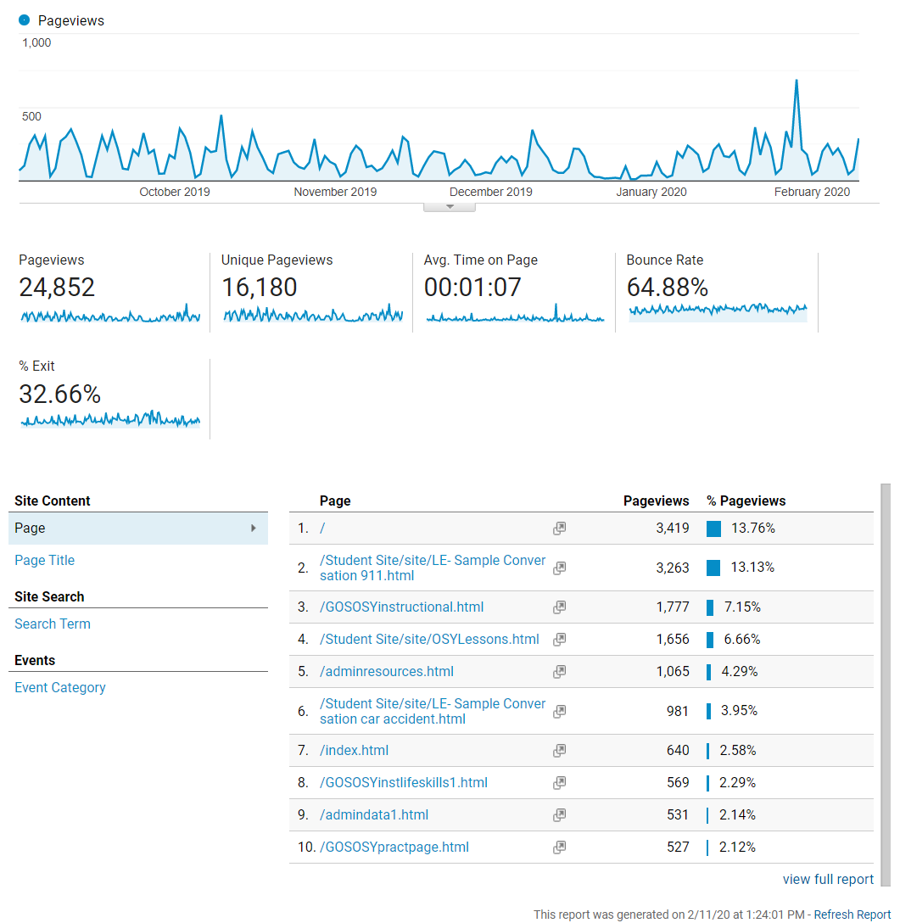

Slide 22
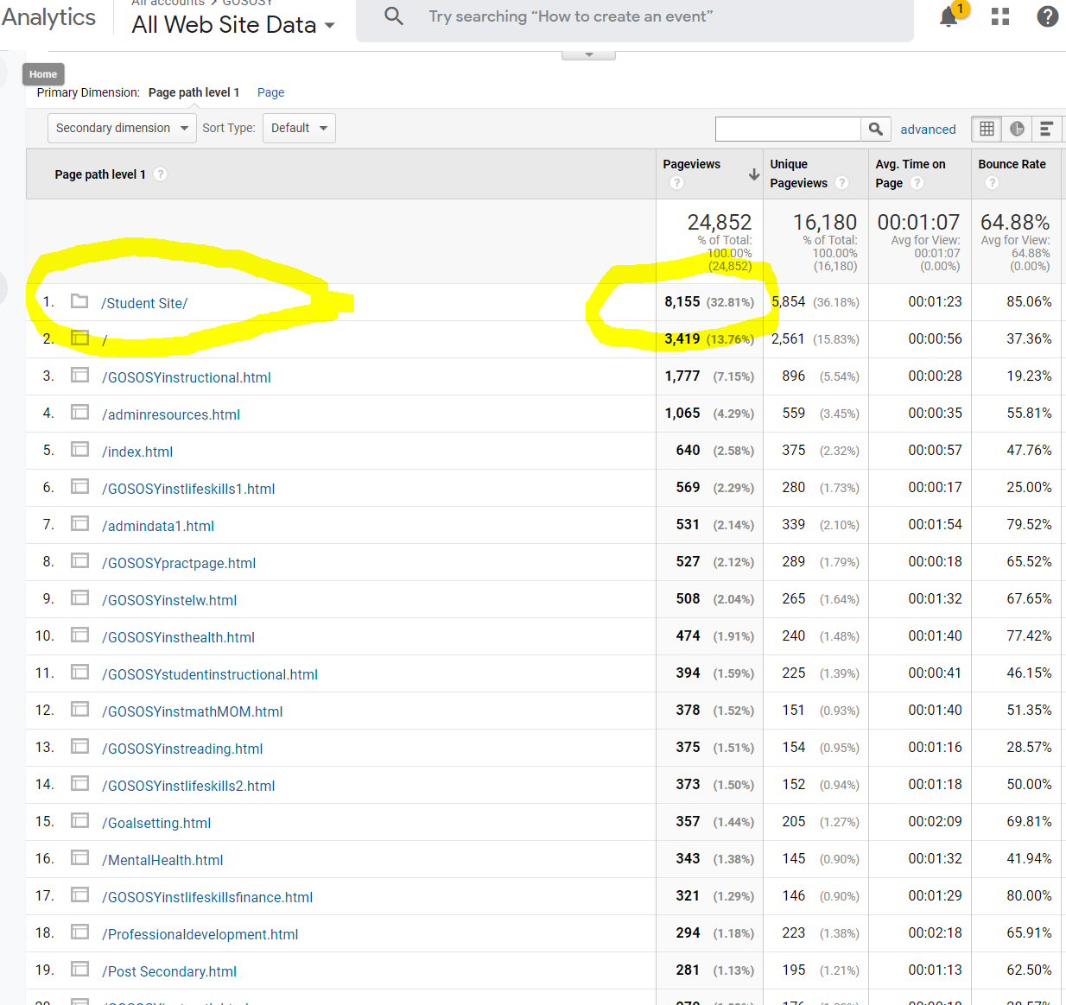

Slide 23
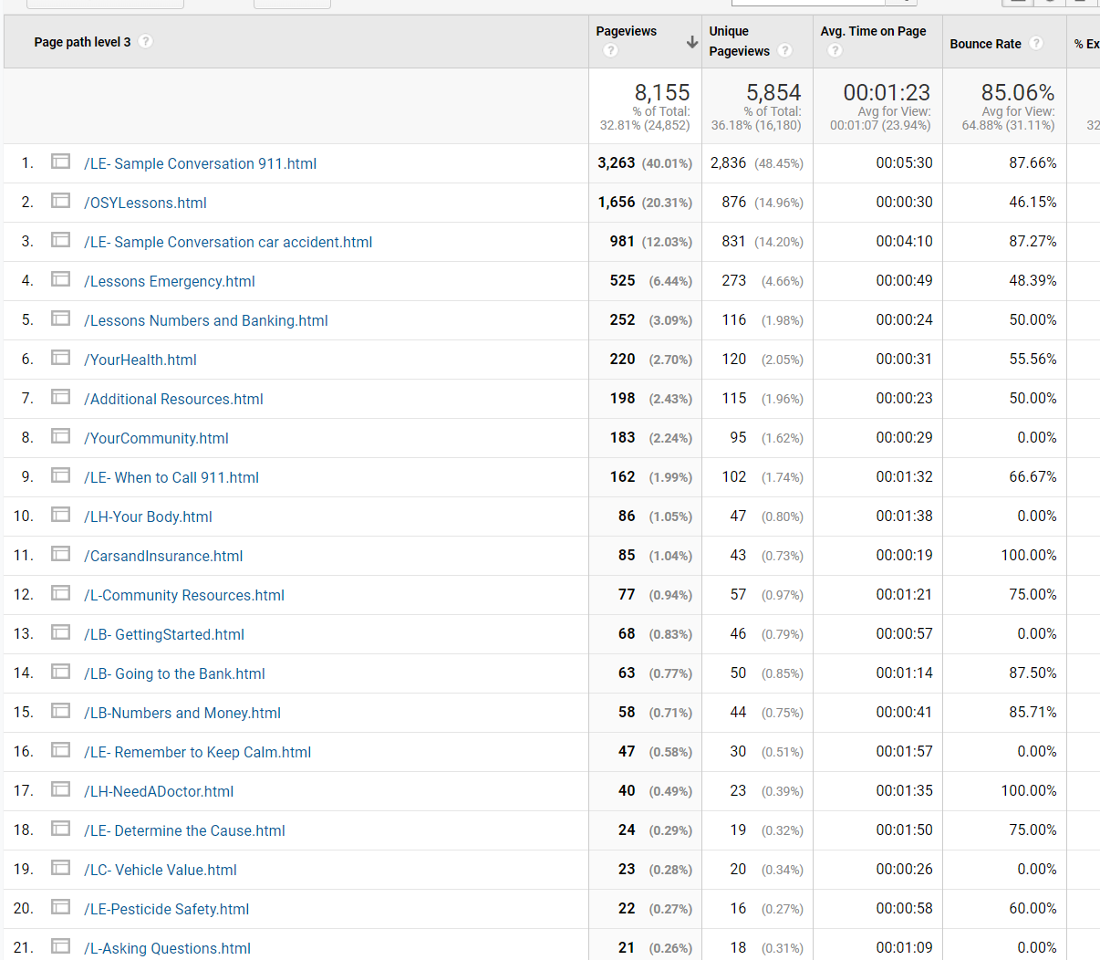

Slide 24
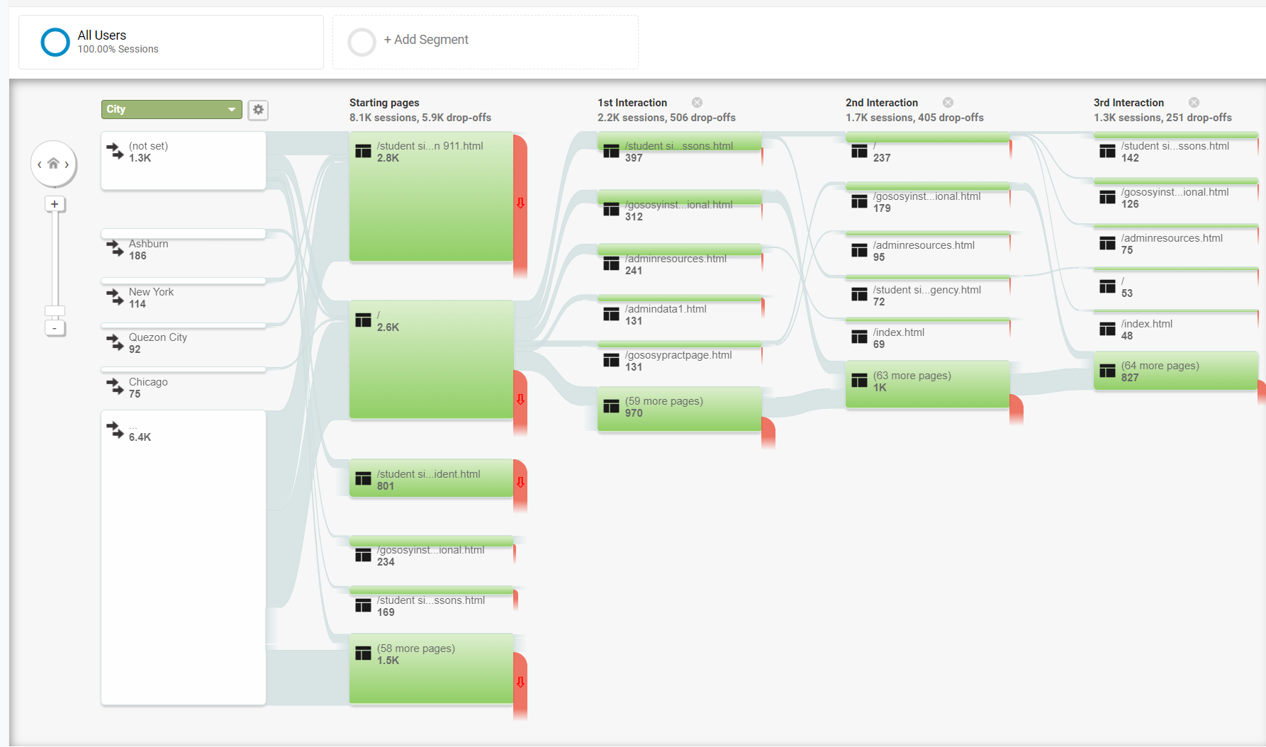

Slide 25
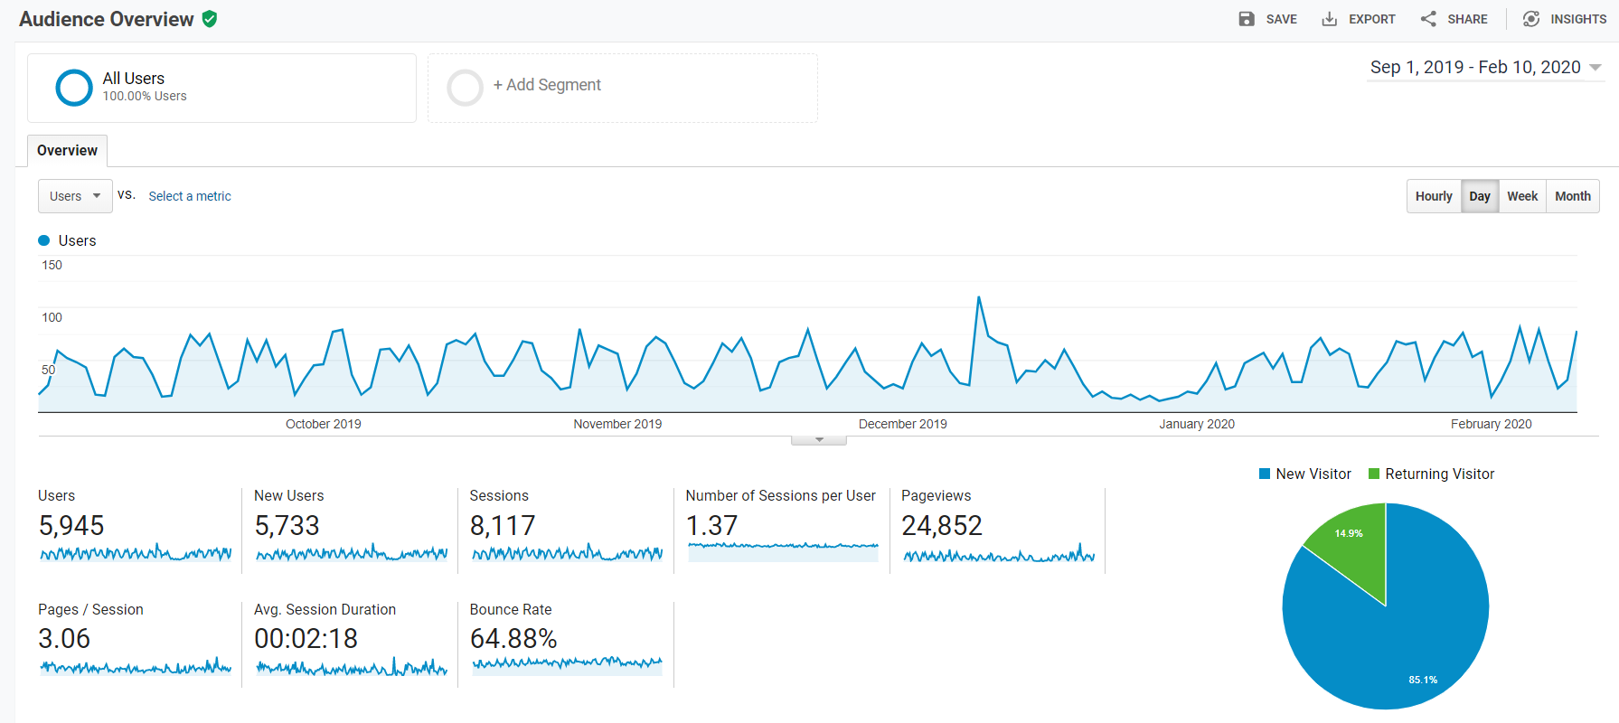

Slide 26
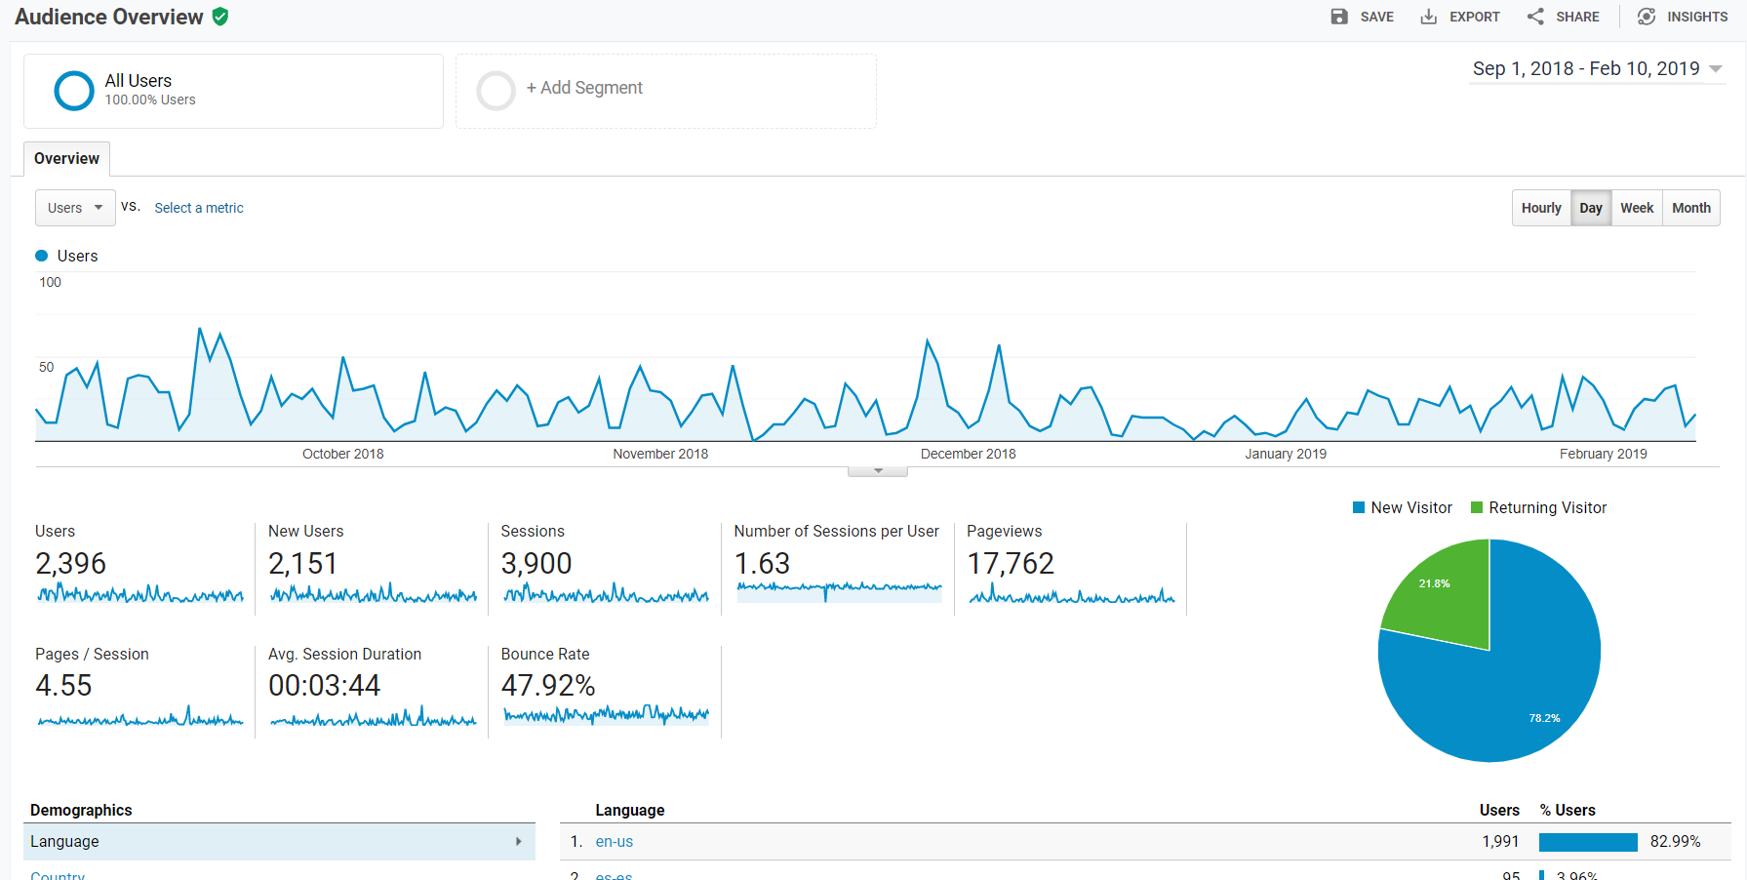

Slide 27
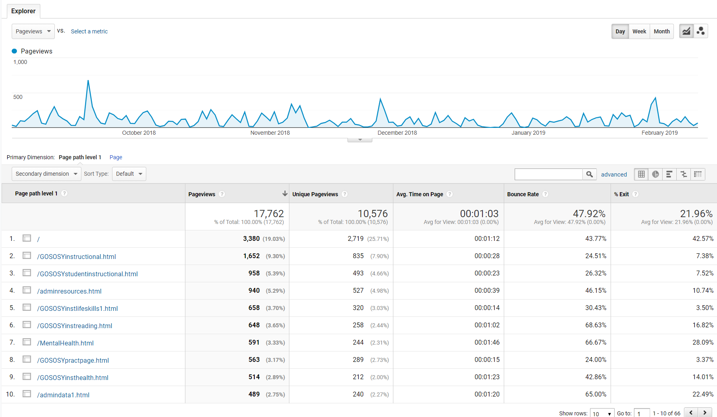

Slide 28
NASDME Proposals
www.osymigrant.org

Slide 29
Goal Setting and Learning Plans
www.osymigrant.org

Slide 32
Preparing for College
www.osymigrant.org

Slide 33
Lesson # | Items to Clarify | Items to Add | Resources Suggested
#1 The Case for College |  | -More discussion about technical/ vocational training and apprenticeships. May be less costly with comparable income potentials.
#3 Considering A Career | -Consider putting lesson #3 before lesson #2 so students can first choose a career, then create relevant goals. | -Include more questioning about careers. | Accuplacer on the College Board website
#4 How Will I Pay for College? | -Differences between subsidized and non-subsidized loans -Check the links. Migrant.net/scholarship does not work. | -Private websites that offer scholarships to non-traditional students. -Include more about parents’ tax returns and how a student with undocumented parents can apply for financial aid.
#7 How to Write the College Essay | -Break down each step in the essay writing process, including benchmarks for specified time frames. --Provide a rubric to assess the essay for use by both students and mentors. | -Add some helpful tips for the mentor such as when the essay should be finalized. Consider including sample essays so students have good examples to review.

Slide 34
General Comments | -Reviewer Pathy Leiva’s name is misspelled. -Provide guidance as to when answers should be in complete sentences and when it’s not necessary. Indicate if expectations relate to specific lessons; i.e. in Lesson 7, Essay Writing, when should the student progress from jotting notes to providing complete sentences? -Include a scoring rubric for the end-of-course assessment for student and mentor use throughout the unit. -Suggest to instructors that they follow the elements of an effective lesson plan (materials, clear objectives, background knowledge, scaffolding strategies, direct instruction action steps, student practice opportunities, and quick assessment). At this time, there are no plans to revise unit content. -Provide guidance re: how to modify the readability of texts, especially the complexity of vocabulary, syntax and background knowledge. | -Provide more specificity re: Lesson Answer Keys. Identify the page #s that have questions. Give advice about how to coach the student—try to eliminate “answers may vary” and provide guidance on types of questions (comprehension and critical thinking) and use of the notes section. Provide reminders that connect the directions from the Introduction and PowerPoint. Mention that many questions are for the student to respond from their own experience. -Provide strategies for scaffolding the reading experience, including bilingual texts. -Consider a comparability study of text difficulty and task characteristics (may need to wait for a unit revision).
#5 College Entrance Exam Strategies #6 Selecting a College #11 The College Interview #12 Becoming an Adult #13 Social Media | These lessons were reported to have been reviewed but no suggestions were offered.

Slide 35
TST Work Groups
OSY Engagement and Relationship Building
Curriculum and Material Development
Goal Setting and OSY Learning Plans
Professional Development
Interstate Collaboration
Mental Health/Trauma
www.osymigrant.org

Slide 36
OSY Engagement and Relationship Building
Emily Hoffman (team lead), Rachel Beech, Joyce Bishop
FII 2.2c
Develop and finalize materials
Provide training on updated OSY engagement/mentoring toolkit
www.osymigrant.org

Slide 37
Curriculum and Material Development
Brenda Pessin (team lead), Peggy Haveard, Rachel Wright-Junio, Jessica Castañeda
1.1f/3.1c/3.1d (in collaboration with GSLP WG)/ Website Redesign
Student Website/Website redesign
English for Daily Life revisions
1.1f Create a list of strategies from the literature with promising evidence for preventing dropouts
3.1d Disseminate tools for portability of GOSOSY materials for highly mobile students
www.osymigrant.org

Slide 38
Professional Development
Sabrina Pineda (team lead), Odillia Cofta, April Dameron,
Veronica Hill
2.1b Provide training and technical assistance on designing services for OSY through the TST and its Workgroups using implementation scenarios
2.1c Create materials for certified and non-certified staff regarding one of the following 1) An Introduction to OSY and 2) Addressing the Needs of OSY with Limited Formal Schooling
www.osymigrant.org

Slide 39
Interstate Collaboration
Travis Williamson (team lead), Barbie Patch, Deke Showman, Monika Lorinczova
CIG Collaboration
1.1e Develop a list of common barriers for recruiting and providing services for OSY and possible solutions
2.2a Provide training at TST and training of trainers regarding networking for effective interstate collaboration and interagency collaboration (e.g. HEP, other CIGs)
2.2b Document and report collaboration results
www.osymigrant.org

Slide 40
Goal Setting and Student Learning Plans
Sarah Braun Hamilton (team lead), Justyn Settles, Emily Williams,
Eugenia Luna
1.2a Create scenarios for best practices in use of the updated OSY Learning Plan templates
1.3a Create scenarios for best practices in the use of updated Goal Setting Workshop (GSW) materials
1.3c Train GSW facilitators based on scenarios
1.3d Conduct GSWs and assess using project-based activity and rubric (design project-based activity and rubric)
3.1d Disseminate tools for portability of GOSOSY materials for highly mobile students
www.osymigrant.org

Slide 41
Personal Wellness
Lora Thomas (team lead), Lysandra Alexander, Susanna Bartee, Susana Des Neves, Maria Dominguez, John Farrell
1.1c Incorporate strategies and best practices from the literature review into mental health lessons for OSY
1.1d Develop materials that describe how trauma impact academic performance and strategies for educators
2.2d Prepare training materials to go along with OSY mental health lessons based on staff needs assessment results
3.1b Disseminate materials that describe how trauma impacts academic performance and strategies for educators
www.osymigrant.org

Slide 42
2020 www.osymigrant.org UPDATES

Slide 43
2020 www.osymigrant.org UPDATES

Slide 44
2020 www.osymigrant.org UPDATES

Slide 45
2020 www.osymigrant.org UPDATES

Slide 46
Student Page
What are students looking for on the Student Page?
What is the most important academic content for the Student Page?
What is the most important advocacy information for the Student Page?
Should certain “big topics” be highlighted (i.e. Personal Wellness, HSED, etc.)?
How should we include this goal in the new proposal?
www.osymigrant.org

Slide 47
IRRC: What’s New

Slide 48
Agenda
Day 2: 8:30 am
Interstate Collaboration with MIRA CORE
English for Daily Life Presentation and Feedback
Interstate Collaboration and Coordination Discussion and Feedback
Personal Wellness Work Group Discussion and Feedback
Data Collection for Year 5
Planning for the Future
Structure of TST
Finalize Work Group Reports/Action Plans
Work Group Reports
NASDME and SST Meeting Planning
Future Meeting Dates
www.osymigrant.org

Slide 49
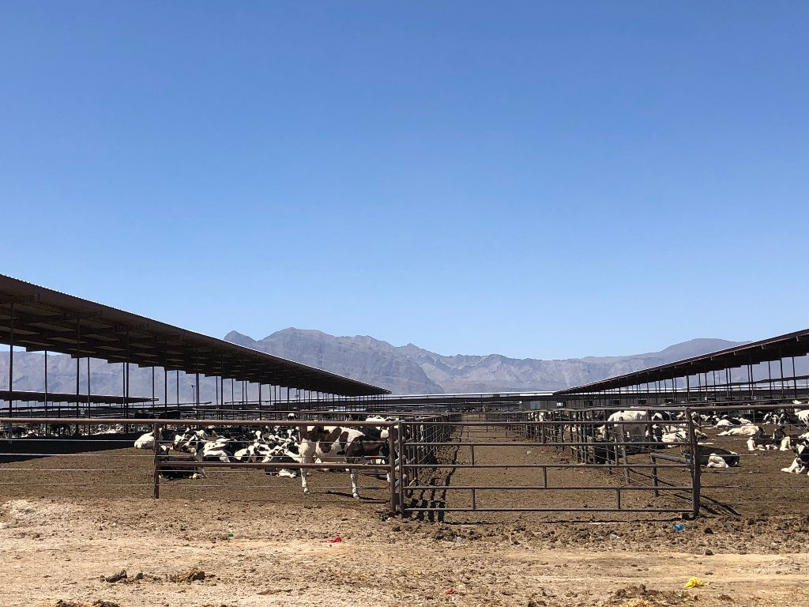
Resources for Out of School Youth Using the Migrant Literacy NET with OSY

Slide 50
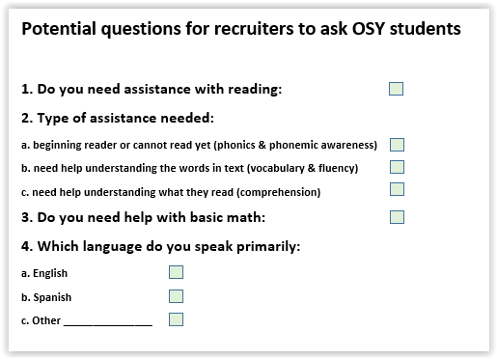
Collecting data as part of recruitment
For the CNA
For the Evaluation
To Provide Services

Slide 51
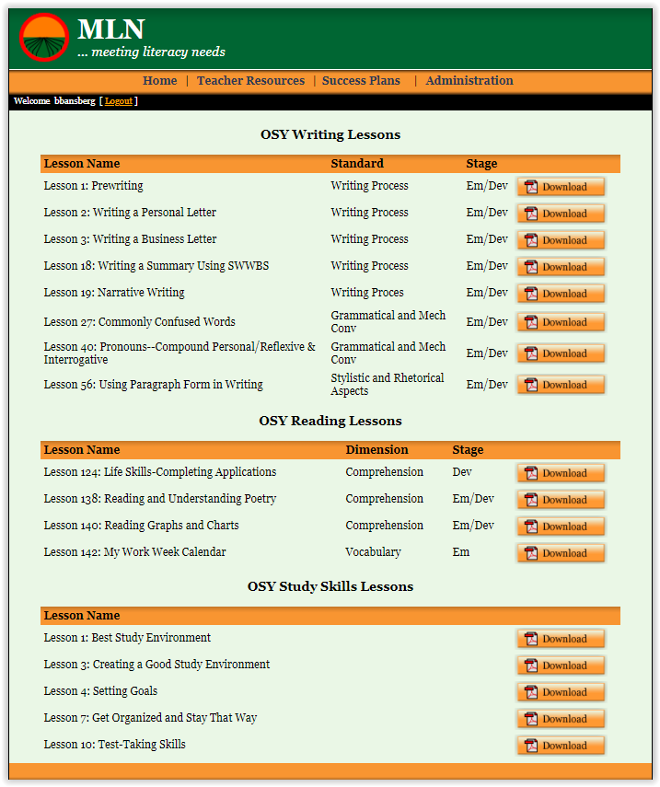
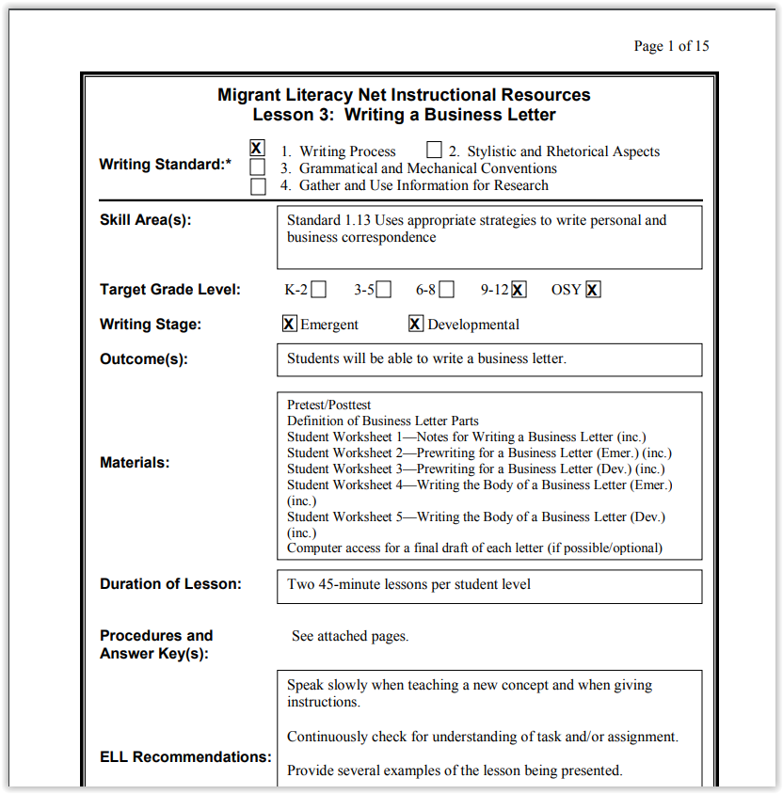
Example resources For OSY on the MLN: for teachers and tutors

Slide 52
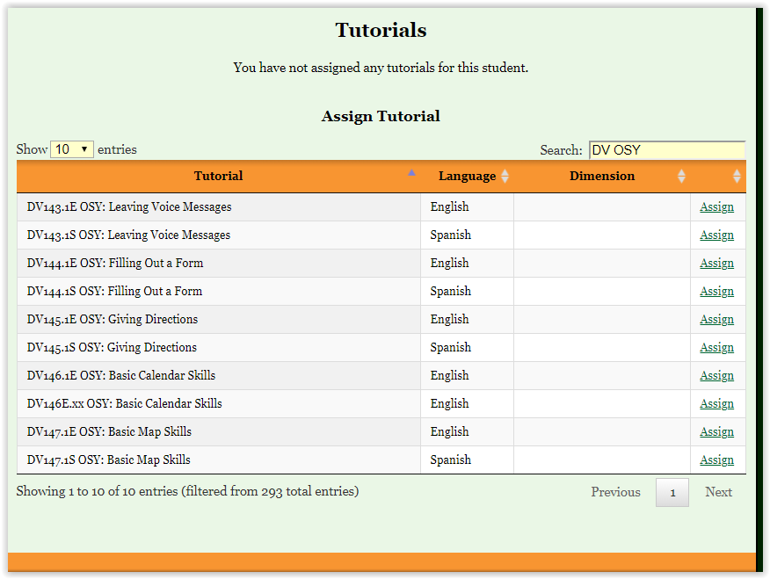
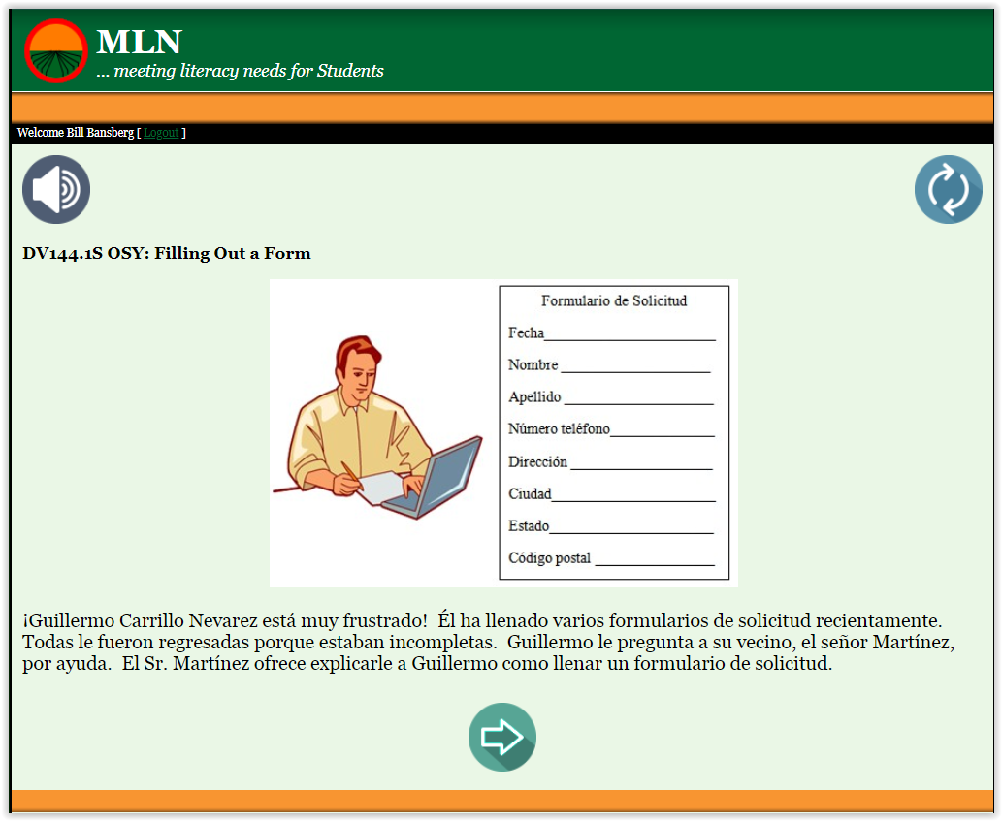
Example resources For OSY on the MLN: for Out of School Youth
Online tutorials targeting life skills

Slide 53
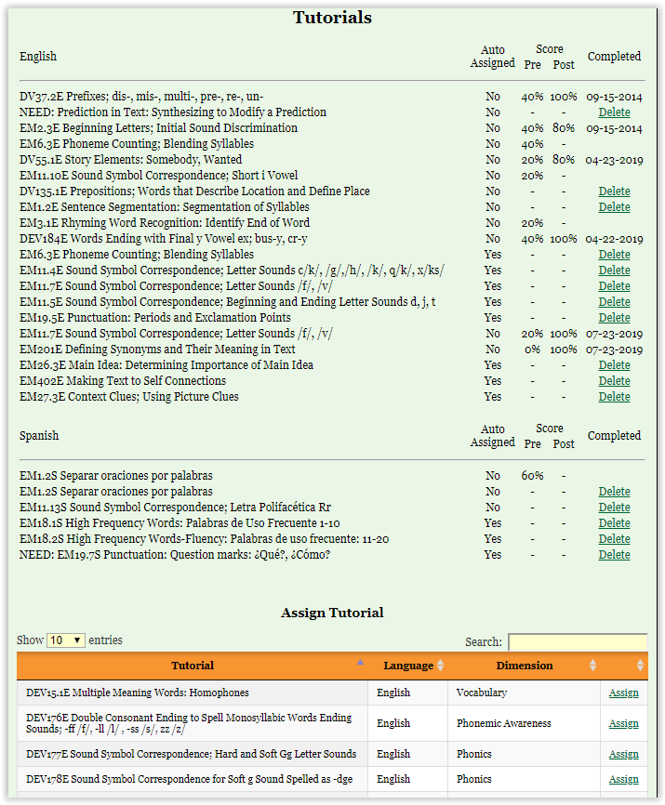
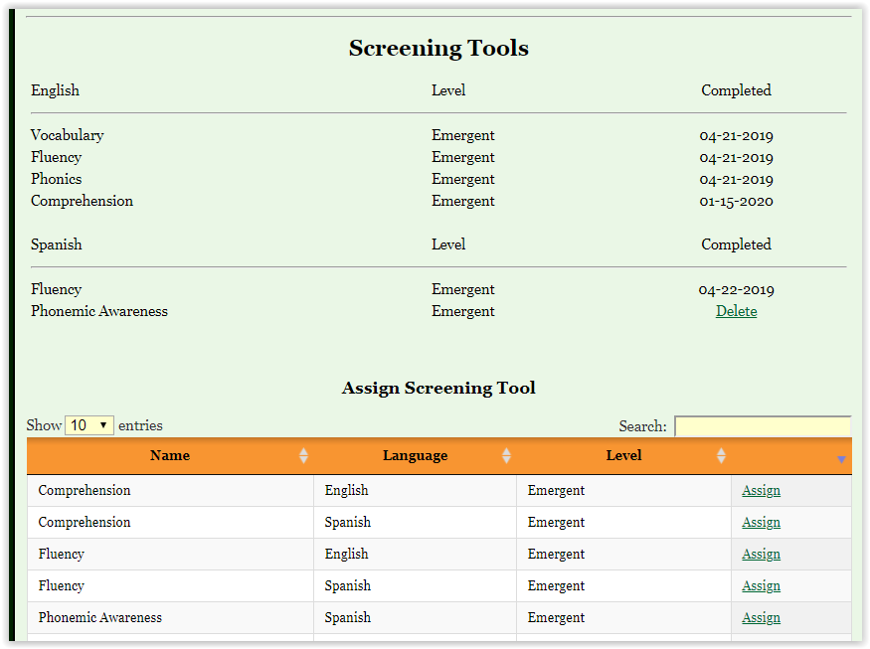
Example resources For OSY on the MLN: for Out of School Youth
Online screeners to identify reading needs
Online tutorials to meet reading needs

Slide 54
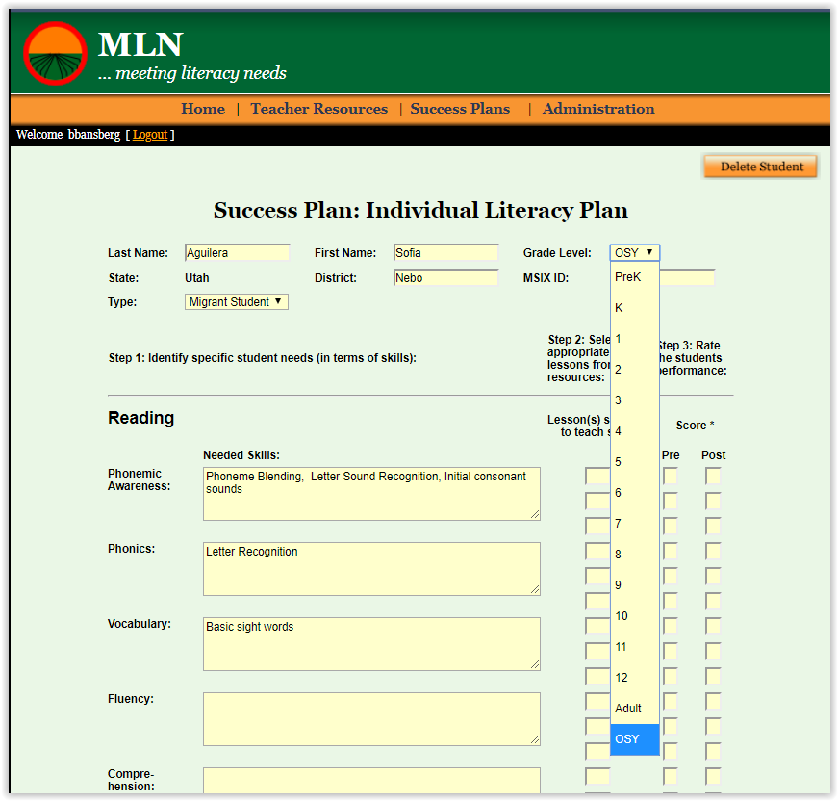
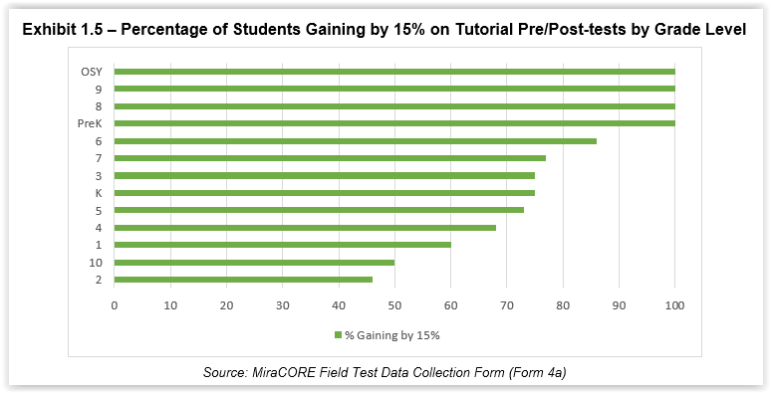
Data for OSY on the MLN
Revised Success Plan now allows collection of data specifically for OSY
2019 Field Test Results

Slide 55
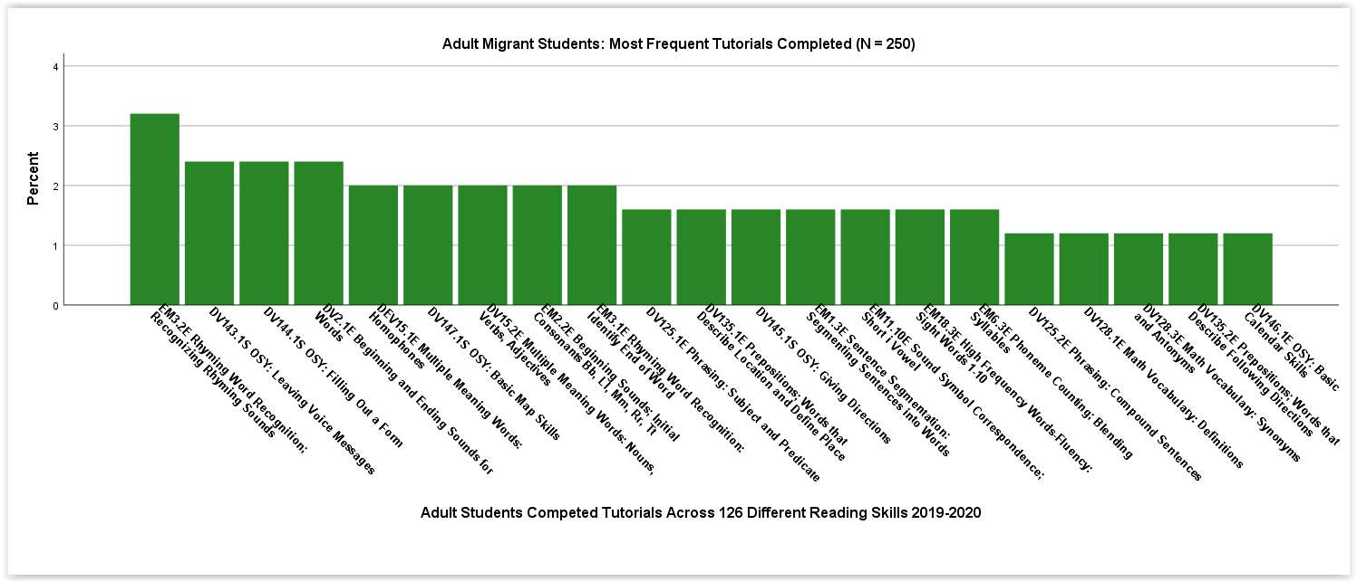
Data for OSY on the MLN

Slide 56
In the next round MiraCORE will propose the…
Development of online training for OSY migrant staff on the MLN
Creation of a model / module for use by migrant staff with Out of School Youth to facilitate the provision of services

Slide 57
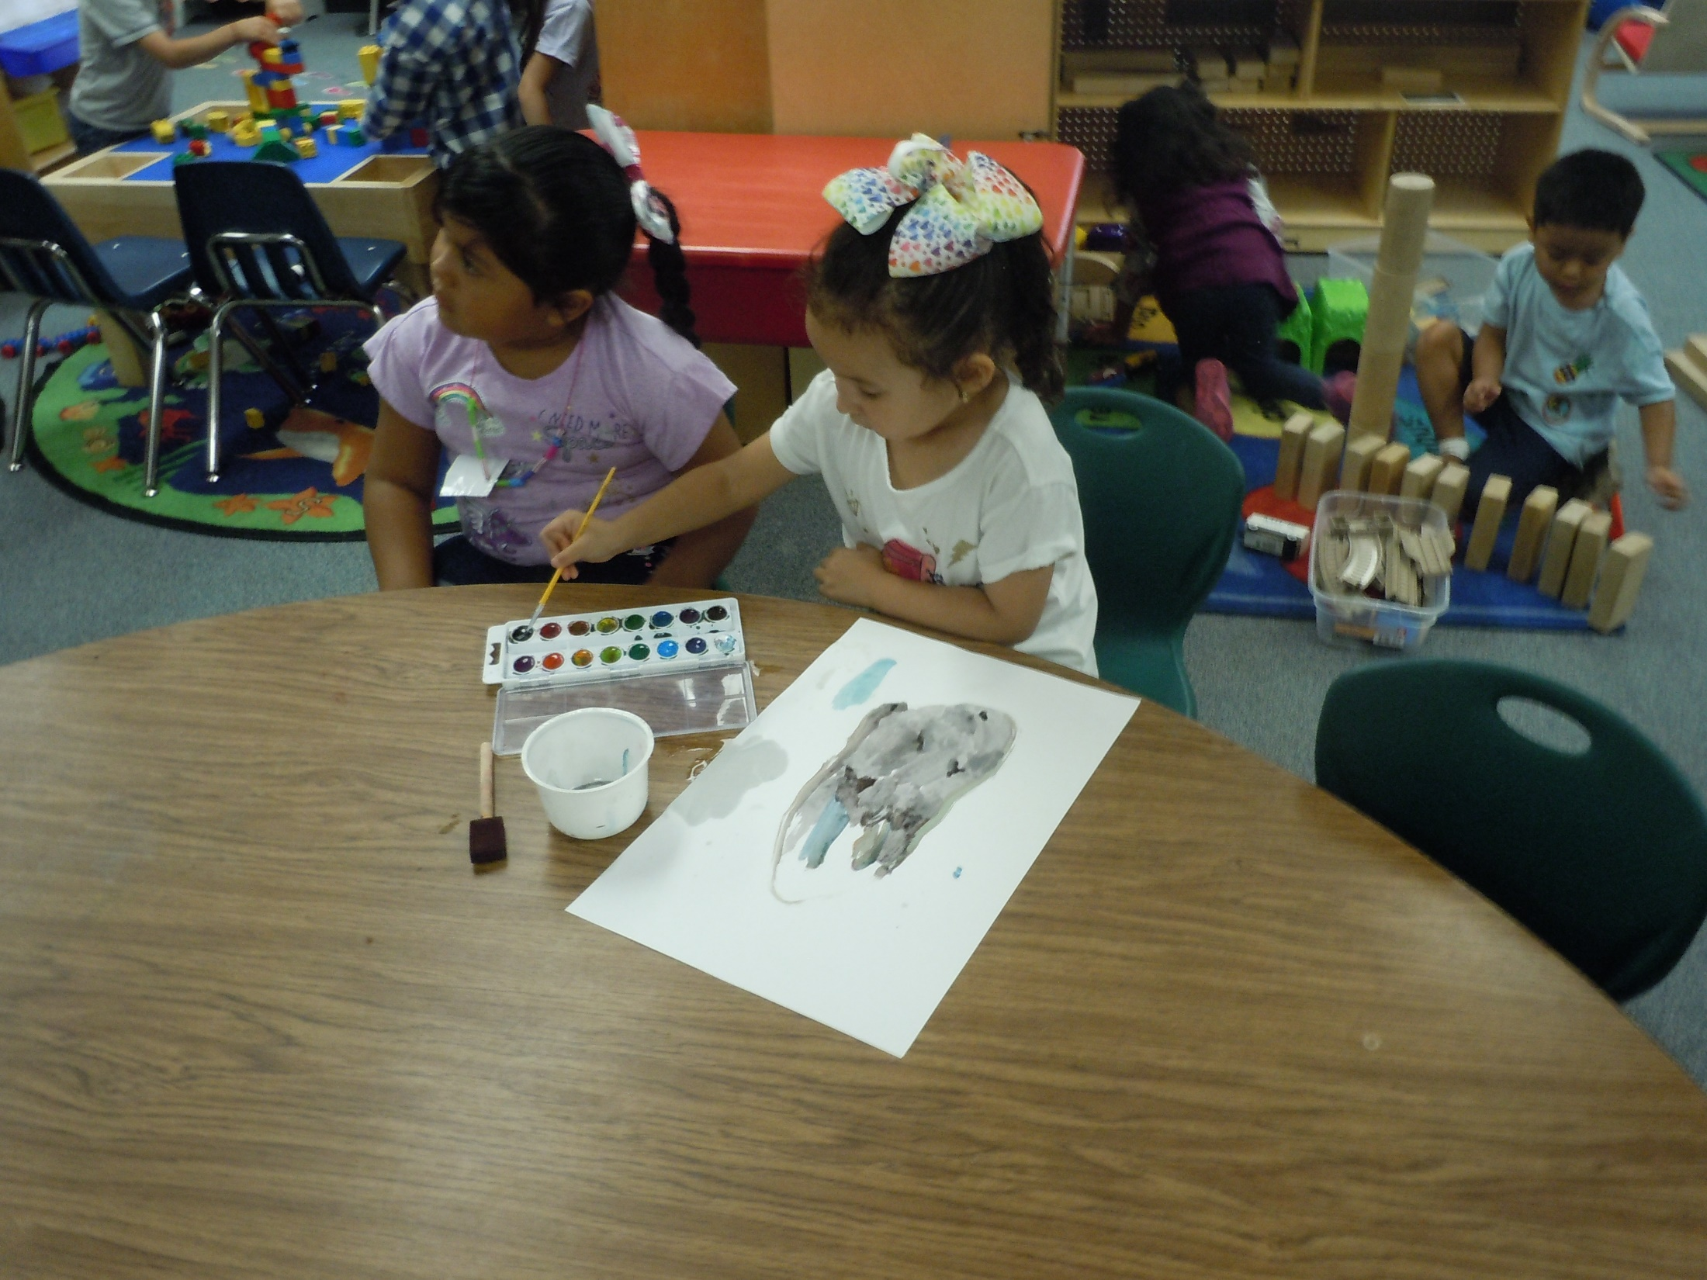
Migrant Literacy NET (MLN) Teachers Guide: February 2020 Supplemental Instructional Tools

Slide 58
MiraCORE: Purpose
To assist migrant students in grades K-12 and out-of-school youth to become proficient in reading
and other literacy skills
www.migrantliteracynet.com or
www.meetingliteracyneeds.com
The Migrant Literacy NET
was created by the
MiraCORE Consortium
Lead state: Member states:
Utah Hawaii Mississippi
New Hampshire Nevada North Dakota South Dakota Vermont Virginia
Partner state: Minnesota

Slide 59
Available Resources on the MLN
Teacher Resources
141 reading lessons across the five reading dimensions at the K-12 level and for out-of-school youth (OSY)
86 writing lessons
44 math lessons in English/Spanish
11 study skills lessons
16 OSY lessons
Pre and post test assessments for each lesson
Parent Resources
Reading and writing activities for parents to assist their children to read (in English and Spanish) online
Electronic Graduation Plans to help overcome barriers to success to high school graduation
Student Resources (Teacher Directed)
Electronic Success Plans to track student progress that can be transferred electronically to teachers anywhere
Online screeners that identify students’ specific reading needs in English and Spanish across all reading dimensions at both the emergent and developmental reading levels. Screeners automatically assign online tutorials to students based on needs.
Over 300 online reading tutorials in English & Spanish that students can access anywhere, anytime - all with audio and pre/post-tests.

Slide 60
www.migrantliteracynet.com
Click on:
‘Teacher Access’

Slide 61
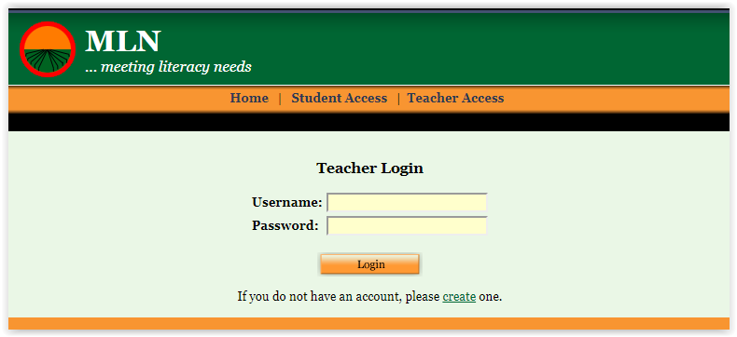
Enter your user name and password or click on register to create your own

Slide 62
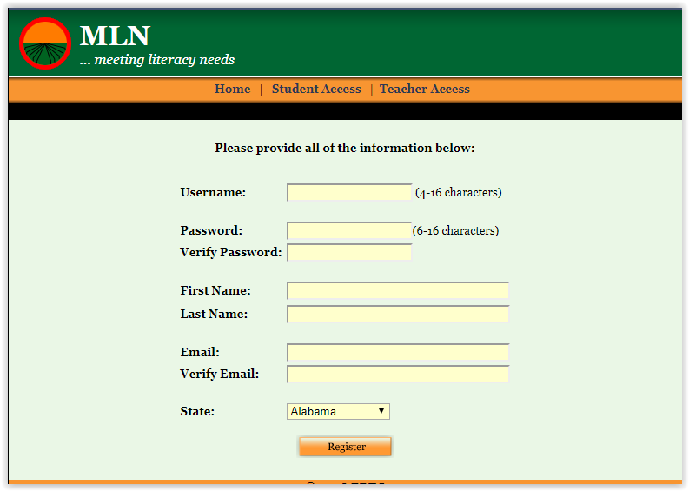
Create your own user name and password

Slide 63
Web-based system with a wide variety of resources for teachers ... and assistance for parents and students

Slide 64
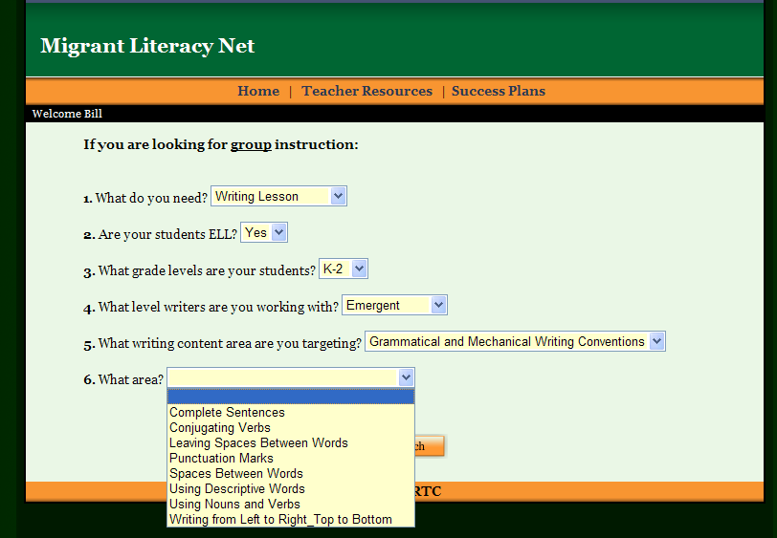
Teachers can search for lessons to meet student needs

Slide 65
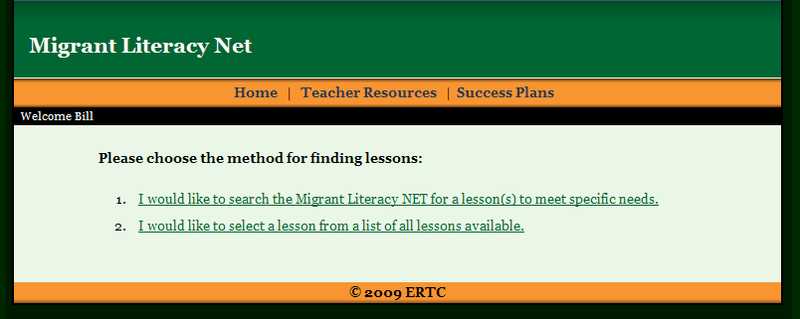
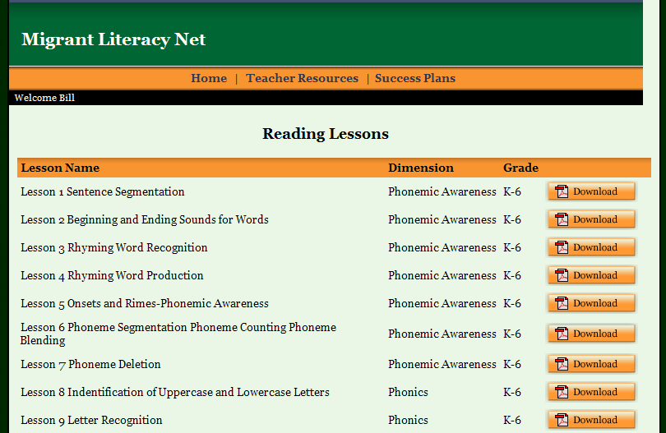
Teachers can select lessons from a list

Slide 66
MLN Lessons (Reading, Writing, Math & Study Skills)
Lessons include all teacher procedures, timelines, student materials, worksheets, assessments, as well as ELL considerations

Slide 67
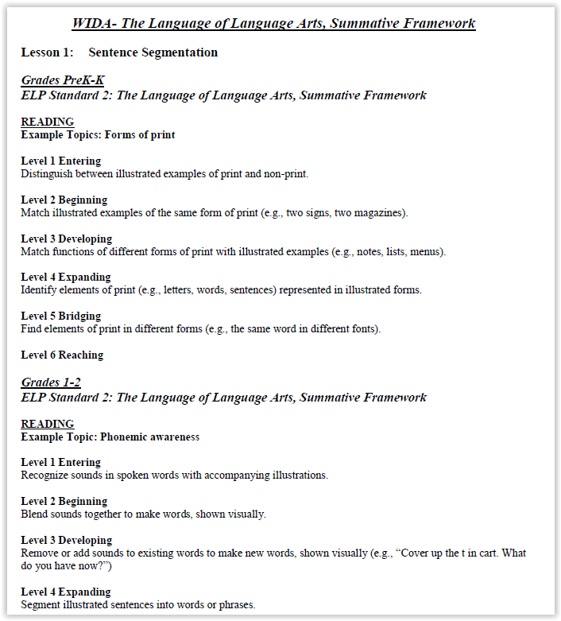
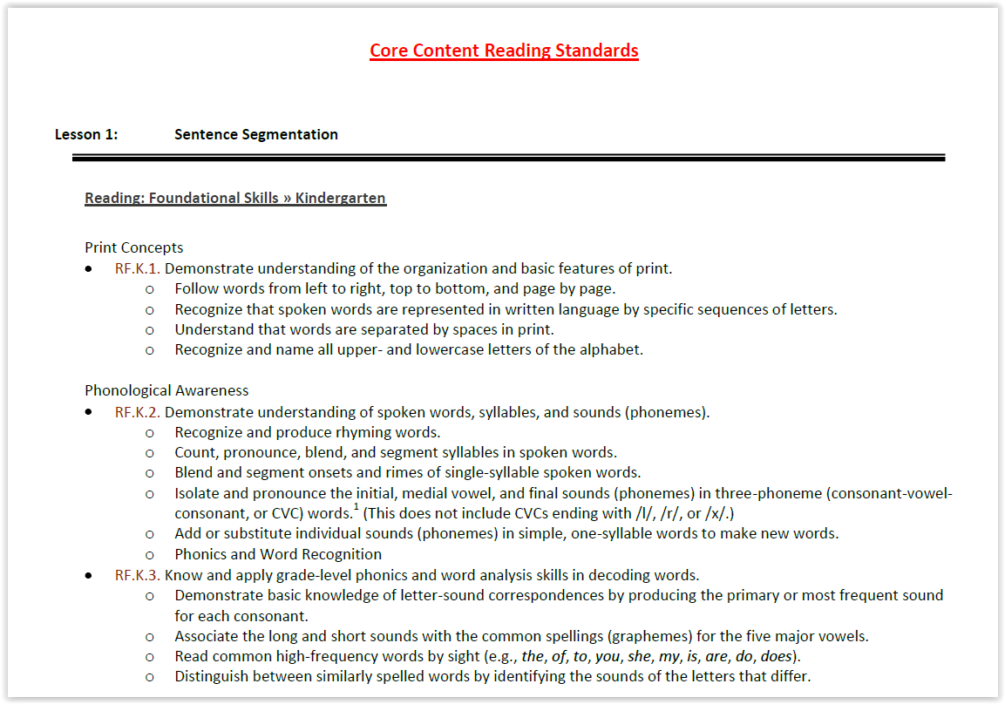
All lessons and online tutorials are mapped to Common Core & WIDA standards

Slide 68
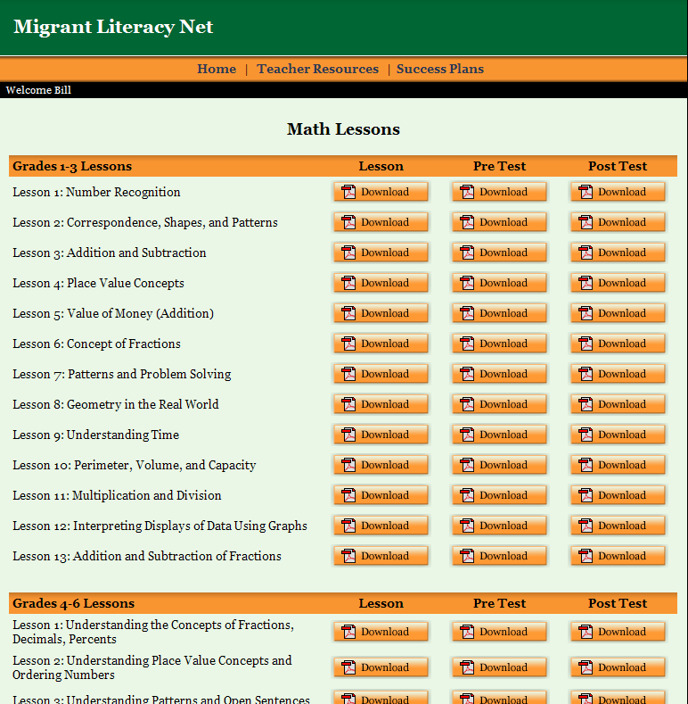
Teacher resources in mathematics are also available on the Migrant Literacy NET in both English & Spanish

Slide 69
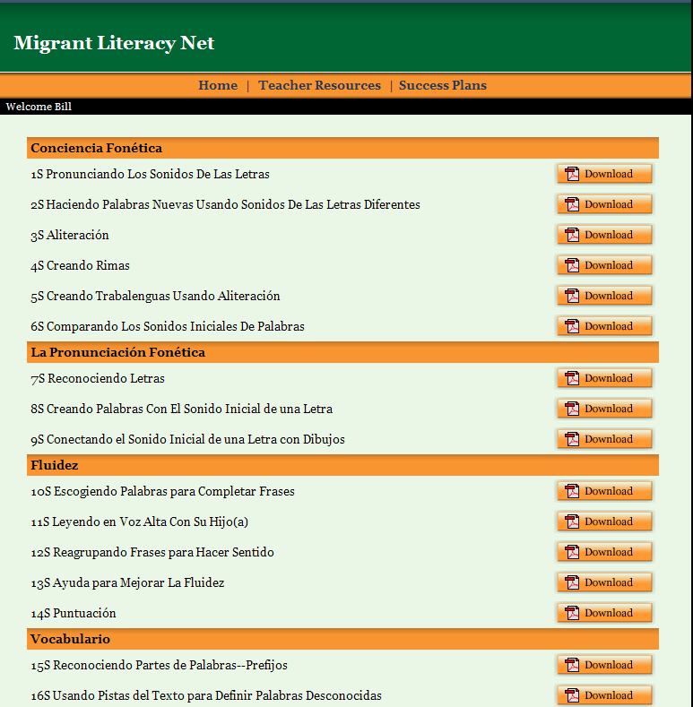
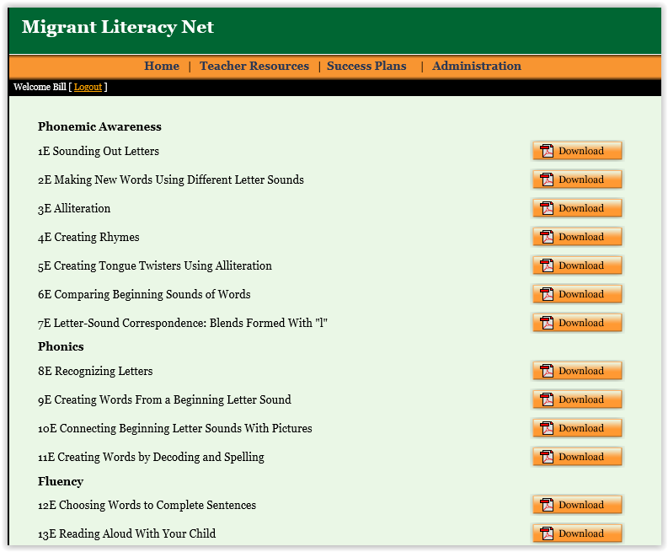
FOR PARENTS - Activities are available in English/Spanish to assist them in helping their children to learn to read.

Slide 70
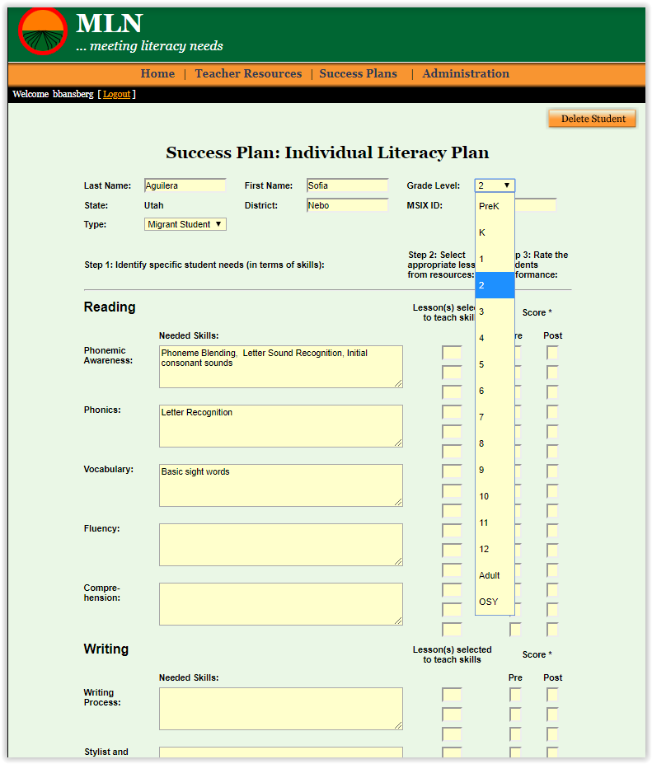
FOR STUDENTS- 1. Success Plans 2. Online screeners to identify needs 3. Online tutorials to meet needs

Slide 71
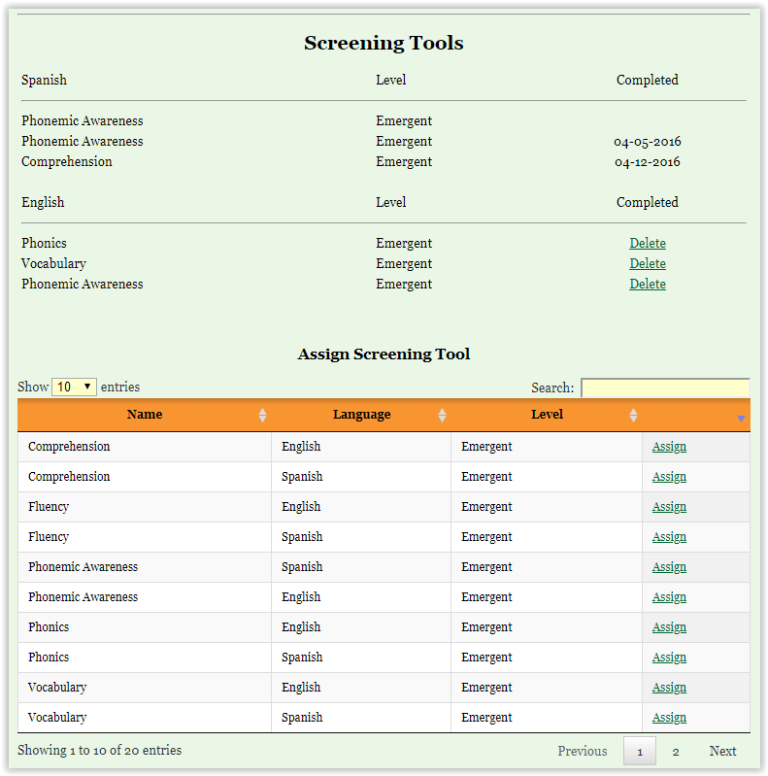
FOR STUDENTS- 1. Success Plans 2. Online screeners to identify needs 3. Online tutorials to meet needs

Slide 72
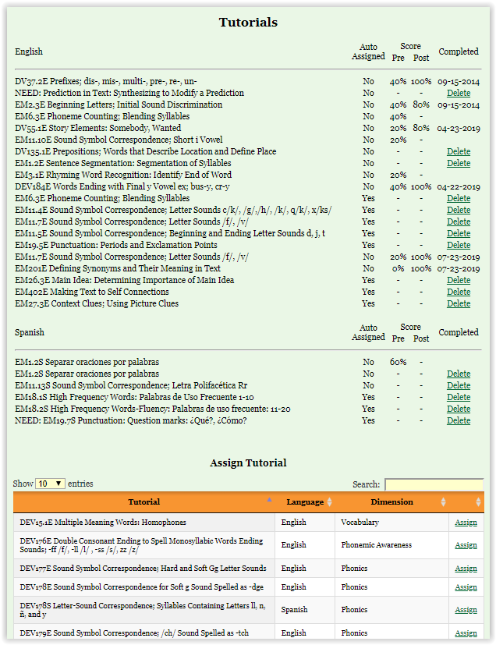
FOR STUDENTS- 1. Success Plans 2. Online screeners to identify needs 3. Online tutorials to meet needs

Slide 73
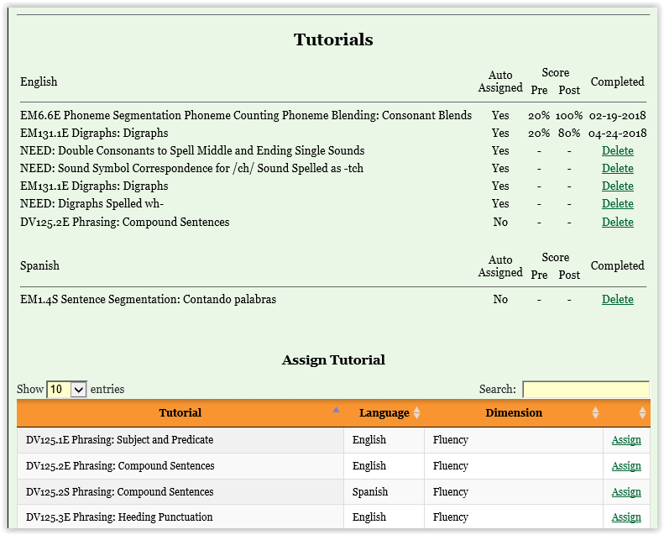
Screeners identify student reading needs and automatically assign online tutorials to meet those needs to each student.

Slide 74
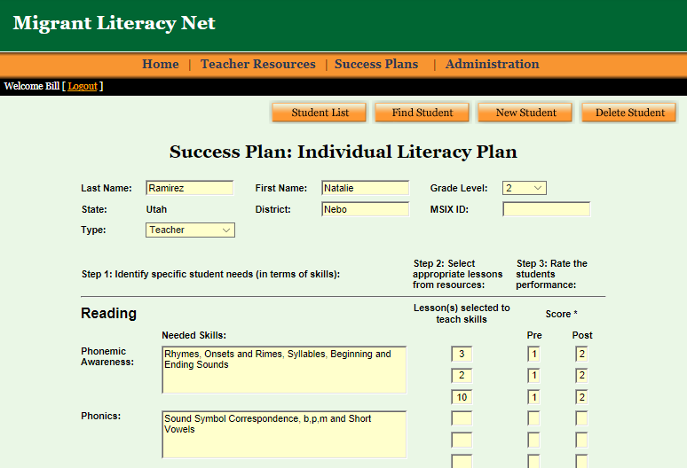
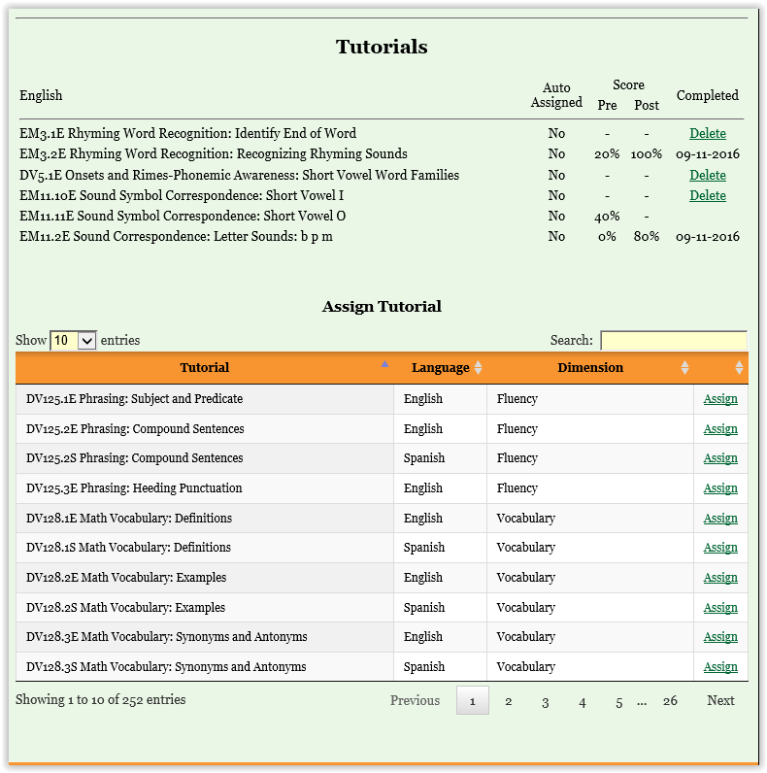
Teachers can also assign online reading tutorials to students at the bottom of the success plans. Tutorial pre and post test results are recorded on each students success plan

Slide 75
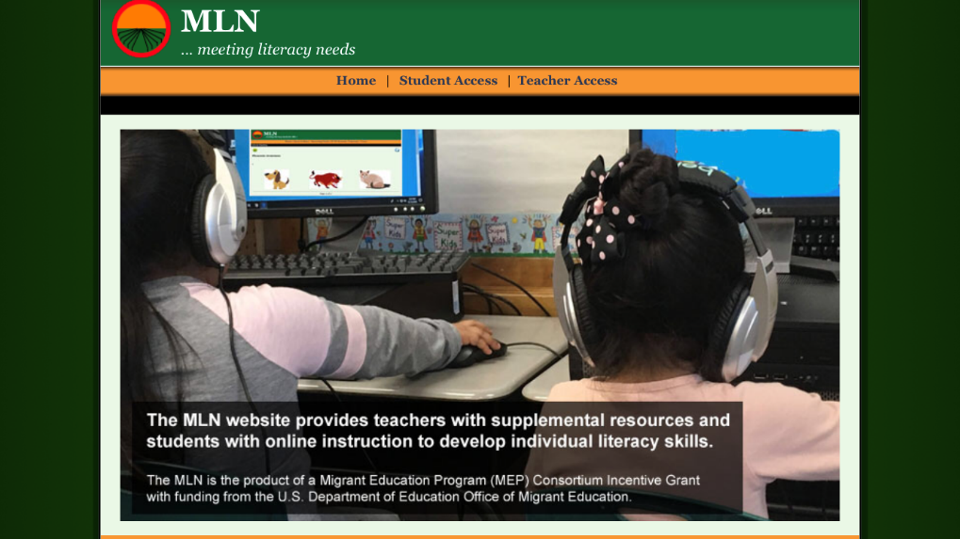
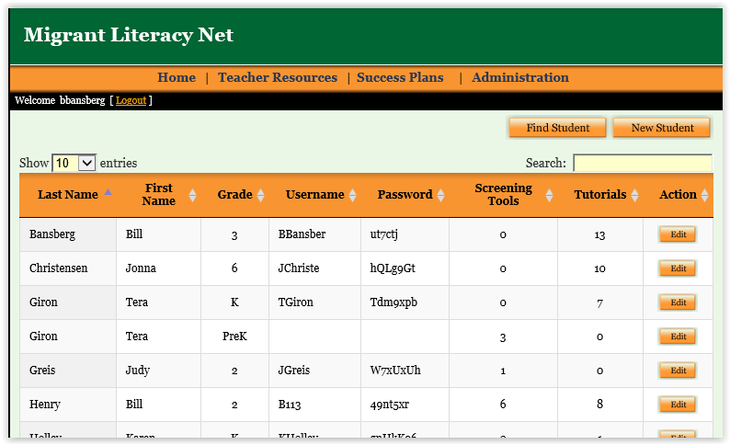
Students go online to complete screeners which identify needs and to complete tutorials which facilitates reading proficiency
Student user names and passwords are automatically generated once a teacher has assigned a student a screener or a tutorial. These are recorded on each teachers login

Slide 76
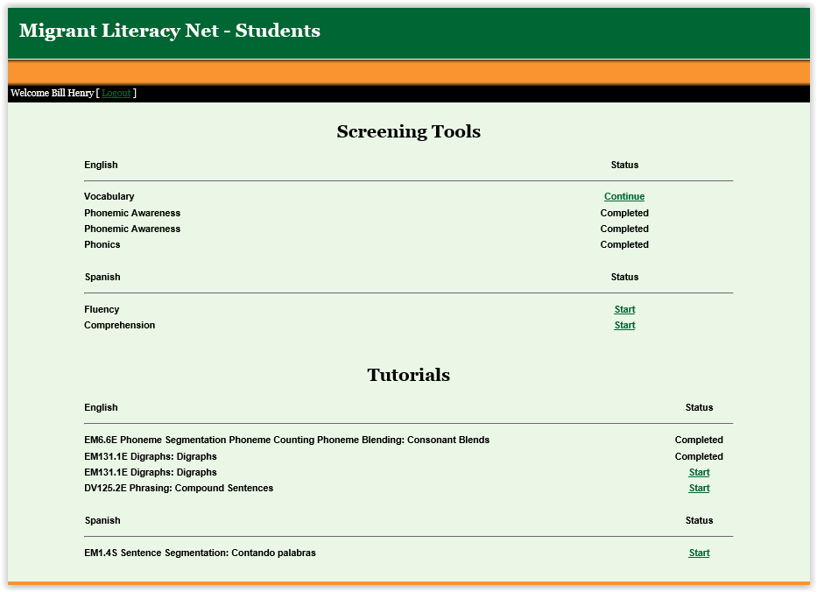
Students go online to complete screeners to identify needs and tutorials to facilitate reading proficiency

Slide 77
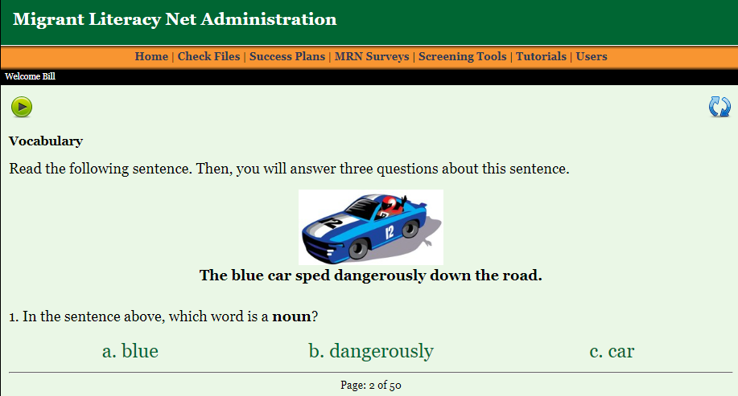
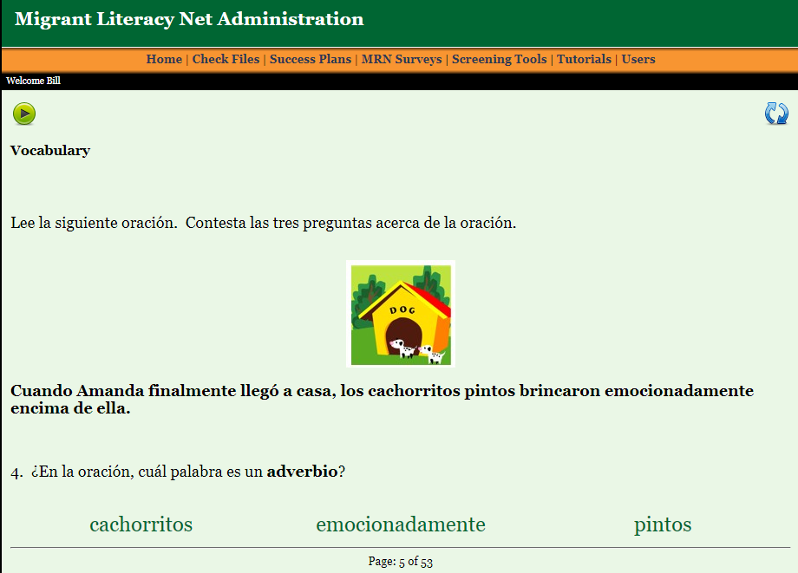
Students complete online reading screeners across the 5 reading dimensions which identify their specific reading needs in English or……………Spanish

Slide 78
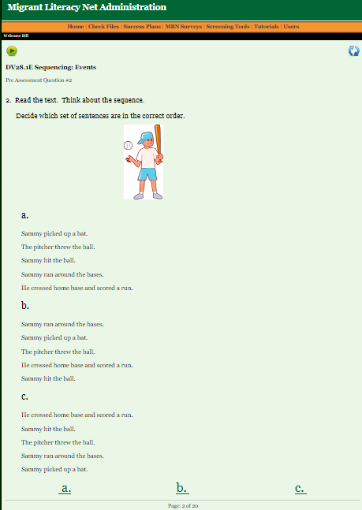
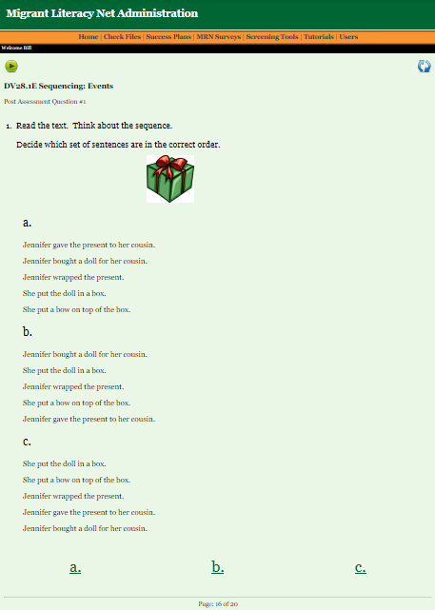
Students complete assigned online reading tutorials for students in English (all with pre and posttest scores to record progress) …or
Pre-test Tutorial Instruction Post-test

Slide 79
Students complete assigned online reading tutorials for students in Spanish (all with pre and posttest scores to record progress)
Pre-test Tutorial Instruction Post-test

Slide 80
Students pre and posttest scores on tutorials are recorded on their Success Plan….

Slide 81
Redesigning the MLN to work effectively on smaller devices
Students can now take screeners and tutorials using tablets and smart phones
Must be accessed in landscape
Initial Screen redesigned
Student login and start screen redesigned
Screeners redesigned
Tutorials Redesigned

Slide 82
Converting the MLN for smaller devices…. Completing screeners & tutorials
Click button
to hear audio directions
Click on your response
Click to go back
Click to review

Slide 83
What teachers say about the system…
I appreciate this new system of having the reading tutorials automatically assigned! It surely saves us educators a lot of time and research.
I really liked how the screener automatically assigned tutorials – easier than a teacher guessing what tutorials students need.
I think the automatic assignment of tutorials on the basis of the results of the screener will be a great benefit to the classroom teacher.

Slide 84
More teacher comments…
It is a great system where teachers can learn the reading skills of their students and their needs. It definitely gives an overall view so we can help students succeed on their reading skills.
Thanks for creating this excellent resource! I think it will really benefit students. It will be great in an after school tutoring environment or summer setting.
The screeners help me identify where my MEP students are struggling with their reading.
This is an excellent tool to accurately address migrant student academic needs. It saves valuable time for teachers.

Slide 85
MLN

Slide 86
Contact Information
For additional information
contact your state director of migrant education
Or - billbansberg@alta-ed.org Bill Bansberg Ed.D.
Applied Learning Technology Associates (ALTA)
(970) 302-4944
alicebansberg#@alta-ed.org Alice Martinez-Bansberg M.A.
Applied Learning Technology Associates
(303) 915-2632

Slide 87
Data Collection
Checklist includes state responsibilities
and a list of forms
Form 1: Director/coordinator report (required)
Form 2: Post-training survey (required)
Form 3: Product adoption report (required)
www.osymigrant.org

Slide 88
Performance Measure Change
Performance Measure 3b: By 5/29/20, 75% of staff participating in GOSOSY training of trainers will rate the training as useful for instructing local staff in the implementation of GOSOSY activities with a 4 or above on the 5-point GOSOSY Training of Trainers Rubric.
Change rationale: This new performance measure replaces the performance measure regarding the impact of the Dissemination Event which was completed in Year 4.
www.osymigrant.org

Slide 89
State Responsibilities
for Meetings and Trainings
TST participation
Training of Trainers participations (this meeting and NASDME training)
Attend one or more GOSOSY sessions at the NASDME conference
Conduct training regarding use of GOSOSY products
Report training provided on Form 1: Director/Coordinator Report
Use the Form 2: Post-Training Survey after each training
Report at least 5 collaborations on Form 1: Director/Coordinator Report. These may be the same as in previous years.
www.osymigrant.org

Slide 90
State Responsibilities
for Use of GOSOSY Products
Adopt at least 2 new GOSOSY products
Assist migratory youth in completing the OSY Personal Learning Plan. (No minimum number is set, but all states must use the product and report results.)
Conduct Goal Setting Workshops with at least 3 students. Results are summarized on Form 1: Director/Coordinator Report. (Note that goal setting may be conducted at the same time as the completion of the personal learning plan.)
Use GOSOSY lessons and conduct post assessments. Report number of students assessed and number earning 80% or more on Form 1: Director/Coordinator Report. (No minimum number is set, but all states must report results.)
Report other activities provided to OSY including post-secondary or career awareness activities and mentoring on Form 1: Director/Coordinator Report. This is not a required activity
www.osymigrant.org

Slide 91
Review Data Checklist

Slide 92
Review Form 1

Slide 93
Review Form 2

Slide 94
Review Form 3

Slide 95
English for Daily Life
www.osymigrant.org

Slide 96
Personal Wellness
www.osymigrant.org

Slide 97
GOSOSY TST Mtg – San Diego 2020
The Brain Architecture Game
Effects of Stress on a Developing Brain
Lysandra Alexander, Pennsylvania Department on Education
Notes:
Good afternoon, I am happy to be your guest at the Counselor Academy! The topic today is Trauma, which is a heavy topic. If at any point you feel triggered, it’s Ok to walk out to take care of yourself. I intend to facilitate this workshop so you can participate more than I talk. I am a firm believer in making you do and I know I can learn as much from you, as you learn from me. Every section of this presentation will have a hands-on component. Let’s have a productive afternoon together!

Slide 98
Three Categories of Stress
Positive
Tolerable
Toxic
https://developingchild.harvard.edu/science/key-concepts/toxic-stress/
Notes:
The Center on the Developing Child identifies three categories of stress: Positive, Tolerable and Toxic.
Positive stress - ACUTE is normal and part of healthy development. Examples of positive stress include the first day of school or with a new caregiver or getting an immunization shot in the arm. Children could experience a slight increase in heart rate and stress hormone levels. - ACUTE
Tolerable stress – EPISODIC is more severe and presents longer-lasting difficulties. Examples of tolerable stress include experiencing a natural disaster like a hurricane or a flood or going through the loss of a loved one. The stress may be categorized as tolerable if there is adult support to assist the child and help him adapt. Stressful situations may be categorized as tolerable when they can be mitigated by adults and children are nurtured and supported.
Toxic stress - CHRONIC occurs when there is strong, frequent or prolonged adversity. Examples include chronic abuse; exposure to violence; and, family economic hardship. When children experience prolonged adversity without adult support and positive changes, their brain development is disrupted. This can result in stress-related disease and/or cognitive impairment.

Slide 99
Effects of Toxic Stress on the Brain
Impedes the brain’s ability to build circuits & develop properly.
Inhibits the brain’s ability to process information.
Can affect the development of socio-emotional skills; language development & executive function skills (behavior control, impulse control, self-regulation).
https://hechingerreport.org/how-trauma-and-stress-affect-a-childs-brain-development/
Notes:
As we said, Toxic stress could impede the brain’s development and lead to long-term mental health and physical health issues.
Toxic stress can delay or prevent the brain’s ability to build circuits, or connections, that allow different regions of the brain to communicate and process information. If those circuits are weak, the development of the executive function needed to regulate behavioral and impulse control, which allow children to focus and follow directions, can be hindered.

Slide 100
The Role of Life Experiences on Brain Development
https://dev.thebrainarchitecturegame.com/
Notes:
We are going to play! The Brain Architecture Game is a tabletop game experience that builds understanding of the powerful role of experiences on early brain development– what promotes it, what derails it, with what consequences for society. The brain architecture game helps people appreciate the impact of early childhood experiences on outcomes across the lifespan. The goal is to build a brain that is as tall as possible!

Slide 101
The Brain Architecture Game Video
http://dev.thebrainarchitecturegame.com/media-resources/
Notes:
Let’s look at the video together. I will go around to see if you have any questions!

Slide 102
How to Play the Game
Notes:
Each of you have a how to play the game cheat-sheet in your package. Let’s go over the instructions.
Separate into groups of no more than 4
Each game contains: Instructions, Rule Book, Life Journal, our Cheat-sheet, deck of cards, dice, weights, straws, pipe cleaners, pen
Open up the package and take the instruction sheets out
Take out the cards and divide them by year
Take out the die from the box
The object is to build a tall and strong as possible
As a group roll the dice to determine base (genetic lottery) and the straws (social supports)
Year one – if you start with a tolerable card roll the dice to determine what building material you get, if positive you get a pipe cleaner and a straw and toxic, just pipe cleaners. At any point during the game you can provide a straw (support), if you have a toxic experience.
Year 2-5 positive is still a straw and straw, toxic is just a pipe cleaner, but for the yellow card you count the number of positive and toxic experiences and if more positive a pipe l cleaner and straw, if more toxic just a pipe cleaner if they are equal just roll the dice (odd pipe cleaner, even pipe cleaner and straw.
Year 6 - 8. No more straws, a positive is a pipe cleaner, a toxic is a weight, a yellow (tolerable card) positive higher than toxic a pipe cleaner, more toxic than positive a weight, if equal roll the dice.
The tower should be able to stand by itself
You have one hour! We will go around.

Slide 103
Activity Wrap-Up
What was your child’s life history?
How did life experiences shape brain development?
How important were early social supports?
Can you have a brain that withstands life stresses later in life after experiencing toxic stress early in life? At what price?
What are the social supports in your community that are available for supporting children’s healthy brain development?
Notes:
Ask for volunteers and get everyone’s thoughts

Slide 104
Interstate Collaboration and Coordination
www.osymigrant.org

Slide 105
www.osymigrant.org

Slide 106
Instructional Services for Out-of-School and Secondary Youth (ISOSY)
Participating States 2020
Want to have your state highlighted? Contact Tracie Kalic tkalic@embarqmail.com
Planning for the Future
Graduation
The ISOSY consortium will provide materials and training for improving educational outcomes for migratory dropout and secondary youth.
Instruction
Staff Training
Collaboration
Key Activities
Key Benefits
❍ MEP staff help develop materials
❍ States participate in professional development
❍ States provide instruction for dropout and secondary-aged youth
Pathways
❍ Consortium Incentive Grant funding
❍ Tiered support for consortium activity implementation
❍ Increasing instructional services for secondary-aged migratory youth, especially during summer services
❍ Materials for helping migratory youth follow a pathway toward a career, high school diploma or equivalent certificate, or college
❍ Training for identifying and addressing trauma and other barriers to high school graduation
❍ Collaboration with national organizations and educational leaders in the field
Needs Assessment

Slide 107
Future Planning
Process (or program implementation) – Describes aspects of the program that will be implemented to help achieve the intended outcome
Outcome (or performance) – Describes student, staff, or parent outcomes as a result of implementing a prescribed program or activity
www.osymigrant.org

Slide 108
Establishing Performance Measures
At your table discuss ideas for potential performance measures
Consider both process measures and outcomes for secondary students and staff
Also consider measures at the consortium level (as opposed to data a state needs to provide)
Consider using information states already have to collect (see next slide)
www.osymigrant.org

Slide 109
NEW PROPOSAL – TST Structure
How should the TST be structured to achieve its objectives in the next CIG? One member per state? Multiple members?
How well do the TST Work Groups represent What are the ideal qualities for TST WG members and team leads?
How much time is reasonable to expect each TST WG member to devote to achieving WG goals and objectives?
What is the best way to communicate TST efforts and achievements to the SST? Entire organization?
www.osymigrant.org

Slide 110
Future Meetings
Schedule PDWG Webinar on Introduction to OSY module
NASDME prep
SST meeting
Future TST Meetings:
Fall/Spring
Date Options and Suggested Locations

